Slide 1
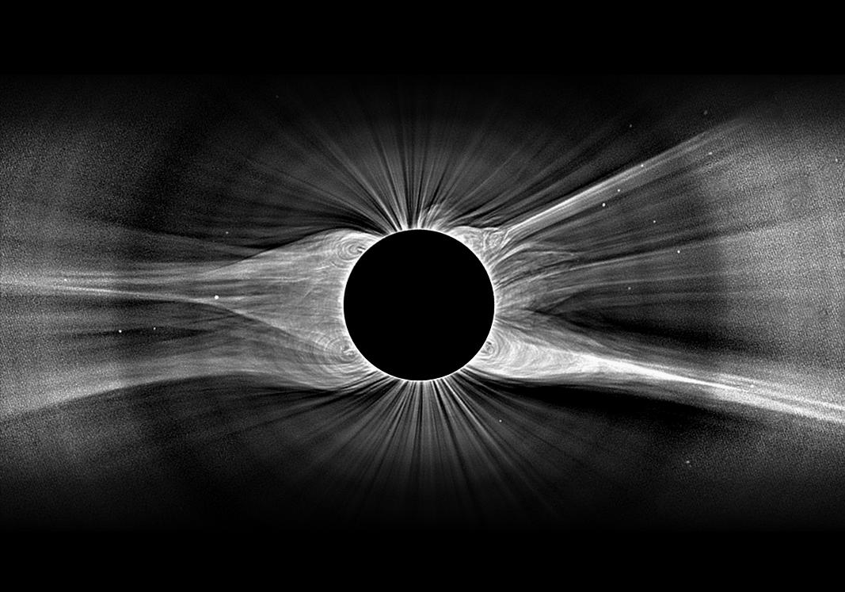
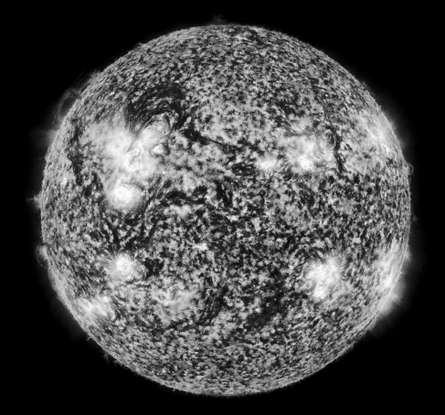


Understanding the Origins of the Solar Wind
Steven R. Cranmer
Harvard-Smithsonian Center for Astrophysics
A. van Ballegooijen, J. Kohl, M. Miralles, L. Woolsey

Slide 2
Understanding the Origins of the Solar Wind
Outline:
Coronal Heating & Wind Acceleration: Survey of Theory
The Power of Off-Limb Spectroscopy!
Steven R. Cranmer
Harvard-Smithsonian Center for Astrophysics
A. van Ballegooijen, J. Kohl, B. Chandran, L. Woolsey

Slide 3
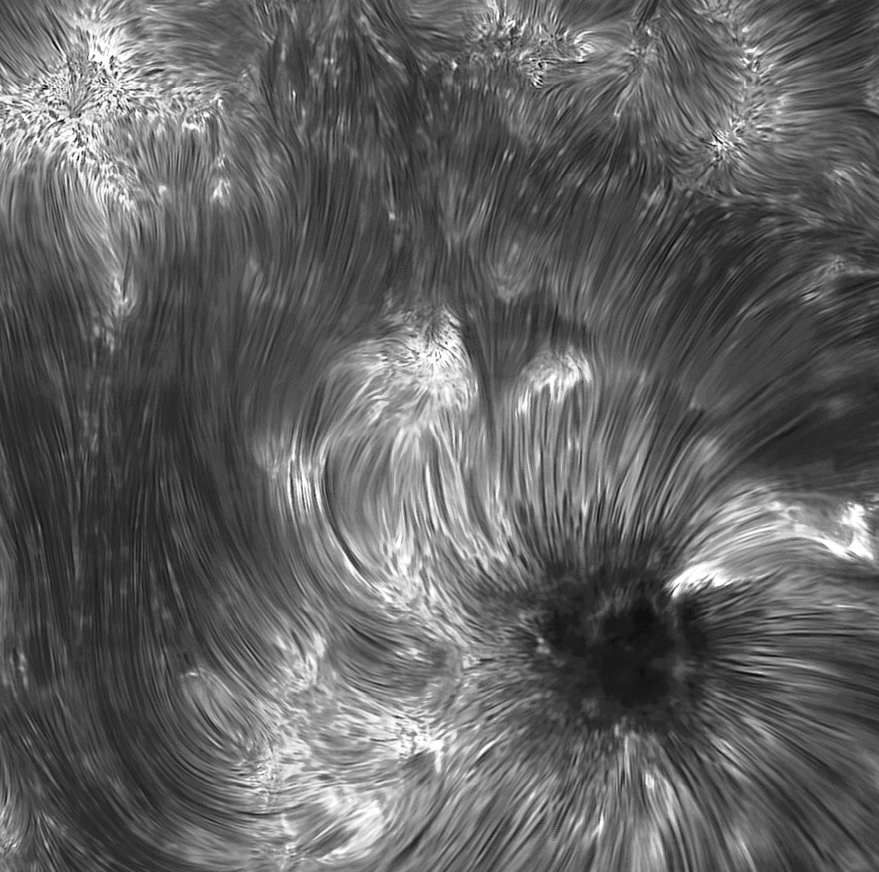
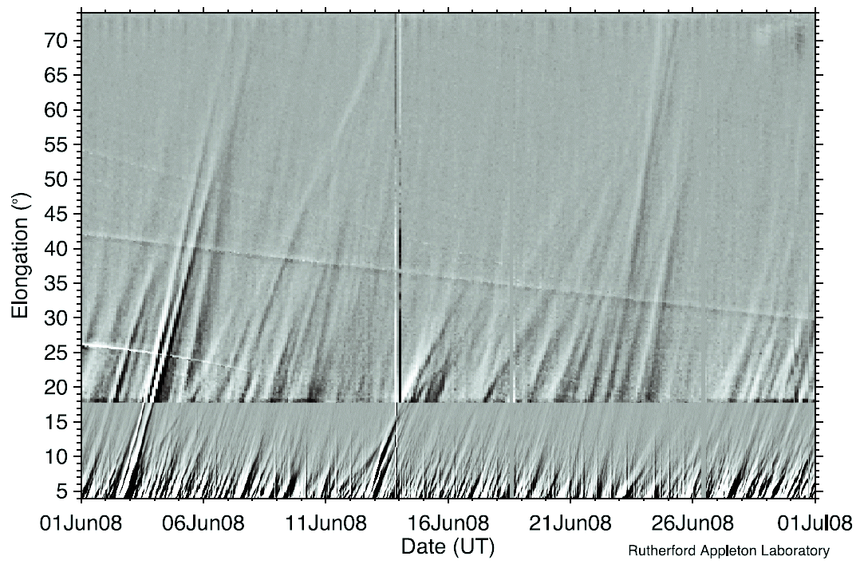
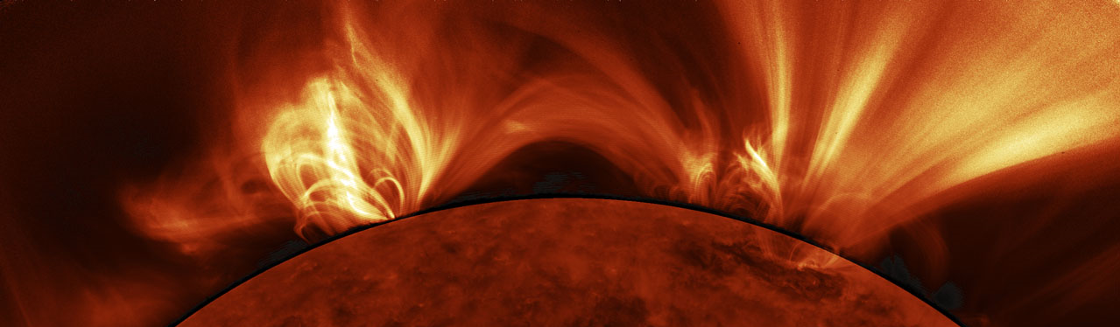
Why haven’t we solved it already?
IBIS
K. Reardon
STEREO HI
Davis et al. 2012
SDO/AIA

Slide 4
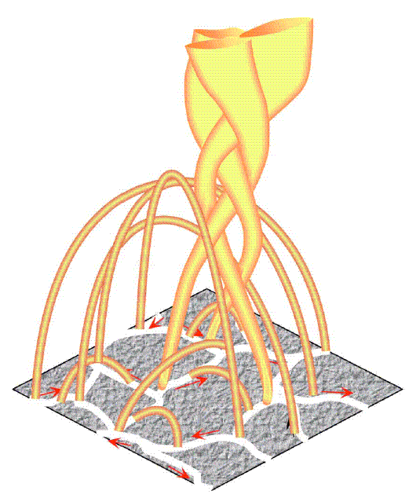
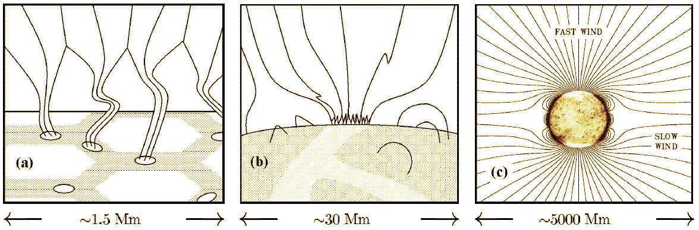
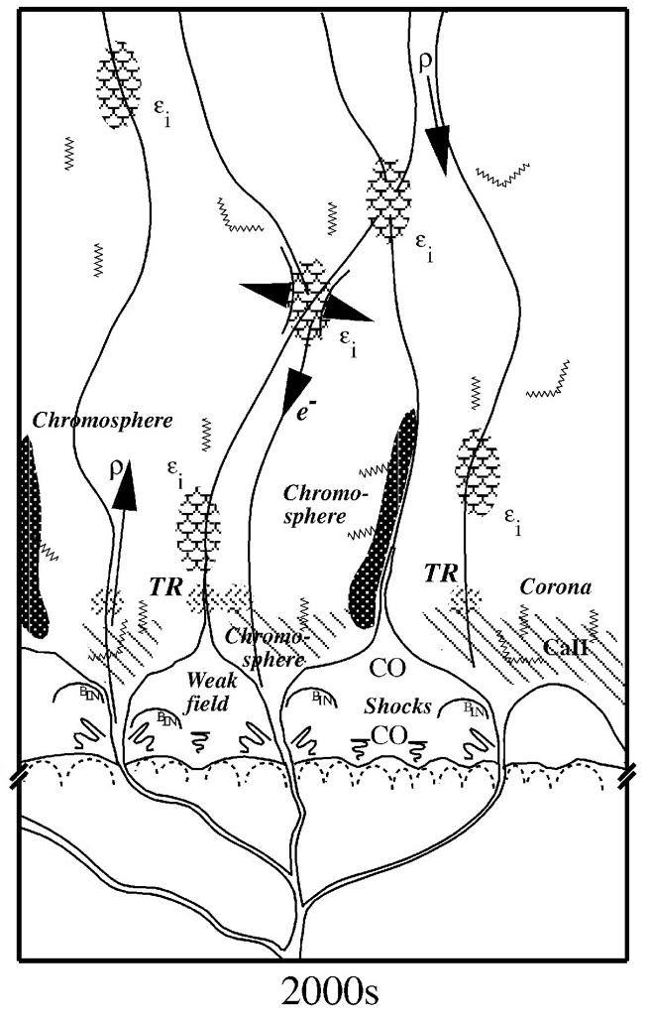
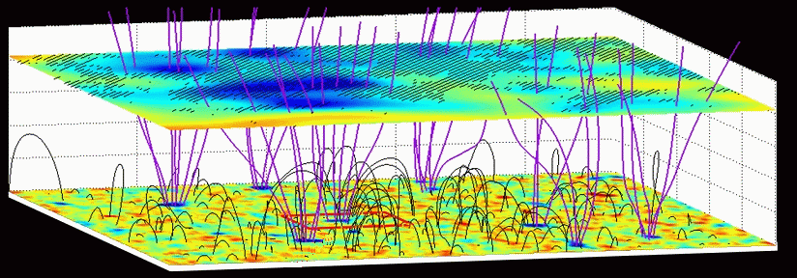
A cartoonified view of multi-scale complexity
Fisk (2005)
Cranmer & van Ballegooijen (2005)
Tu et al. (2005)
Schrijver (2001)

Slide 5
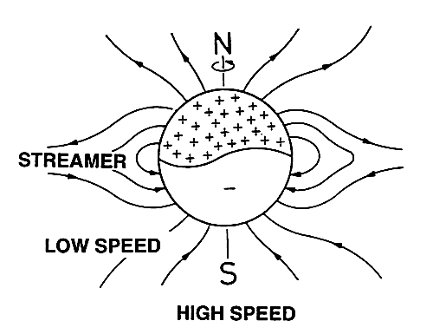
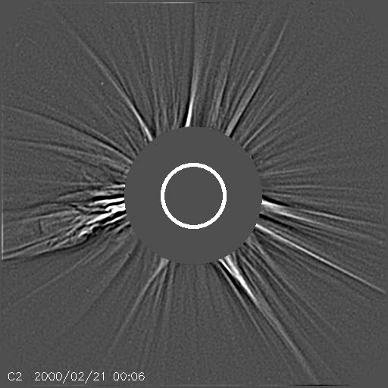
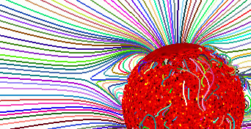
Fast and slow solar wind
High-speed wind: strong connections to largest coronal holes
Low-speed wind: still no agreement on the full range of coronal sources:
hole/streamer boundaries
HCS plasma sheets (“stalks”)
small coronal holes? ARs?
“pseudo-streamers?”
Rušin et al. (2010)

Slide 6
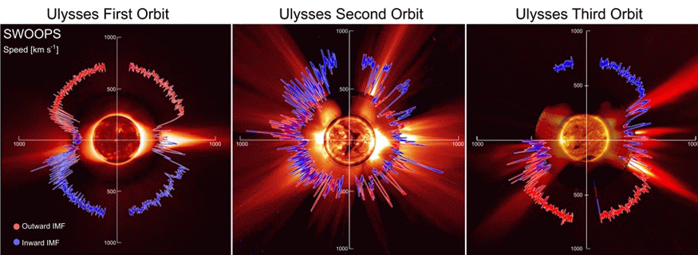
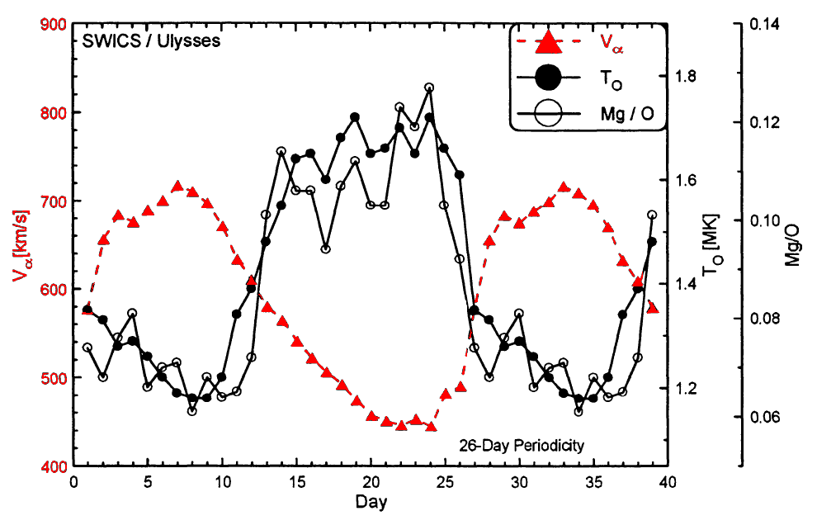
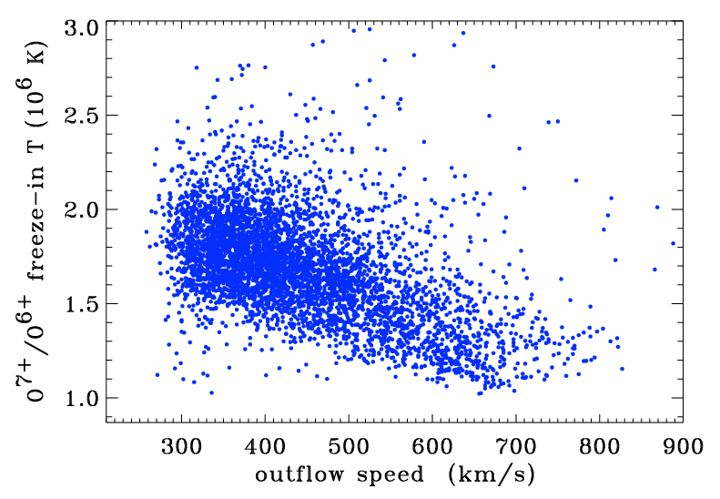
Fast and slow solar wind
Ulysses revealed that the high-latitude fast wind is structurally “simpler” than the chaotic slow wind in the ecliptic.
How “bimodal” are the 2 types?
McComas et al. (2008)
Geiss et al 1995
ACE
SWICS

Slide 7
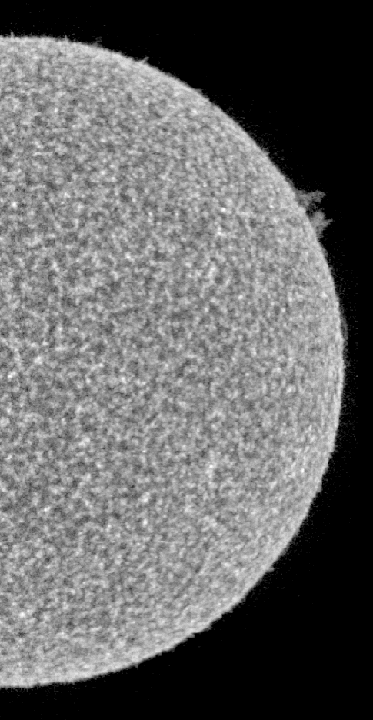
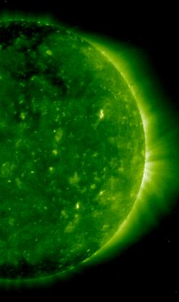
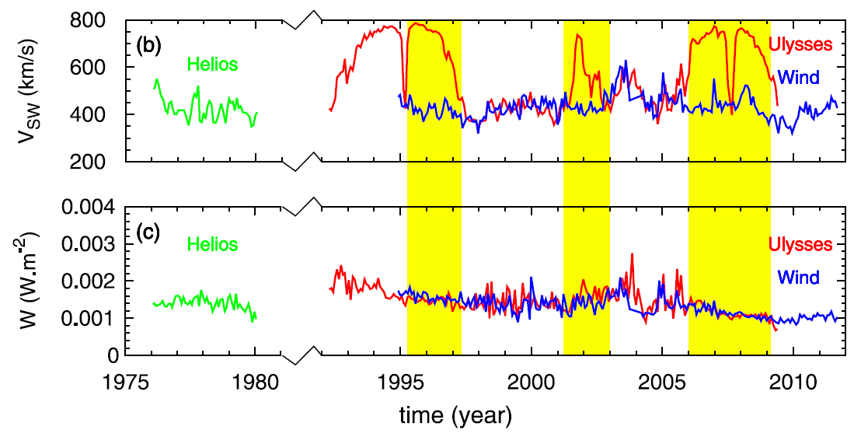
One mechanism for fast and slow wind?
Should that be the default Occam’s Razor point of view?
At least 2 pieces of evidence point to a single mechanism.
  Plasma in the chromosphere/TR doesen’t seem to “care” about overlying large-scale MHD.
  In many models, wind mass/energy flux is set ≤ TR.
  The energy flux is roughly constant.
Le Chat et al. 2012
log T = 5
log T = 6

Slide 8
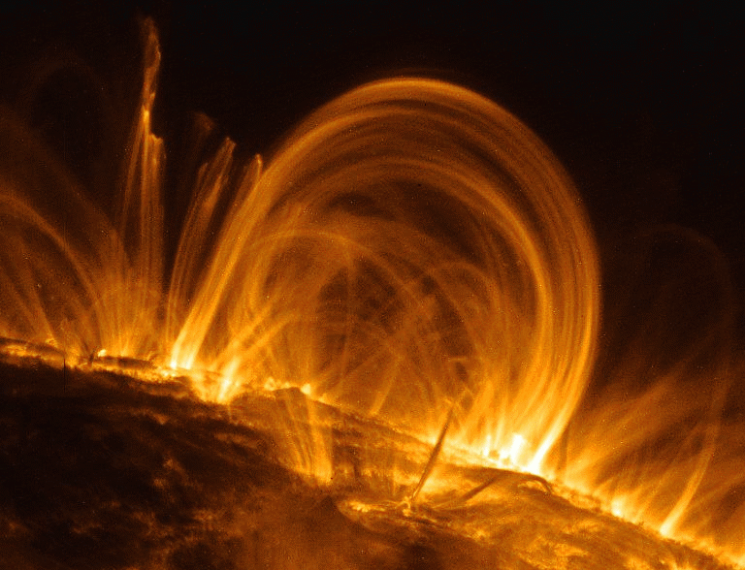
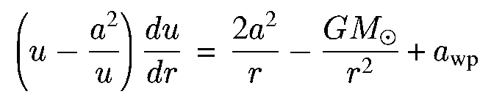
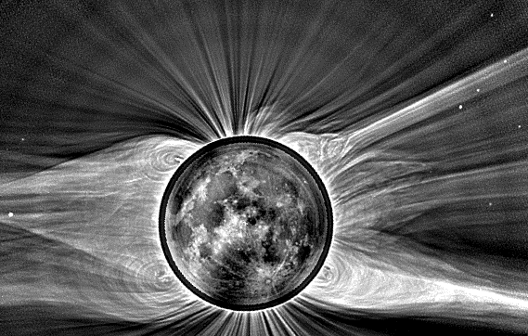
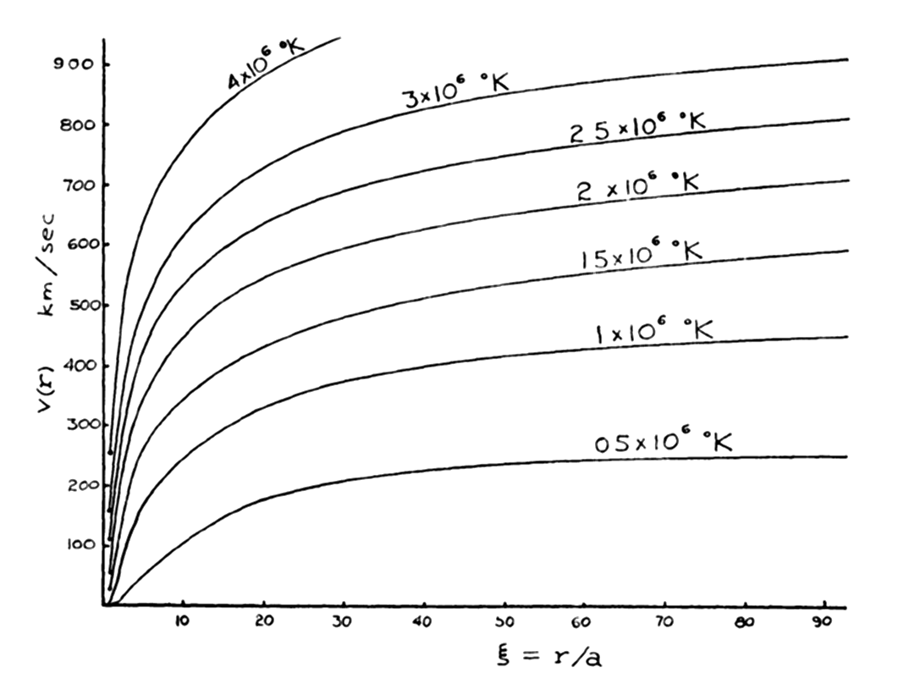
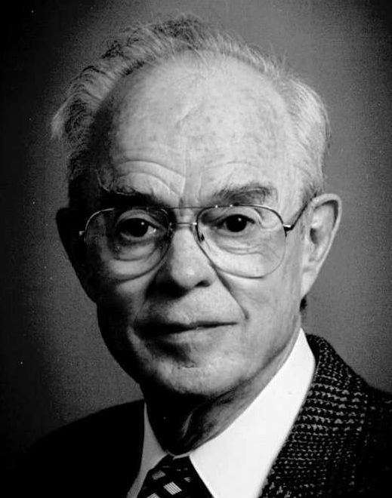
The coronal heating problem
Although convection provides ample kinetic energy for heating the corona, we still do not understand the physics that makes it happen.
Once we have a ~10⁶ K corona, we still don’t know if Parker’s (1958) theory for gas-pressure acceleration is sufficient for driving the solar wind.

Slide 9
What is the dominant source of energy?
Two general ideas have emerged . . .
Wave/Turbulence-Driven (WTD) models, in which open flux tubes are jostled continuously from below. MHD fluctuations propagate up and damp.
Reconnection/Loop-Opening (RLO) models, in which energy is injected from closed-field regions in the “magnetic carpet.”
vs.
Counterpoint:
Roberts (2010) says WTD doesn’t work.
Cranmer & van Ballegooijen (2010) say RLO doesn’t work.

Slide 10
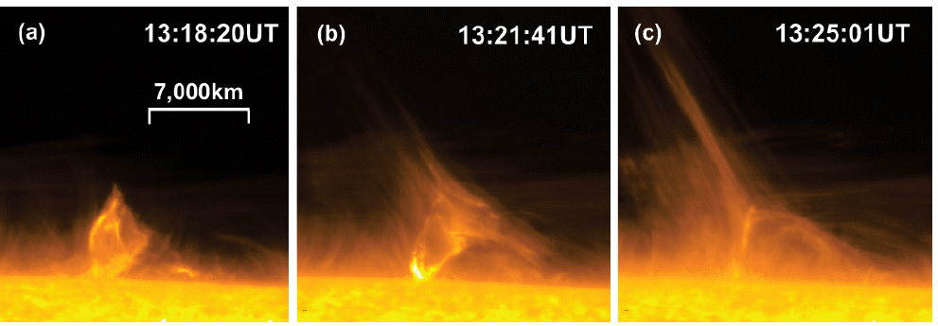
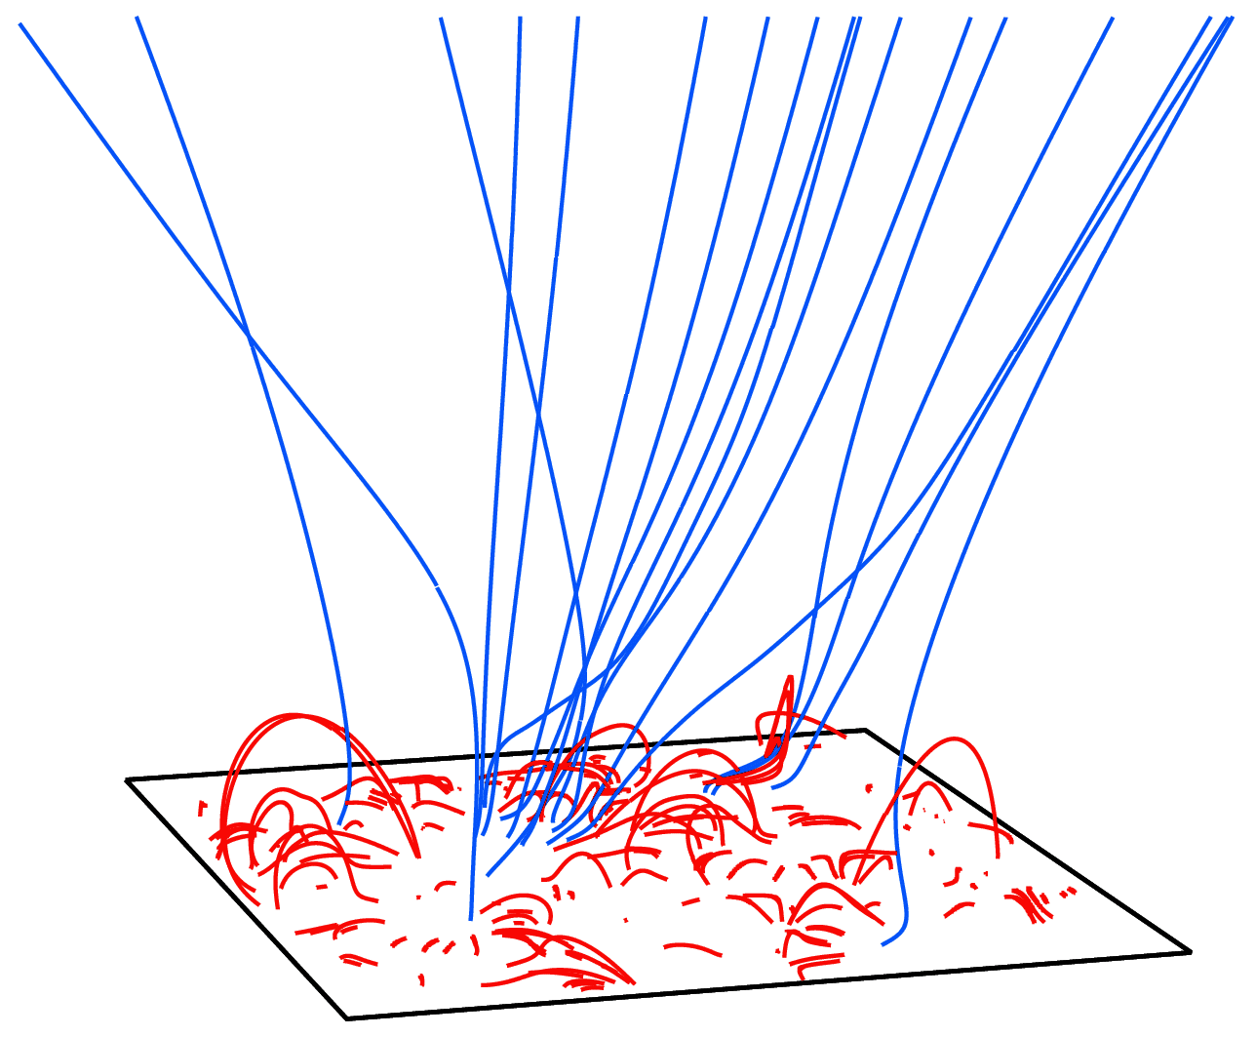
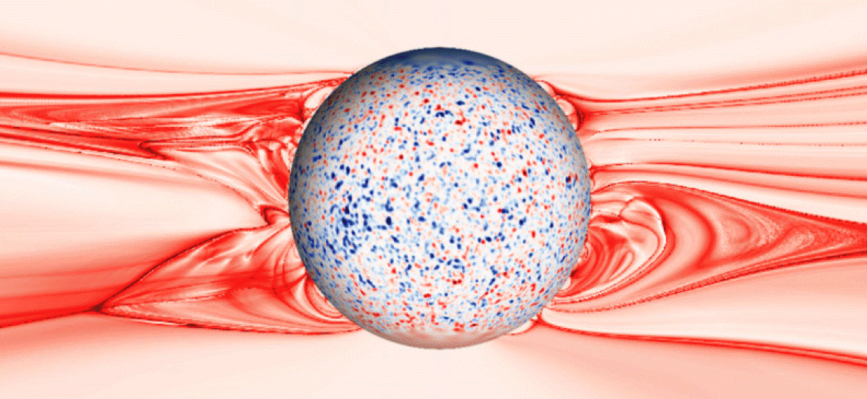
There’s a natural appeal to “RLO”
Open-field regions show frequent jet-like events.
Evidence of magnetic reconnection between open and closed fields.
Hinode/SOT: Nishizuka et al. (2008)
But is there enough mass & energy released (in the subset of reconnection events that turn closed fields into open fields) to heat/accelerate the entire solar wind?
Antiochos et al. (2011)

Slide 11
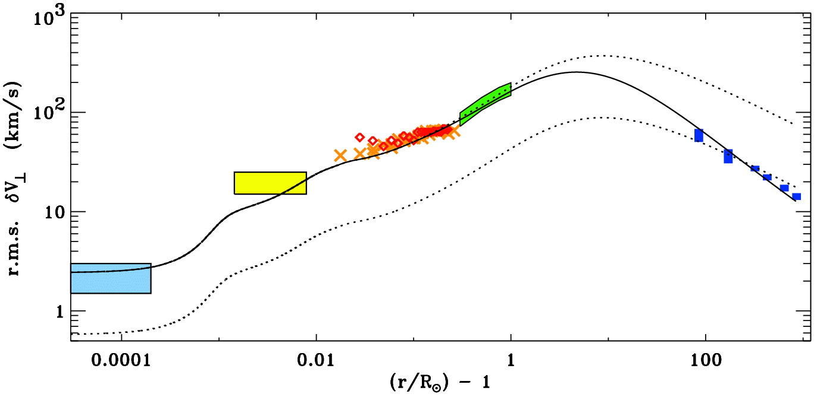
What processes drive solar wind acceleration?
No matter the relative importance of reconnection events, we do know that waves and turbulent motions are present everywhere... from photosphere to heliosphere.
How much can be accomplished by only these processes?
Hinode/SOT
SUMER/SOHO
G-band bright points
UVCS/SOHO
Helios & Ulysses
Undamped (WKB) waves
Damped (non-WKB) waves

Slide 12
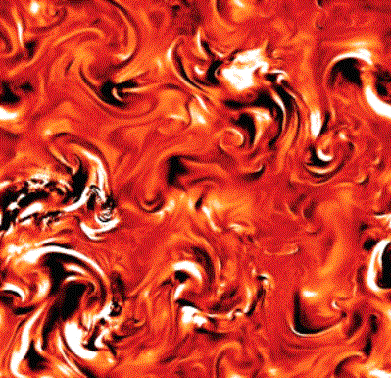
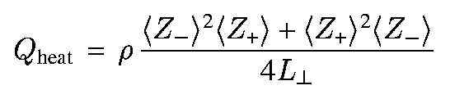
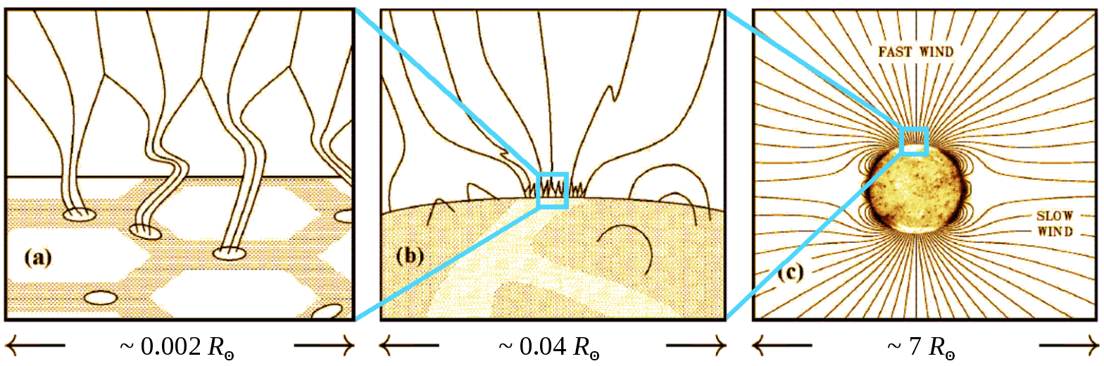
Turbulence-driven solar wind models
A likely scenario is that the Sun produces MHD waves that propagate up open flux tubes, partially reflect back down, and undergo a turbulent cascade until they are damped at small scales, causing heating.
Z–
Z₊
Z–
(e.g., Matthaeus et al. 1999)

Slide 13
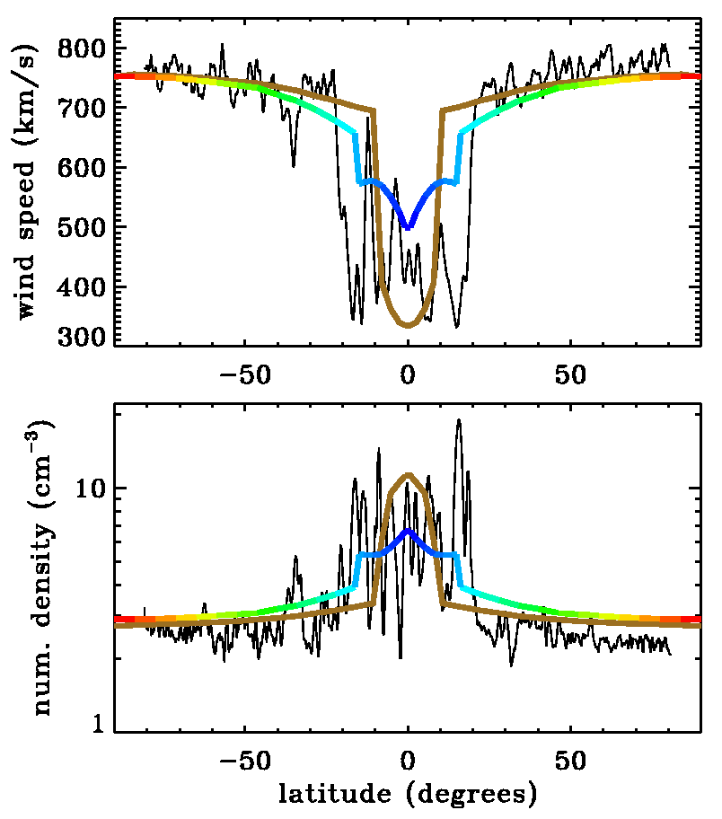
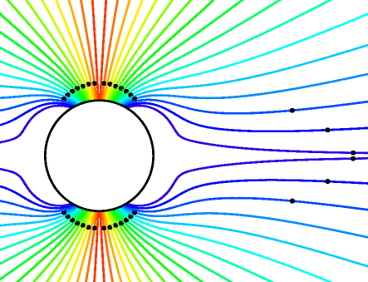
Turbulence-driven solar wind models
Cranmer et al. (2007) computed self-consistent solutions of waves & background one-fluid plasma state along various flux tubes.
Only free parameters: waves at photosphere & radial magnetic field.
Coronal heating occurs “naturally” with T_{max} ~ 1–2 MK.
Varying radial dependence of field strength (B_{r} ~ A^{–1}) changes location of the Parker (1958) critical point.
Crit. pt. low: most heating occurs above it → kinetic energy → fast wind.
Crit. pt. high: most heating occurs below it → thermal energy → denser and slower wind.
Ulysses SWOOPS
Goldstein et al.
(1996)

Slide 14
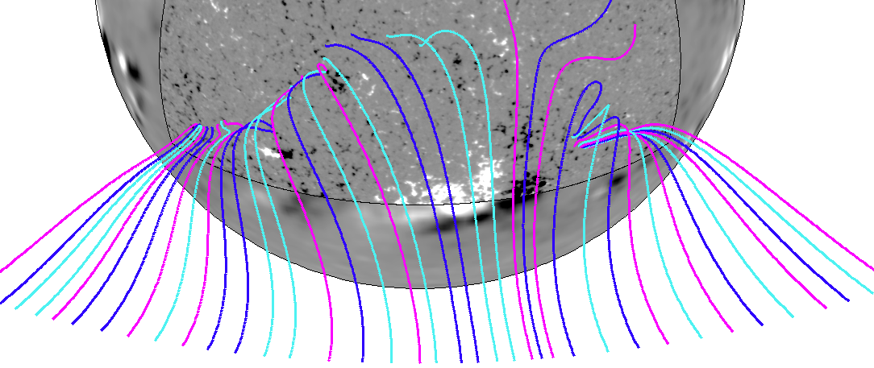
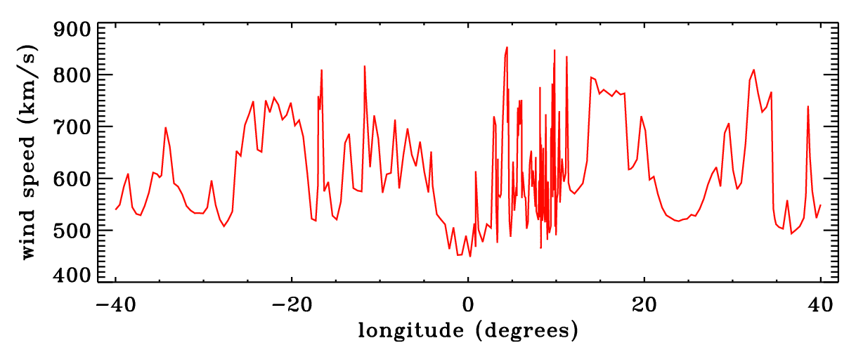
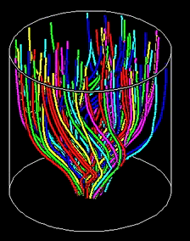
Recent extensions of “WTD”
Turbulent solar wind computed along field lines mapped from high-resolution SOLIS magnetograms.
Result: Power spectra of field magnitude fluctuations at 1 AU may be explained by self-consistent evolution of hi-res collections of flux tubes.
van Ballegooijen et al. (2011) & Asgari-Targhi et al. (2012) simulated incompressible MHD turbulence in expanding flux tubes → coronal loops & open fields.
Result: Basic WTD phenomenology works well, but departures from “critical balance” may be important.

Slide 15
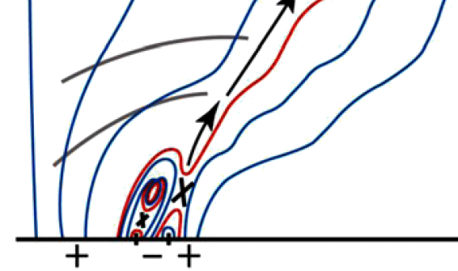
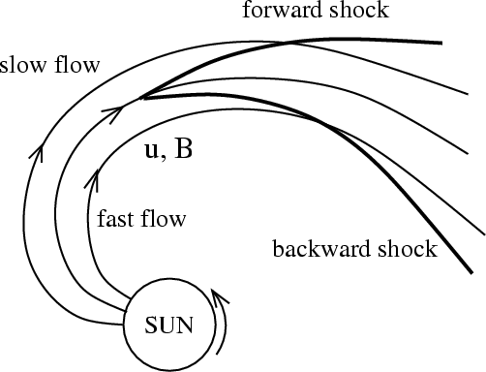
Other sources & sinks of MHD waves?
Moore et al. (2011), McIntosh (2012), and others summarize evidence for waves coming from reconnection events in spicules.
Large-scale velocity shears between flux tubes can act as an “outer scale” source for turbulence (e.g., Breech et al. 2008).
Hahn et al. (2012) and Bemporad & Abbo (2012): EIS line widths indicate wave damping?

Slide 16
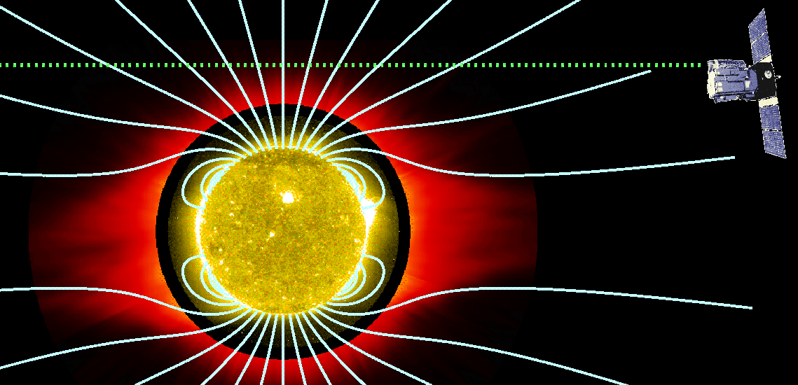
Outline:
Coronal Heating & Wind Acceleration: Survey of Theory
The Power of Off-Limb Spectroscopy!

Slide 17
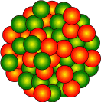
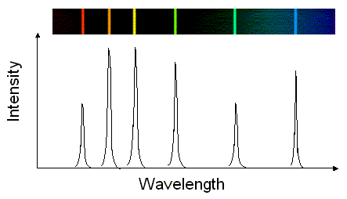
Emission line formation
There are 2 general ways of producing photons at a discrete wavelength in a hot plasma: incoming particles provide energy . . .
A free electron from some other ionized atom (“collisional excitation”)
A photon at the right wavelength from the bright solar disk (“resonant scattering”)
Incoming particle
Energy
re-emitted as light
Electron absorbs energy
If profiles are Doppler shifted up or down in wavelength (from the known rest wavelength), this gives bulk flow speed along line of sight.
The widths of the profiles tell us about unresolved (“random?”) motions along the line of sight: temperatures & MHD waves.

Slide 18
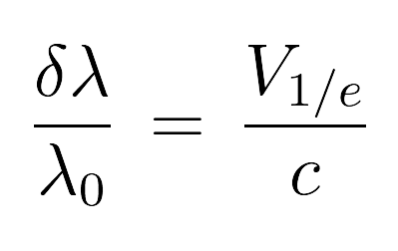
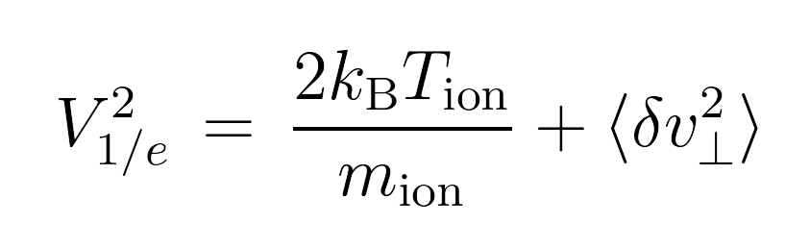
Line widths show “random” line-of-sight motions
Space (many incoherent “elements” along line of sight)
Time (spectrum integration time >> intrinsic fluctuation time)
Unresolved in
δλ
λ₀
How does one disentangle thermal from wave contributions? Need lots of lines . . .
Assume: All wave amplitudes are the same?
Assume:
OK
All T_{ion} are the same?
T_{ion} ≥ T_{e} ? T_{ion} ≥ T_{e} (formation) ?
not OK!
maybe... gives <δv²>_{max}
(Tu et al. 1998; Esser et al. 1999; Dolla & Solomon 2008, 2009; Landi & Cranmer 2009)

Slide 19
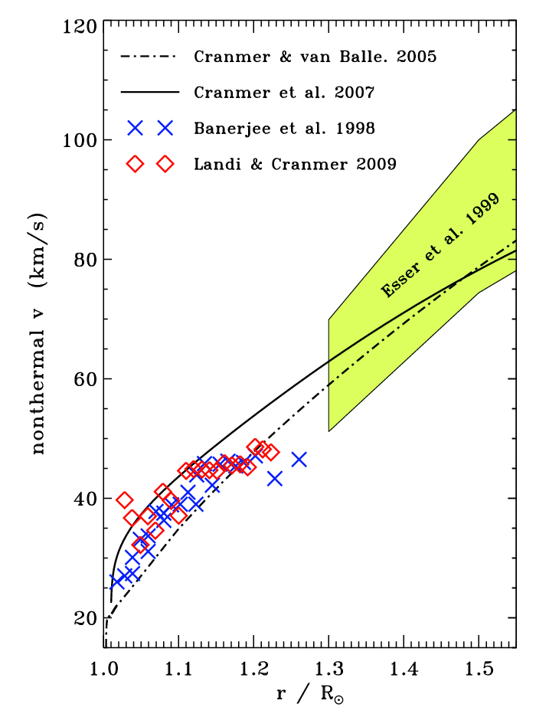
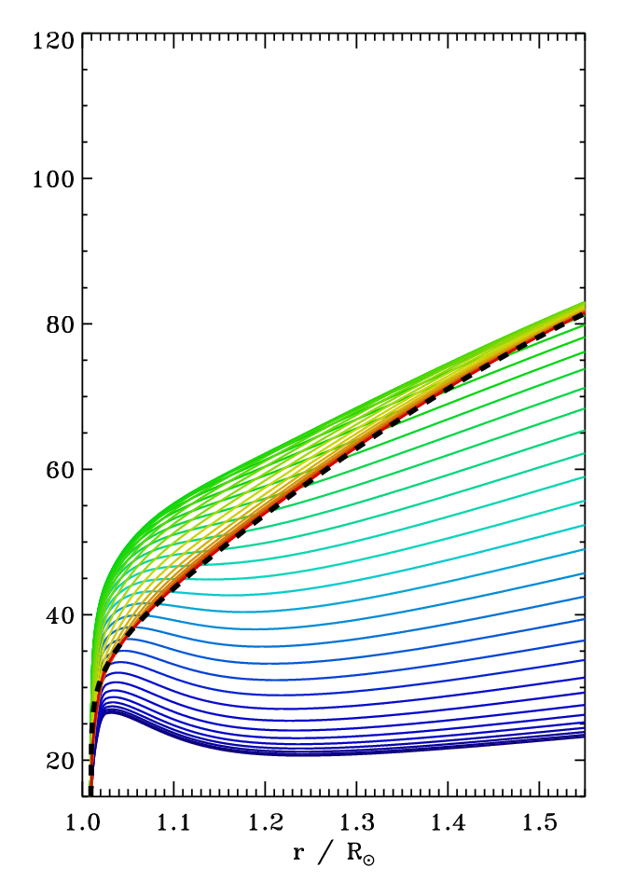
Alfvén wave amplitudes: observation summary
Non-WKB wave reflection:
Use CvB (2005) energy density
(no damping); vary period:
< 5 min
10-30 min
>10 hours
EIS/Hinode
?

Slide 20
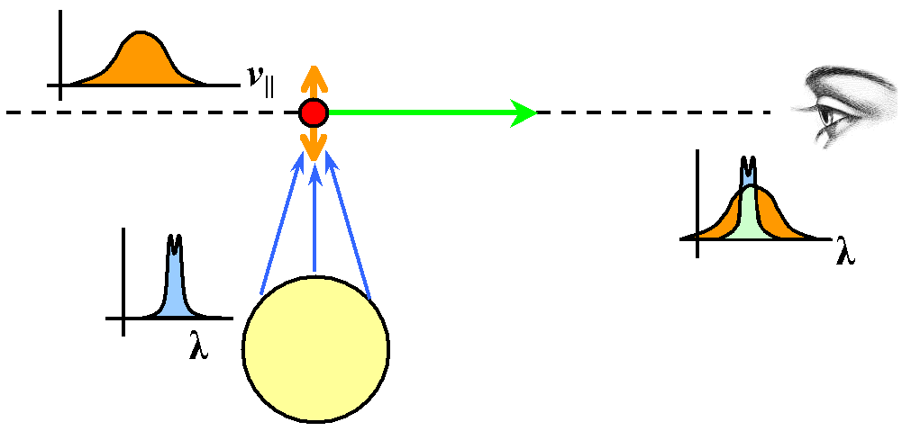
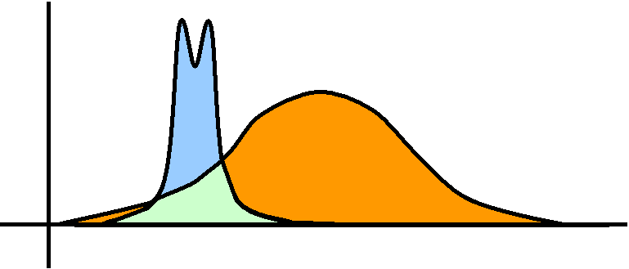
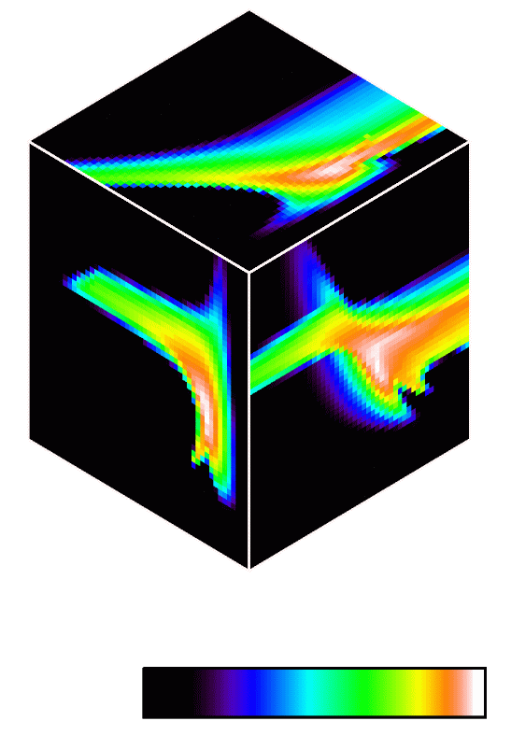
Additional plasma diagnostics
Many of the lines seen by UVCS are formed by resonantly scattered disk photons.
The total intensity (i.e., number of photons) tells us mainly about the density of atoms, but for resonant scattering there’s also another “hidden” Doppler effect that tells us about the flow speeds perpendicular to the line of sight.
If atoms are flow in the same direction as incoming disk photons, “Doppler dimming/pumping” occurs.
The ratio of O VI 1032 to 1037 intensity depends on both the bulk outflow speed (of O⁵⁺ ions) and their parallel temperature.
Lines = probe of temperature anisotropy.
Forward modeling: The best way to “measure” speeds & temperatures . . .

Slide 21
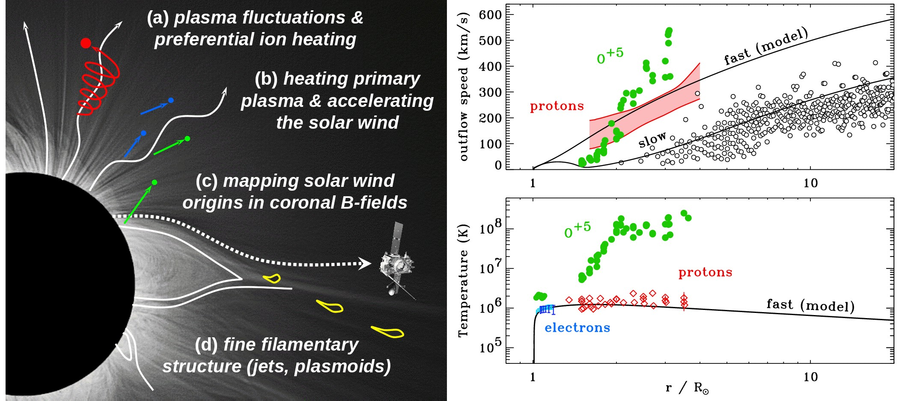
UVCS results: 1996-1997 solar minimum
UVCS/SOHO led to new views of the collisionless nature of solar wind acceleration.
In coronal holes, heavy ions (e.g., O⁺⁵) both flow faster and are heated hundreds of times more strongly than protons and electrons, and have anisotropic velocity distributions.
(Kohl et al. 1995, 1997, 1998, 1999, 2006; Cranmer et al. 1999, 2008; Cranmer 2000, 2001, 2002)

Slide 22
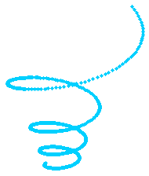
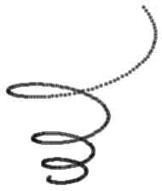


Wave-particle interactions
Parallel-propagating ion cyclotron waves (10–10,000 Hz in the corona) have been suggested as a natural energy source . . .
instabilities
Alfven wave’s oscillating
E and B fields
ion’s Larmor motion around radial B-field
dissipation
something else?
wave reflection?
MHD turbulence?

Slide 23
What is that “something else?”
Alfvénic turbulence may induce some kind of “parallel cascade” that gradually produces ion cyclotron waves in the corona and solar wind.
When MHD turbulence cascades to small perpendicular scales, the small-scale shearing motions may be unstable to generation of cyclotron waves (Markovskii et al. 2006).
Dissipation-scale current sheets may preferentially spin up ions (Dmitruk et al. 2004).
If MHD turbulence exists for both Alfvén and fast-mode waves, the two types of waves can nonlinearly couple with one another to produce high-frequency ion cyclotron waves (Chandran 2005; Cranmer & van Ballegooijen 2012).
If nanoflare-like reconnection events in the low corona are frequent enough, they may fill the extended corona with electron beams that would become unstable and produce ion cyclotron waves (Markovskii 2007).
If kinetic Alfvén waves reach large enough amplitudes, they can damp via wave-particle interactions and heat ions (Voitenko & Goossens 2006; Wu & Yang 2007; Chandran 2010).
Kinetic Alfvén wave damping in the extended corona could lead to electron beams, Langmuir turbulence, and Debye-scale electron phase space holes which could heat ions perpendicularly (Matthaeus et al. 2003; Cranmer & van Ballegooijen 2003).

Slide 24




Conclusions
Although the “problems” are not conclusively solved, we’re including more and more real physics (e.g., MHD turbulence) in models that are doing better at explaining the heating & acceleration of solar wind plasma.
Spectroscopy has been crucial for driving us toward deeper understanding.
However, we still do not have complete enough observational constraints to be able to choose between competing theories . . .
For more information:
http://www.cfa.harvard.edu/~scranmer/

Slide 25
extra slides . . .

Slide 26


Slide 27
CPI is a large-aperture ultraviolet coronagraph spectrometer that has been proposed to be deployed on the International Space Station (ISS).
The primary goal of CPI is to identify and characterize the physical processes that heat and accelerate the plasma in the fast and slow solar wind.
CPI follows on from the discoveries of UVCS/SOHO, and has unprecedented sensitivity, a wavelength range extending from 25.7 to 126 nm, higher temporal resolution, and the capability to measure line profiles of He II, N V, Ne VII, Ne VIII, Si VIII, S IX, Ar VIII, Ca IX, and Fe X, never before seen in coronal holes above 1.3 solar radii. See white paper at: http://arXiv.org/abs/1104.3817
2011 September 29: NASA selected CPI as an Explorer Mission of Opportunity project to undergo an 11-month Phase A concept study.

Slide 28

Cranmer et al. (2007): other results
Wang & Sheeley (1990)
ACE/SWEPAM
ACE/SWEPAM
Ulysses
SWICS
Ulysses
SWICS
Helios
(0.3-0.5 AU)

Slide 29


Anisotropic MHD turbulence
Can MHD turbulence explain the presence of perpendicular ion heating? Maybe not!
k
?
Energy input
k

Slide 30
Anisotropic MHD turbulence
Can MHD turbulence explain the presence of perpendicular ion heating? Maybe not!
Alfvén waves propagate ~freely in the parallel direction (and don’t interact easily with one another), but field lines can “shuffle” in the perpendicular direction.
Thus, when the background field is strong, cascade proceeds mainly in the plane perpendicular to field (Strauss 1976; Montgomery 1982).
k
Energy input
k

Slide 31
Anisotropic MHD turbulence
Can MHD turbulence explain the presence of perpendicular ion heating? Maybe not!
Alfvén waves propagate ~freely in the parallel direction (and don’t interact easily with one another), but field lines can “shuffle” in the perpendicular direction.
Thus, when the background field is strong, cascade proceeds mainly in the plane perpendicular to field (Strauss 1976; Montgomery 1982).
k
ion cyclotron waves
Ω_{p}/V_{A}
kinetic Alfvén waves
In a low-β plasma, cyclotron waves heat ions & protons when they damp, but kinetic Alfvén waves are Landau-damped, heating electrons.
Energy input
k
Ω_{p}/c_{s}

Slide 32

Multi-mode coupling?
Fast-mode waves propagate – and cascade – more isotropically than Alfvén waves.
Chandran (2005) suggested that Alfvén and fast-mode waves may share energy via nonlinear couplings (AAF, AFF). If coupling is strong enough, some high-frequency fast-mode wave energy may feed back to the Alfvén modes → ion cyclotron!
We model the wave transport → cascade → coupling → heating, in fast solar wind.
First, we solve radial transport equations for the energy densities (U_{m}) of the individual Alfvén, fast, and slow mode fluctuations.
(Jacques 1977)
For the Alfvén waves, Q_{m} depends on:
Wave reflection: Z₊ ≠ Z– (Chandran & Hollweg 2009)
Turb. correlation length L (obeys its own transport eqn.)
Damping rate:
turb. cascade
visc/cond/Ohm

Slide 33


Alfvén, fast, & slow mode waves in fast wind
We compute how the A, F, S modes perturb velocity, magnetic field, & density:
Free parameters: lower boundary conditions on U_{m} & normalization for corr. length.

Slide 34

Alfvén, fast, & slow mode waves in fast wind
Caveat: changing correlation length (L ~ 1/k_{outer}) changes collisional damping a lot:
Our standard model for fast-mode waves is a representative example, not a definitive prediction!
L at r = R_{s} :
Earlier estimates:
75 km (CvB07)
300 km (CvB05)
300 km
200 km
130 km
100 km
50 km
It’s unlikely for Sun-generated slow-mode waves to survive to large heights, so we ignore them for remainder of this work (see, however, Howes et al. 2011).
30 km

Slide 35

Model cascade + Alfvén/fast-mode coupling
Turbulent cascade modeled as time-steady advection/diffusion in wavenumber space.
Dissipation from KAW Landau damping (A) and transit-time damping (F) included.
Coupling between A & F modes treated with Chandran (2005) weak turb. timescale.
Pure Alfvén mode:
Alfvén mode with AAF/AFF coupling:

Slide 36


Preliminary coupling results
We computed heating rates for protons & electrons from Vlasov-Maxwell dispersion. Fast-mode wave power varied up & down from the standard model . . .
Helios & Ulysses

Slide 37

Preferential heavy ion heating
UV spectroscopy provides constraints on Q_{ion} for O⁺⁵ ions in the corona . . .
SUMER (Landi & Cranmer 2009); UVCS (Cranmer et al. 1999)

