Slide 1
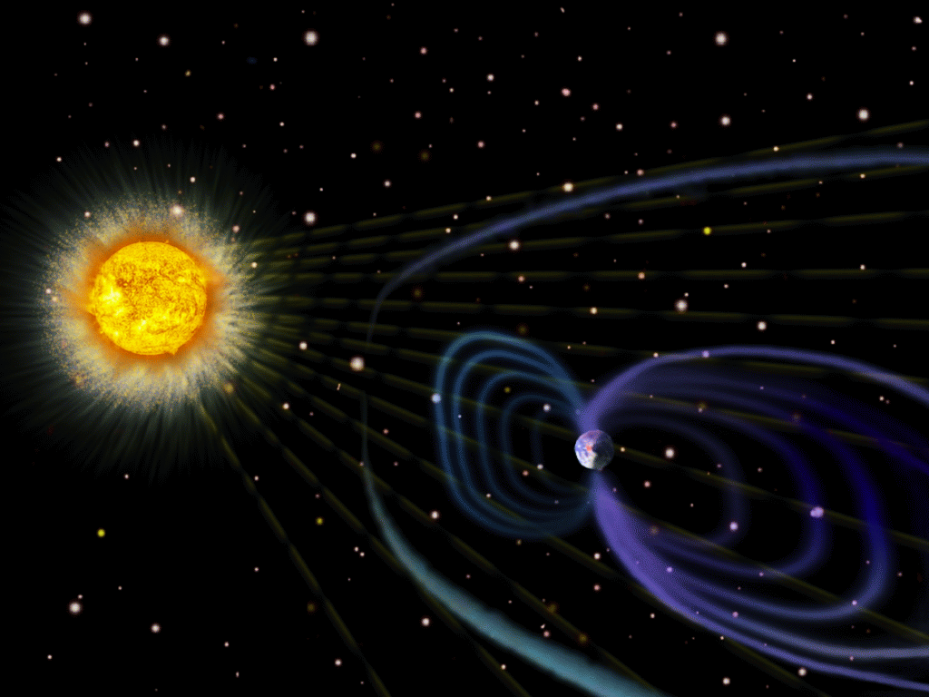
Turbulent Origins of the
Sun’s Hot Corona and the Solar Wind
Steven R. Cranmer
Harvard-Smithsonian
Center for Astrophysics

Slide 2
Turbulent Origins of the
Sun’s Hot Corona and the Solar Wind
Outline:
Solar overview: Our complex “variable star”
How do we measure waves & turbulence?
Coronal heating & solar wind acceleration
Preferential energization of heavy ions
Steven R. Cranmer
Harvard-Smithsonian
Center for Astrophysics

Slide 3
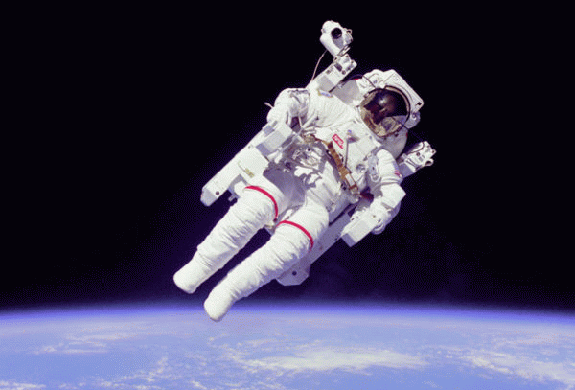
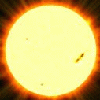
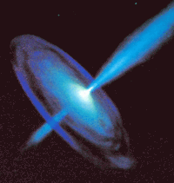
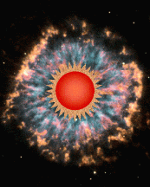
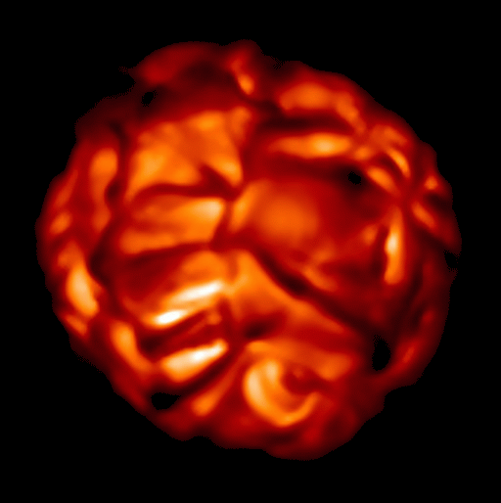
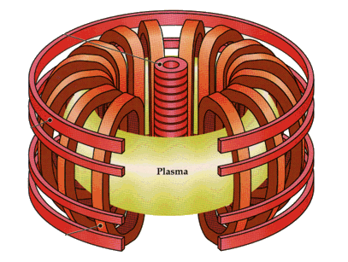
Motivations for “heliophysics”
Space weather can affect satellites, power grids, and astronaut safety.
The Sun’s mass-loss & X-ray history impacted planetary formation and atmospheric erosion.
The Sun is a unique testbed for many basic processes in physics, at regimes (T, ρ, P) inaccessible on Earth . . .
plasma physics
nuclear physics
non-equilibrium thermodynamics
electromagnetic theory

Slide 4
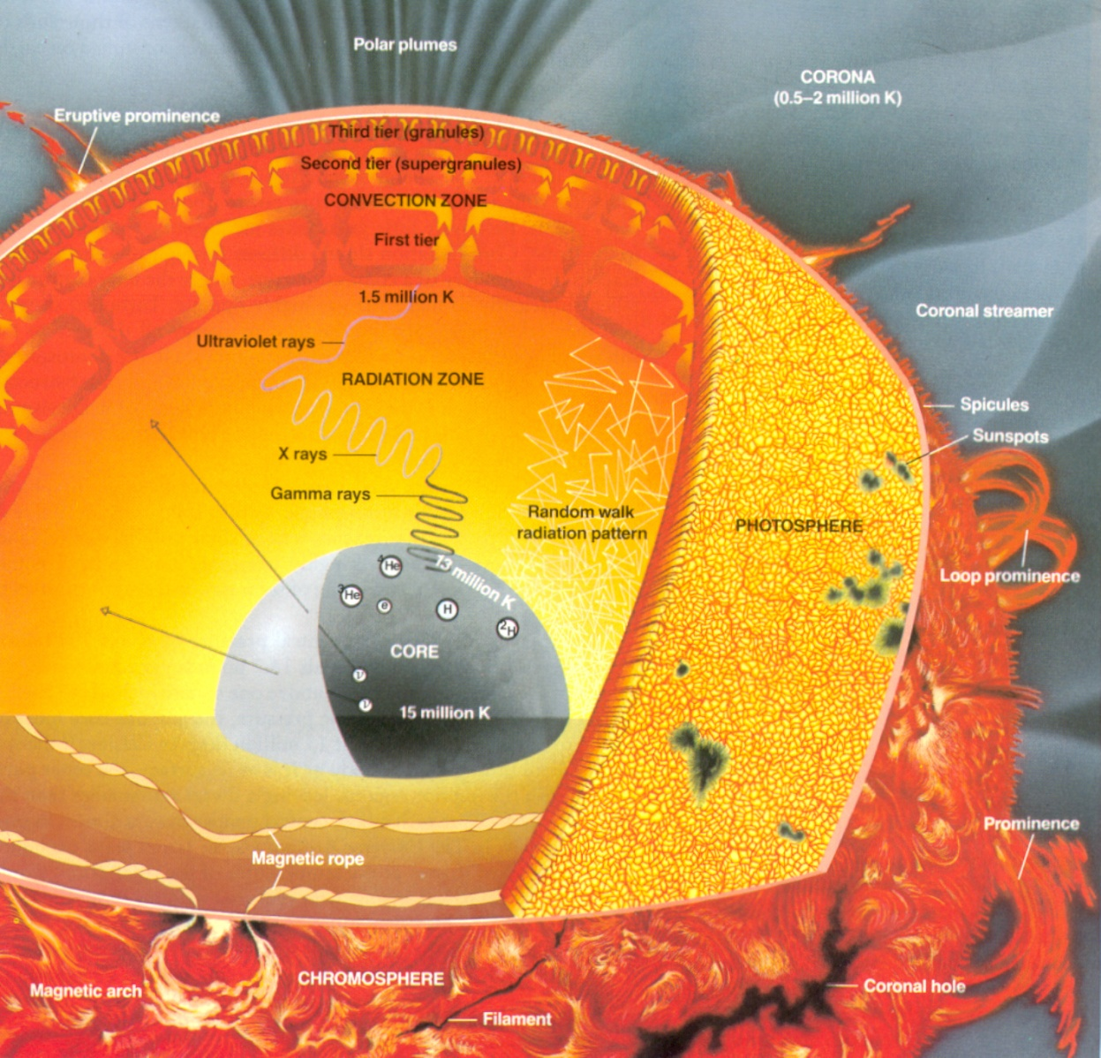
The Sun’s overall structure
Core:
  Nuclear reactions fuse hydrogen atoms into helium.
Radiation Zone:
  Photons bounce around in the dense plasma, taking millions of years to escape the Sun.
Convection Zone:
  Energy is transported by boiling, convective motions.
Photosphere:
  Photons stop bouncing, and start escaping freely.
Corona:
  Outer atmosphere where gas is heated from ~5800 K to several million degrees!

Slide 5
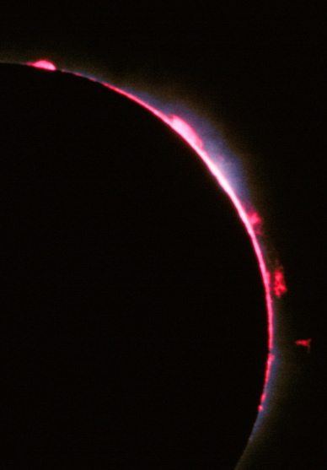
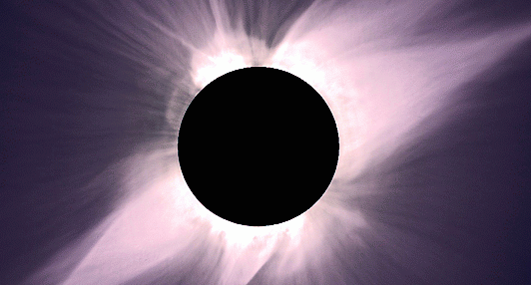
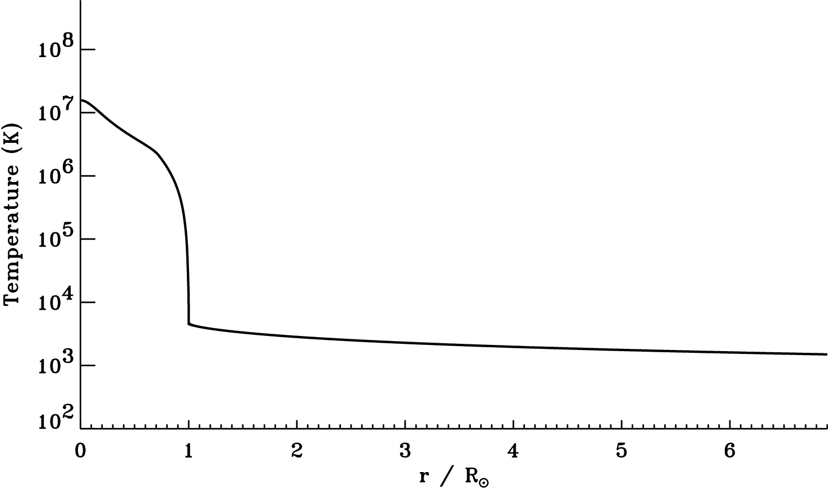
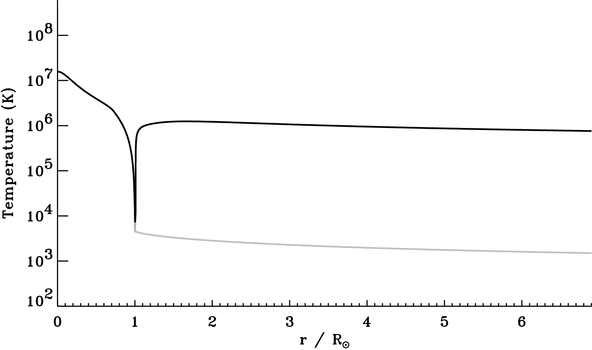
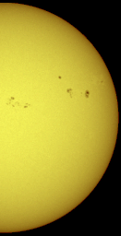
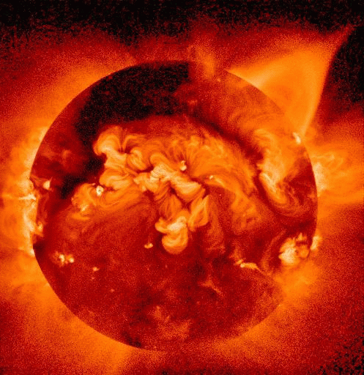
The extended solar atmosphere
The “coronal heating problem”

Slide 6
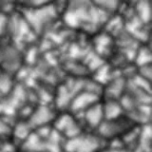

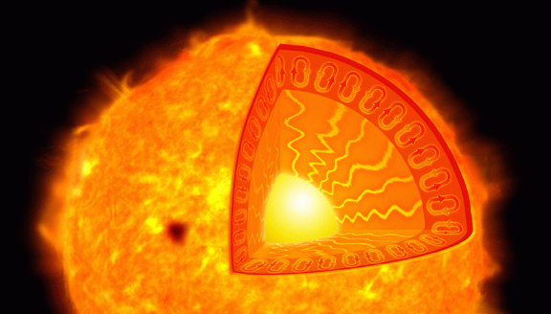
The solar photosphere
The lower boundary for space weather is the top of the convection zone:
β << 1
β ~ 1
β > 1

Slide 7
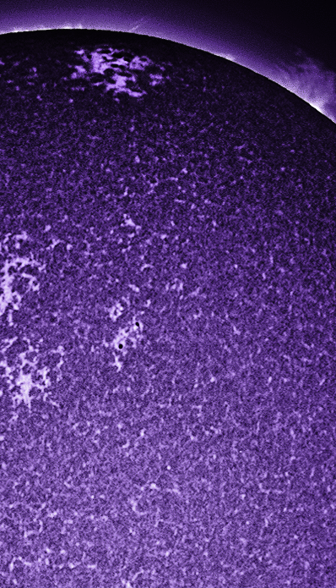
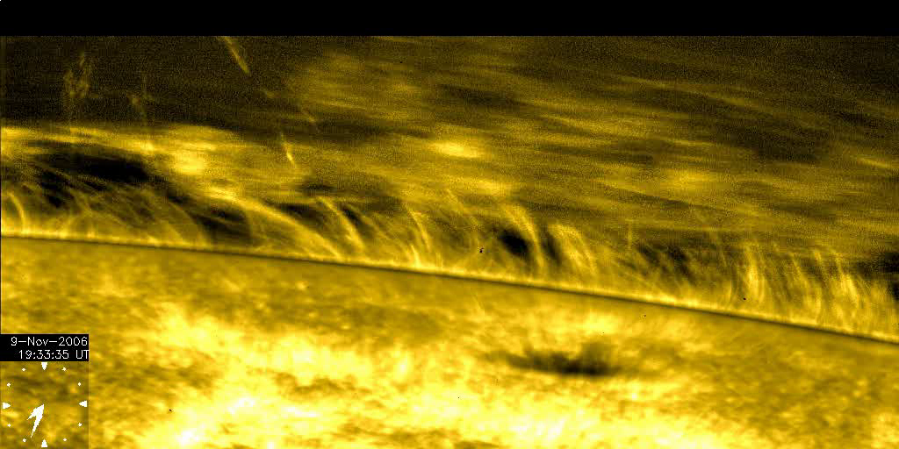
The solar chromosphere
After T drops to ~4000 K, it rises again to ~20,000 K over 0.002 R_{sun} of height.
Observations of this region show shocks, thin “spicules,” and an apparently larger-scale set of convective cells (“super-granulation”).
Most… but not all… material ejected in spicules appears to fall back down. (Controversial?)

Slide 8
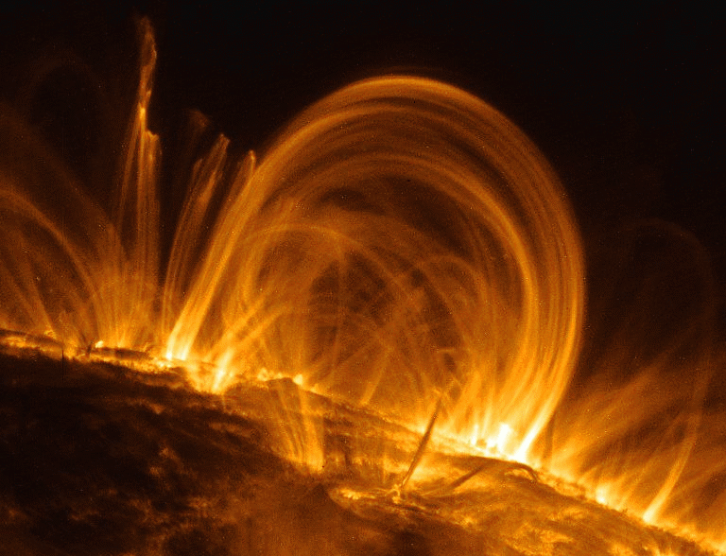
The solar corona
Plasma at 10⁶ K emits most of its spectrum in the UV and X-ray . . .
Although there is more than enough kinetic energy at the lower boundary, we still don’t understand the physical processes that heat the plasma.
Most suggested ideas involve 3 steps:
1. Churning convective motions tangle up magnetic fields on the surface.
2. Energy is stored in twisted/braided/ swaying magnetic flux tubes.
3. Something on small (unresolved?) scales releases this energy as heat.
Particle-particle collisions?
Wave-particle interactions?

Slide 9
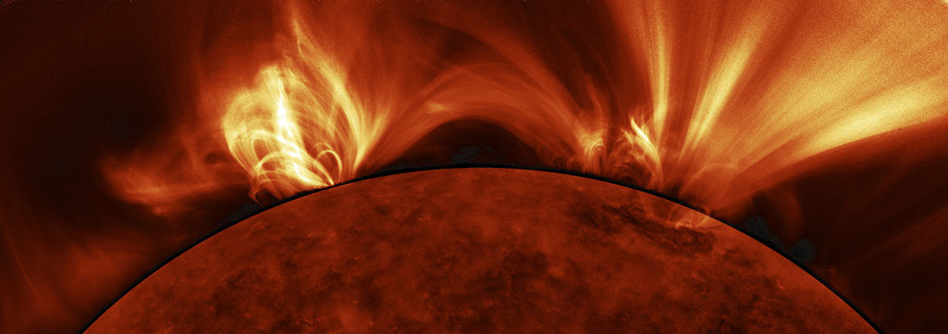
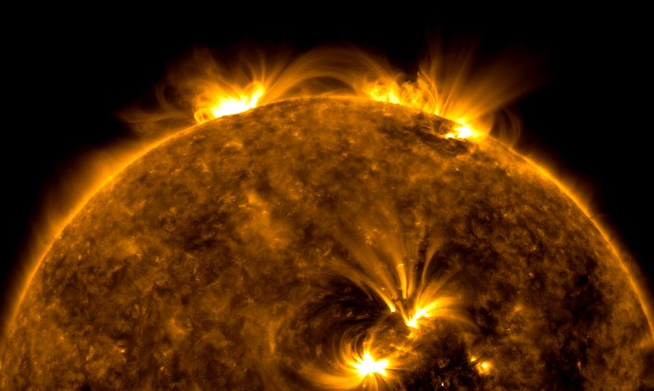
SDO/AIA 171 Å (sensitive to T ~ 10⁶ K)

Slide 10
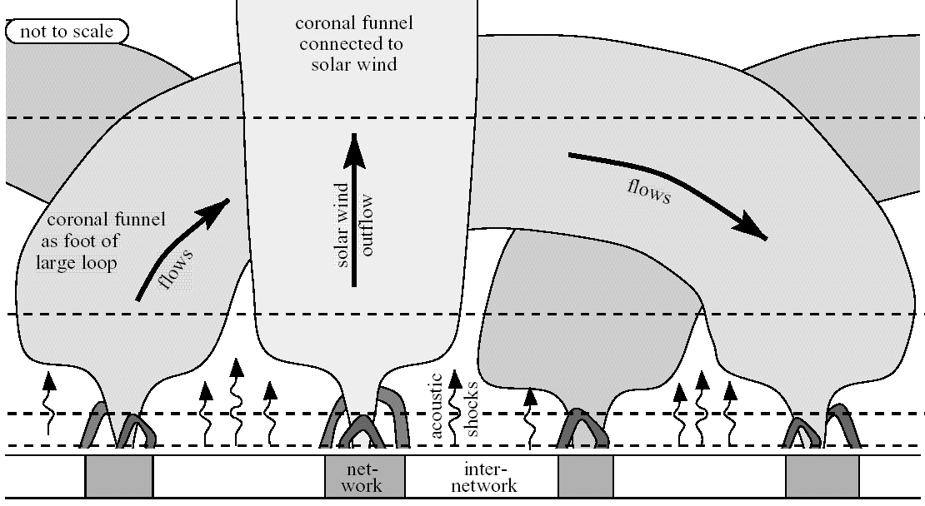
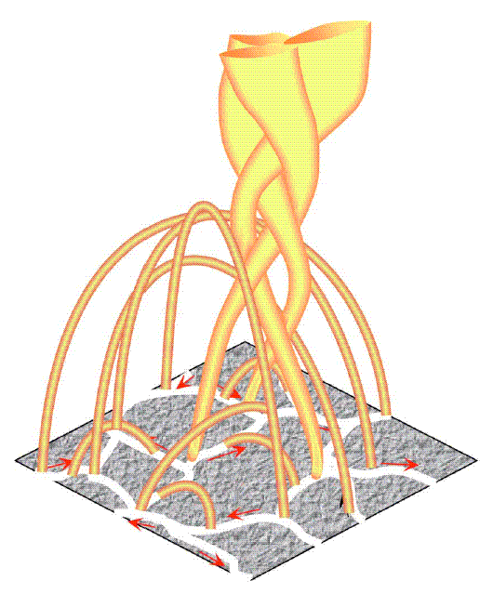
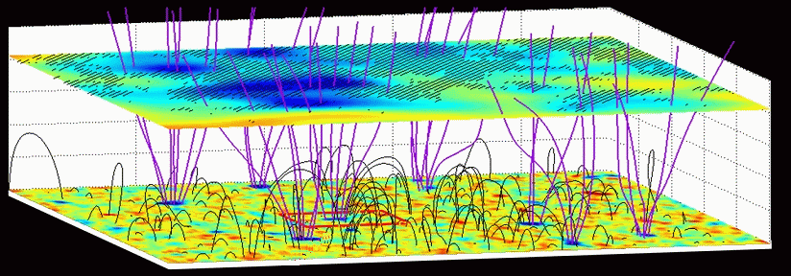
A small fraction of magnetic flux is OPEN
Peter (2001)
Fisk (2005)
Tu et al. (2005)

Slide 11
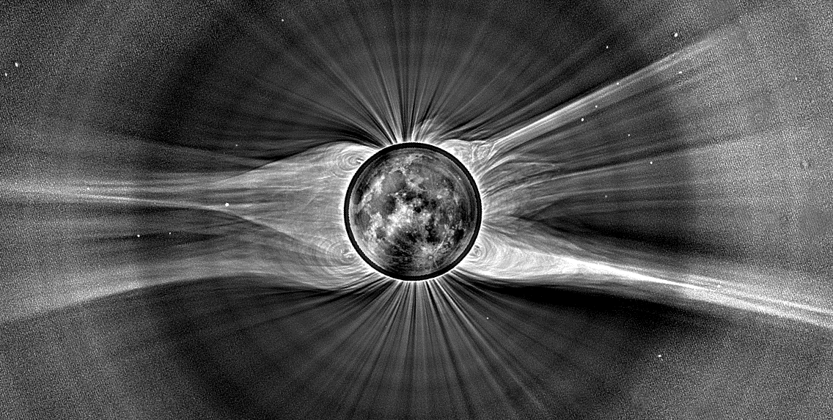
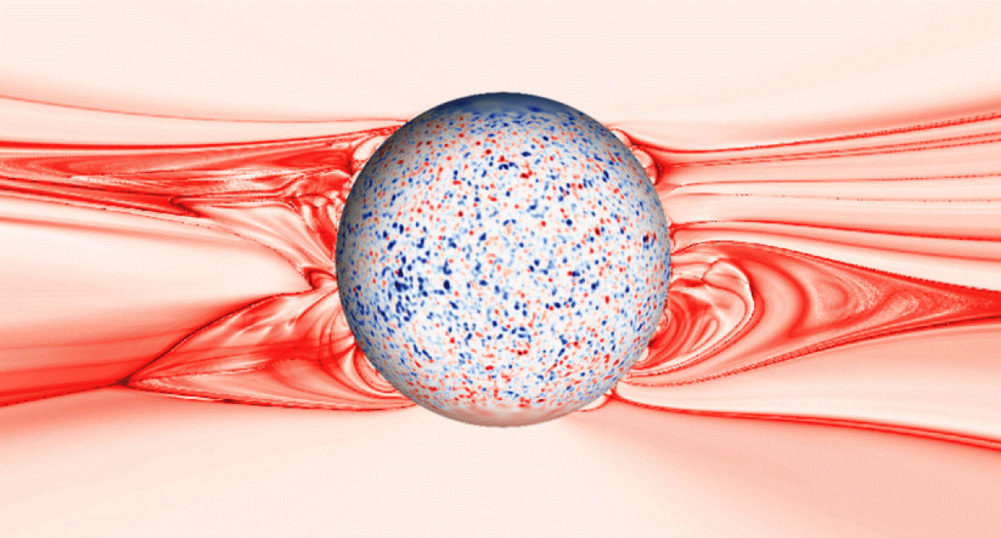
2008 Eclipse:
M. Druckmüller (photo)
S. Cranmer (processing)
Rušin et al. 2010 (model)

Slide 12
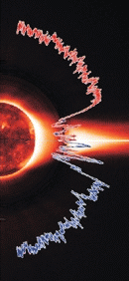
In situ solar wind: properties
1958: Eugene Parker proposed that the hot corona provides enough gas pressure to counteract gravity and produce steady supersonic outflow.
Mariner 2 (1962): first confirmation of fast & slow wind.
1990s: Ulysses left the ecliptic; provided first 3D view of the wind’s source regions.
1970s: Helios (0.3–1 AU). 2007: Voyagers @ term. shock!
fast
slow
speed (km/s)
density
variability
temperatures
abundances
600–800
low
smooth + waves
T_{ion} >> T_{p} > T_{e}
photospheric
300–500
high
chaotic
all ~equal
more low-FIP

Slide 13
Outline:
Solar overview: Our complex “variable star”
How do we measure solar waves & turbulence?
Coronal heating & solar wind acceleration
Preferential energization of heavy ions

Slide 14
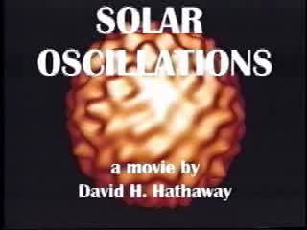
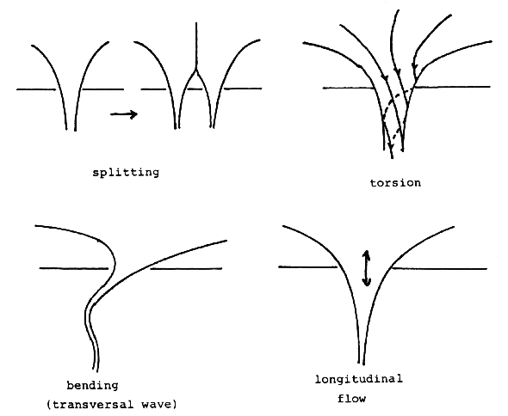
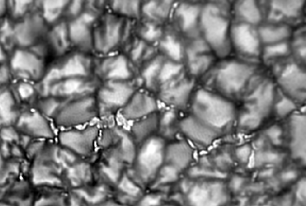
Waves & turbulence in the photosphere
Helioseismology: direct probe of wave oscillations below the photosphere (via modulations in intensity & Doppler velocity)
How much of that wave energy “leaks” up into the corona & solar wind?
Still a topic of vigorous debate!
Measuring horizontal motions of magnetic flux tubes is more difficult . . . but may be more important to regions higher up.
splitting/merging
torsion
< 0.1″
bending
(kink-mode wave)
longitudinal flow/wave

Slide 15
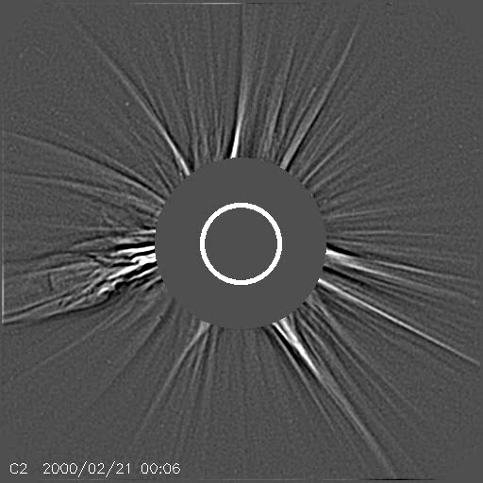
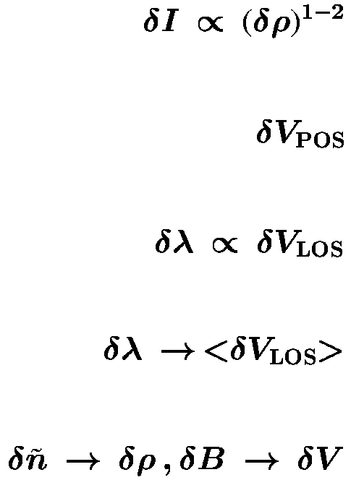
Waves in the corona
Remote sensing provides several direct (and indirect) detection techniques:
Intensity modulations . . .
Motion tracking in images . . .
Doppler shifts . . .
Doppler broadening . . .
Radio sounding . . .
SOHO/LASCO (Stenborg & Cobelli 2003)

Slide 16
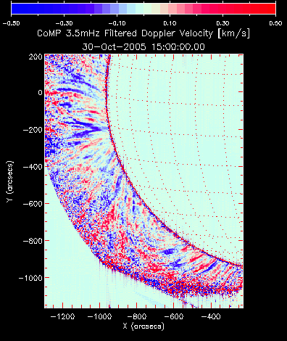
Wavelike motions in the corona
Remote sensing provides several direct (and indirect) detection techniques:
Intensity modulations . . .
Motion tracking in images . . .
Doppler shifts . . .
Doppler broadening . . .
Radio sounding . . .
Tomczyk et al. (2007)

Slide 17
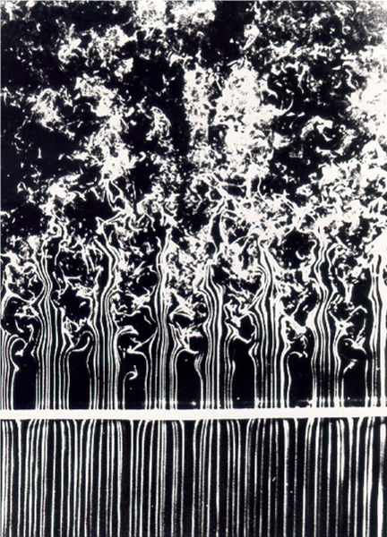

In situ fluctuations & turbulence
Fourier transform of B(t), v(t), etc., into frequency:
f ⁻¹ energy containing range
f ^{-5/3}
inertial range
Magnetic Power
The inertial range is a “pipeline” for transporting magnetic energy from the large scales to the small scales, where dissipation can occur.
f ⁻³
dissipation range
few hours
0.5 Hz

Slide 18
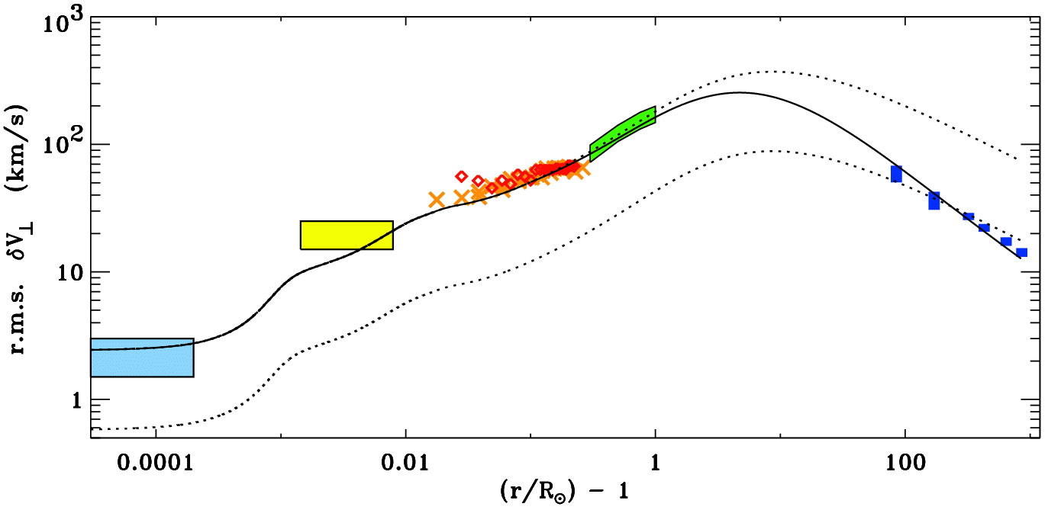
Alfvén waves: from photosphere to heliosphere
Cranmer & van Ballegooijen (2005) assembled together much of the existing data on Alfvénic fluctuations:
Hinode/SOT
SUMER/SOHO
G-band bright points
UVCS/SOHO
Helios & Ulysses
Undamped (WKB) waves
Damped (non-WKB) waves

Slide 19
Outline:
Solar overview: Our complex “variable star”
How do we measure solar waves & turbulence?
Coronal heating & solar wind acceleration
Preferential energization of heavy ions

Slide 20
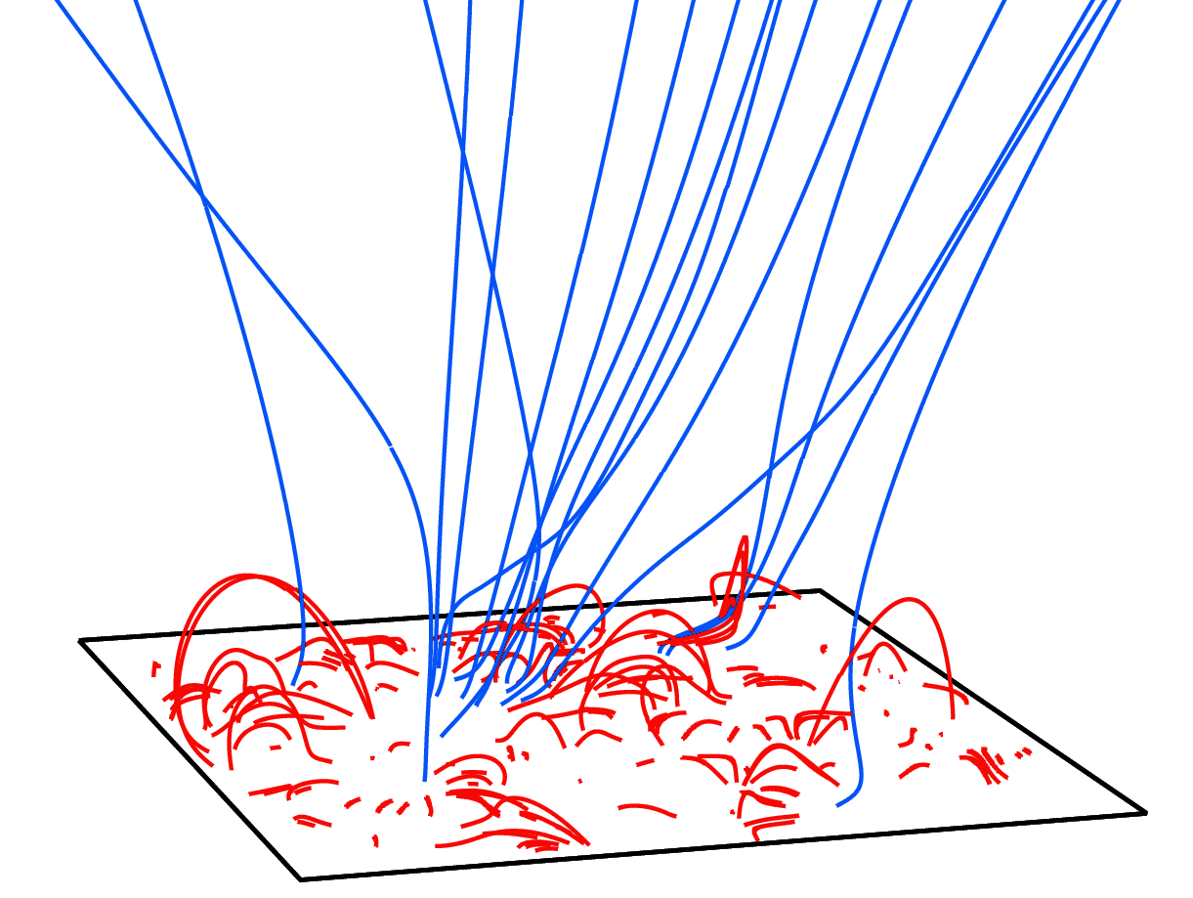
What processes drive solar wind acceleration?
Two broad paradigms have emerged . . .
Wave/Turbulence-Driven (WTD) models, in which flux tubes stay open.
Reconnection/Loop-Opening (RLO) models, in which mass/energy is injected from closed-field regions.
vs.
There’s a natural appeal to the RLO idea, since only a small fraction of the Sun’s magnetic flux is open. Open flux tubes are always near closed loops!
The “magnetic carpet” is continuously churning (Cranmer & van Ballegooijen 2010).
Open-field regions show frequent coronal jets (SOHO, STEREO, Hinode, SDO).

Slide 21
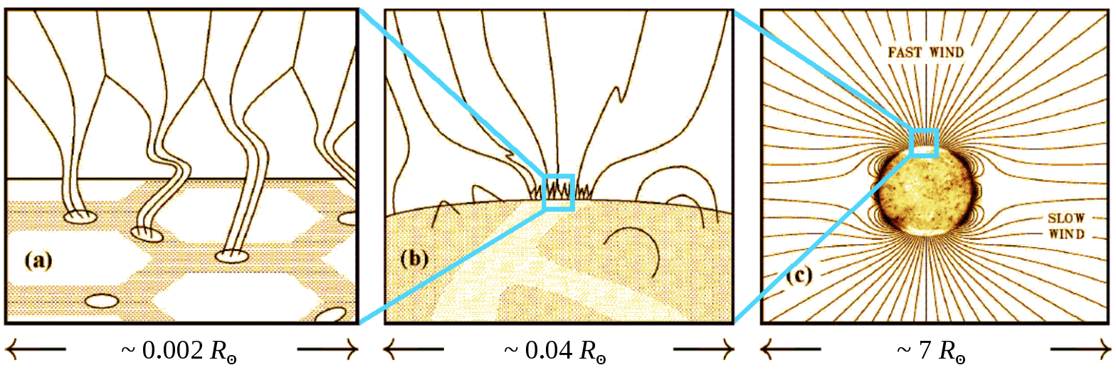
Waves & turbulence in open flux tubes
Photospheric flux tubes are shaken by an observed spectrum of horizontal motions.
Alfvén waves propagate along the field, and partly reflect back down (non-WKB).
Nonlinear couplings allow a (mainly perpendicular) cascade, terminated by damping.
(Heinemann & Olbert 1980; Hollweg 1981, 1986; Velli 1993; Matthaeus et al. 1999; Dmitruk et al. 2001, 2002; Cranmer & van Ballegooijen 2003, 2005; Verdini et al. 2005; Oughton et al. 2006; many others)

Slide 22
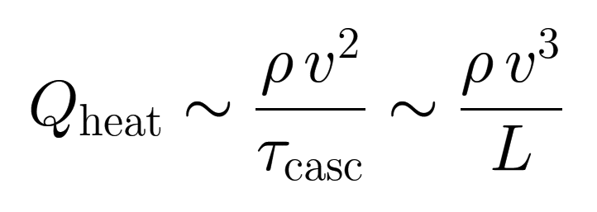
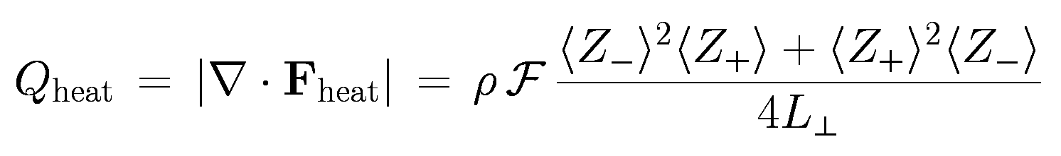
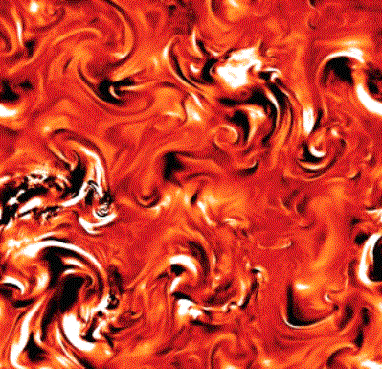
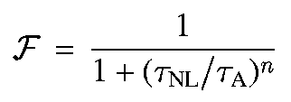
Turbulent dissipation = coronal heating?
In hydrodynamics, von Kármán, Howarth, & Kolmogorov worked out cascade energy flux via dimensional analysis. Known: eddy density ρ, size L, turnover time τ, velocity v=L/τ
In MHD, the same general scaling applies… with some modifications…
(“cascade efficiency”)
Z–
Z₊
n = 1: an approximate “golden rule” from theory
Caution: this is still an order-of-magnitude scaling.
Requires counter-propagating waves!
(e.g., Pouquet et al. 1976; Dobrowolny et al. 1980; Zhou & Matthaeus 1990; Hossain et al. 1995; Dmitruk et al. 2002; Oughton et al. 2006)
Z–

Slide 23
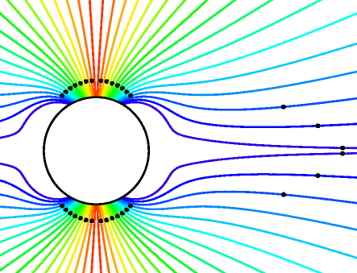
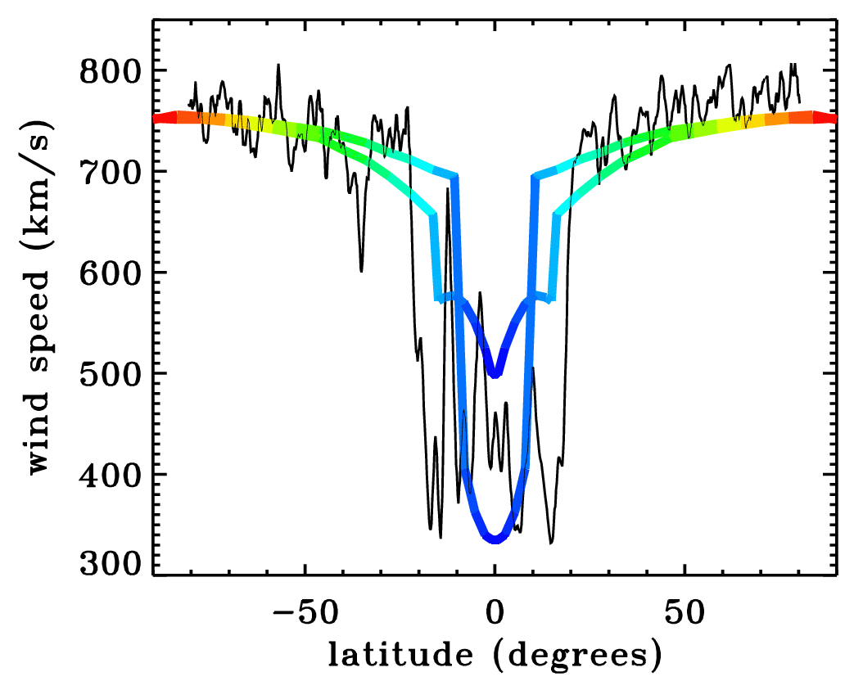
Implementing the wave/turbulence idea
Cranmer et al. (2007) computed self-consistent solutions for waves & background plasma along flux tubes going from the photosphere to the heliosphere.
Only free parameters: radial magnetic field & photospheric wave properties. (No arbitrary “coronal heating functions” were used.)
Self-consistent coronal heating comes from gradual Alfvén wave reflection & turbulent dissipation.
Is Parker’s critical point above or below where most of the heating occurs?
Models match most observed trends of plasma parameters vs. wind speed at 1 AU.
Ulysses 1994-1995

Slide 24
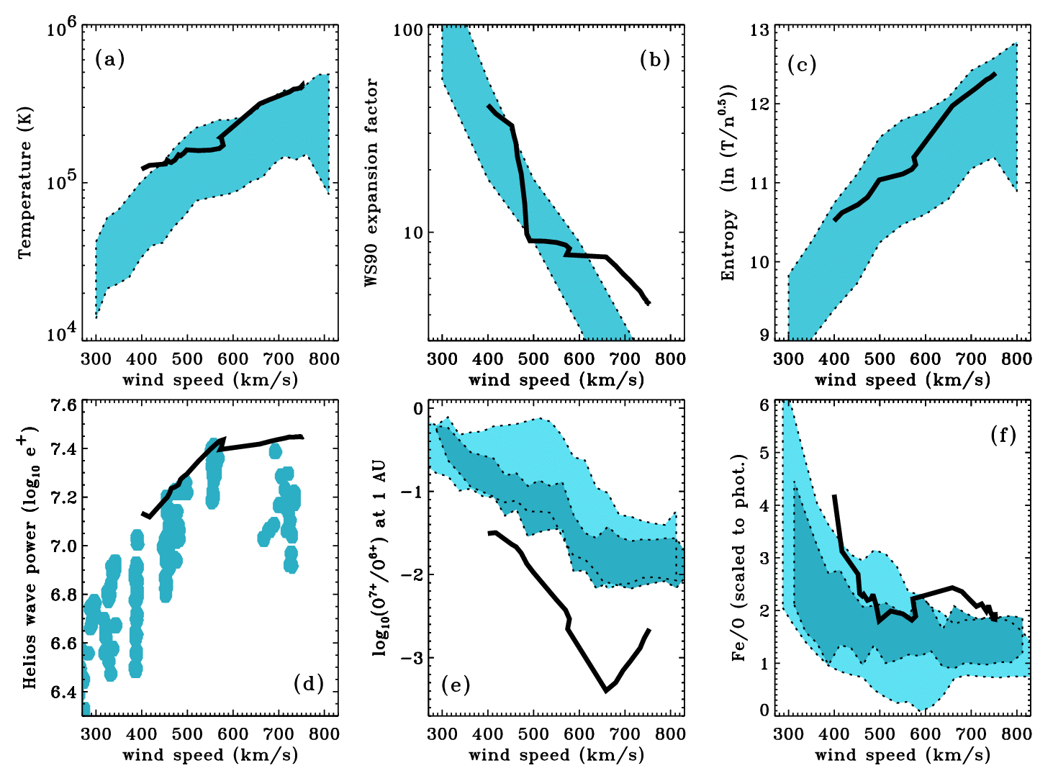
Cranmer et al. (2007): other results
Wang & Sheeley (1990)
ACE/SWEPAM
ACE/SWEPAM
Ulysses
SWICS
Ulysses
SWICS
Helios
(0.3-0.5 AU)

Slide 25
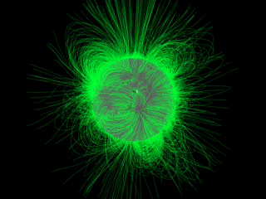
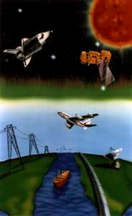
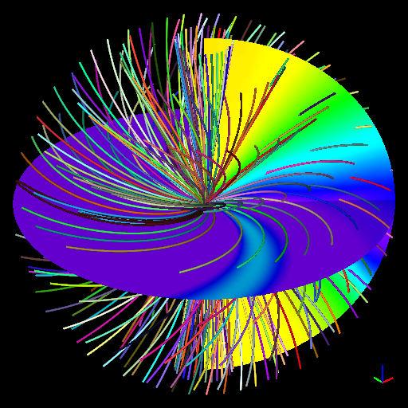
Understanding physics reaps practical benefits
3D global MHD models
Real-time
space weather predictions?
Self-consistent WTD models
Z–
Z₊
Z–

Slide 26
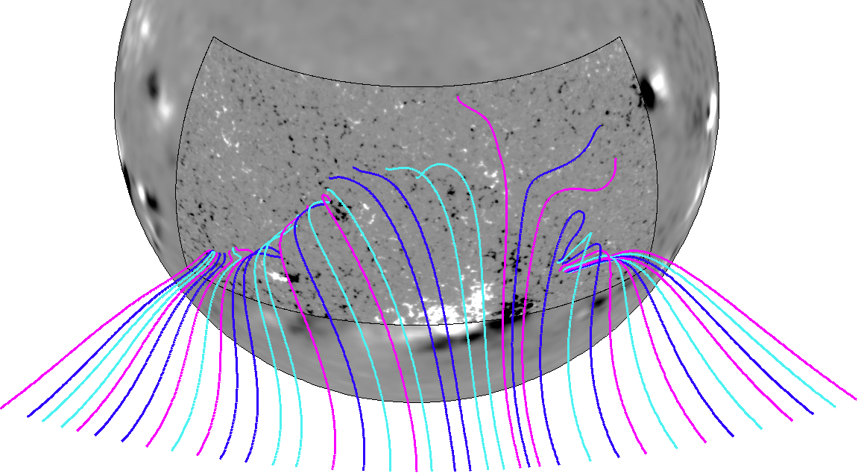
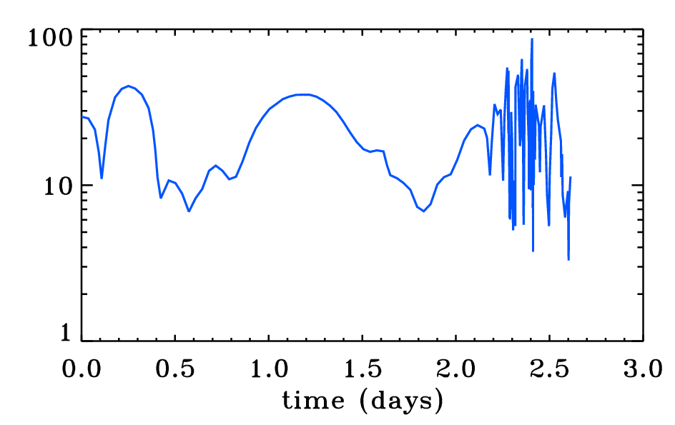
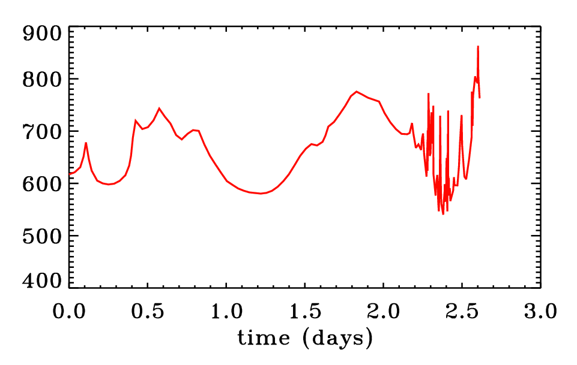
High-resolution 3D fields: prelminary results
Newest magnetograph instruments allow field-line tracing down to scales smaller than the supergranular network.
SOLIS VSM on Kitt Peak.
SDO/HMI is even better...
Does the solar wind retain this fine flux-tube structure?
flux tube expansion factor
wind speed at 1 AU (km/s)

Slide 27
Outline:
Solar overview: Our complex “variable star”
How do we measure solar waves & turbulence?
Coronal heating & solar wind acceleration
Preferential energization of heavy ions

Slide 28


Coronal heating: multi-fluid & collisionless
O⁺⁵
protons
In the lowest density solar wind streams . . .
electron temperatures
proton temperatures
heavy ion temperatures

Slide 29




Preferential ion heating & acceleration
Parallel-propagating ion cyclotron waves (10–10,000 Hz in the corona) have been suggested as a natural energy source . . .
instabilities
Alfven wave’s oscillating
E and B fields
ion’s Larmor motion around radial B-field
dissipation
lower q_{i}/m_{i}
faster diffusion
(e.g., Cranmer 2001)

Slide 30
However . . .
Does a turbulent cascade of Alfvén waves (in the low-beta corona) actually produce ion cyclotron waves?
Most models say NO!

Slide 31


Anisotropic MHD turbulence
When magnetic field is strong, the basic building block of turbulence isn’t an “eddy,” but an Alfvén wave packet.
k
?
Energy input
k

Slide 32
Anisotropic MHD turbulence
When magnetic field is strong, the basic building block of turbulence isn’t an “eddy,” but an Alfvén wave packet.
k
Alfvén waves propagate ~freely in the parallel direction (and don’t interact easily with one another), but field lines can “shuffle” in the perpendicular direction.
Thus, when the background field is strong, cascade proceeds mainly in the plane perpendicular to field (Strauss 1976; Montgomery 1982).
Energy input
k

Slide 33
Anisotropic MHD turbulence
When magnetic field is strong, the basic building block of turbulence isn’t an “eddy,” but an Alfvén wave packet.
k
Alfvén waves propagate ~freely in the parallel direction (and don’t interact easily with one another), but field lines can “shuffle” in the perpendicular direction.
Thus, when the background field is strong, cascade proceeds mainly in the plane perpendicular to field (Strauss 1976; Montgomery 1982).
ion cyclotron waves
Ω_{p}/V_{A}
kinetic Alfvén waves
In a low-β plasma, cyclotron waves heat ions & protons when they damp, but kinetic Alfvén waves are Landau-damped, heating electrons.
Energy input
k
Ω_{p}/c_{s}

Slide 34
Can turbulence preferentially heat ions?
If turbulent cascade doesn’t generate the “right” kinds of waves directly, the question remains: How are the ions heated and accelerated?
When turbulence cascades to small perpendicular scales, the tight shearing motions may be able to generate ion cyclotron waves (Markovskii et al. 2006).
Dissipation-scale current sheets may preferentially spin up ions (Dmitruk et al. 2004; Lehe et al. 2009).
If MHD turbulence exists for both Alfvén and fast-mode waves, the two types of waves can nonlinearly couple with one another to produce high-frequency ion cyclotron waves (Chandran 2005; Cranmer et al. 2012).
If nanoflare-like reconnection events in the low corona are frequent enough, they may fill the extended corona with electron beams that would become unstable and produce ion cyclotron waves (Markovskii 2007).
If kinetic Alfvén waves reach large enough amplitudes, they can damp via stochastic wave-particle interactions and heat ions (Voitenko & Goossens 2006; Wu & Yang 2007; Chandran 2010).

Slide 35
Conclusions
Advances in MHD turbulence theory continue to help improve our understanding about coronal heating and solar wind acceleration.
It is becoming easier to include “real physics” in 1D → 2D → 3D models of the complex Sun-heliosphere system.
However, we still do not have complete enough observational constraints to be able to choose between competing theories.
For more information: http://www.cfa.harvard.edu/~scranmer/

Slide 36
Extra slides . . .

Slide 37


What’s next?
Data at 1 AU shows us plasma that has been highly “processed” on its journey . . . Models must keep track of 3D dynamical effects, Coulomb collisions, etc.
McGregor et al. (2011)
Kasper et al. (2010)
New missions!
In ~2018, Solar Probe Plus will go in to r ≈ 9.5 R_{s} to tell us more about the sub-Alfvénic solar wind.
The Coronal Physics Investigator (CPI) has been proposed as a follow-on to UVCS/SOHO to observe new details of minor ion heating & kinetic dissipation of turbulence in the extended corona (see arXiv:1104.3817).

Slide 38


The outermost solar atmosphere
Total eclipses let us see the vibrant outer solar corona: but what is it?
1870s: spectrographs pointed at corona:
1930s: Lines identified as highly ionized ions: Ca⁺¹² , Fe⁺⁹ to Fe⁺¹³ → it’s hot!
Fraunhofer lines (not moon-related)
unknown bright lines
1860–1950: Evidence slowly builds for outflowing magnetized plasma in the solar system:
solar flares → aurora, telegraph snafus, geomagnetic “storms”
comet ion tails point anti-sunward (no matter comet’s motion)
1958: Eugene Parker proposed that the hot corona provides enough gas pressure to counteract gravity and accelerate a “solar wind.”

Slide 39
Self-consistent 1D models
Cranmer, van Ballegooijen, & Edgar (2007) computed solutions for the waves & background one-fluid plasma state along various flux tubes... going from the photosphere to the heliosphere.
The only free parameters: radial magnetic field & photospheric wave properties.
Some details about the ingredients:
Alfvén waves: non-WKB reflection with full spectrum, turbulent damping, wave-pressure acceleration
Acoustic waves: shock steepening, TdS & conductive damping, full spectrum, wave-pressure acceleration
Radiative losses: transition from optically thick (LTE) to optically thin (CHIANTI + PANDORA)
Heat conduction: transition from collisional (electron & neutral H) to a collisionless “streaming” approximation

Slide 40

Magnetic flux tubes & expansion factors
A(r) ~ B(r)^{–1} ~ r² f(r)
(Banaszkiewicz et al. 1998)
Wang & Sheeley (1990) defined the expansion factor between “coronal base” and the source-surface radius ~2.5 R_{s}.
TR
polar coronal holes f ≈ 4
quiescent equ. streamers f ≈ 9
“active regions” f ≈ 25

Slide 41


Results: turbulent heating & acceleration
T (K)
Ulysses SWOOPS
Goldstein et al.
(1996)
reflection coefficient

Slide 42


Results: flux tubes & critical points
Wind speed is ~anticorrelated with flux-tube expansion & height of critical point.
Cascade efficiency:
n=1
n=2
r_{crit}
r_{max}
(where T=T_{max} )

Slide 43


Results: scaling with magnetic flux density
Mean field strength in low corona:
.
.
.
B ≈ 1500 G (universal?)
f ≈ 0.002–0.1
B ≈ f B ,
.
If the regions below the merging height can be treated with approximations from “thin flux tube theory,” then:
B ~ ρ^{1/2}
Z± ~ ρ^{–1/4}
L┴ ~ B^{–1/2}
Thus,
.
.
. . . and since Q/Q ≈ B/B , the turbulent heating in the low corona scales directly with the mean magnetic flux density there (e.g., Pevtsov et al. 2003; Schwadron et al. 2006; Kojima et al. 2007; Schwadron & McComas 2008).

Slide 44

The UVCS instrument on SOHO
1979–1995: Rocket flights and Shuttle-deployed Spartan 201 laid groundwork.
1996–present: The Ultraviolet Coronagraph Spectrometer (UVCS) measures plasma properties of coronal protons, ions, and electrons between 1.5 and 10 solar radii.
Combines “occultation” with spectroscopy to reveal the solar wind acceleration region!
slit field of view:
Mirror motions select height
UVCS “rolls” independently of spacecraft
2 UV channels:
1 white-light polarimetry channel
LYA (120–135 nm)
OVI (95–120 nm + 2nd ord.)

Slide 45



UVCS results: solar minimum (1996-1997 )
The Ultraviolet Coronagraph Spectrometer (UVCS) on SOHO measures plasma properties of coronal protons, ions, and electrons between 1.5 and 10 solar radii.
In June 1996, the first measurements of heavy ion (e.g., O⁺⁵) line emission in the extended corona revealed surprisingly wide line profiles . . .
On-disk profiles: T = 1–3 million K
Off-limb profiles: T > 200 million K !

Slide 46

Coronal holes: the impact of UVCS
UVCS/SOHO has led to new views of the acceleration regions of the solar wind.
Key results include:
The fast solar wind becomes supersonic much closer to the Sun (~2 R_{s}) than previously believed.
In coronal holes, heavy ions (e.g., O⁺⁵) both flow faster and are heated hundreds of times more strongly than protons and electrons, and have anisotropic temperatures. (e.g., Kohl et al. 1998, 2006)

Slide 47


Evidence for ion cyclotron resonance
Indirect:
UVCS (and SUMER) remote-sensing data
Helios (0.3–1 AU) proton velocity distributions (Tu & Marsch 2002)
Wind (1 AU): more-than-mass-proportional heating (Collier et al. 1996)
(more) Direct:
Leamon et al. (1998): at ω ≈ Ω_{p}, magnetic helicity shows deficit of proton-resonant waves in “diffusion range,” indicative of cyclotron absorption.
Jian, Russell, et al. (2009) : STEREO shows isolated bursts of ~monochromatic waves with ω ≈ 0.1–1 Ω_{p}

Slide 48


Synergy with other systems
T Tauri stars: observations suggest a “polar wind” that scales with the mass accretion rate. Cranmer (2008, 2009) modeled these systems...
Pulsating variables: Pulsations “leak” outwards as non-WKB waves and shock-trains. New insights from solar wave-reflection theory are being extended.
AGN accretion flows: A similarly collisionless (but pressure-dominated) plasma undergoing anisotropic MHD cascade, kinetic wave-particle interactions, etc.
Freytag et al. (2002)
Matt & Pudritz (2005)

Slide 49

T Tauri stars: Testing models of accretion-driven activity
Pre-main-sequence (T Tauri) stars show complex signatures of time-variable accretion from a disk, X-ray coronal emission, and polar outflows.
Cranmer (2008, 2009) showed that “clumpy” accretion streams that impact the star can generate MHD waves that propagate across the stellar surface. The energy in these waves is sufficient to heat an X-ray corona and accelerate a stellar wind.
Brickhouse et al. (2010, 2011) combined Chandra X-ray data with an MHD accretion model to discover a new region of turbulent “post-shock” plasma on TW Hya that contains >30 times more mass than the accretion stream itself. The MHD model also allowed new measurements of the time-variable accretion rate to be made.

Slide 50


Ansatz: accretion stream impacts make waves
The impact of inhomogeneous “clumps” on the stellar surface can generate MHD waves that propagate out horizontally and enhance existing surface turbulence.
Scheurwater & Kuijpers (1988) computed the fraction of a blob’s kinetic energy that is released in the form of far-field wave energy.
Cranmer (2008, 2009) estimated wave power emitted by a steady stream of blobs.
similar to solar flare generated Moreton/EUV waves?

Slide 51



Coronal loops: MHD turbulent heating
Cranmer (2009) modeled equatorial zones of T Tauri stars as a collection of closed loops, energized by “footpoint shaking” (via blob-impact surface turbulence).
Coronal loops are always in motion, with waves & bulk flows propagating back and forth along the field lines.
Traditional Kolmogorov (1941) dissipation must be modified because counter-propagating Alfvén waves aren’t simple “eddies.”
n = 0 (Kolmogorov), 3/2 (Gomez), 5/3 (Kraichnan), 2 (van Ballegooijen), f (V_{A}/v_{eddy}) (Rappazzo)
T, ρ along loops computed via Martens (2010) scaling laws: log T_{max} ~ 6.6–7.

Slide 52



Results: coronal loop X-rays

Slide 53

Stellar winds from polar regions
The Scheurwater & Kuijpers (1988) wave generation mechanism allows us to compute the Alfvén wave velocity amplitude on the “polar cap” photosphere . . .
Waves propagate up the flux tubes & accelerate the flow via “wave pressure.”
If densities are low, waves cascade and dissipate, giving rise to T > 10⁶ K.
If densities are high, radiative cooling is too strong to allow coronal heating.
Cranmer (2009) used the “cold” wave-driven wind theory of Holzer et al. (1983) to solve for stellar mass loss rates.
photosph. sound speed
(
)
v┴ from accretion impacts
v┴ from interior convection
1 solar mass model

Slide 54


Results: wind mass loss rates
O I 6300 blueshifts (yellow)
(Hartigan et al. 1995)
Model predictions
O I 6300 blueshifts (yellow)
(Hartigan et al. 1995)
Model predictions

Slide 55

Emission-line B stars (Be stars)
“Classical” Be stars are non-supergiant B stars that exhibit (or have exhibited in the past) emission in H Balmer lines.
A wide range of observed properties is consistent with Be stars having dense equatorial disks & variable polar winds.
Be stars are rapid rotators, but are not rotating at “critical” / “breakup”
V_{rot} ≈ (0.5 to 0.9) V_{crit}
Unanswered questions:
(Struve 1931; Slettebak 1988)
What is their evolutionary state?
Are their {masses, T_{eff}, abundances, winds} different from normal B stars?
How does the star feed mass & angular momentum into its “decretion disk?”

Slide 56

Nonradial pulsations
Photometry &spectroscopy reveal that many (all?) Be stars undergo nonradial pulsations (NRPs).
Rivinius et al. (1998, 2001) found correlations between emission-line “outbursts” and constructive interference (“beating”) between multiple NRP periods.
Observed velocity amplitudes in photosphere often reach 10–20 km/s, i.e., δv ≈ sound speed!
Most of the pulsational energy is trapped below the surface, and evanescently damped in the atmosphere. But can some of the energy “leak” out as propagating waves?
Movie courtesy John Telting

Slide 57



The acoustic cutoff resonance
Evanescent NRP mode: a “piston” with frequency < acoustic cutoff.
Bird (1964)
Fleck & Schmitz (1991) showed how easy it is for a stratified atmosphere to be excited in modes with ω = ω_{ac} .
Effects that can lead to “ringing” at ω_{ac} :
Reflection at gradients in bkgd ?
NRP modes with finite lifetimes ?
These resonant waves can transport energy and momentum upwards, and they may steepen into shocks.

Slide 58




A model based on “wave pressure”
Propagating & dissipating waves/shocks exert a ponderomotive wave pressure.
Cranmer (2009, ApJ, 701, 396) modeled the production of resonant waves from evanescent NRP modes, and followed their evolution up from the photosphere:
TΔS depends on shock Mach #, which depends on radial velocity amplitude <δv_{r}²>

Slide 59



Model results for an example B2 V star

