Slide 1
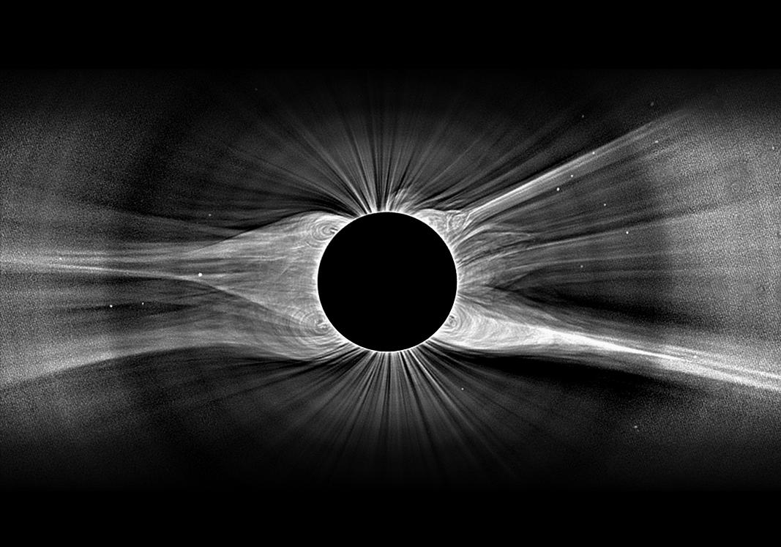
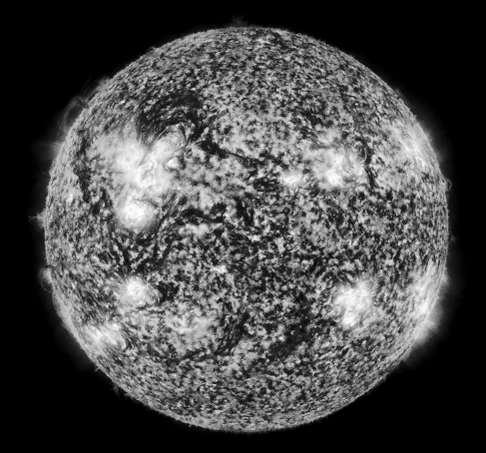


Turbulence as a Unifying Principle in Coronal Heating and
Solar Wind Acceleration
Steven R. Cranmer
Harvard-Smithsonian Center for Astrophysics
A. van Ballegooijen, L. Woolsey, M. Asgari-Targhi, J. Kohl, M. Miralles

Slide 2
Turbulence as a Unifying Principle in Coronal Heating and
Solar Wind Acceleration
Outline:
Brief survey of physical processes and debates
Turbulence micro-tutorial
Successful applications of turbulence to corona/wind
Steven R. Cranmer
Harvard-Smithsonian Center for Astrophysics
A. van Ballegooijen, L. Woolsey, M. Asgari-Targhi, J. Kohl, M. Miralles

Slide 3
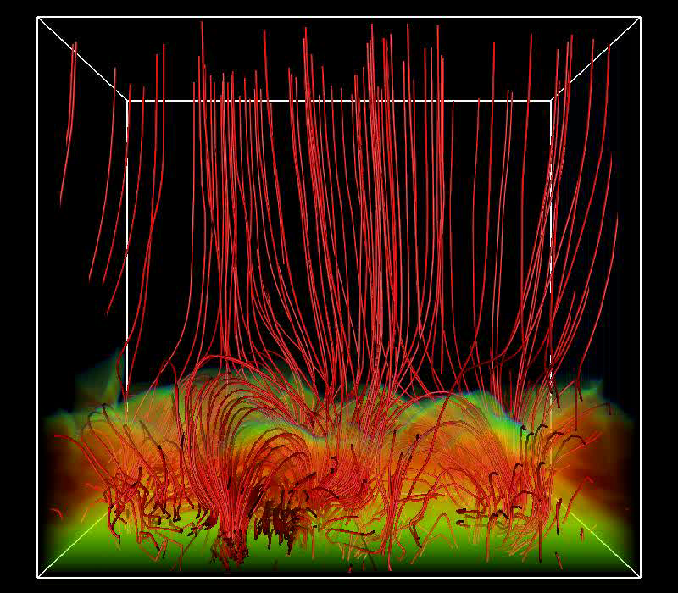
Coronal heating problems
(Nearly!) everyone agrees that there is more than enough “mechanical energy” in the convection to heat the corona. How does a fraction (~1%) of that energy get:
transported up to the corona,
converted to magnetic energy,
dissipated as heat, (and/or)
provide direct wind acceleration
Waves (AC) vs. reconnection (DC) ?
Heating: top-down vs. bottom-up ?
Open-field: jostling vs. loop-feeding ?
Kinetics: MHD vs. “filtration” ?
Source: Mats Carlsson

Slide 4
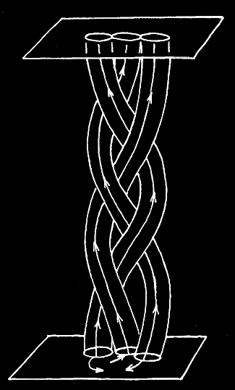
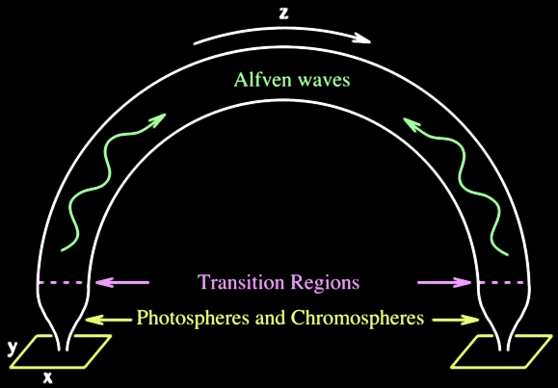
Waves versus reconnection
Slow footpoint motions (τ > L/V_{A}) cause the field to twist & braid into a quasi-static state; parallel currents build up and are released via reconnection. (“DC”)
Rapid footpoint motions
(τ < L/V_{A}) propagate through the field as waves, which are eventually dissipated. (“AC”)
However . . .
The Sun’s atmosphere exhibits a continuum of time scales bridging AC/DC limits.
“Waves” in the real corona aren’t just linear perturbations.
  (amplitudes are large) (polarization relations are not “classical”)
“Braiding” in the real corona is highly dynamic. (see Hi-C!)

Slide 5
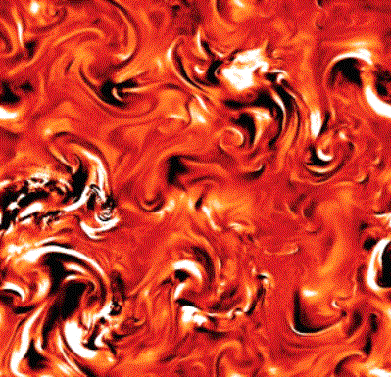
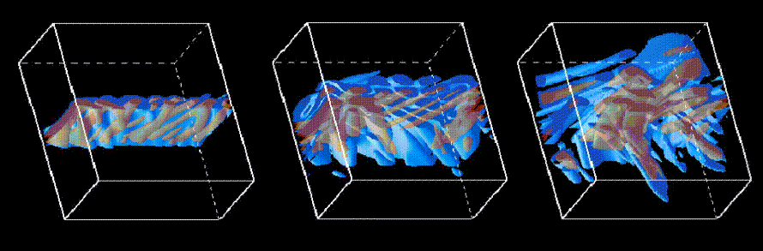
Waves go along with reconnection
To complicate things even more . . .
Waves cascade into MHD turbulence (eddies), which tends to:
break up into thin reconnecting sheets on its smallest scales.
accelerate electrons along the field and generate currents.
Coronal current sheets can emit waves, and can be unstable to growth of turbulent motions which may dominate the energy loss & particle acceleration.
e.g., Dmitruk et al. (2004)
Turbulence may drive “fast” reconnection rates (Lazarian & Vishniac 1999), too.
Onofri et al. (2006)

Slide 6
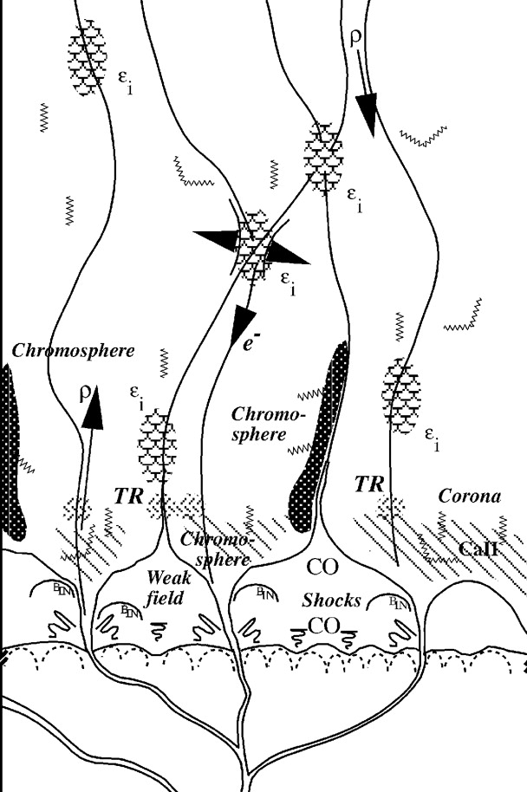
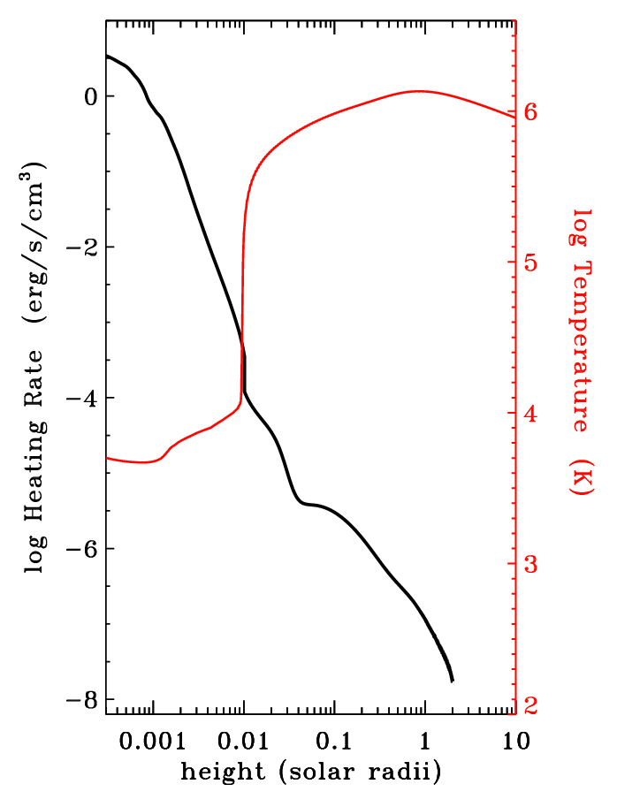
Where is the heat source?
Jim Klimchuk summarized the debate . . .
Traditional: “coronal heating” conducts down.
New idea: spicules/jets feed in mass from below.
Many models already show orders of magnitude more heating in chromosphere than in corona.
If just a small fraction of that chromospheric energy deposition makes it up to the corona, it can dominate the “local” heating.
Schrijver (2001)
Reality is dynamic and intermittent, but there are plenty of viable “local” sources of coronal heating, too.

Slide 7
Turbulence: a unifying picture? *
Convection shakes & braids field lines...
Alfvén waves propagate upward...
partially reflect back down...
...and cascade from large to small eddies, eventually dissipating to heat the plasma.
spicules
jets
shock steepening
density fluct’s
* Not included in this basic cartoon: motions along the field

Slide 8
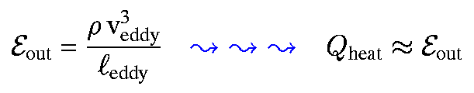
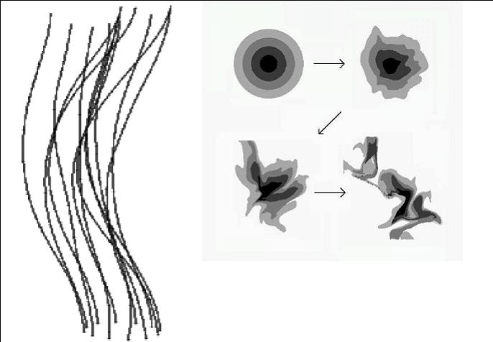
Turbulence: pure hydrodynamics
The original von Karman & Howarth (1938) theory of fluid turbulence assumed a constant energy flux from large to small eddies.
The inertial range is a “pipeline” for transporting energy from the large scales to the small scales, where dissipation can occur.
energy injection range
Fluctuation power
Kolmogorov (1941)
dissipation range
frequency or wavenumber

Slide 9
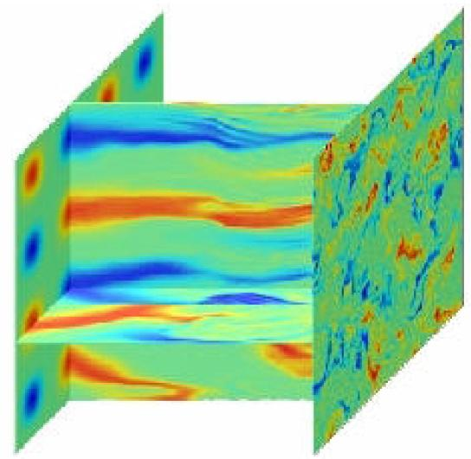
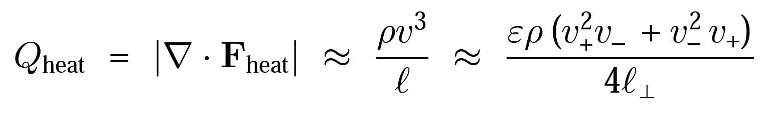
Anisotropic MHD turbulence
With a strong background field, it is easier to mix field lines (perp. to B) than it is to bend them (parallel to B).
Also, the energy transport along the field is far from isotropic.
Turbulent eddies are formed and “shredded” by collisions of counter-propagating Alfvén wave packets.
MHD simulations inspire phenomenological scalings for the cascade/heating rate:
(e.g., Iroshnikov 1963; Kraichnan 1965; Strauss 1976; Shebalin et al. 1983; Hossain et al. 1995; Goldreich & Sridhar 1995; Matthaeus et al. 1999; Dmitruk et al. 2002)

Slide 10
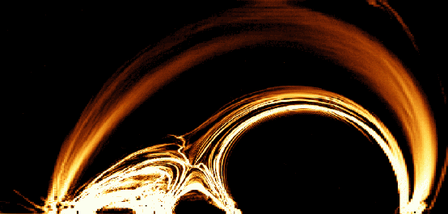
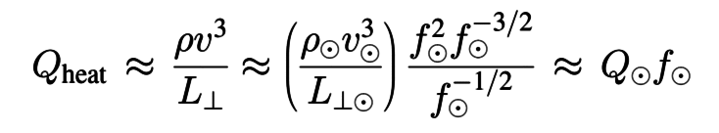
Turbulent heating proportional to B
Sometimes wave/turbulence heating is contrasted with purely “magnetic” heating, but it’s often the case that the turbulent heating rate scales with field strength:
Mean field strength in low corona:
B ≈ f B ,
B ≈ 1500 G (universal?)
f ≈ 0.002 – 0.1
If the low atmosphere can be treated with approximations from thin flux tube theory, and the turbulence is “balanced” (i.e., loops with similar footpoints) then:
B ~ ρ^{1/2}
v± ~ ρ^{–1/4}
L┴ ~ B^{–1/2}
Thus, Q/Q ≈ B/B as was found by Pevtsov et al. (2003); Schwadron et al. (2006).

Slide 11
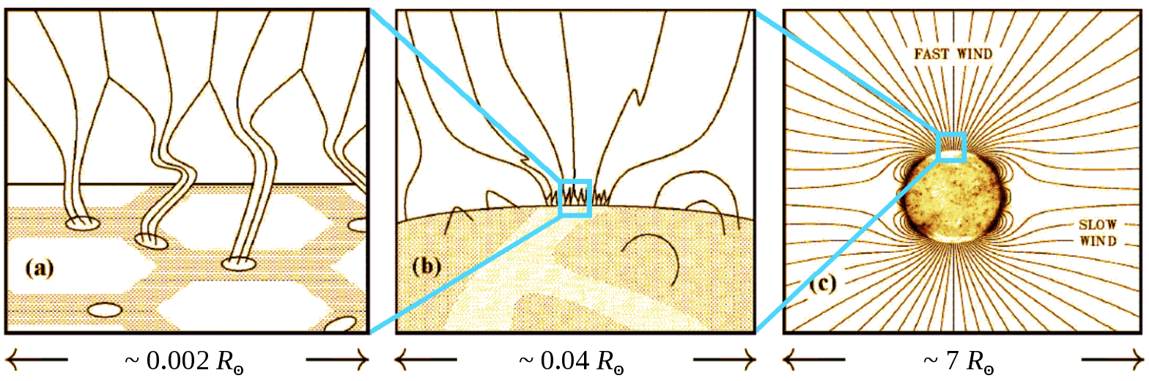
Putting it all together
mechanical energy
magnetic energy
thermal energy
kinetic energy

Slide 12
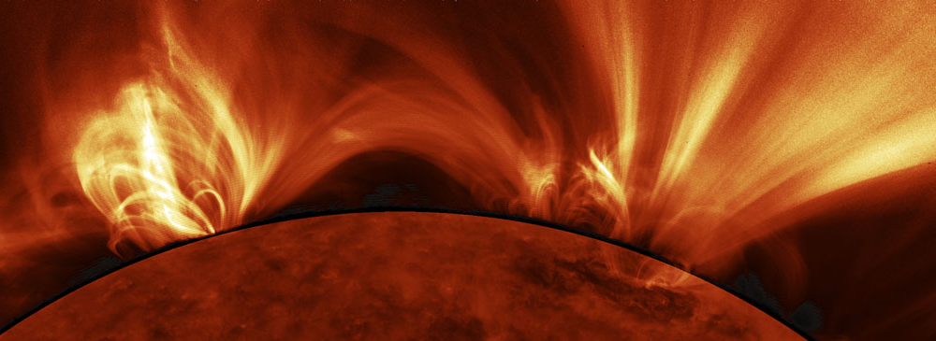
Open flux tubes feeding the solar wind
Once we have a ~10⁶ K corona, we still don’t know if Parker’s (1958) theory for gas-pressure acceleration is sufficient for driving the solar wind.
SDO/AIA
What is the source of mass, momentum, and energy that goes into the solar wind?
Wave/turbulence input in open tubes?
Reconnection & mass input from loops?
vs.
Cranmer & van Ballegooijen (2010) say reconn./loop-opening doesn’t work.
Roberts (2010) says neither idea works !?

Slide 13
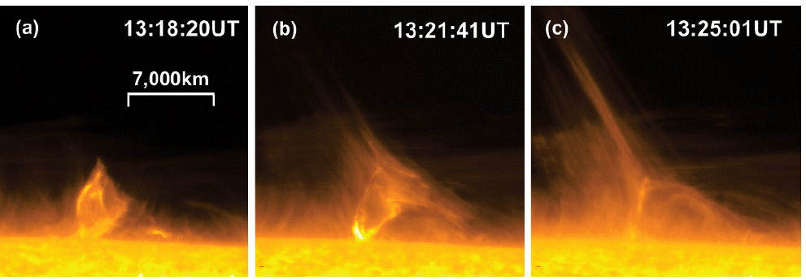
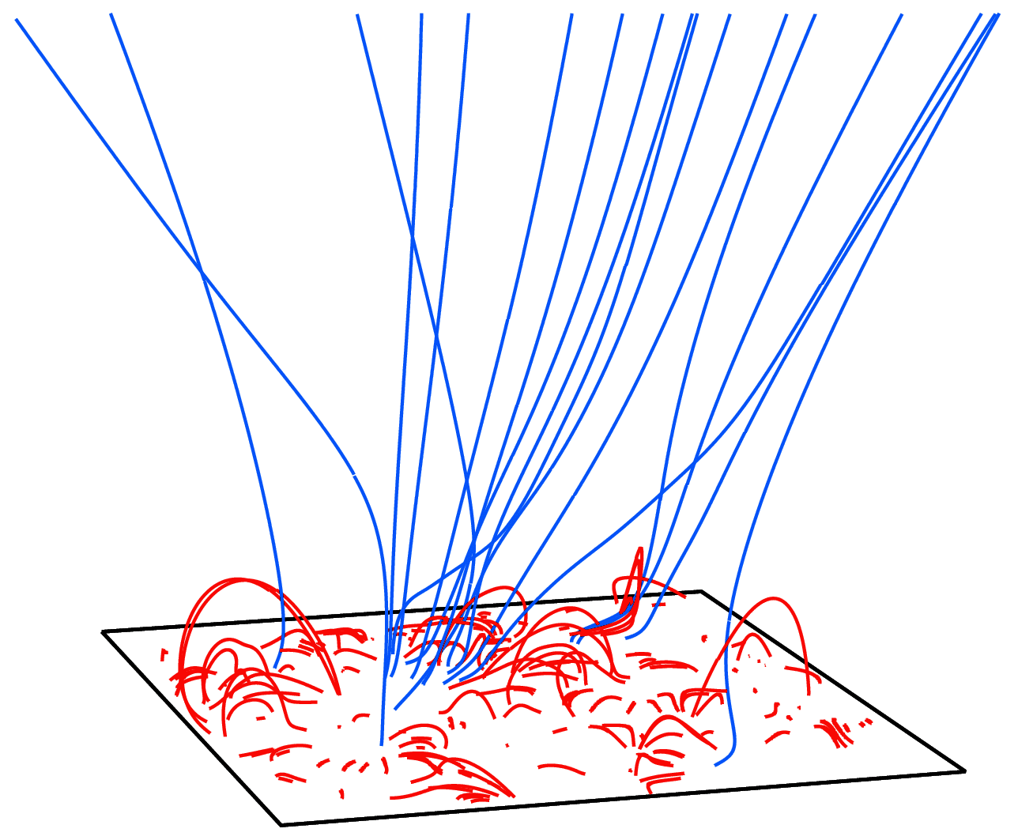
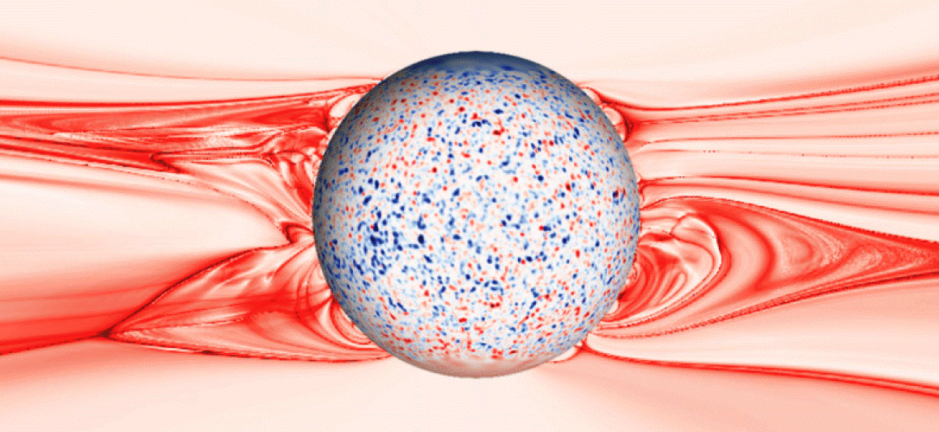
There’s a natural appeal to “RLO”
Open-field regions show frequent jet-like events.
Evidence of magnetic reconnection between open and closed fields.
Hinode/SOT: Nishizuka et al. (2008)
But is there enough mass & energy released (in the subset of reconnection events that turn closed fields into open fields) to heat/accelerate the entire corona & wind?
Antiochos et al. (2011)

Slide 14
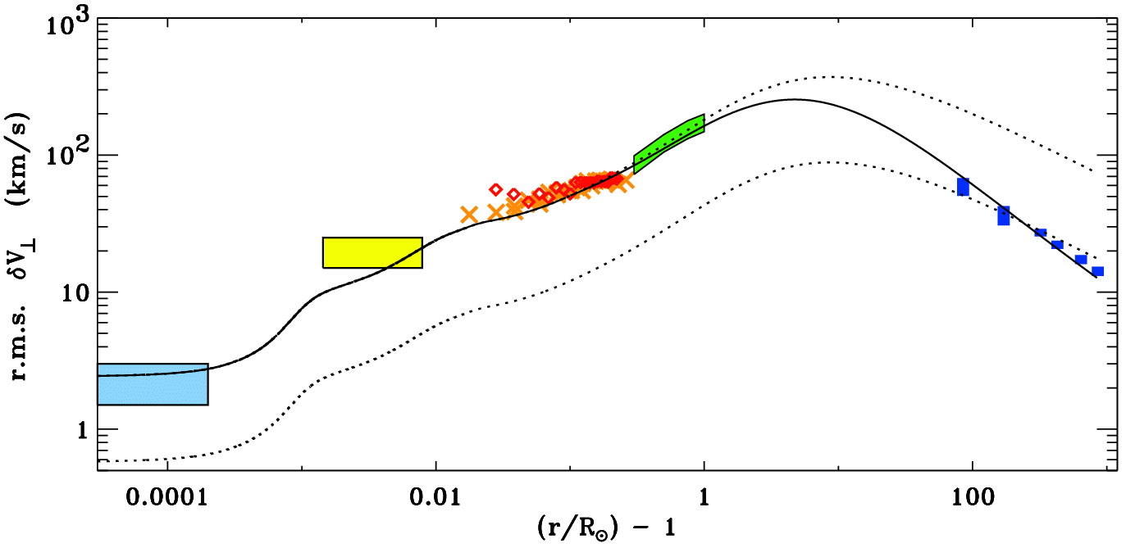
What processes drive solar wind acceleration?
No matter the relative importance of reconnection events, we do know that waves and turbulent motions are present everywhere... from photosphere to heliosphere.
How much can be accomplished by only these processes?
Hinode/SOT
SUMER/SOHO
G-band bright points
UVCS/SOHO
Helios & Ulysses
Undamped (WKB) waves
Damped (non-WKB) waves

Slide 15
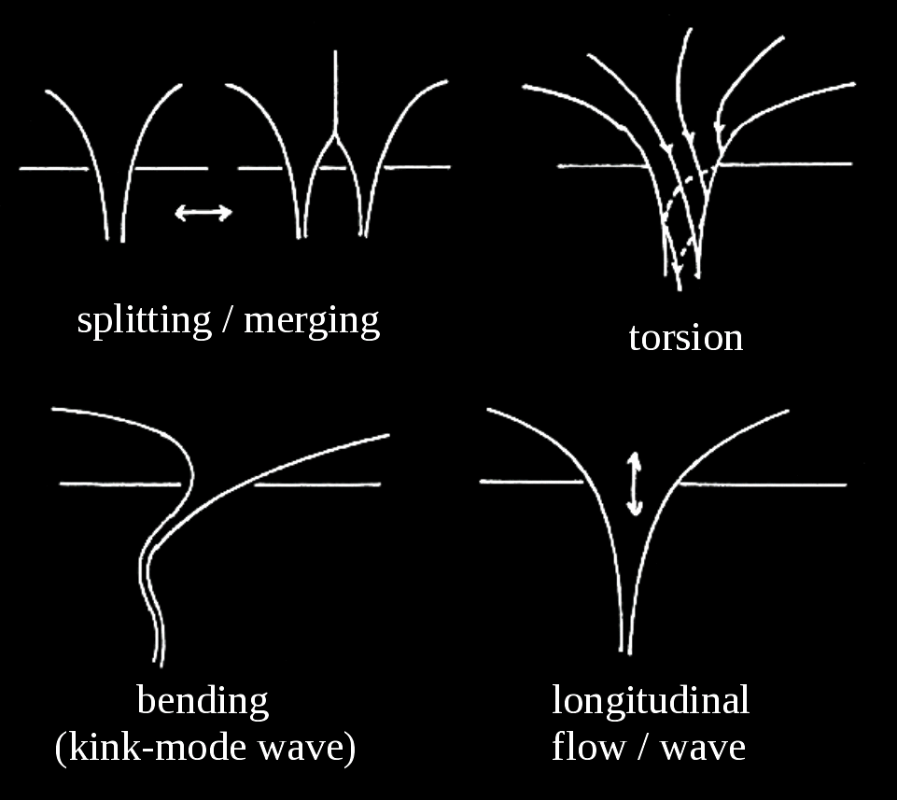
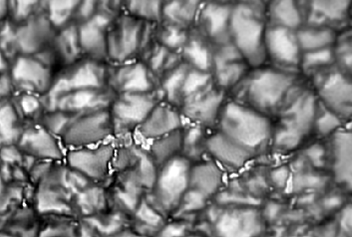
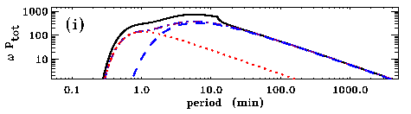
Photospheric origin of waves
Much of the magnetic field is concentrated into small inter-granular flux tubes, which ultimately connects up to the corona & wind.
< 0.1″
Observations of G-band bright points show a spectrum of both random walks and intermittent “jumps” (Cranmer & van Ballegooijen 2005; Chitta et al. 2012).

Slide 16
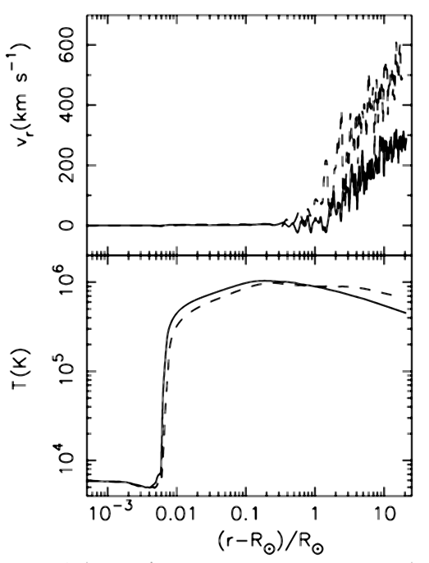
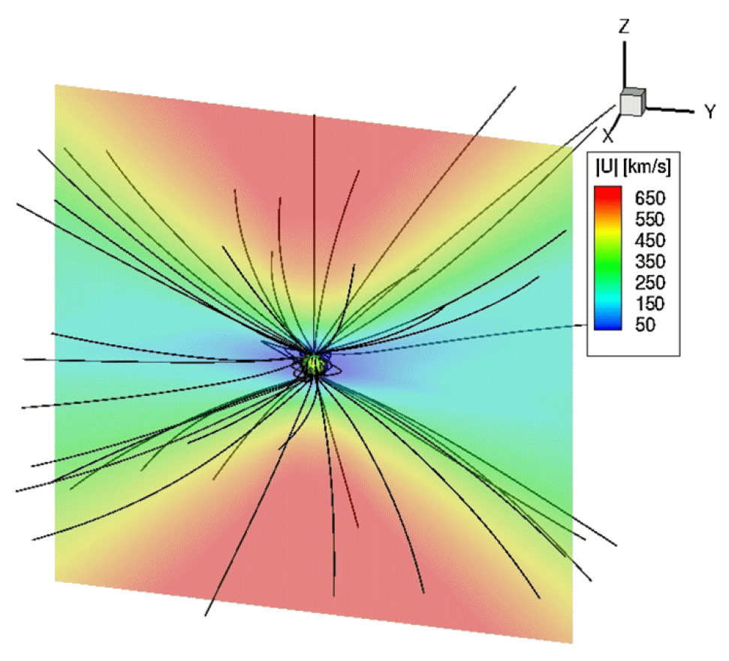
Turbulence-driven solar wind models
A number of recent models seem to be converging on a combination of turbulent dissipation (heating) and wave ponderomotive forces (acceleration) as being both sufficient to accelerate the wind and consistent with coronal & in situ observations.
For example, wave/turbulence processes can produce:
Realistic/variable coronal heating (Suzuki & Inutsuka 2006):
3D variability (Breech et al. 2009; Usmanov
et al. 2011; Evans et al. 2012; Ofman et al. 2013)

Slide 17
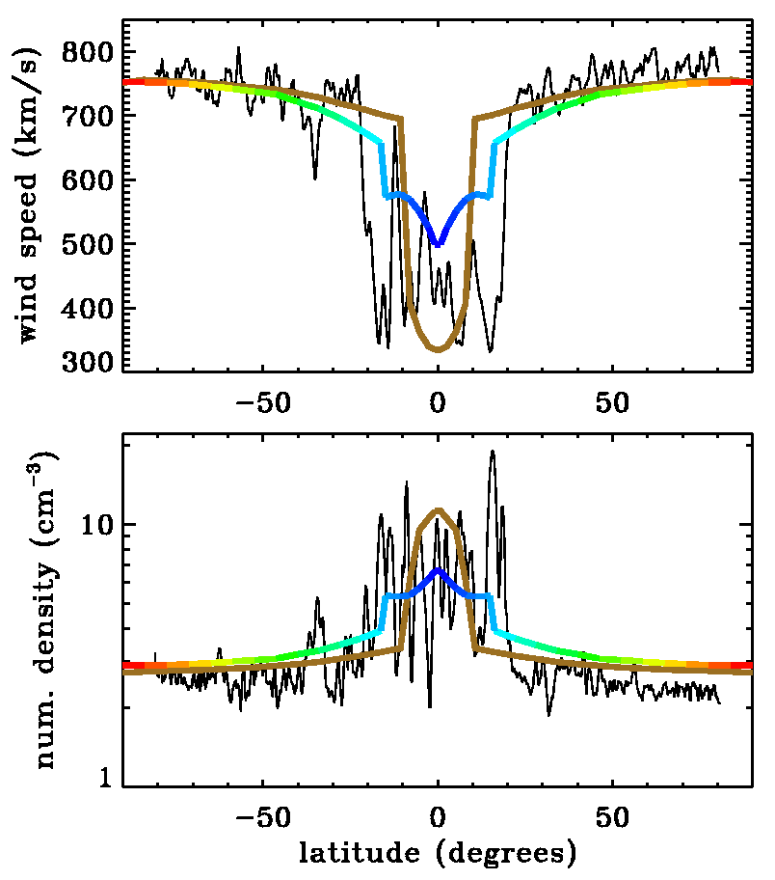
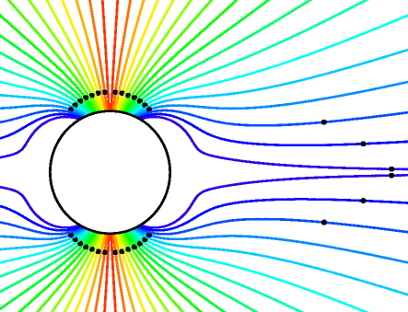
Turbulence-driven solar wind models
Cranmer et al. (2007) computed self-consistent solutions of waves & background one-fluid plasma state along various flux tubes.
Only free parameters: waves at photosphere & radial magnetic field.
Coronal heating occurs “naturally” with T_{max} ~ 1–2 MK.
Varying radial dependence of field strength (B_{r} ~ A^{–1}) changes location of the Parker (1958) critical point.
Crit. pt. low: most heating occurs above it → kinetic energy → fast wind.
Crit. pt. high: most heating occurs below it → thermal energy → denser and slower wind.
Ulysses SWOOPS
Goldstein et al.
(1996)

Slide 18
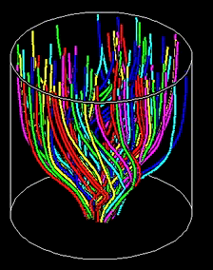
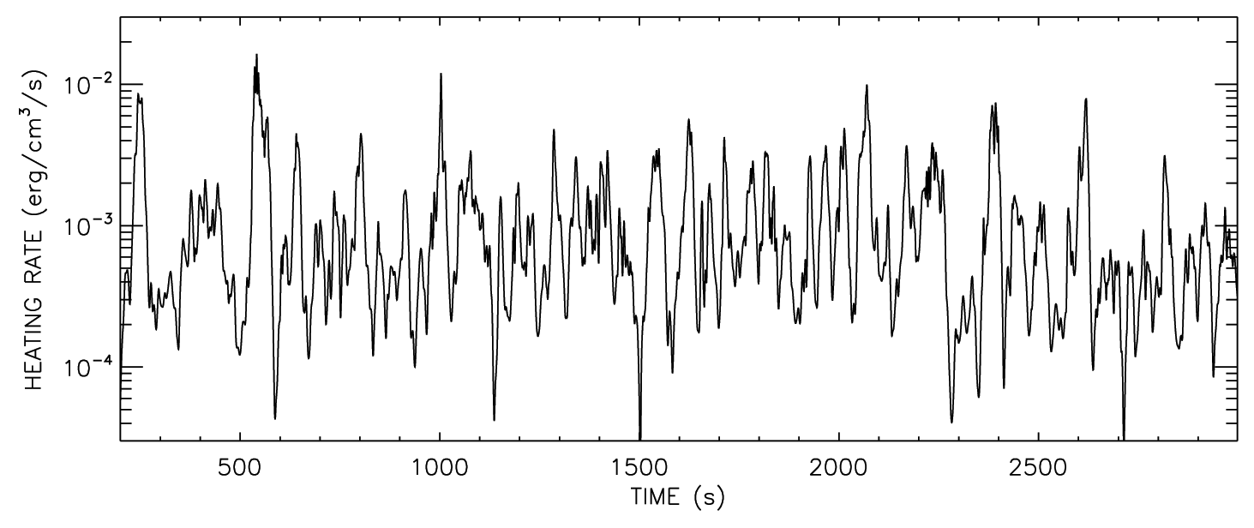
Time-dependent turbulence models
van Ballegooijen et al. (2011) & Asgari-Targhi et al. (2012) simulated MHD turbulence in expanding flux tubes → 3D fluctuations in loops & open fields.
Assumptions:
  No background flows along field.
  No density fluctuations.
  Fluctuations confined to flux tube interior.
  Reduced MHD equations govern nonlinear “wave packet collision” cascade interactions.
Chromospheric and coronal heating is of the right magnitude, and is highly intermittent (“nanoflare-like”).

Slide 19
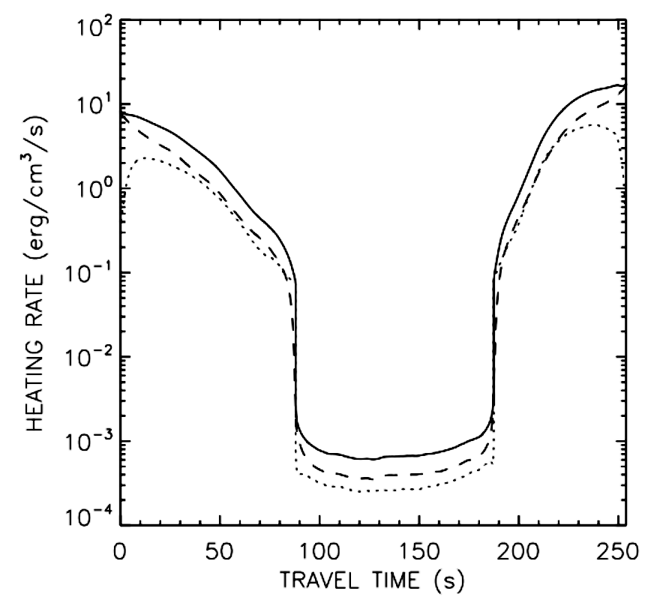
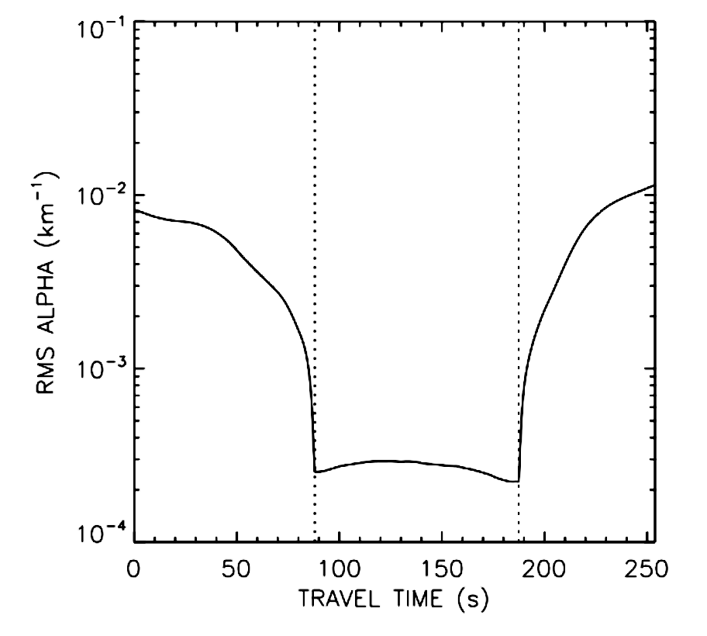
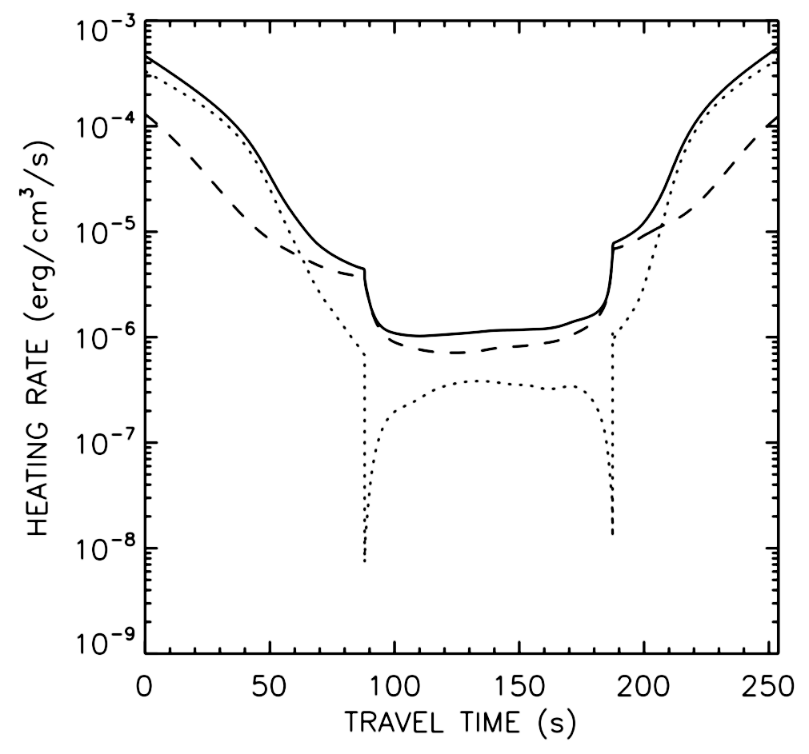
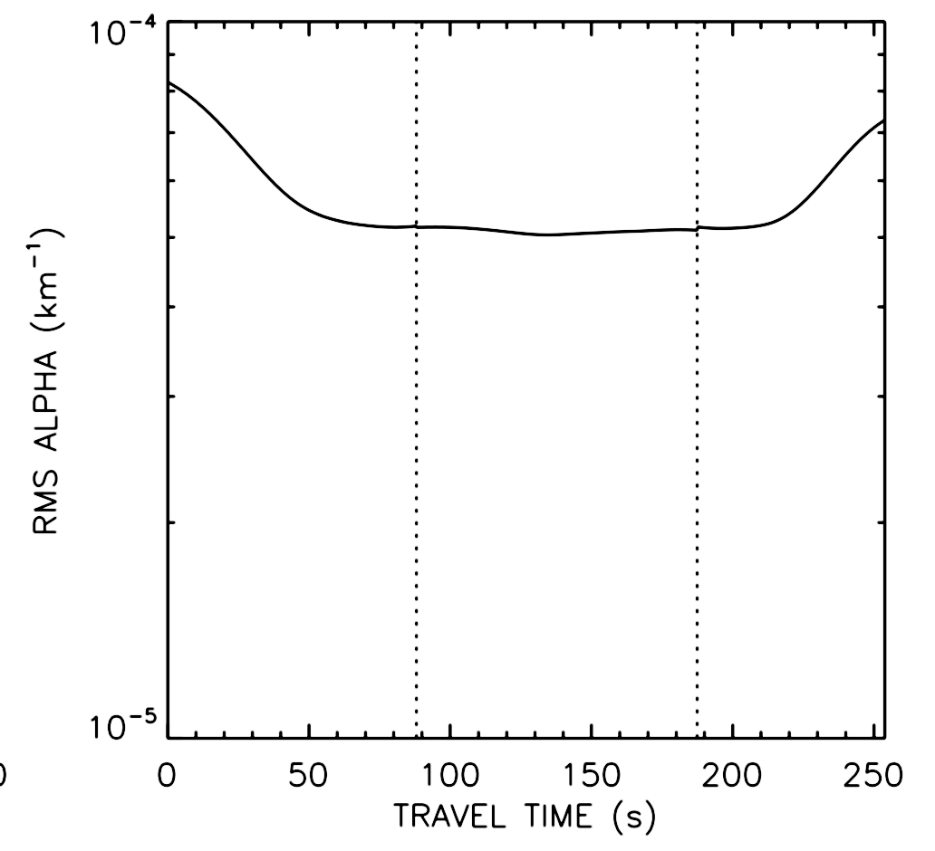
Time-dependent turbulence models
For reasonable footpoint driving (v┴ =1.5 km/s), the corona responds dynamically with substantial heating & variable “alpha” (i.e., a non force-free state).
Heating rate
Magnetic torsion
α = (∇ x B)║ / B
10^{–3}
r.m.s. averages
For reduced footpoint driving (v┴ =0.1 km/s), the corona twists and braids in a quasi-static way (i.e., alpha stays ~constant), but the turbulent cascade rate is far too low to heat the corona.
Heating rate
10^{–6}
Magnetic torsion
α = (∇ x B)║ / B

Slide 20
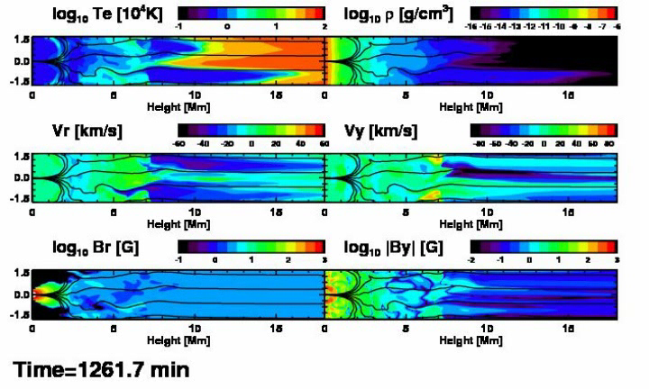
Alternate approach: 2.5D wave driving
Matsumoto & Suzuki (2012, 2013) insert Alfvén waves at chromospheric boundary of a flux tube and follow MHD motions, coronal heating, & wind acceleration . . .
Is it MHD turbulence? “Reduced MHD” nonlinearities are not present,
but other nonlinearities (shocks, mode conversion) are. There is a cascade!

Slide 21
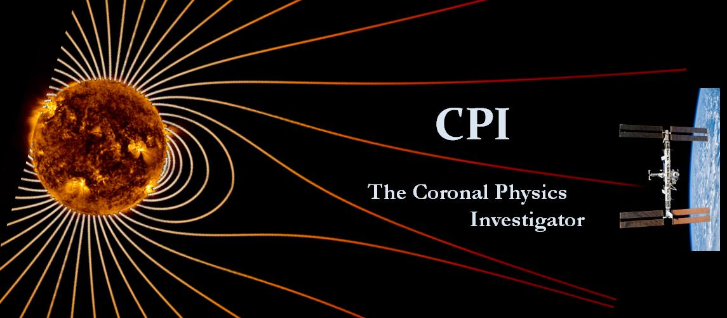
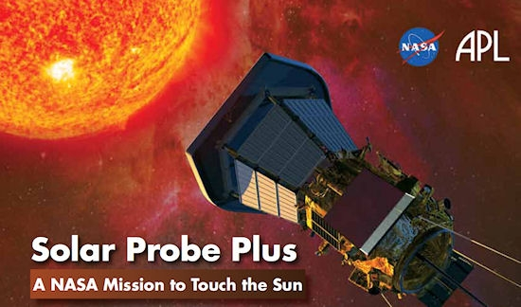

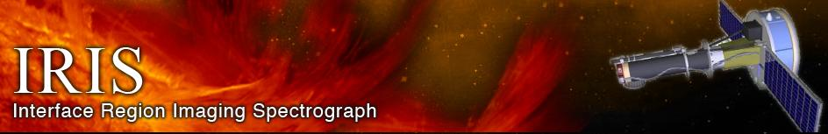
Conclusions
Although the “problems” are not conclusively solved, we’re including more and more real physics (e.g., MHD turbulence) in models that are doing better at explaining the heating & acceleration of solar wind plasma.
However, we still do not have complete enough observational constraints to be able to choose between competing theories . . .
For more information:
http://www.cfa.harvard.edu/~scranmer/

Slide 22
Extra slides . . .

Slide 23
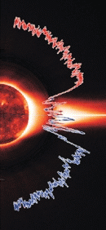
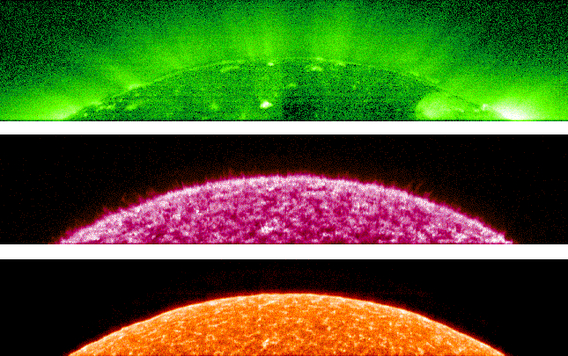
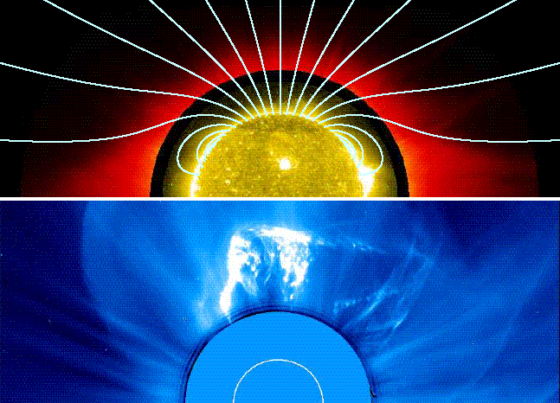
The solar wind: very brief history
Mariner 2 (1962): first direct confirmation of continuous supersonic solar wind, validating Parker’s (1958) model of a gas-pressure driven wind.
Helios probed in to 0.3 AU, Voyager continues past 100+ AU.
Ulysses (1990s) left the ecliptic; provided 3D view of the wind’s connection to the Sun’s magnetic geometry.
SOHO gave us new views of “source regions” of solar wind and the physical processes that accelerate it . . .

Slide 24
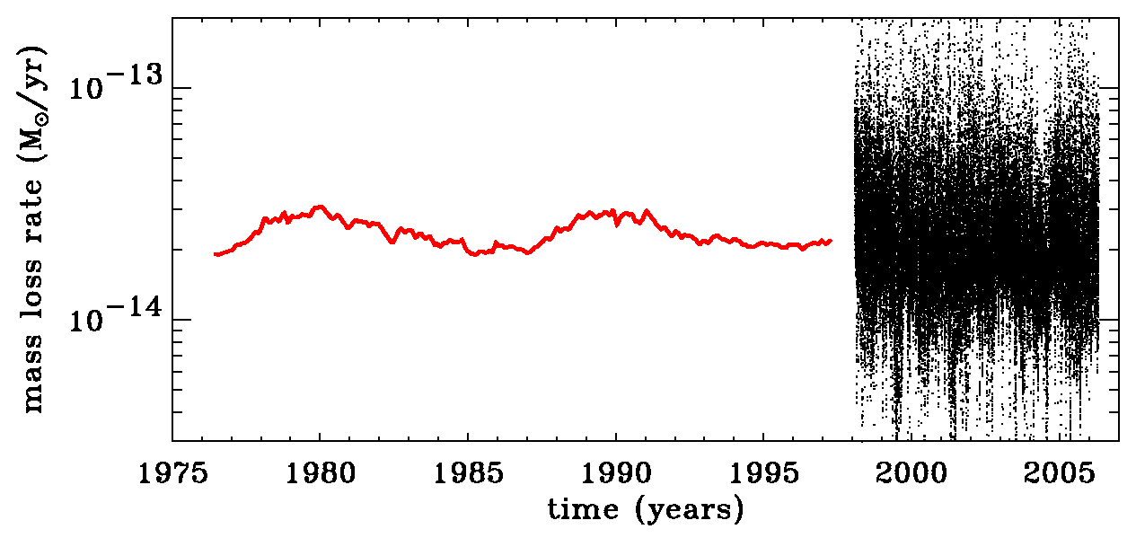
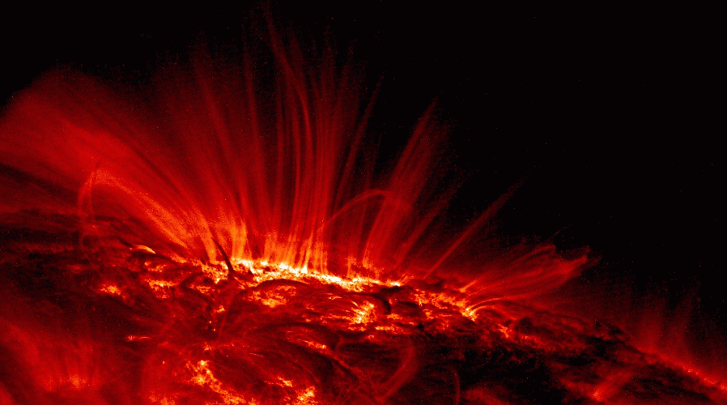

What sets the Sun’s mass loss?
The sphere-averaged mass flux is remarkably constant.
Coronal heating seems to be ultimately responsible, but that varies by orders of magnitude over the solar cycle.
Hammer (1982) & Withbroe (1988) suggested an energy balance with a “thermostat.”
Only a fraction of total coronal heat flux conducts down, but in general, we expect something close to
Wang (1998)
heat conduction
radiation losses
5
2
— ρvkT
. . . along open flux tubes!

Slide 25
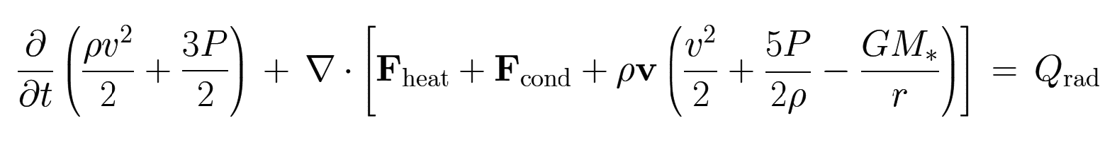
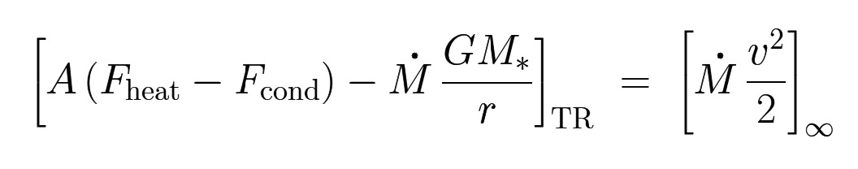
Energy conservation in outer stellar atmospheres
Photosphere
Chromosphere
Transition region & low corona
Supersonic wind (r >> R*)
. . . . . . . . . . . . . . . . . . . . . . . . . . . . . . . . . . . . . . . . . . . . . . . . . .
. . . . . . . . . . . . . . . . . . . . . . . . . . . . . . . . . . . . . . . . . . . . . . . . . .
. . . . . . . . . . . . . . . . . . . . . . . . . . . . . . . . . . . . . . . . . . . . . . . . . .
. . . . . . . . . . . . . . . . . . . . . . . . . . . . . . . . . . . . . . . . . . . . . . . . . .
Leer et al. (1982) and Hansteen et al. (1995) found that one can often simplify the energy balance to be able to solve for the mass flux:
However, the challenge is to determine values for all the parameters!
≈

Slide 26
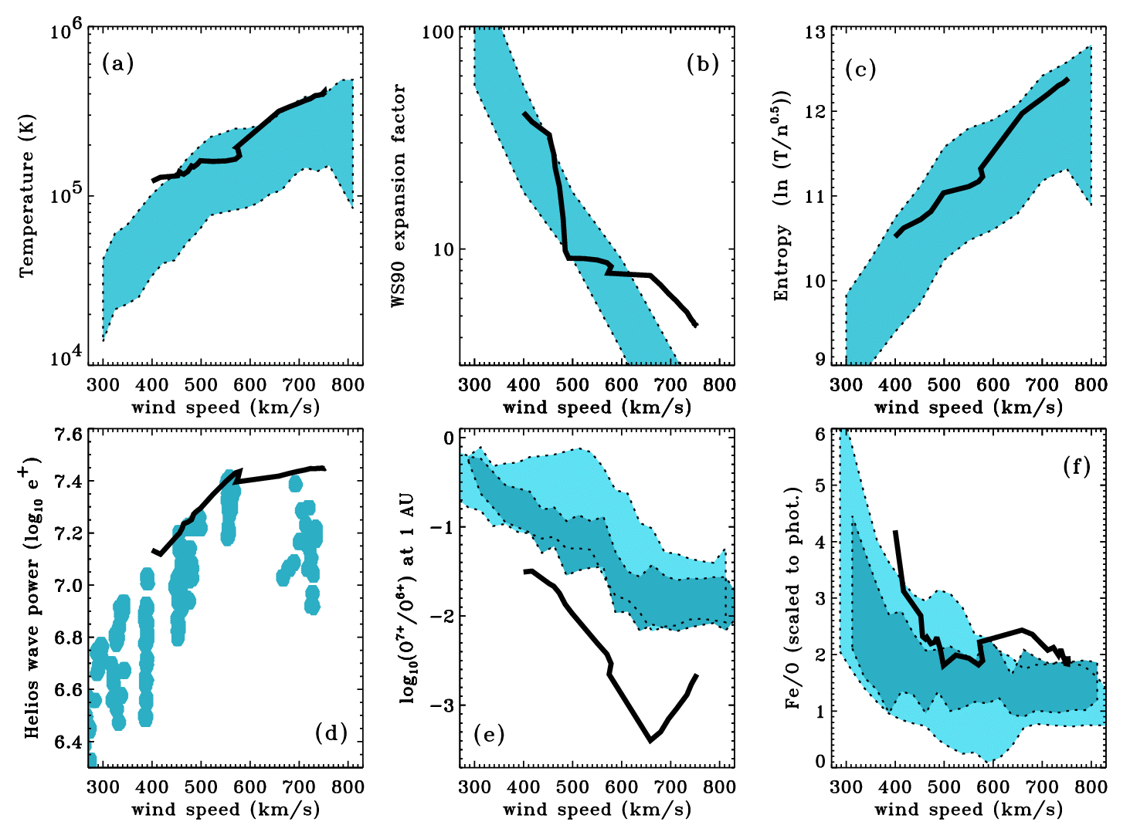
Cranmer et al. (2007): other results
Wang & Sheeley (1990)
ACE/SWEPAM
ACE/SWEPAM
Ulysses
SWICS
Ulysses
SWICS
Helios
(0.3-0.5 AU)

Slide 27
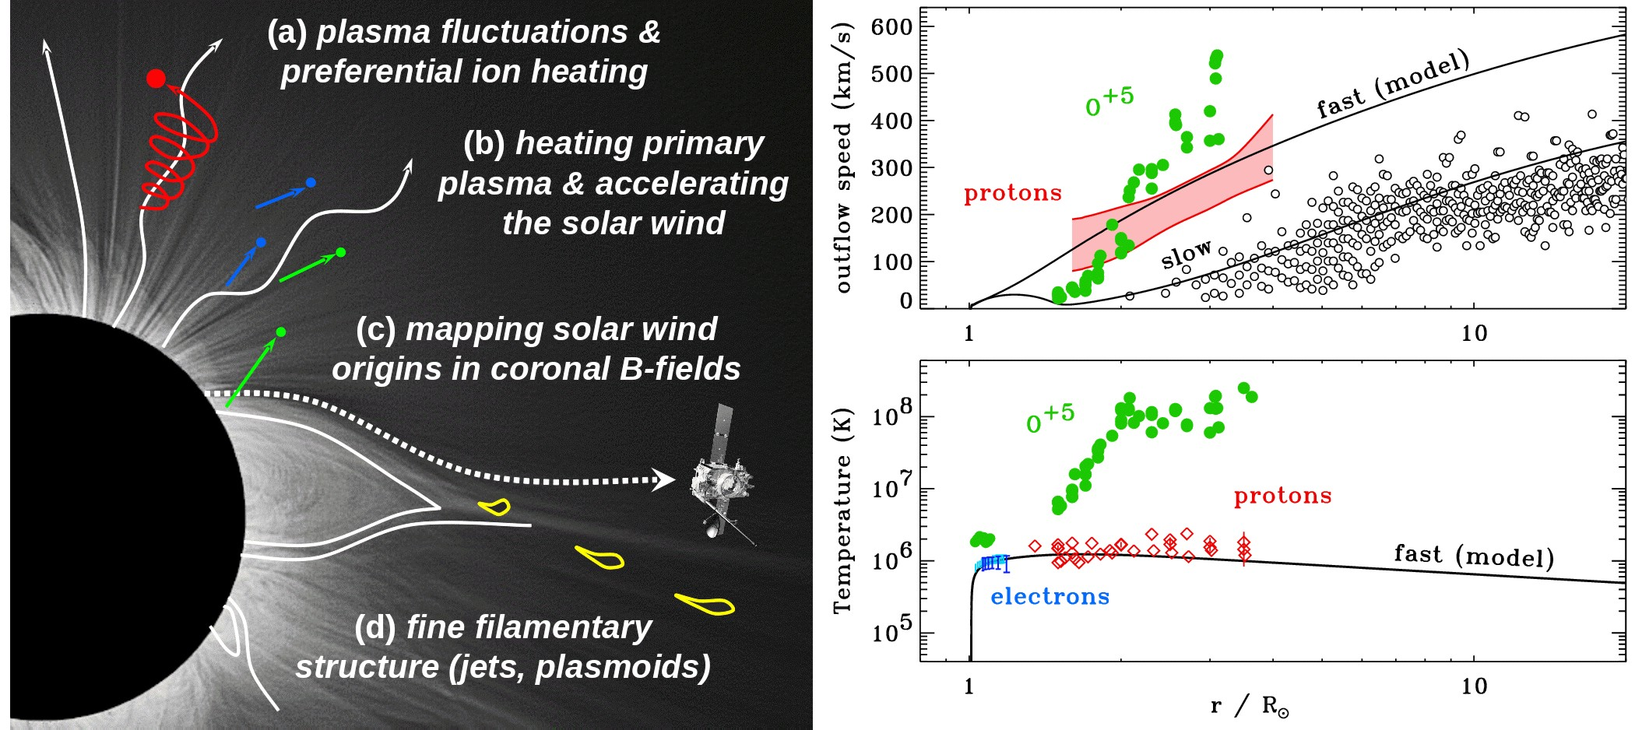
The power of off-limb UV spectroscopy
UVCS/SOHO led to new views of the collisionless nature of solar wind acceleration.
In coronal holes, heavy ions (e.g., O⁺⁵) both flow faster and are heated hundreds of times more strongly than protons and electrons, and have anisotropic velocity distributions.
(Kohl et al. 1995, 1997, 1998, 1999, 2006; Cranmer et al. 1999, 2008; Cranmer 2000, 2001, 2002)

Slide 28
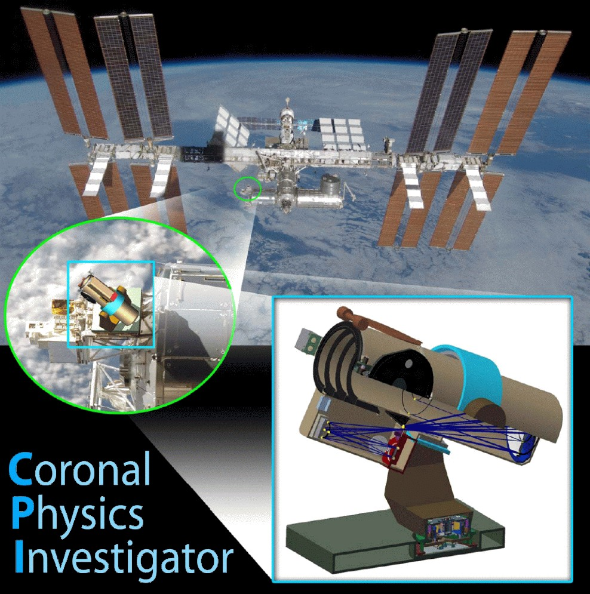

Slide 29
CPI is a large-aperture ultraviolet coronagraph spectrometer that has been proposed to be deployed on the International Space Station (ISS).
The primary goal of CPI is to identify and characterize the physical processes that heat and accelerate the plasma in the fast and slow solar wind.
CPI follows on from the discoveries of UVCS/SOHO, and has unprecedented sensitivity, a wavelength range extending from 25.7 to 126 nm, higher temporal resolution, and the capability to measure line profiles of He II, N V, Ne VII, Ne VIII, Si VIII, S IX, Ar VIII, Ca IX, and Fe X, never before seen in coronal holes above 1.3 solar radii. See white paper at: http://arXiv.org/abs/1104.3817
2011-2013: Undergoing Phase A concept study as an Explorer Mission of Opportunity: downselect decision to come in April-May 2013 ?

