Slide 1
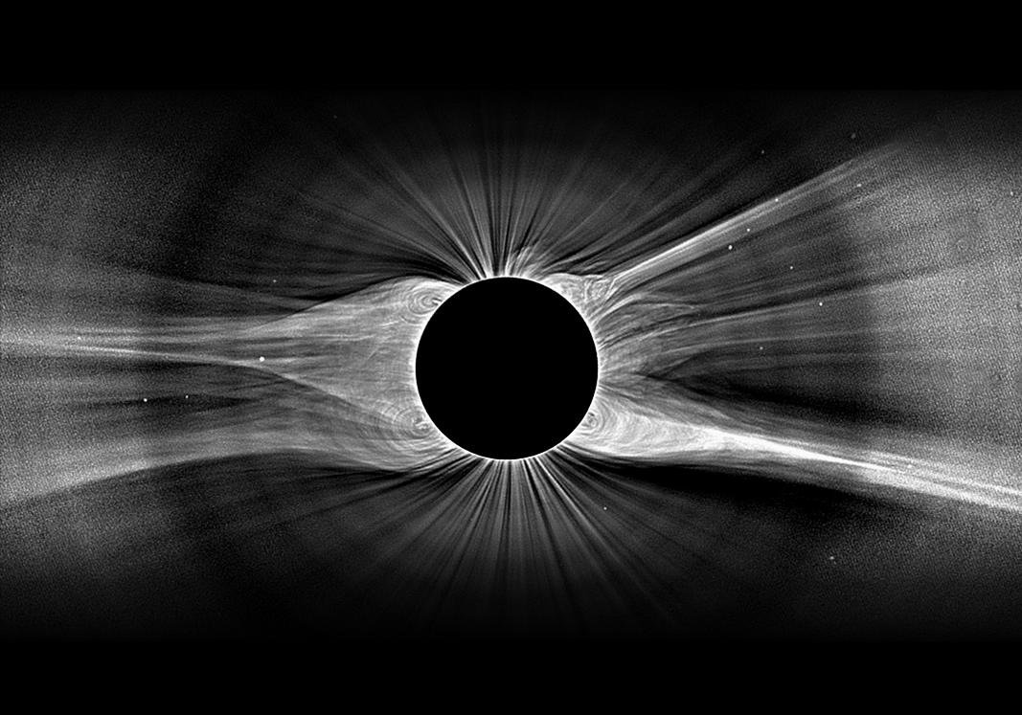
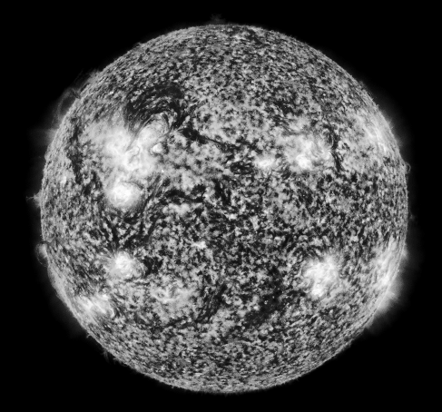
Stellar Wind Theory
Steven R. Cranmer Harvard-Smithsonian Center for Astrophysics
with A. van Ballegooijen, S. Saar, A. Dupree, N. Brickhouse, et al.

Slide 2
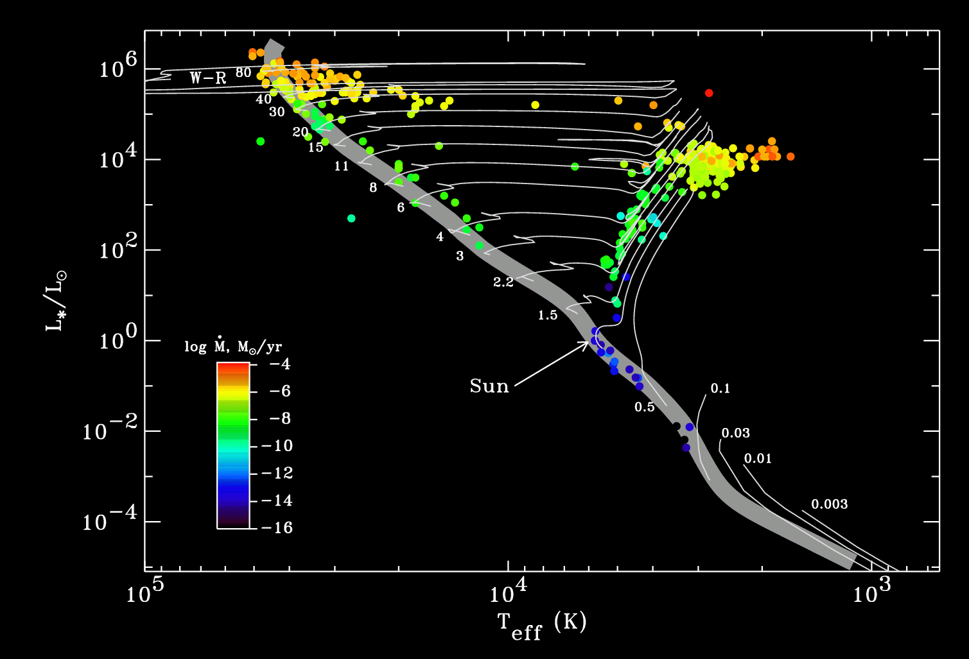
Stellar winds across the H-R Diagram
Massive stars: radiation-driven winds
Cool luminous stars: pulsation/dust-driven winds?
Solar-type stars: coronal winds (driven by MHD turbulence?)

Slide 3
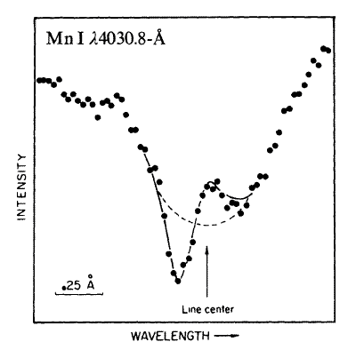
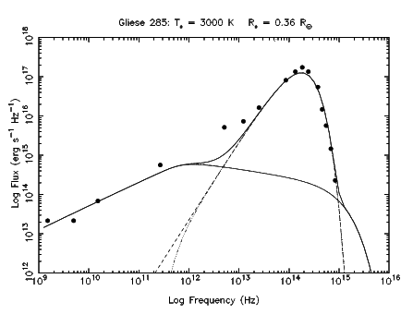
Traditional diagnostics of mass loss
Optical/UV spectroscopy: either blueshifted absorption or full “P Cygni” profiles.
IR continuum: circumstellar dust causes SED excess.
Molecular lines (mm, sub-mm): CO, OH masers.
Radio: free-free emission from (partially ionized?) components of the wind.
Continuum methods need V∞ from another diagnostic to get mass loss rate.
Clumping?
(Bernat 1976)
wind
star
(van den Oord & Doyle 1997)

Slide 4
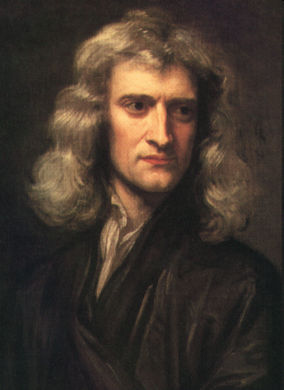
Driving a stellar wind
Gravity must be counteracted above the photosphere (not below) by some continuously operating outward force . . .
Gas pressure: needs T ~ 10⁶ K (“coronal heating”)
Radiation pressure: possibly important when L* > 100 L
Wave pressure / Shocks: can produce time-averaged net acceleration
MHD effects: closed fields can be ejected (CMEs), or “plasmoids” can be pinched like melon seeds and carry along some of the surrounding material.
F = ma
free electron (Thomson) opacity? (goes as 1/r² ; needs to be supplemented)
ion opacity? (T_{eff} > 15,000 K)
dust opacity? (T_{eff} < 3,500 K)
~
~

Slide 5
Stellar winds across the H-R Diagram
Massive stars: radiation-driven winds

Slide 6
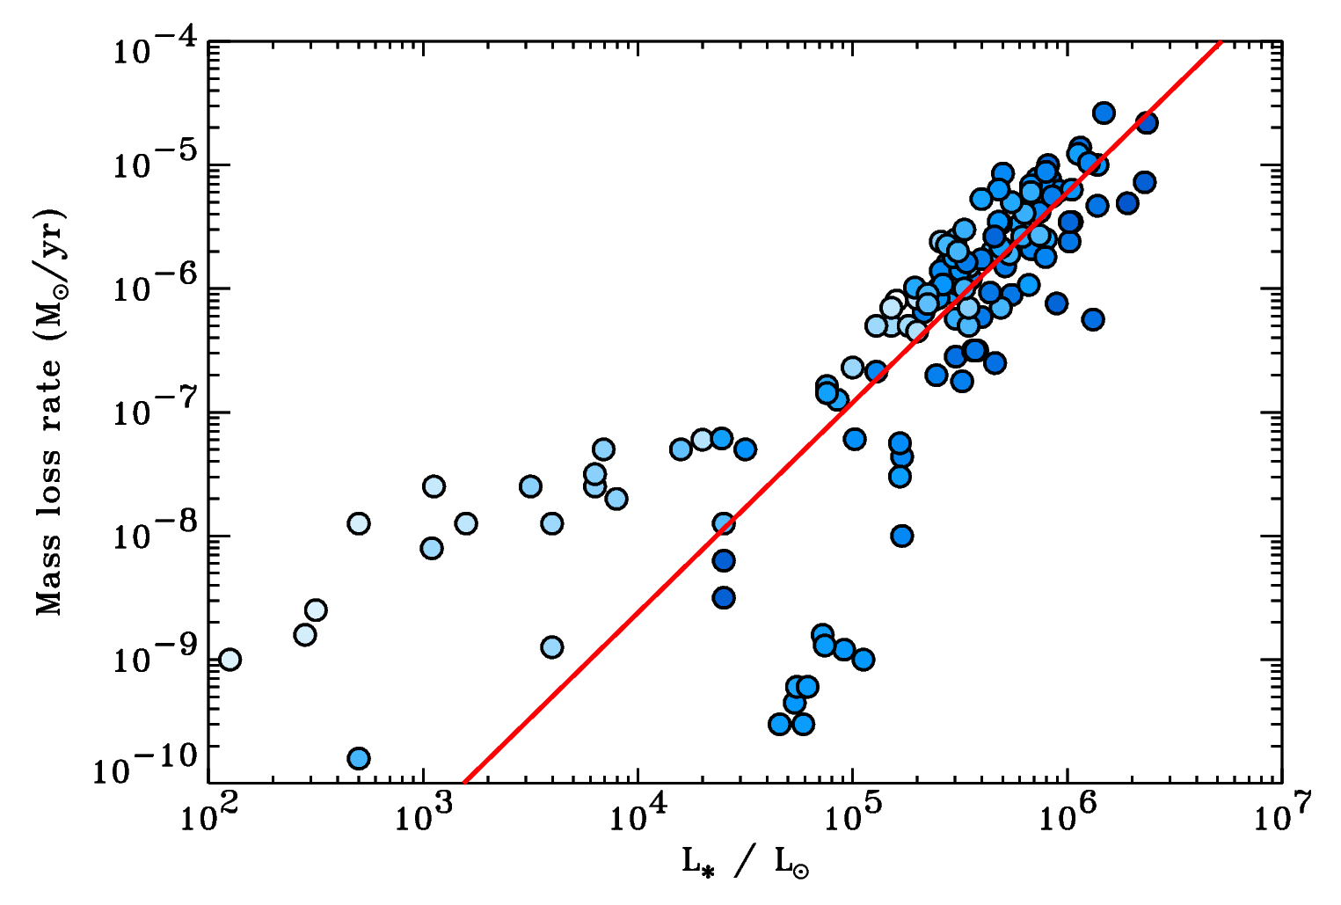
Massive star winds: observations
~L*^{1.7}

Slide 7
Massive star winds: radiative driving
Castor, Abbott, & Klein (1975) worked out how a hot star’s radiation field can accelerate a time-steady wind, even if its “Eddington factor” Γ << 1.
Bound electron resonances have higher cross-sections than free electrons (i.e., spectral lines dominate the opacity κ_{ν})
In the accelerating wind, these narrow opacity sources become Doppler shifted with respect to the star’s photospheric spectrum.
Acceleration thus depends on velocity & velocity gradient! This turns “F=ma” on its head! (Nonlinear feedback...)

Slide 8
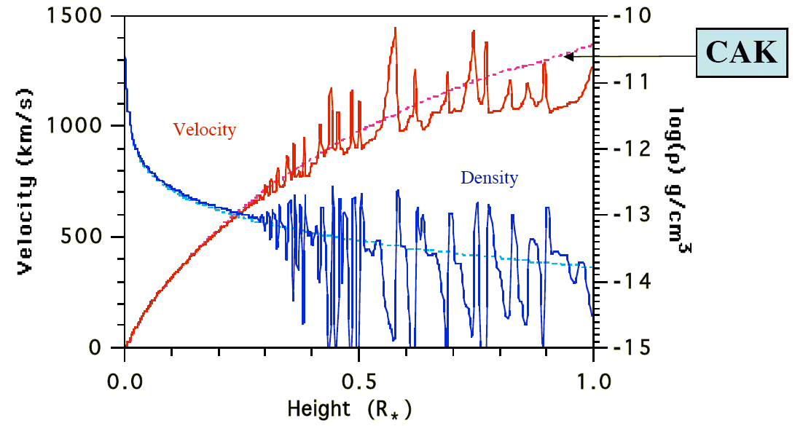
Massive star winds: radiative driving
The Castor, Abbott, & Klein (CAK) theory gives a prediction for mass loss rates:
Metallicity dependence (largely) verified by observations in SMC and LMC, but it flattens out for lower Z (Vink 2008).
“Clumping” can affect predicted mass loss rates by up to a factor of 10.
What causes clumping? Radiative driving is unstable!

Slide 9
Rapid rotation
Because of competition between gravity and centrifugal forces at the equator, rapid rotators become oblate and “gravity darkened” (von Zeipel 1924).
Existence of gravity darkening has been confirmed via eclipsing binaries and visible interferometry of oblate stars.
For hot stars with radiative interiors, β ≈ 0.25 (down to late-A / early-F)
For cooler stars with convective layers below photosphere, β ≈ 0 to 0.08

Slide 10
Rapid rotation: impact on mass loss
(Cranmer 1996)

Slide 11
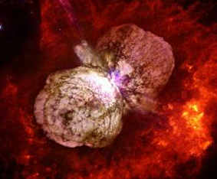
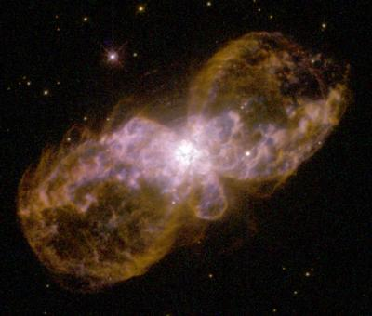
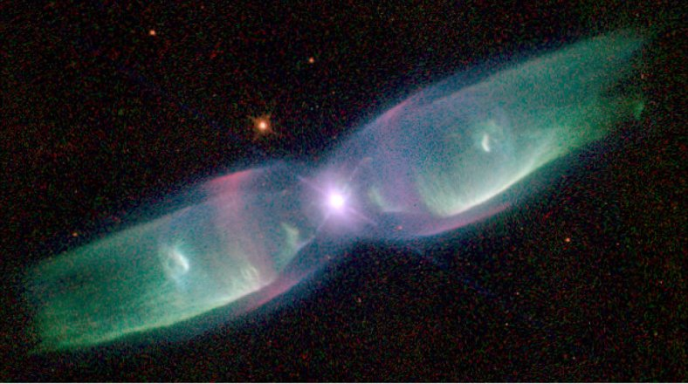
Rapid rotation: impact on mass loss
(Dwarkadas & Owocki 2002)

Slide 12
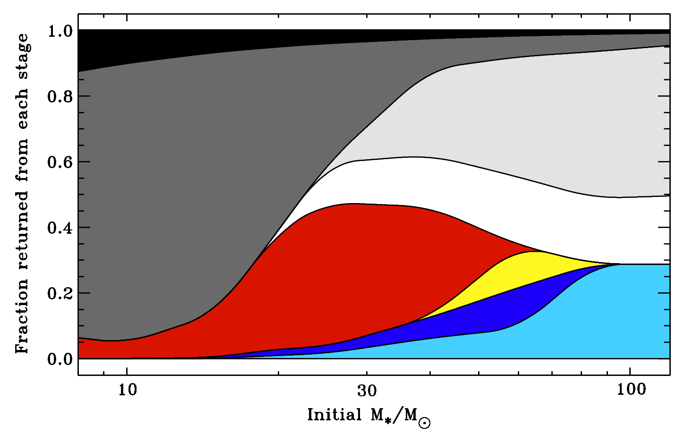
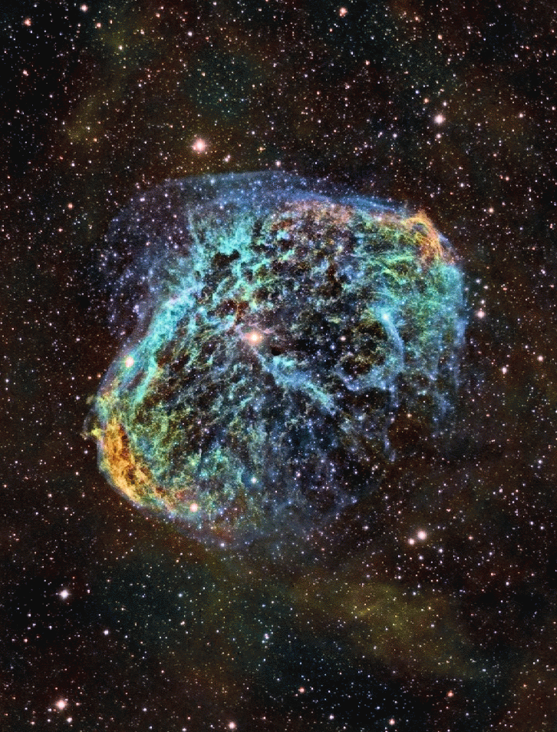
Massive star evolution: winds matter!
Mass loss affects evolutionary tracks (isochrones, cluster HB/RGB), SN yields.
Hot-star winds influence ISM abundances & ionization state of Galaxy.
Wolf-Rayet stars: H stripped off by O-star wind; dense, multiple-scattering CAK.
NS/BH
W-R (WC)
SN (Ib, Ic, II)
W-R (WN)
RSG
LBV
BSG
O-star
NGC 6888 (WR 136)
J.-P. Metsavainio
Castor (1993)

Slide 13
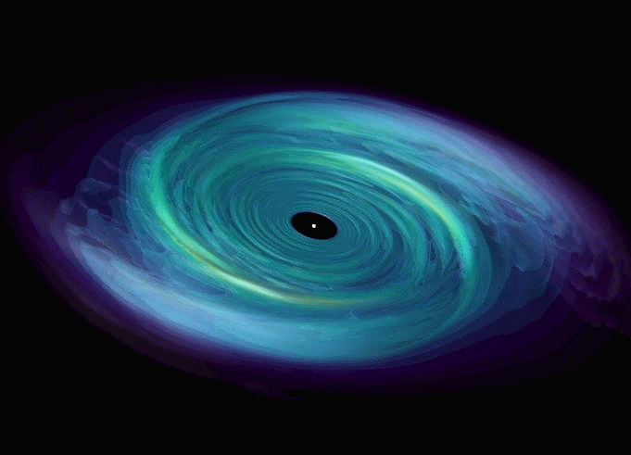
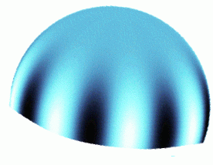
Be stars: “decretion disks”
Classical Be stars are non-supergiant B stars with emission in H Balmer lines.
Be stars are rapid rotators, but are not rotating at “critical” / “breakup:”
V_{rot} ≈ (0.5 to 0.9) V_{crit}
How does angular momentum get added to the circumstellar gas?
Hints:
Many (all?) Be stars undergo nonradial pulsations (NRPs).
Rivinius et al. (1998, 2001) found correlations between emission-line “outbursts” and constructive interference (“beating”) between NRP periods.
Ando (1986) & Saio (1994) suggested that NRPs can transfer angular momentum outwards. More detailed models show that this can provide enough “spinup” for centrifugal forces to cancel gravity (Cranmer 2009).

Slide 14
Stellar winds across the H-R Diagram
Cool luminous stars: pulsation/dust-driven winds?
Solar-type stars: coronal winds (driven by MHD turbulence?)

Slide 15
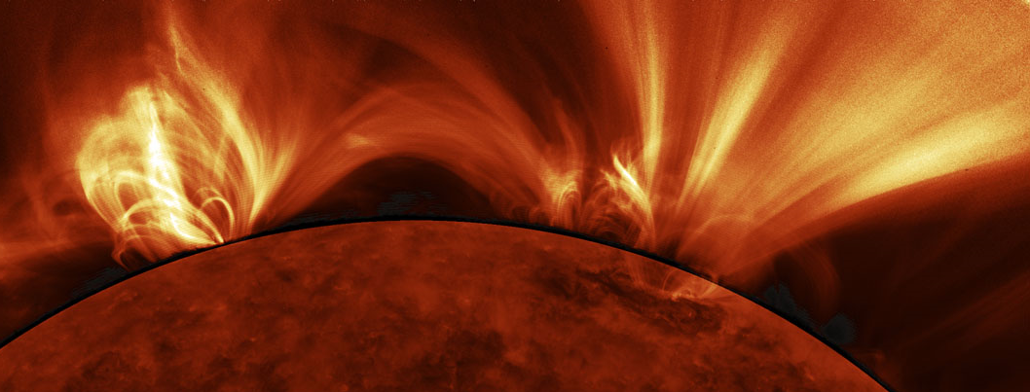
The solar wind
Parker (1958) proposed that gas pressure in the hot (T > 10⁶ K) corona counteracts gravity and accelerates a steady supersonic wind. 1962: Mariner 2 confirmed it.
Decades of remote sensing & in situ probing have revealed much of the physics of this turbulent MHD system . . .
SDO/AIA
What determines how much energy and momentum goes into the solar wind?
Waves & turbulence input from below?
Reconnection & mass input from loops?
vs.

Slide 16
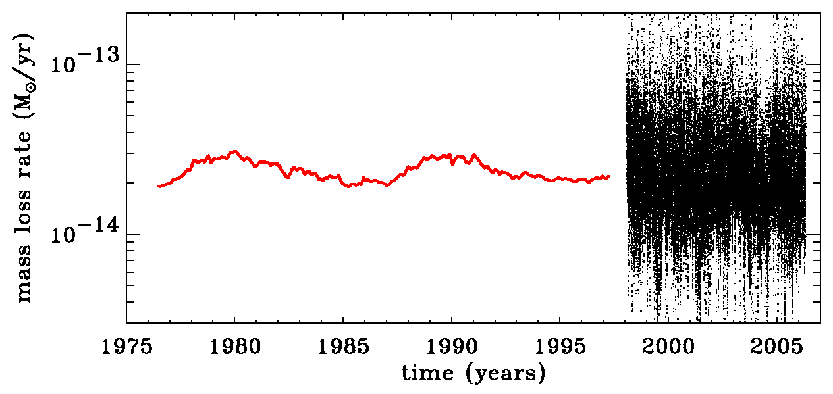
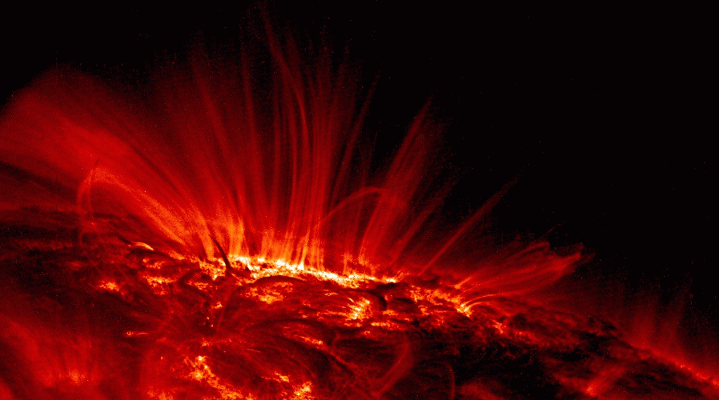
What sets the Sun’s mass loss?
The sphere-averaged mass flux is remarkably constant.
Coronal heating seems to be ultimately responsible, but that varies by orders of magnitude over the solar cycle.
Hammer (1982) & Withbroe (1988) suggested an energy balance with a “thermostat.”
Only a fraction of total coronal heat flux conducts down, but in general, we expect something close to
Wang (1998)
heat conduction
radiation losses
5
2
— ρvkT
. . . along open flux tubes!

Slide 17
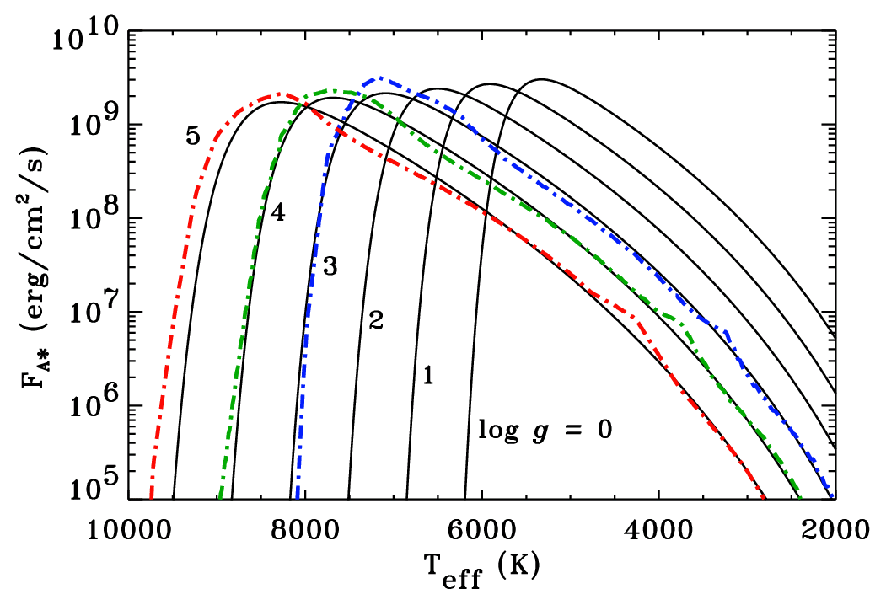
Convection-driven MHD waves
Cranmer & Saar (2011) focused on Alfvén waves as primary source of heating.
Other sources of energy & momentum probably exist, but we chose to explore how much can be explained with just this one set of processes.
Turbulent convection excites waves (Lighthill 1952), and in a magnetized stellar atmosphere the dominant type of waves should be transverse “kink modes” (Musielak & Ulmschneider 2002).

Slide 18
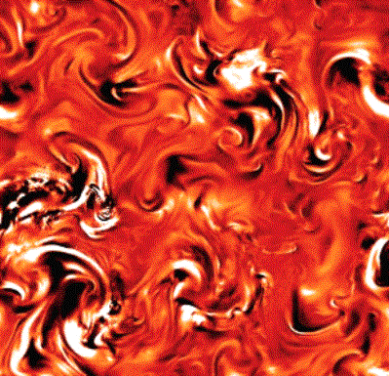
Heating from MHD turbulence
Convection shakes open field lines...
Alfvén waves propagate upward...
partially reflect back down...
...and cascade from large to small eddies, eventually dissipating to heat the plasma.
MHD simulations inspire “phenomenological” scalings:

Slide 19
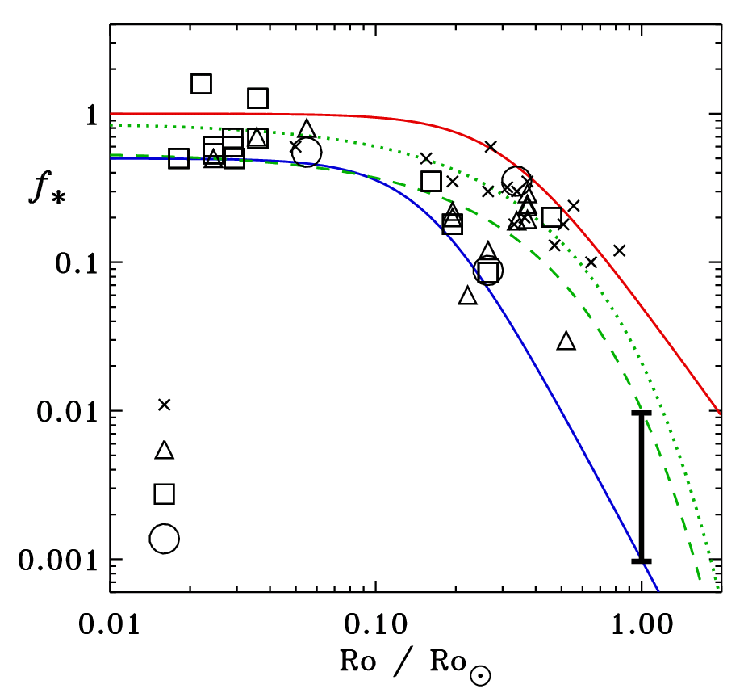
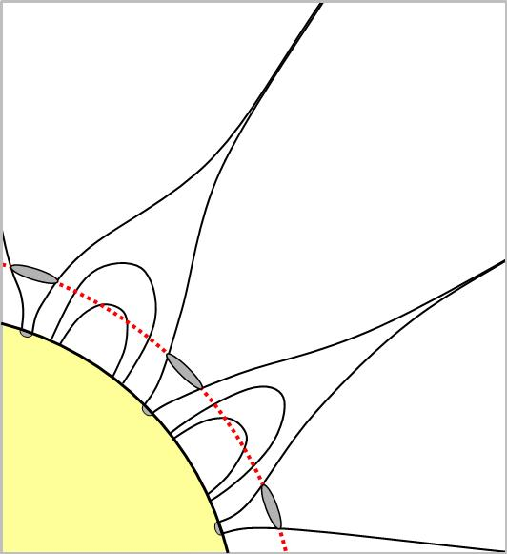
Open magnetic flux tubes
The evolution of Q_{heat} with height depends on the magnetic field . . .
Mass flux depends on the area covered by open field lines at the TR:
A = 4πr² f
Measurements of Zeeman-broadened lines constrain the filling factor of (open + closed) photospheric B-field.
f ∞ → 1
G, K, M dwarfs
f _{TR} ≈ f*^{θ}
low-qual. data
high-qual. data
Sun
f*
θ ≈ 0.3 to 0.5

Slide 20
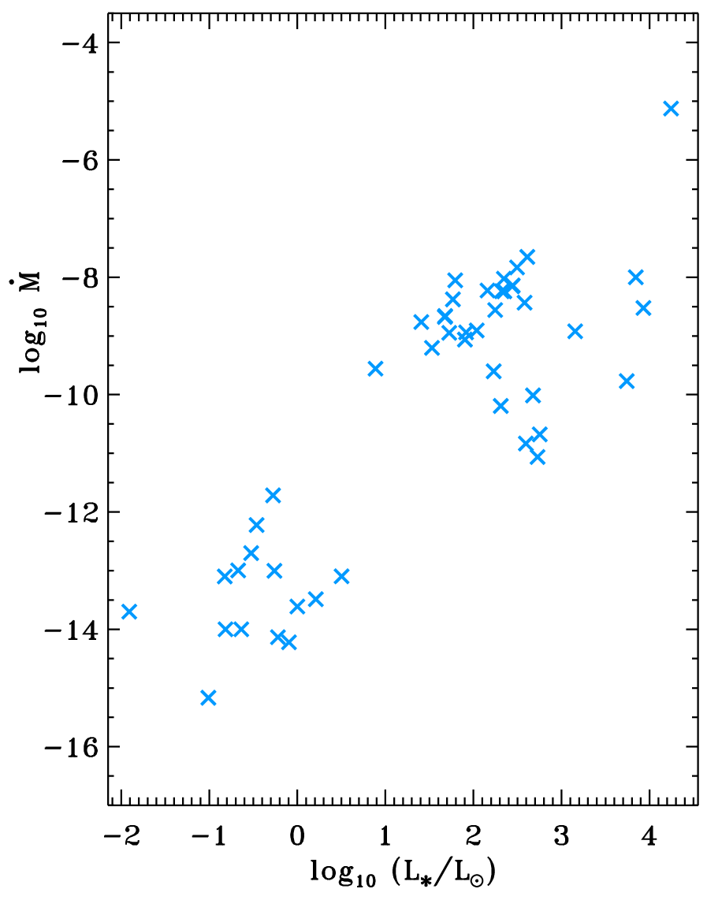
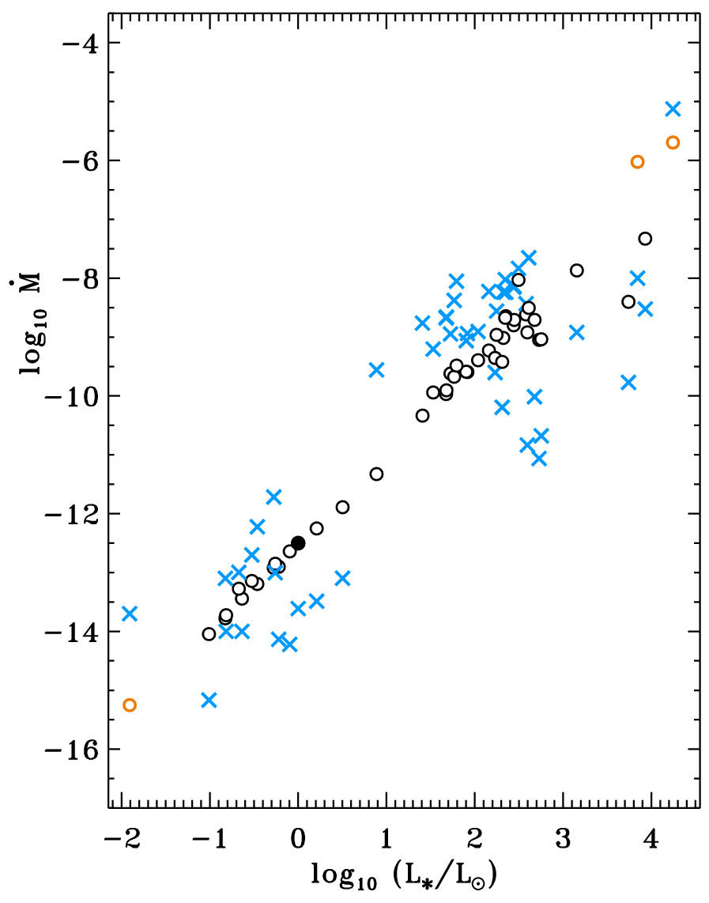
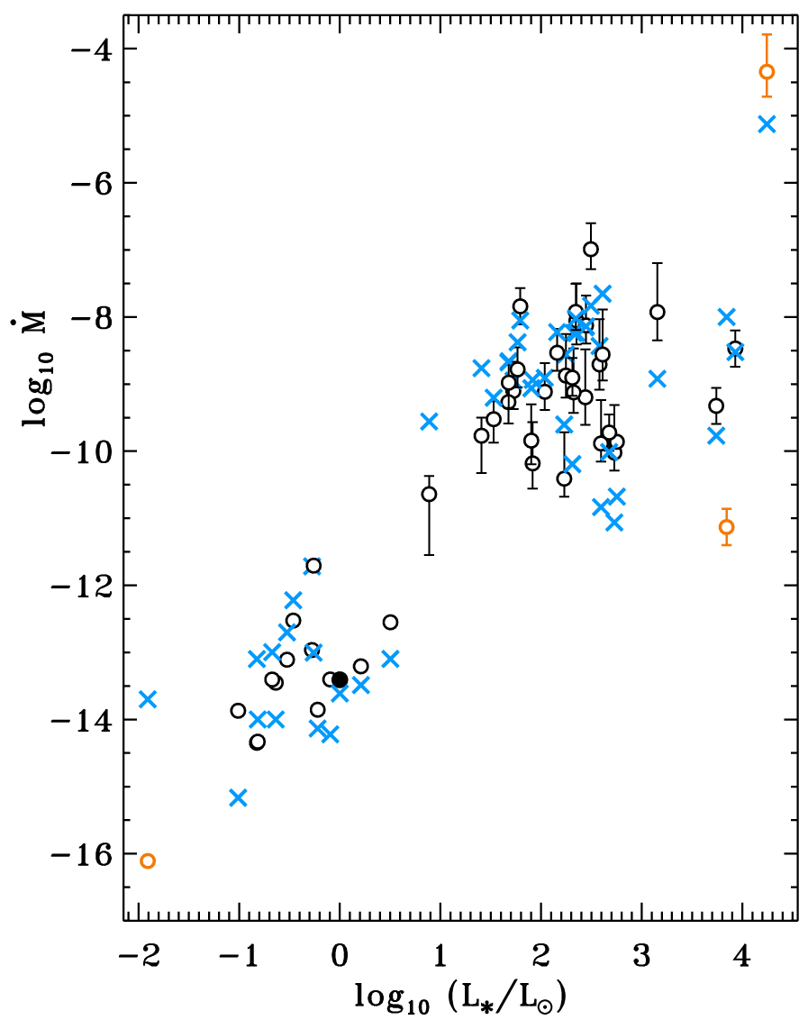
Results for 47 cool stars with measured M
.
Measurements (x)
Cranmer & Saar 2011 (o)
Schröder & Cuntz 2005 (o)
χ² = 1.131
χ² = 0.504

Slide 21
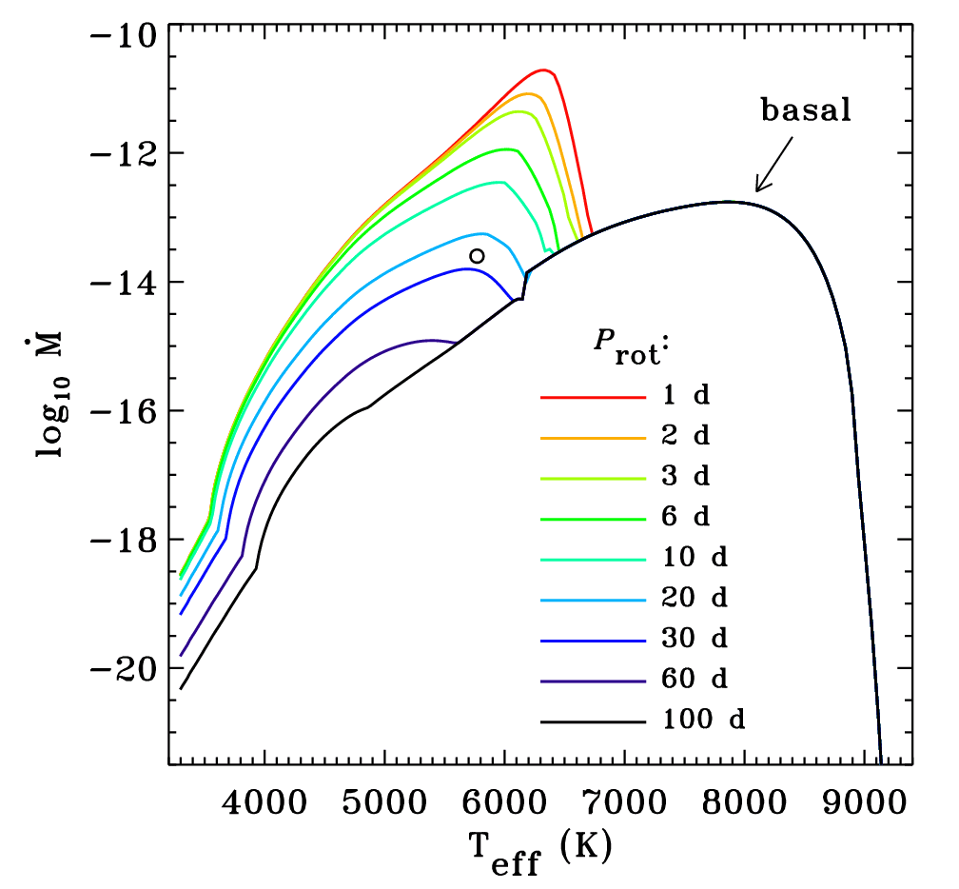
Mass loss on an ideal main sequence
Is there really a basal “floor” in the age-rotation-activity relationship?
P_{rot}
Saturation
Super-saturation?

Slide 22
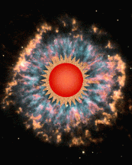
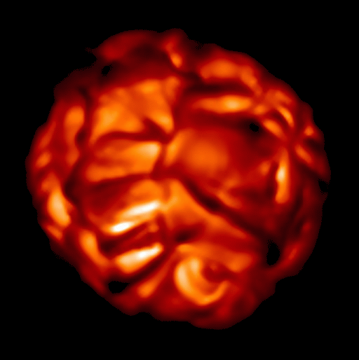
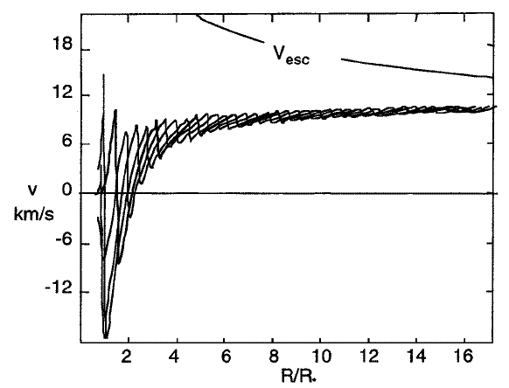
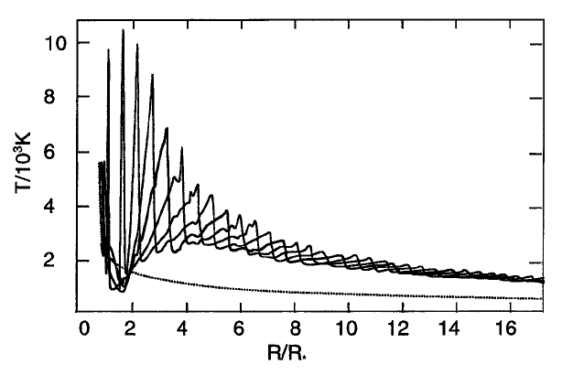
Evolved cool stars: RG, HB, AGB, Mira
The extended atmospheres of red giants and supergiants are likely to be cool (i.e., not highly ionized or “coronal” like the Sun).
High-luminosity: radiative driving... of dust?
Shock-heated “calorispheres” (Willson 2000) ?
Numerical models show that pulsations couple with radiation/dust formation to be able to drive mass loss rates up to 10 ^{–5} to 10 ^{–4} M_{s}/yr.
(Struck et al. 2004)

Slide 23
Radio diagnostics of winds/coronae: Future prospects?
Multi-thermal atmospheres:
Cool luminous stars: UV spectroscopy detects “warm” chromospheric gas. Radio & IR detect “cold” dust-forming gas. Do these outflowing populations coexist?
Age-Rotation-Activity relations:
Can combined radio & X-ray data help answer questions about “super-saturation” or the “basal flux floor?”
Magnetic fields:
Can combined radio (gyroresonance emission) & optical (Zeeman-broadened line) data better constrain weak-field (B < 50 G) “filling factors?”
Massive stars: There are many new measurements of B-fields (MiMeS project). Is nonthermal/synchrotron radio emission preferentially strong in these stars, or does the traditional (?) interpretation of “wind shocks” hold up?

Slide 24
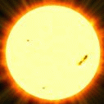
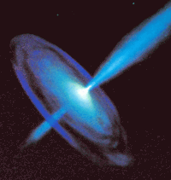
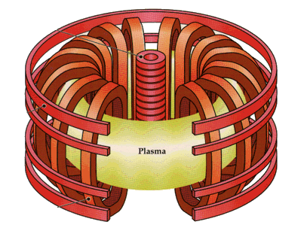
Conclusions
Within an order of magnitude, theories aren’t doing too badly in predicting mass loss rates… but to get a decent estimate, lots of information about the star is needed (e.g., luminosity, mass, age, rotation period, magnetic field, pulsational properties).
Simulations of stellar interiors are still the key to unlocking many puzzles, since the properties of rotation, pulsation, convection, dynamos, etc., are all determined “down there.”
Understanding is greatly aided by ongoing collaboration between the solar physics, plasma physics, and astrophysics communities.

Slide 25
Extra slides . . .

Slide 26
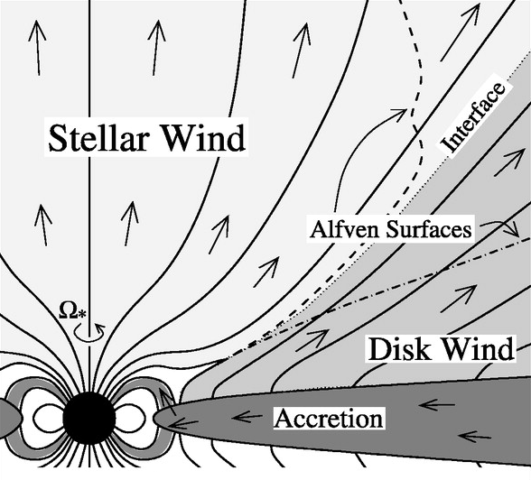
Young cool stars: classical T Tauri
T Tauri stars exhibit disks, magnetospheric accretion streams, X-ray coronae, and various kinds of polar outflow.
Cranmer (2008, 2009) modeled coronal heating & mass loss via turbulence excited on the surface by accretion impacts.
(Matt & Pudritz 2005, 2008)

Slide 27
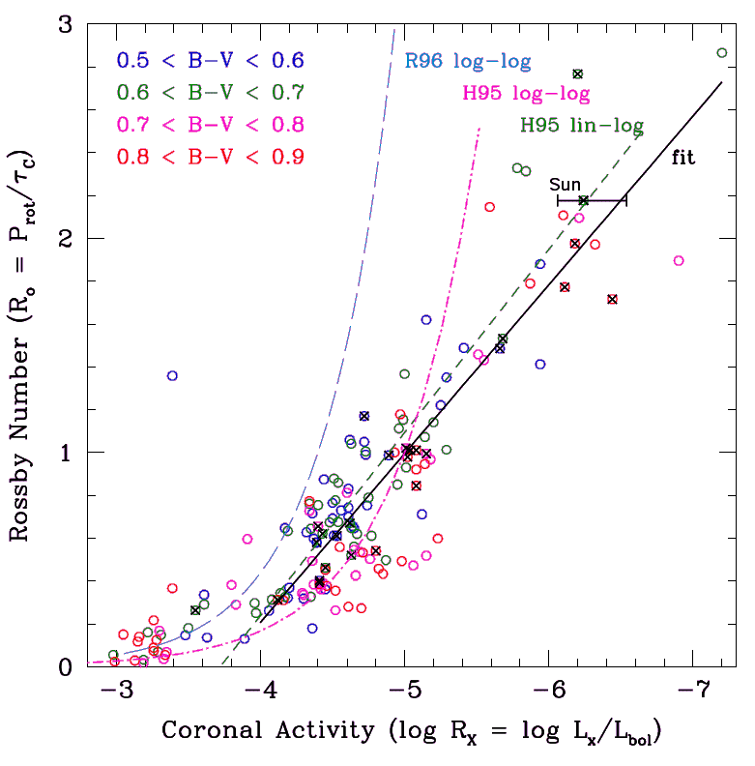
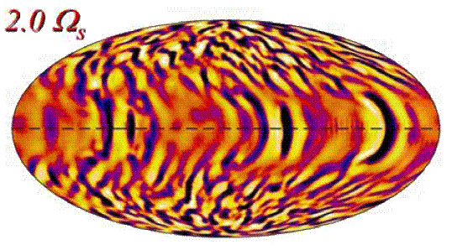
Cool-star rotation → mass loss?
There is a well-known “rotation-age-activity” relationship that shows how coronal heating weakens as young (solar-type) stars age and spin down (Noyes et al. 1984).
X-ray fluxes also scale with mean magnetic fields of dwarf stars (Saar 2001).
For solar-type stars, mass loss rates scale with coronal heating & field strength.
What’s the cause? With more rapid rotation,
(Mamajek 2009)
Convection may get more vigorous (Brown et al. 2008, 2010) ?
Lower effective gravity allows more magnetic flux to emerge, thus giving a higher filling factor of flux tubes on the surface (Holzwarth 2007)?

Slide 28
Cool-star dimensional analysis . . .
Stellar wind power:
Reimers (1975, 1977) proposed a semi-empirical scaling:
Schröder & Cuntz (2005) investigated an explanation via convective turbulence generating atmospheric waves . . .
Use caution with “p” exponent: once T_{eff} > 7000 K, it flattens out (p → 0).
For T_{eff} > 9000 K, F_{mech} plummets because convection zone disappears!

Slide 29
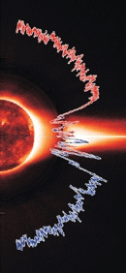
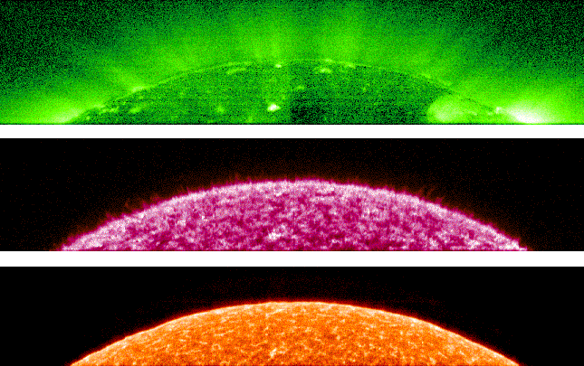
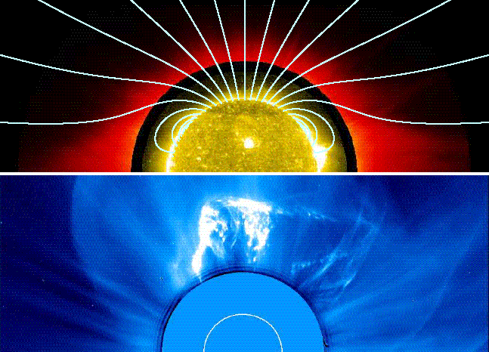
The solar wind: very brief history
Mariner 2 (1962): first direct confirmation of continuous supersonic solar wind, validating Parker’s (1958) model of a gas-pressure driven wind.
Helios probed in to 0.3 AU, Voyager continues past 100+ AU.
Ulysses (1990s) left the ecliptic; provided 3D view of the wind’s connection to the Sun’s magnetic geometry.
SOHO gave us new views of “source regions” of solar wind and the physical processes that accelerate it . . .

Slide 30
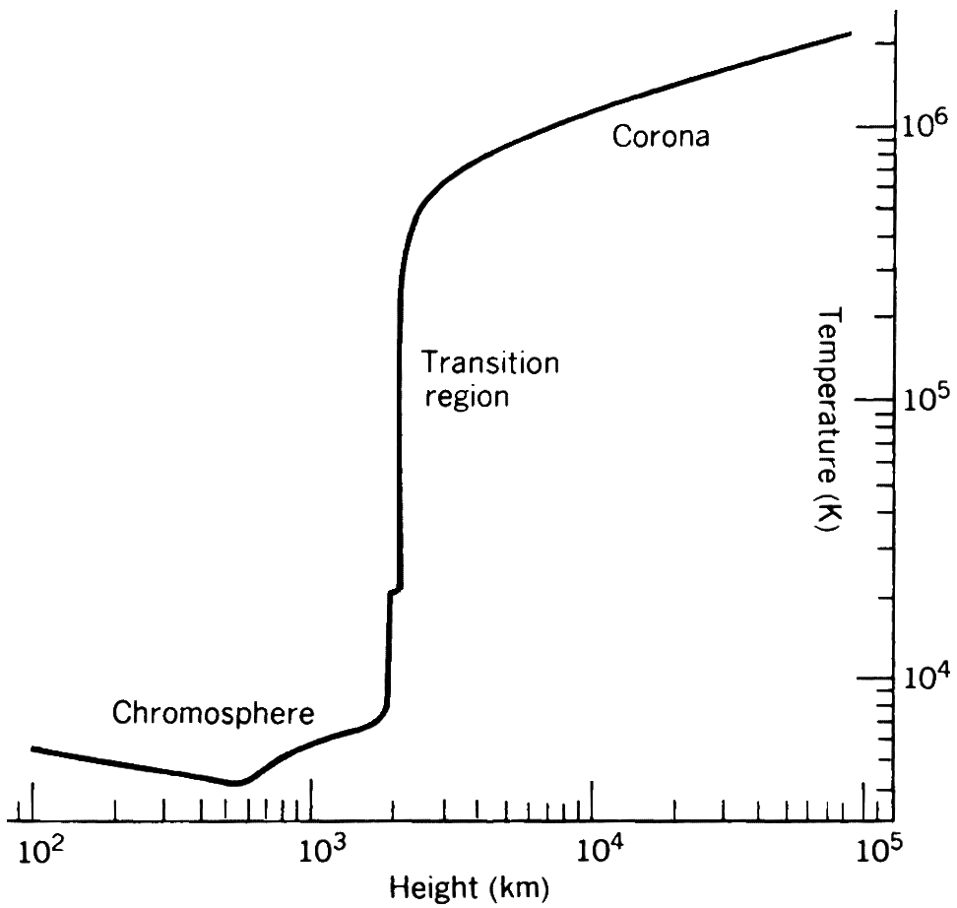
The coronal heating problem
We still don’t understand the physical processes responsible for heating up the coronal plasma. A lot (not all!) of the heating occurs in a narrow “shell.”
Most suggested ideas involve 3 general steps:
1. Churning convective motions that tangle up magnetic fields on the surface.
2. Energy is “stored” (above the photosphere) in the magnetic field.
3. Energy is released as heat, either via particle-particle or wave-particle “collisions.”
Heating Solar wind acceleration

Slide 31
Energy conservation in outer stellar atmospheres
Photosphere
Chromosphere
Transition region & low corona
Supersonic wind (r >> R*)
. . . . . . . . . . . . . . . . . . . . . . . . . . . . . . . . . . . . . . . . . . . . . . . . . .
. . . . . . . . . . . . . . . . . . . . . . . . . . . . . . . . . . . . . . . . . . . . . . . . . .
. . . . . . . . . . . . . . . . . . . . . . . . . . . . . . . . . . . . . . . . . . . . . . . . . .
. . . . . . . . . . . . . . . . . . . . . . . . . . . . . . . . . . . . . . . . . . . . . . . . . .
Leer et al. (1982) and Hansteen et al. (1995) found that one can often simplify the energy balance to be able to solve for the mass flux:
However, the challenge is to determine values for all the parameters!
≈

Slide 32
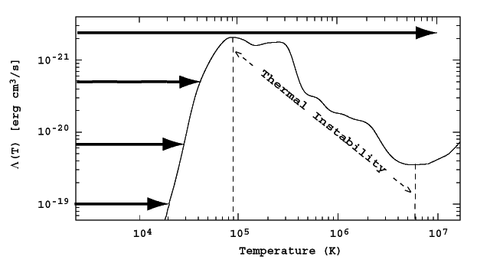
How can massive winds be “cold?”
The extended solar corona is so low-density, the conservation of internal energy is essentially a balance between local heating, downward conduction, and upward adiabatic losses.
When the outer atmosphere becomes massive enough, though, radiative cooling [~ρ² Λ(T)] becomes more efficient throughout the wind:
The high-density wind becomes an extended chromosphere (supported by wave pressure??).
For this case, Holzer et al. (1983) showed the energy equation is ~irrelevant in determining mass flux! A simple analytic model (of the momentum equation) suffices.

Slide 33
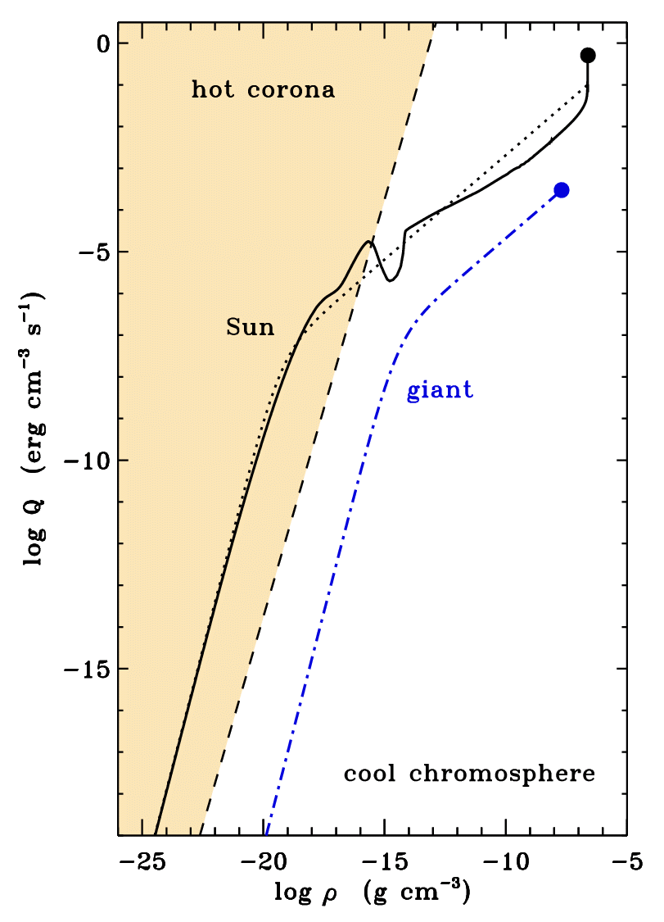
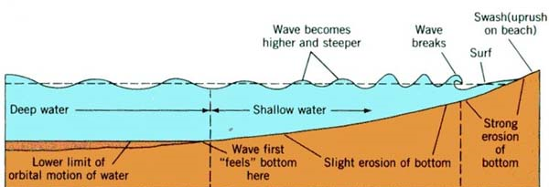
Do Alfvén waves always heat a corona?
With the above inputs (and assuming v∞ ≈ V_{esc}), we can solve for the mass loss rate in the case of a “hot coronal wind.”
Sometimes, the heating rate Q drops off more steeply (with decreasing density ρ) than in the solar case, and radiative cooling always remains able to keep T < 10⁴ K.
In those “cold” cases (usually for luminous giants), gas pressure cannot accelerate a wind.
Alfvén wave pressure may take the place of gas pressure (Holzer et al. 1983).

Slide 34
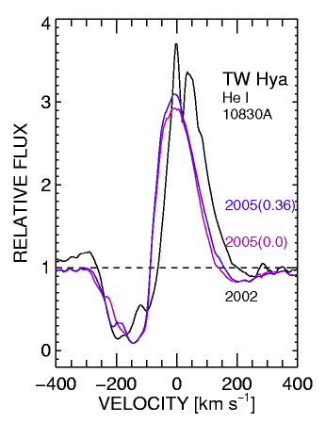
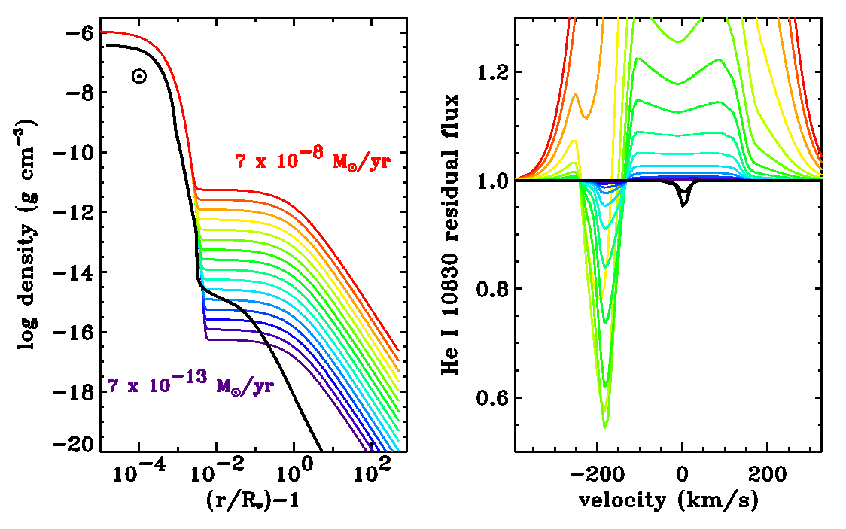
Multi-line spectroscopy
1990s: more self-consistent treatments of radiative transfer AND better data (GHRS, FUSE, high-spectral-res ground-based) led to better stellar wind diagnostic techniques!
A nice example: He I 10830 Å for TW Hya (pole-on T Tauri star) . . .
Dupree et al. (2006)

Slide 35
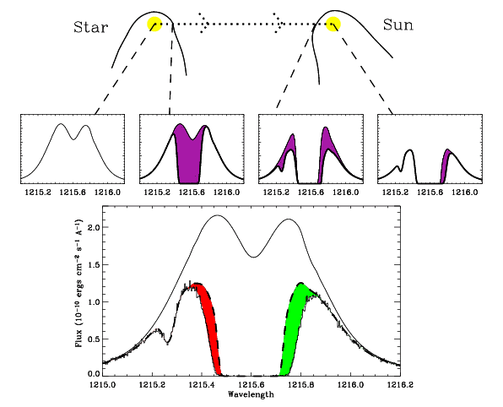
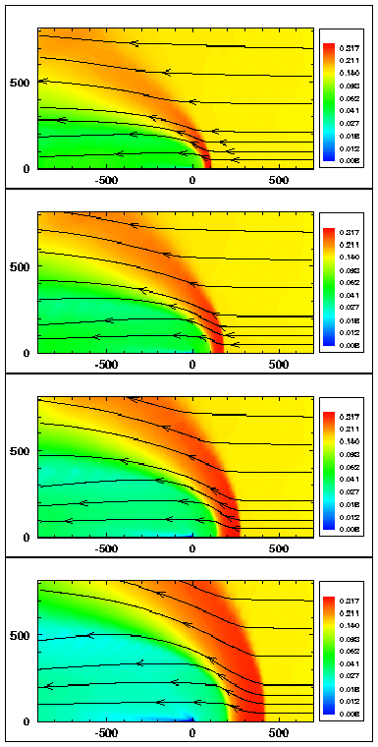
New ideas: astrosphere absorption
Wood et al. (2001, 2002, 2005) distinguished cool ISM H I Lyα absorption from hotter “piled up” H⁰ in stellar astrospheres. Derived M depends on models . . .

