Slide 1
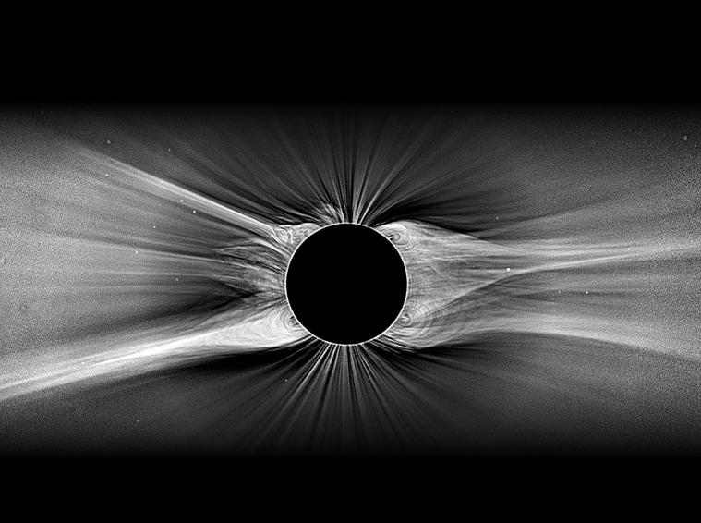
Turbulent Origins
of Solar & Stellar Winds
Steven R. Cranmer
University of Colorado Boulder, LASP
van Ballegooijen, L. Woolsey, A. Schiff, J. Jost, J. Kohl, S. Saar, M. P. Miralles,
M. Asgari-Targhi, A. Dupree, N. Brickhouse, D. Wilner, M. MacGregor

Slide 2
Turbulent Origins
of Solar & Stellar Winds
Outline:
Brief intro & basic physics of stellar winds
The Sun: convection → coronal heating?
Cool stars: mass loss, pulsations, accretion
Steven R. Cranmer
University of Colorado Boulder, LASP
van Ballegooijen, L. Woolsey, A. Schiff, J. Jost, J. Kohl, S. Saar, M. P. Miralles,
M. Asgari-Targhi, A. Dupree, N. Brickhouse, D. Wilner, M. MacGregor

Slide 3
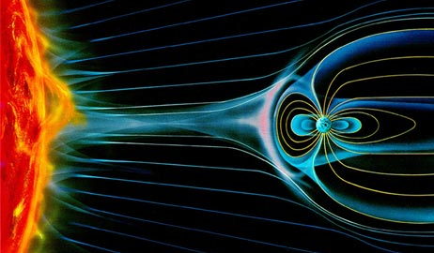
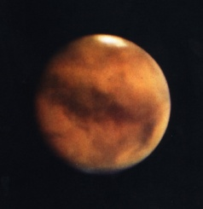
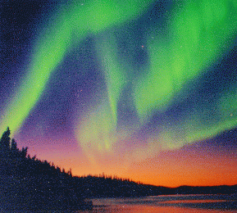
What are stellar winds?
A stellar wind is a continuous outflow of matter from the surface layers of a star.
All stars have them!
≠ supernova-like explosions, flares, outbursts
Why do we care?
Stellar winds affect how individual stars evolve… from pre-main-sequence accreting phases to post-main-sequence “stellar death” phases.
Consequently, they affect the formation & habitability of planets, too.
In our own solar system, “space weather” affects satellites, power grids, pipelines, and safety of astronauts & high-altitude airline crews.
If you can understand how plasmas behave in turbulent, expanding stellar atmospheres, you’ll have a superb grounding in many fields.

Slide 4
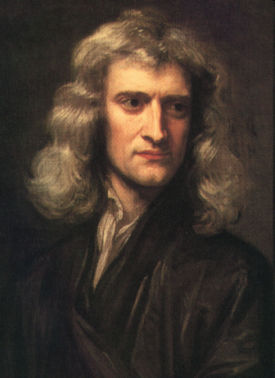
Driving a stellar wind
Gravity must be counteracted above the photosphere (not below) by some continuously operating outward force . . .
Gas pressure gradient: needs T ~ 10⁶ K (“coronal heating”)
Radiation pressure: possibly important when L* > 100 L
Pulsations / Waves / Shocks: can produce time-averaged net acceleration.
Magnetic effects: closed loops of plasma (“plasmoids”) can be pinched like melon seeds and carry along some of the surrounding gas.
F = ma
free electron (Thomson) opacity? (goes as 1/r² ; needs to be supplemented)
ion opacity? (T_{eff} > 15,000 K)
dust opacity? (T_{eff} < 3,000 K)
~
~

Slide 5
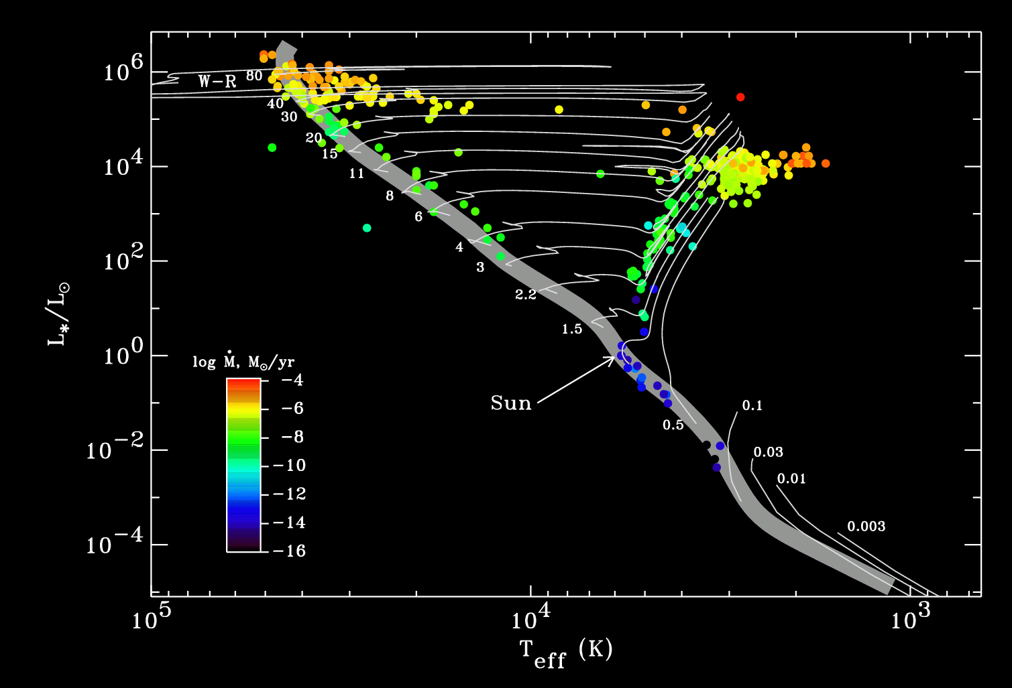
Stellar winds across the H-R Diagram
Massive stars: radiation-driven winds
Cool luminous stars: pulsation/dust-driven winds?
Solar-type stars: coronal winds (driven by MHD turbulence?)

Slide 6
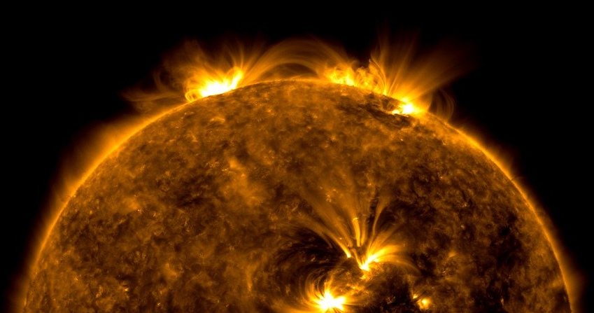
The solar corona
1870s: First off-limb solar spectroscopy: unknown emission lines (“coronium?”)
1930s: Atomic physics identified lines: Fe⁺⁹, Fe⁺¹³ (T needs to be > 1 million K).
Of course, UV & X-ray observations sealed the deal . . .

Slide 7
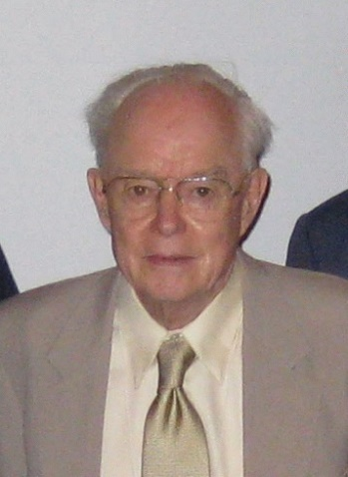
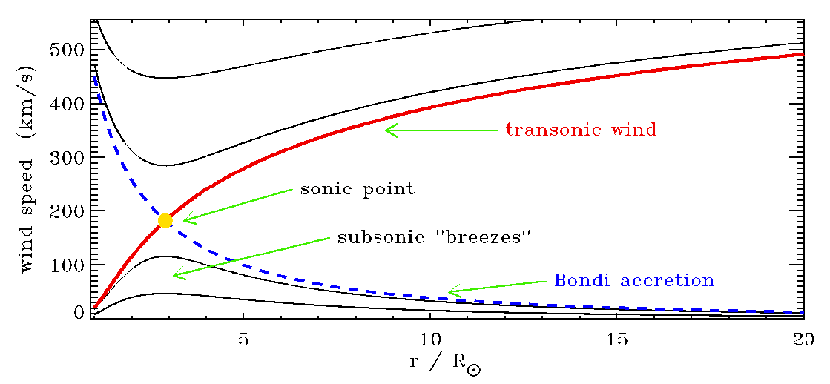
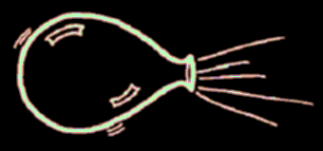
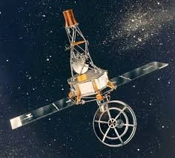
The solar wind: prediction & discovery
1958: Eugene Parker put the pieces together: the million-degree corona has such a high gas pressure that it naturally expands!
1959-1961: Intermittent detections: Russian Lunik, Venera; American Explorer 10
1962: Marcia Neugebauer & colleagues got continuous data from Mariner 2 on its journey to Venus.
The solar wind fills the solar system!

Slide 9
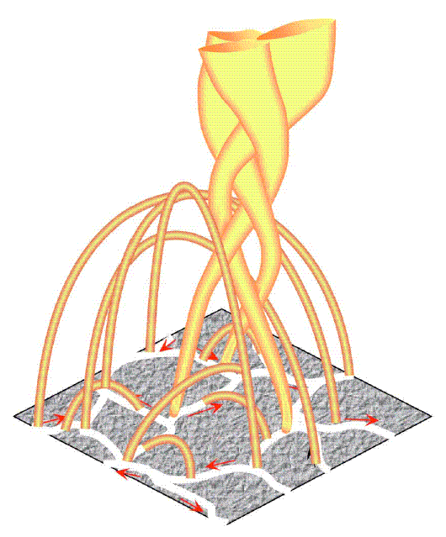
The “coronal heating problem”
Why is the corona’s T ~ 1 million K, when underlying atmosphere is ~6000 K ?
(Nearly!) everyone agrees that there is more than enough “mechanical energy” in the sub-surface convection zone to do the job…
Fisk (2005)
How does a fraction (~1%) of the available energy get:
transported up to the corona,
converted to magnetic energy,
dissipated as heat, (and/or)
provide direct wind acceleration

Slide 10
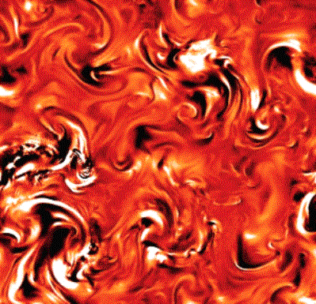
Magnetohydrodynamic turbulence?
A number of recent models seem to be converging on the idea that convection drives waves, which then break up into turbulent eddies (heating) and also exert a net outward force on the gas (acceleration).
van Ballegooijen et al. (2011)
Convection shakes & braids field lines...
Alfvén waves propagate upward...
partially reflect back down...
...and cascade from large to small eddies, eventually dissipating to heat the plasma.

Slide 11
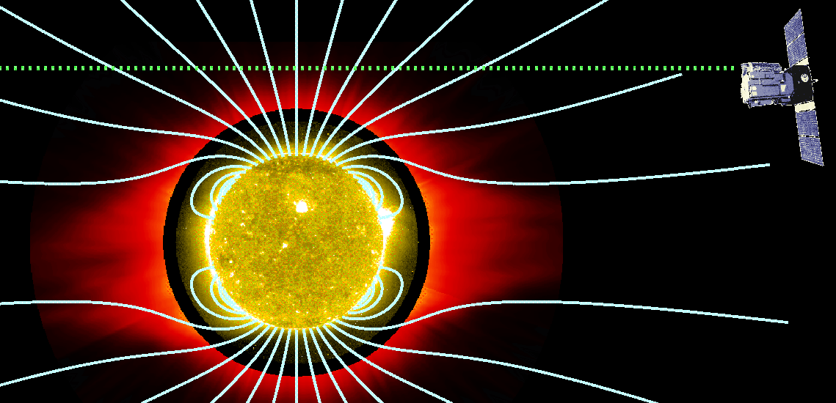
Research projects (1/2): Solar
Theory
Convection jostles photospheric flux tubes → MHD waves, but the full range of possible motions haven’t been studied. New simulations need to be “mined” to prepare for DKIST!
There are some well-developed codes for turbulent coronal heating (ZEPHYR, BRAID) that still need to be put through their paces.
MHD waves don’t just go up… some come back down, crash into surface, & generate other kinds of waves. What kinds?
Observations
Off-limb spectroscopy probes the wind’s “acceleration region:” UVCS on SOHO ran for 17 years… only a tiny fraction of data has been analyzed.
In general, the line-of-sight integration problem still needs to be tackled, so we can understand what off-limb data are telling us.

Slide 12
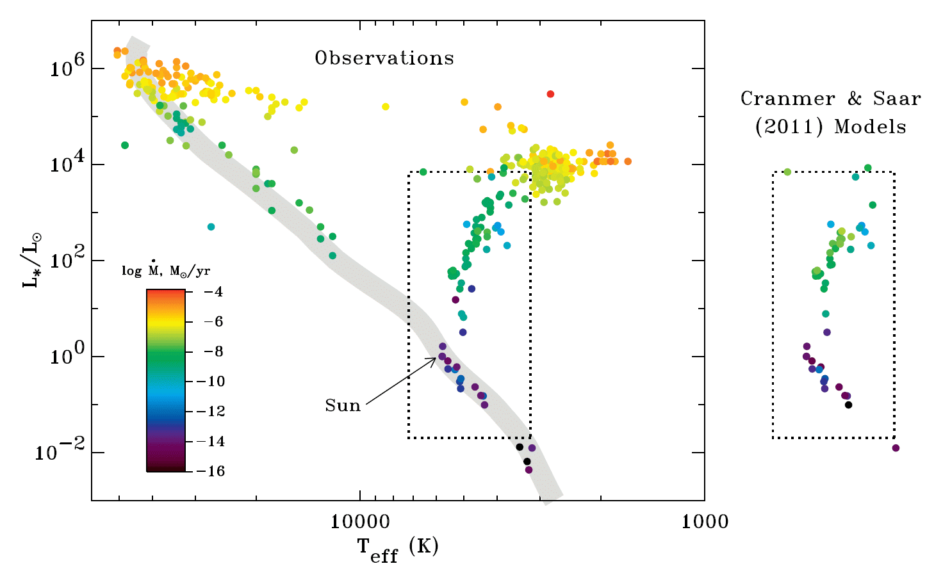
Applying turbulence theory to solar-type stars

Slide 13
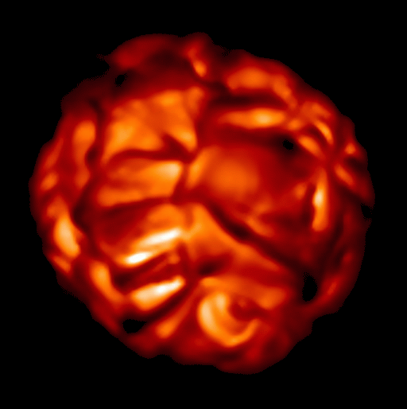
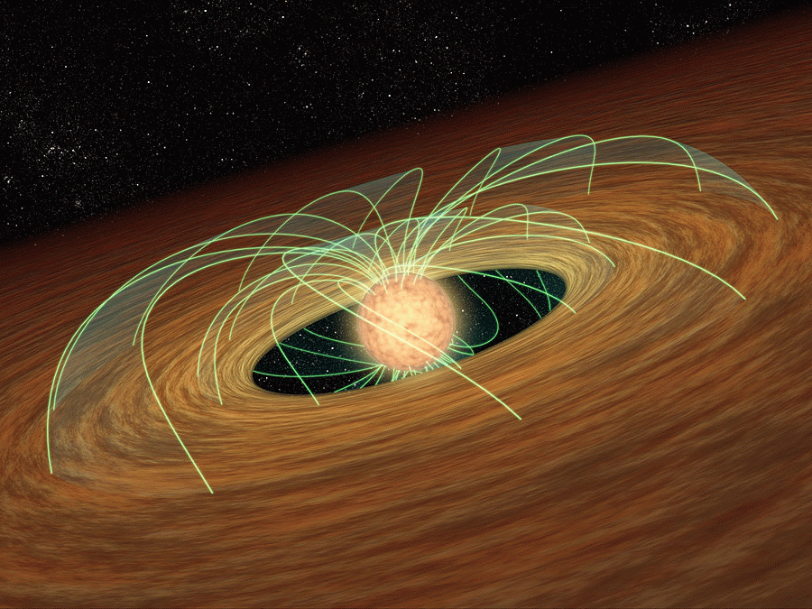
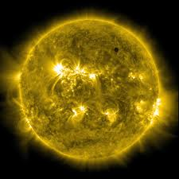
Evolution of inflows & outflows
100
10
1
0.1
0.01
0.001
0.0001
0.00001
0.000001
Accretion rate
Red giant
Mass gained or lost (Moons /yr)
T Tauri phase
Present-day Sun
Mass loss rate
0.01 0.1 1 2 3 4 10
AGE (Billions of years)

Slide 14
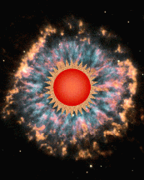
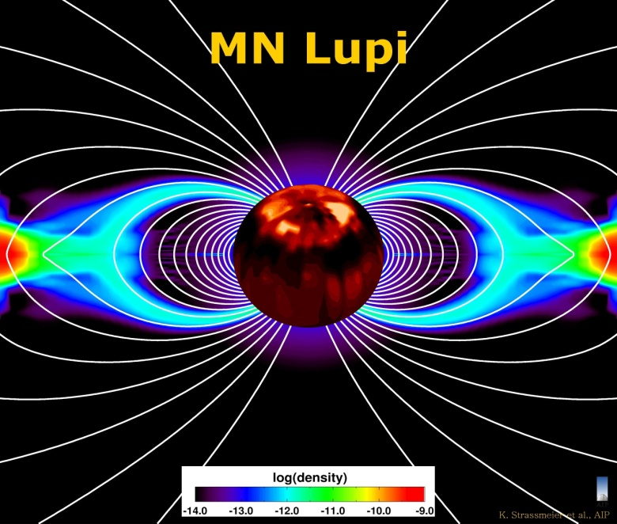
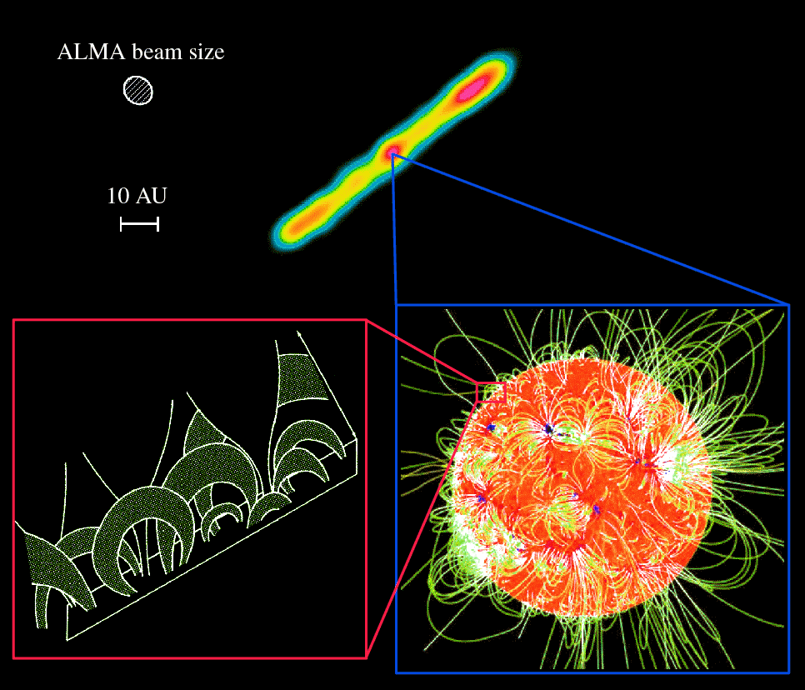
Research projects (2/2): Cool stars
For evolved stars (low-gravity giants), winds are likely to be intermittent & clumpy.
1D hydrodynamic simulations can shed lots of light on the physics.
For young (T Tauri) stars, does accretion change the picture?
ALMA sees mm-wave coronal emission from young M dwarfs; can turbulence explain it?

Slide 15
Stellar winds across the H-R Diagram
Massive stars: radiation-driven winds

Slide 16
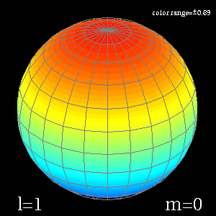
Massive star winds: radiative driving
Castor, Abbott, & Klein (1975) worked out how a hot star’s radiation can accelerate a time-steady wind, even if gravity >> continuum radiation force.
Spectral lines are the key!
CAK-type theory works well for spherical stars, but massive stars are…
κ_{ν}
ν
Rapidly rotating
Most pulsational energy is trapped below the surface.
But can some of the variability “leak out” into the wind?
Strongly pulsating

Slide 17
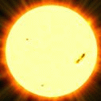
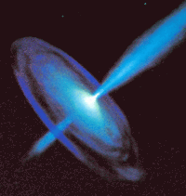
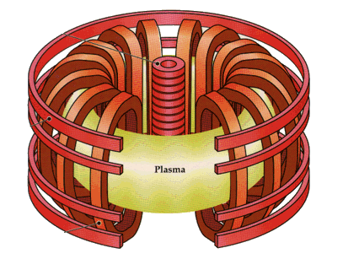
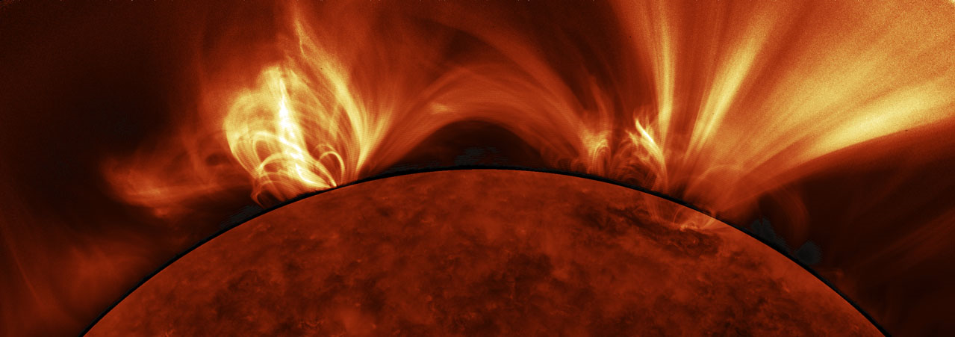
Conclusions
Within an order of magnitude, theories aren’t doing too badly in predicting observed properties of solar & stellar winds.
However, there’s still much to do . . .
Understanding is greatly aided by ongoing collaboration between the solar physics, plasma physics, and astrophysics communities.
@solarstellar

Slide 18
Extra slides . . .

Slide 19
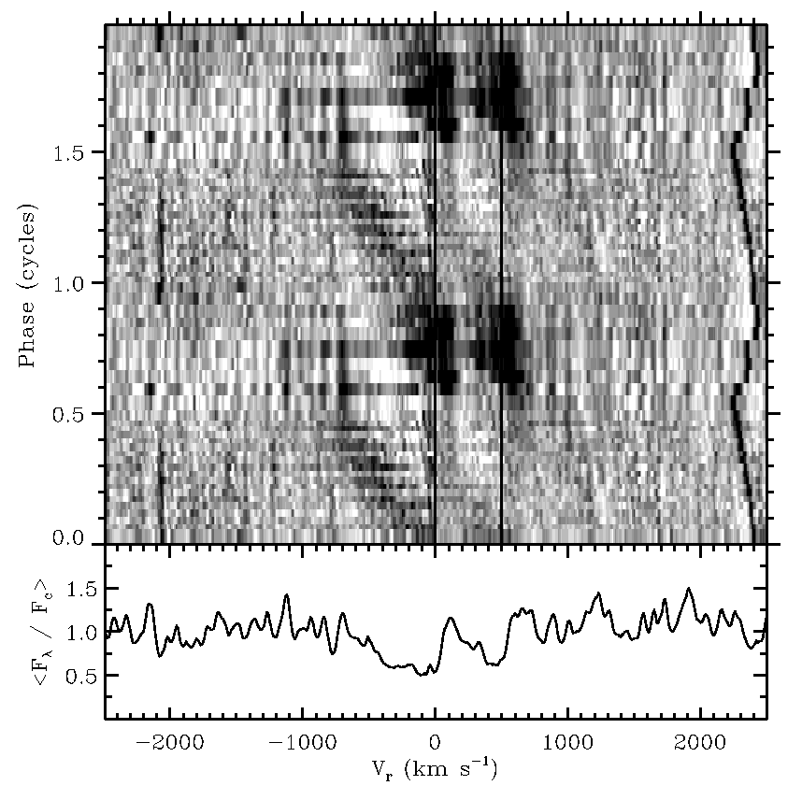
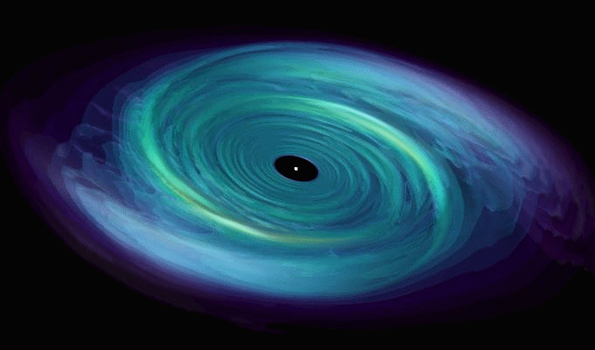
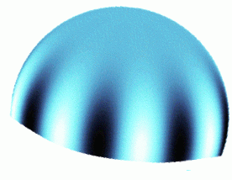
Research projects (3/?): Hot stars
Some stars show evidence for strong shocks propagating out through their stellar winds (e.g., BW Vul)
Pulsations may be strong enough to propel clumps of mass out through the winds. Some simulations done for my PhD thesis (1996) & a meeting poster (2007), but no time to explore further…
Classical Be stars have “decretion disks,” but aren’t rotating fast enough to eject them from their surfaces.
Are pulsations helping?
Cranmer (2009) said yes, but “real” hydro simulations are needed to prove it.

Slide 20
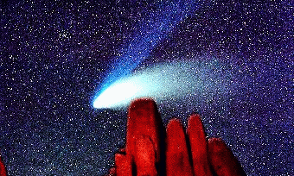
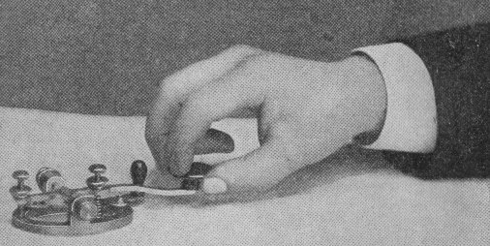
Solar wind: parallel history to stellar winds
1850–1950: Evidence slowly builds for outflowing magnetized plasma in the solar system:
solar flares → aurora, telegraph snafus, geomagnetic “storms”
comet ion tails point anti-sunward (no matter comet’s motion)
“Celestial battery:”
Transcript between Portland & Boston telegraph stations, after “Carrington event” (1859):
Portland: “Please cut off your battery; let us see if we can work with the auroral current alone.”
Boston: “I have already done so! How do you receive my writing?”
Portland: “Very well indeed – much better than with batteries.”

Slide 21
Quantifying a stellar wind
Stars themselves are characterized by mass, radius, luminosity (& chemical abundances, rotation rate, magnetic field strength).
Winds: at least 2 more parameters: mass loss rate & “terminal wind speed.”
(Typically expressed in units of M/year)
kg/s
m²
kg/m³
m/s
v∞
v∞ can be > surface V_{esc}
(most main-seq. stars)
v∞ can also be << surface V_{esc} as long as it eventually exceeds the local V_{esc}
(red supergiants)
v_{r}
r
R*

Slide 22
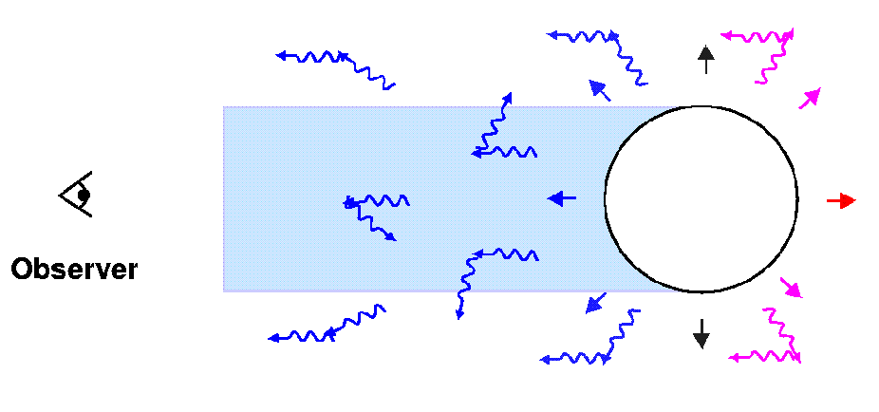
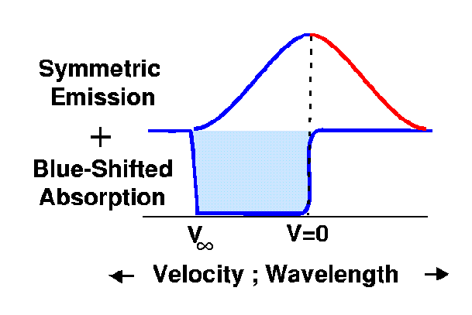
Measuring properties of stellar winds
Late 19th century: astronomical spectroscopy + understanding of Doppler effect…
1920s-1930s: “P Cygni profiles” measured as diagnostics of stellar wind outflow.
Lots of other diagnostic techniques developed throughout 20th century.
Our own solar wind is a special case… we’re bathed in it!

Slide 23
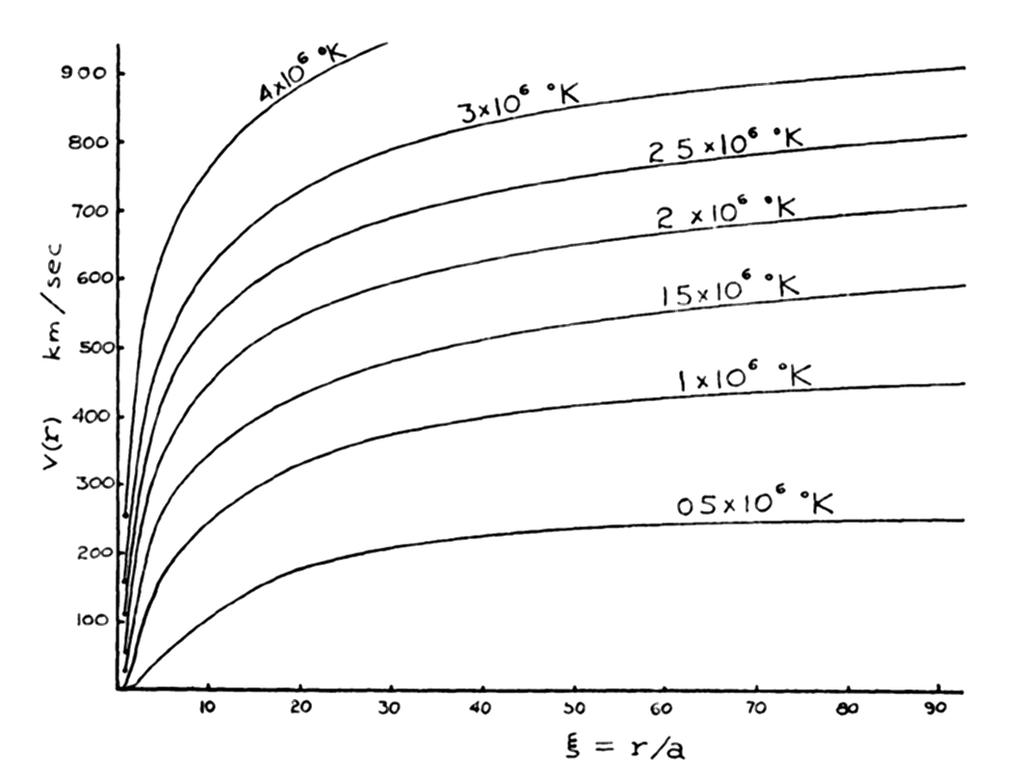
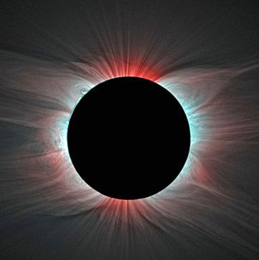
Link to coronal heating: not so simple
The Parker (1958) theory says that a higher-temperature corona accelerates a faster wind.
Do observations of the coronal source regions back this up?
Habbal et al. (2010)
Red:
low T_{e}
Blue:
high T_{e}
No! (see also measurements of ion charge states in the solar wind)
It is clear the fast wind needs something besides gas pressure to accelerate so fast!

Slide 24
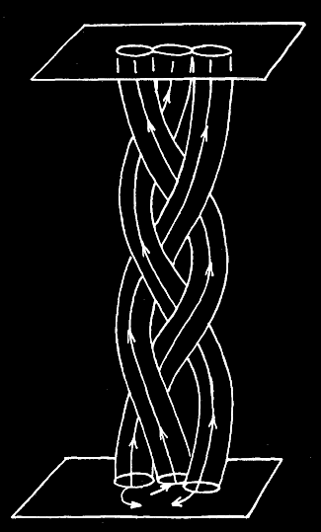
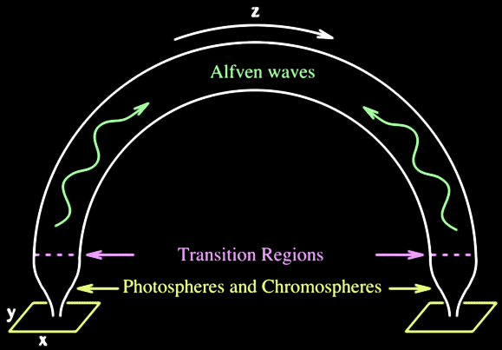
Waves versus reconnection
Slow footpoint motions (τ > L/V_{A}) cause the field to twist & braid into a quasi-static state; parallel currents build up and are released via reconnection. (“DC”)
Rapid footpoint motions
(τ < L/V_{A}) propagate through the field as waves, which are eventually dissipated. (“AC”)
However . . .
The Sun’s atmosphere exhibits a continuum of time scales bridging AC/DC limits.
“Waves” in the real corona aren’t just linear perturbations.
(amplitudes are large) (polarization relations are not “classical”)
“Braiding” in the real corona is highly dynamic. (see: Hi-C sounding rocket!)

Slide 25
Turbulence: pure hydrodynamics
The original von Karman & Howarth (1938) theory of fluid turbulence assumed a constant energy flux from large to small eddies.
The inertial range is a “pipeline” for transporting energy from the large scales to the small scales, where dissipation can occur.
energy injection range
Fluctuation power
Kolmogorov (1941)
dissipation range
frequency or wavenumber

Slide 26
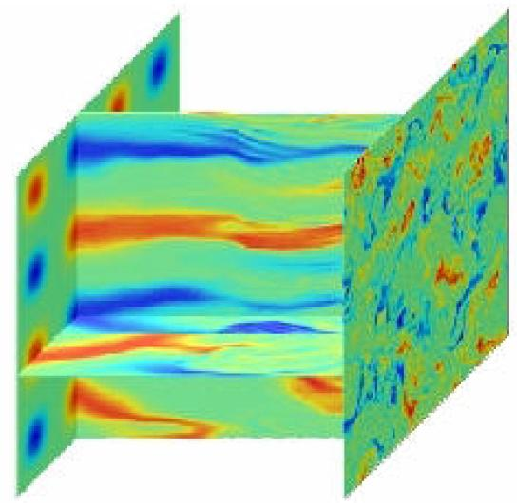
Anisotropic MHD turbulence
With a strong background field, it is easier to mix field lines (perp. to B) than it is to bend them (parallel to B).
Also, the energy transport along the field is far from isotropic.
Turbulent eddies are formed and “shredded” by collisions of counter-propagating Alfvén wave packets.
MHD simulations inspire phenomenological scalings for the cascade/heating rate:
(e.g., Iroshnikov 1963; Kraichnan 1965; Strauss 1976; Shebalin et al. 1983; Hossain et al. 1995; Goldreich & Sridhar 1995; Matthaeus et al. 1999; Dmitruk et al. 2002)

Slide 27
Open flux tubes feeding the solar wind
Once we have a ~10⁶ K corona, we still don’t know if Parker’s (1958) theory for gas-pressure acceleration is sufficient for driving the solar wind.
SDO/AIA
What is the source of mass, momentum, and energy that goes into the solar wind?
Wave/turbulence input in open tubes?
Reconnection & mass input from loops?
vs.
Cranmer & van Ballegooijen (2010) say reconn./loop-opening doesn’t work.
Roberts (2010) says neither idea works !?

Slide 28
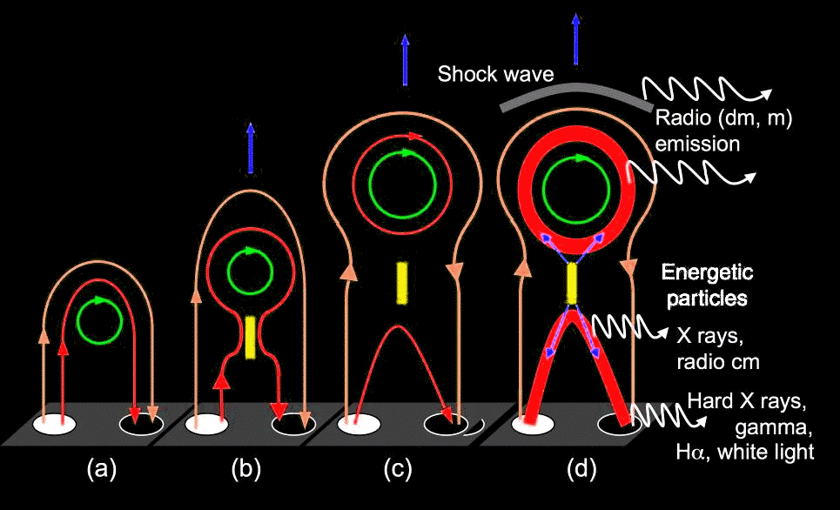
Magnetic reconnection
Popular alternative to waves/turbulence: if convective churning is slow, then the magnetic field twists & braids, slowly building up energy, until it “breaks!”
Flares, jets, & coronal mass ejections (CMEs) drive much of the variability seen at 1 AU.
K.-L. Klein & E. Pariat

Slide 29
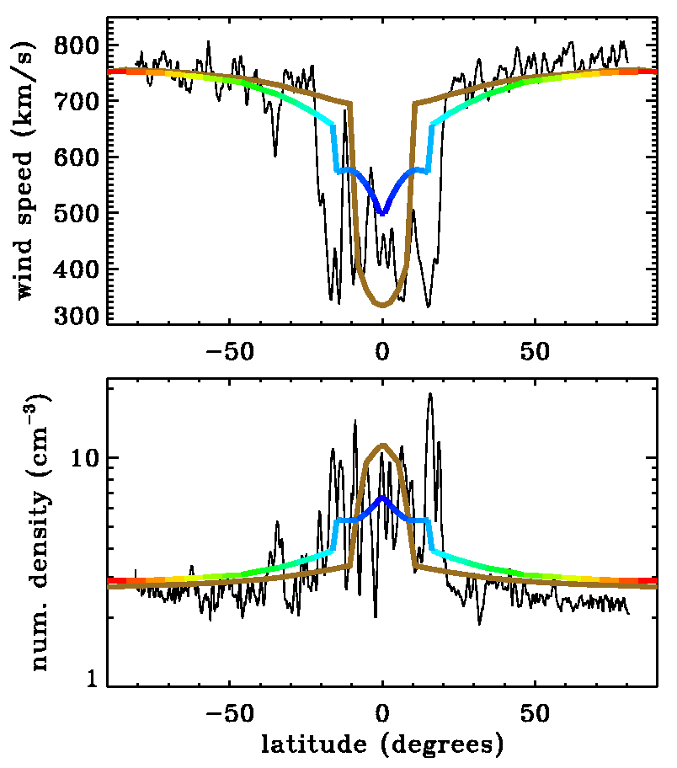
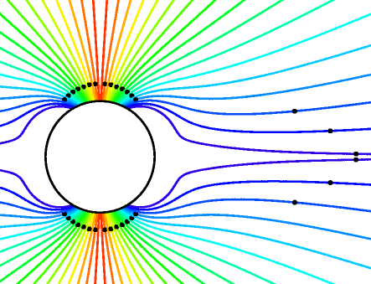
Turbulence-driven solar wind models
Cranmer et al. (2007) computed self-consistent solutions of waves & background one-fluid plasma state along various flux tubes.
See also Suzuki & Inutsuka (2006), Verdini et al. (2010), Chandran et al. (2011), van der Holst et al. (2013).
Only free parameters: waves at photosphere & radial magnetic field.
Coronal heating occurs “naturally” with T_{max} ~ 1–2 MK.
Varying radial dependence of field strength (B_{r} ~ A^{–1}) changes location of the Parker (1958) critical point.
Wave pressure ≈ gas pressure for all but the slowest wind streams.
Ulysses SWOOPS
Goldstein et al.
(1996)

Slide 30
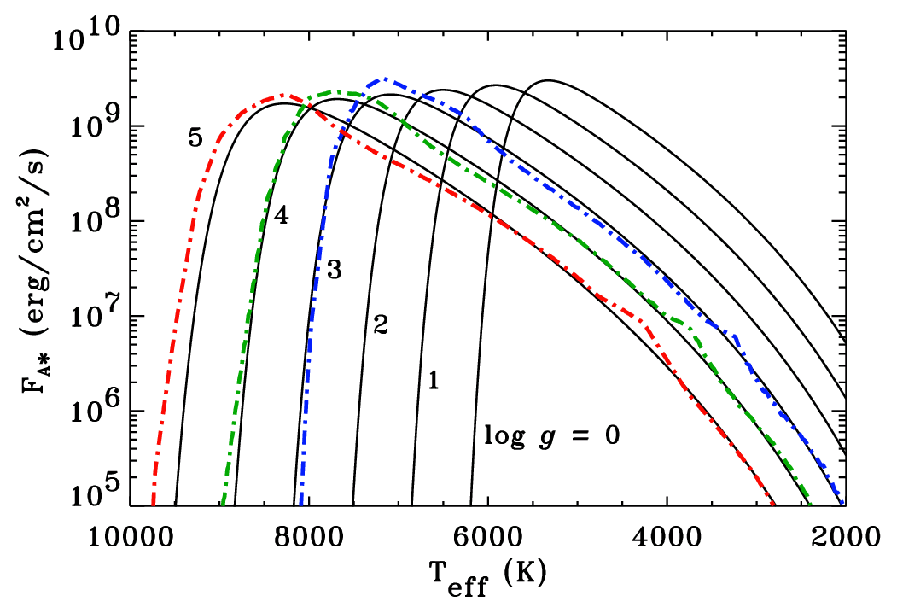
Other stars: a simpler approach?
Cranmer et al. (2007) and others solved the full set of mass, momentum, and energy conservation equations.
Cranmer & Saar (2011) solved a simplified version of energy conservation to get just the mass loss rate as a function of the energy input from turbulence.
Same MHD heating rate used in stellar models as was used in the solar model.
Photospheric Alfvén waves are driven by turbulent convection (Musielak & Ulmschneider 2002).

Slide 31
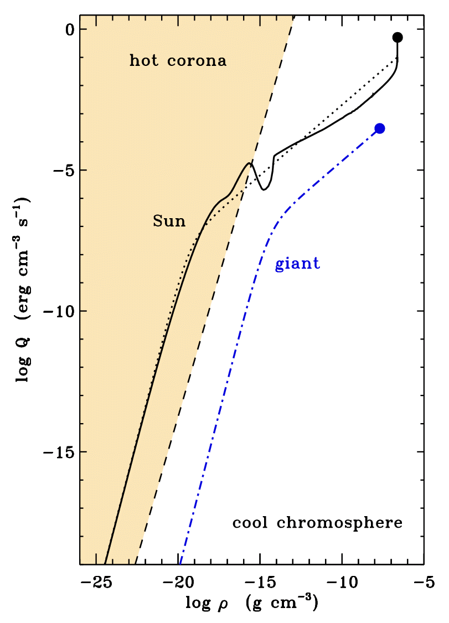
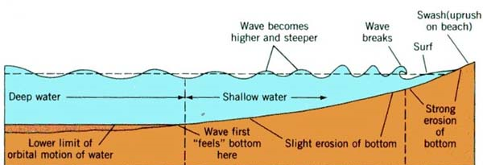
Do Alfvén waves always heat a corona?
With the above inputs (and assuming v∞ ≈ V_{esc}), we can solve for the mass loss rate in the case of a “hot coronal wind.”
Sometimes, the heating rate Q drops off more steeply (with decreasing density ρ) than in the solar case, and radiative cooling always remains able to keep T < 10⁴ K.
In those “cold” cases (usually for luminous giants), gas pressure cannot accelerate a wind.
Alfvén wave pressure may take the place of gas pressure (Holzer et al. 1983).

Slide 32
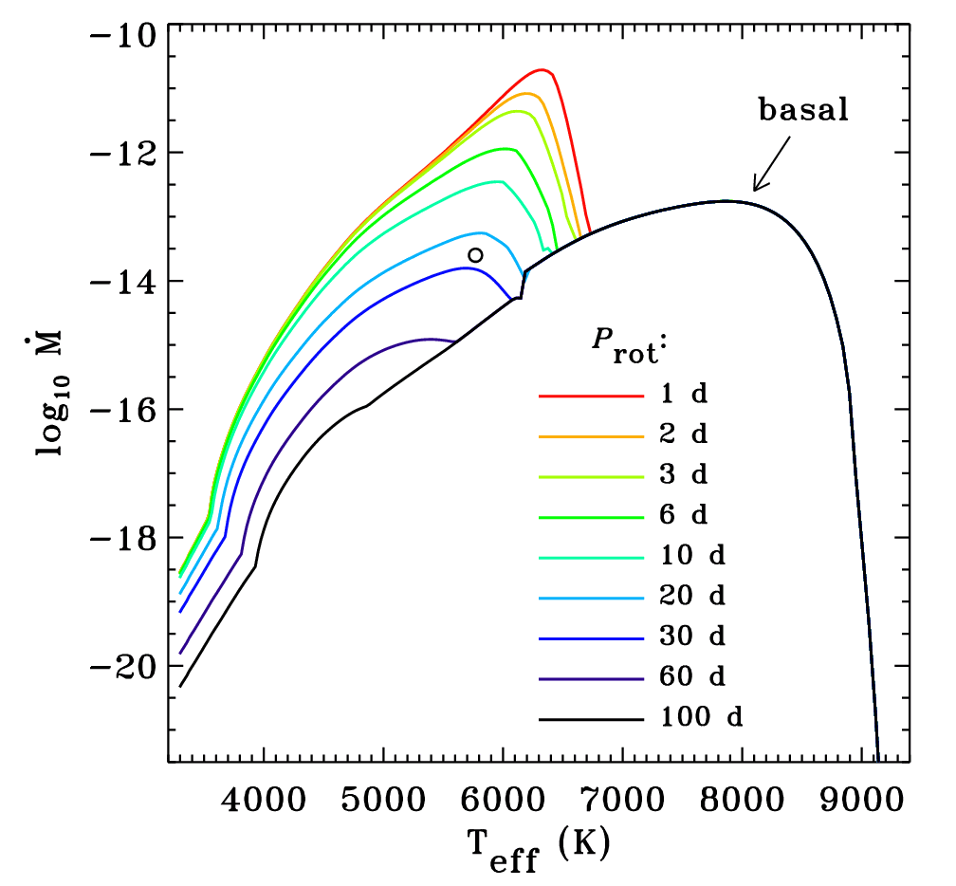
Mass loss on an ideal main sequence
Is there really a basal “floor” in the age-rotation-activity relationship?
P_{rot}
Saturation
Super-saturation?

Slide 33
Young stars: turbulence also produces X-rays
Cranmer (2008, 2009) estimated the turbulence produced by impact of accretion streams onto T Tauri stars.
Accretion-driven X-rays agree with observations, but stellar wind mass loss rate << “disk wind” mass loss rate.
Cranmer, Wilner, & MacGregor (2013) modeled the X-ray corona of young M dwarf AU Microscopii, whose debris disk is observed edge-on by ALMA.
X-ray, radio, & sub-mm emission all help constrain the properties of the turbulence.

Slide 34
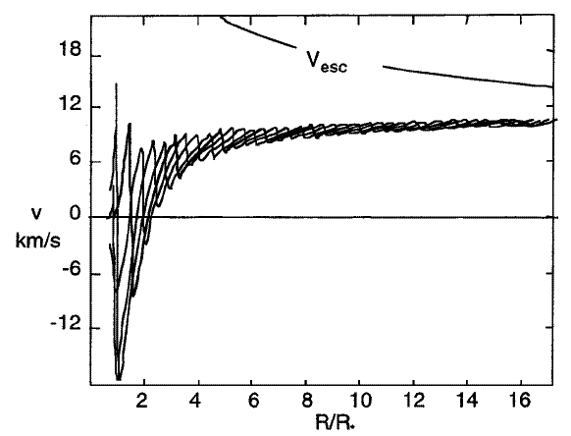
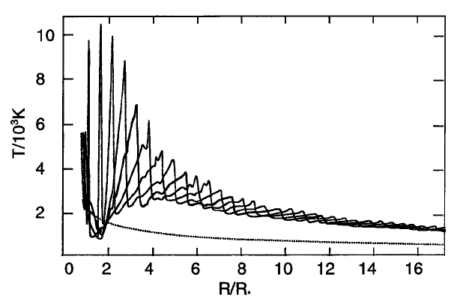
Post-main-sequence stellar winds
The extended atmospheres of red giants and supergiants are likely to be cool (i.e., not highly ionized or “coronal” like the Sun).
High-luminosity: radiative driving... of dust?
Numerical models show that pulsations couple with radiation/dust formation to be able to drive mass loss rates up to 10^{–5} to 10^{–4} M/yr.
Shock-heated “calorispheres” (Willson 2000) ?
(Struck et al. 2004)

Slide 35
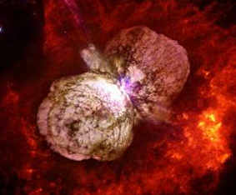
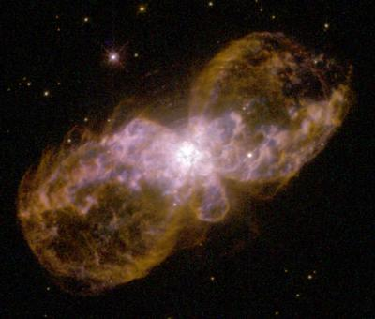
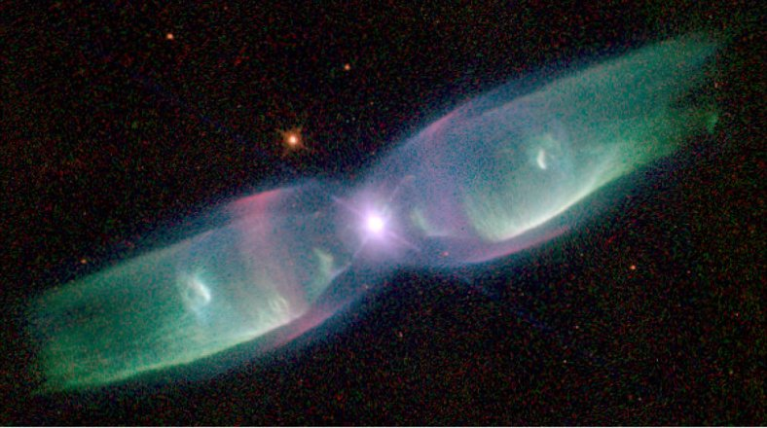
Rapid rotation: impact on mass loss
(Dwarkadas & Owocki 2002)

Slide 36
Rapid rotation: impact on mass loss
(Cranmer 1996)

Slide 37
Massive star evolution: winds matter!
Mass loss affects evolutionary tracks & the appearance of supernovae (light curves).
Hot-star winds influence ISM abundances & ionization state of Galaxy.
Wolf-Rayet stars: H stripped off by O-star wind; dense, multiple-scattering CAK.
NS/BH
W-R (WC)
SN (Ib, Ic, II)
W-R (WN)
RSG
LBV
BSG
O-star
Castor (1993)
WR 124: Tuesday’s
apod.nasa.gov

