Slide 1
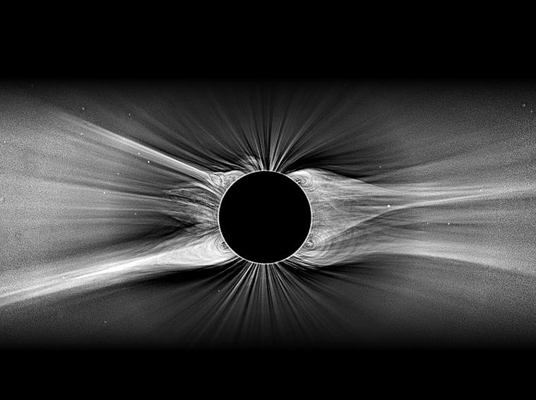


Solar Wind Turbulent Dissipation:
A Collisionless Zoo
Steven R. Cranmer
University of Colorado Boulder, LASP
A. van Ballegooijen, L. Woolsey, J. Kohl, B. Chandran, J. Kasper, G. Field

Slide 2
Solar Wind Turbulent Dissipation:
A Collisionless Zoo
~Collisionless
Space
Plasma
Steven R. Cranmer
University of Colorado Boulder, LASP
A. van Ballegooijen, L. Woolsey, J. Kohl, B. Chandran, J. Kasper, G. Field

Slide 3
Solar Wind Turbulent Dissipation:
A Collisionless Zoo
Outline:
Measurements of collisionless particle properties
How are those properties produced & maintained?
  Lots of ideas have been proposed
  I’ve got opinions…
Steven R. Cranmer
University of Colorado Boulder, LASP
A. van Ballegooijen, L. Woolsey, J. Kohl, B. Chandran, J. Kasper, G. Field

Slide 4
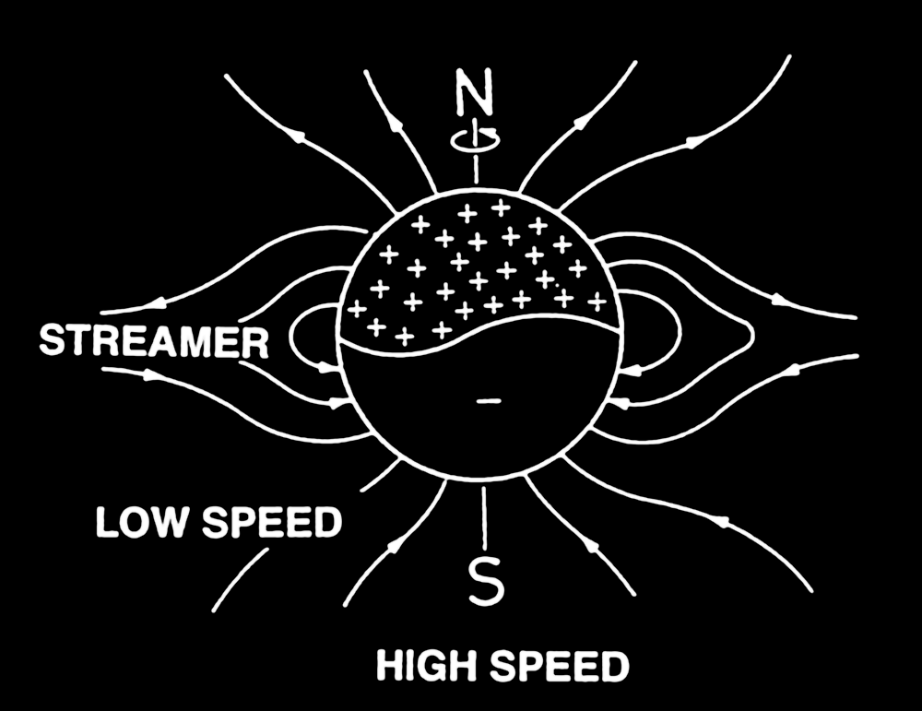
It depends on solar wind “type”
Different regions of the solar magnetic field produce different amounts of coronal heating & solar wind acceleration…
Slow wind (u ≈ 250–450 km/s):
high density, chaotic flow,
frequent Coulomb collisions,
higher electron temperatures
Fast wind (u ≈ 500–800 km/s):
low density, ~smooth flow (with waves),
infrequent Coulomb collisions,
lower electron temperatures
LOW SPEED
HIGH SPEED
Plasma physicists tend to focus on the fast wind, since the properties of protons, electrons, & heavy ions to all diverge from one another.
We can see the charge & mass dependence of the heating processes.

Slide 5
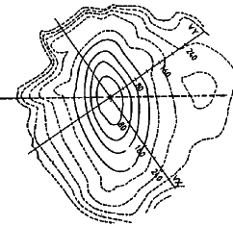
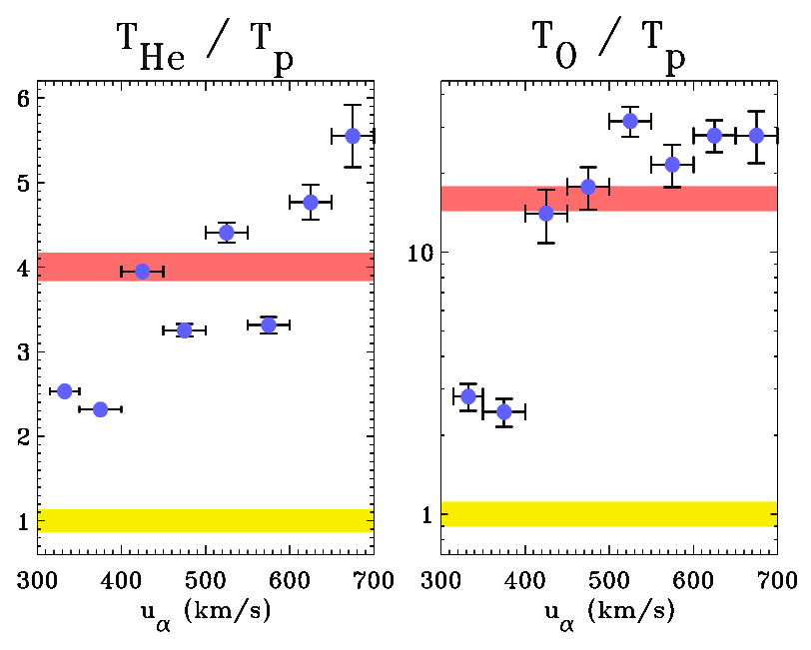
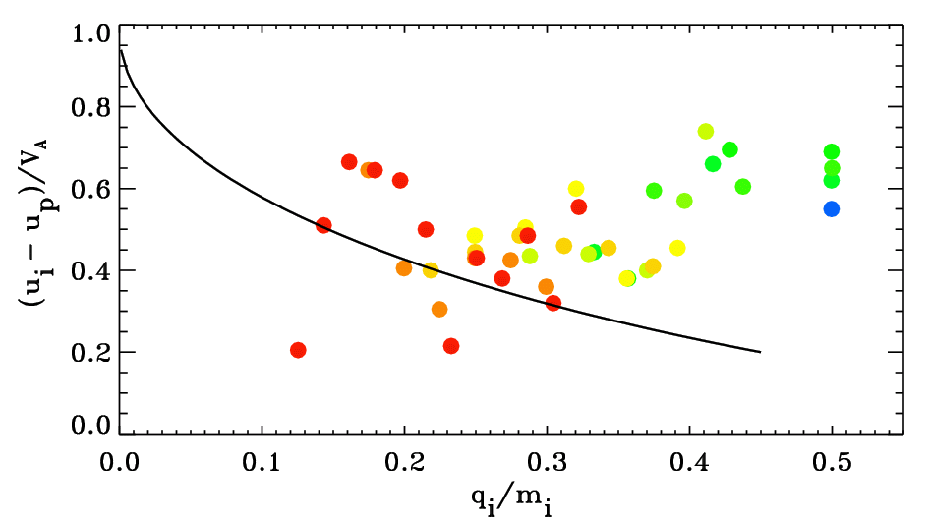
Fast wind: in situ particle properties
Faraday cups, mass spectrometers, & electrostatic analyzers collect charged particles (from given solid angle, in given energy range) & convert to currents.
If enough energies & angles collected, one gets the velocity distribution function.
B
f_{p}(v)
Also: proton μ = v┴²/B increases w/ distance
Helios @ 0.3–1 AU
(Marsch 1991)
Wind @ 1 AU (Collier et al. 1996)
ACE @ 1 AU (Berger et al. 2011)

Slide 6
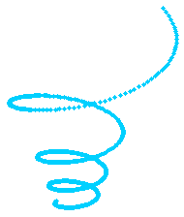
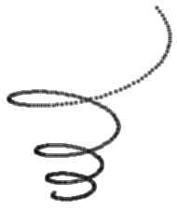
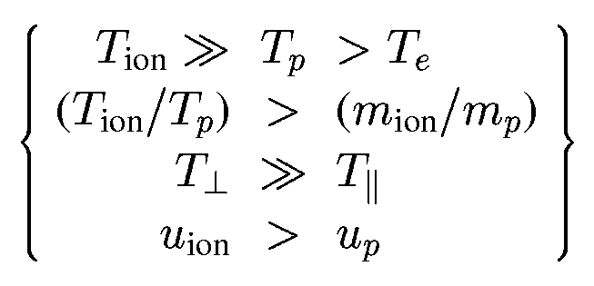
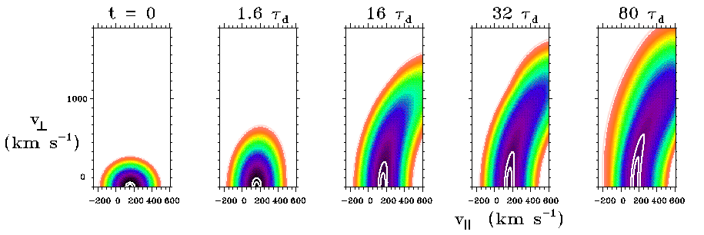
Fast wind: in situ particle properties
Summary: there’s strong “preferential” energization of protons & heavy ions:
instabilities
Alfven wave’s oscillating
E and B fields
ion’s Larmor motion around radial B-field
dissipation
Since the late 1970s, people have suggested that ion cyclotron resonance can be a natural way of producing these properties.

Slide 7
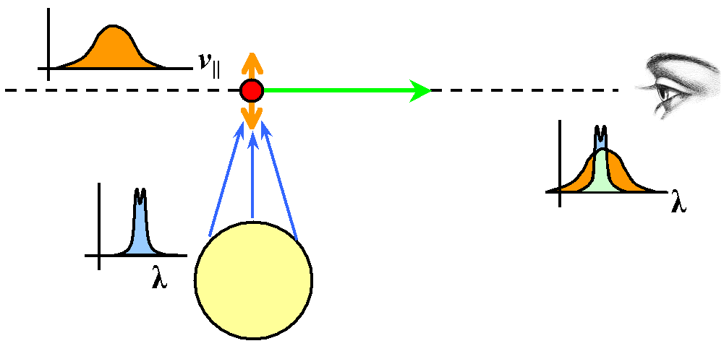
Remote sensing: spectroscopy
For a hot plasma, spectral lines are a powerhouse of plasma diagnostics . . .
If line profiles are Doppler shifted up or down in wavelength (from known rest wavelength), this gives bulk flow speed along line of sight.
Profile widths tell us about unresolved (random?) motions along line of sight: temperatures & MHD wave “sloshing.”
δλ
VLOS
=
λ₀
c
δλ
λ₀
For scattering lines, the total # of photons scattered depends on how well the radial velocity distribution lines up with the narrow source of photons.
“Doppler dimming” can help tell us about velocities transverse to the line of sight.

Slide 8
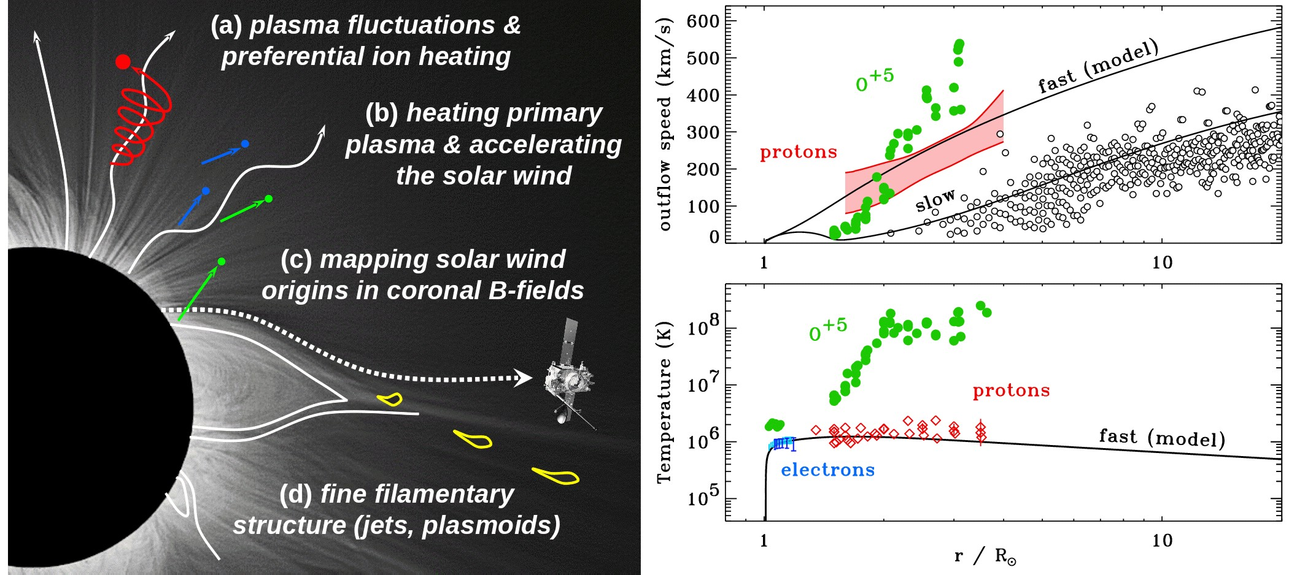
The power of off-limb UV spectroscopy
UVCS/SOHO led to new views of the collisionless nature of the solar wind.
Heavy ions are “minor ions,” but they’re valuable probes of the physics!
In coronal holes, heavy ions (e.g., O⁺⁵) both flow faster and are heated hundreds of times more strongly than protons and electrons, and have anisotropic velocity distributions.
T┴ ≈ (3-10) T||
(Kohl et al. 1995, 1997, 1998, 1999, 2006; Cranmer et al. 1999, 2008; Cranmer 2000, 2001, 2002)

Slide 9
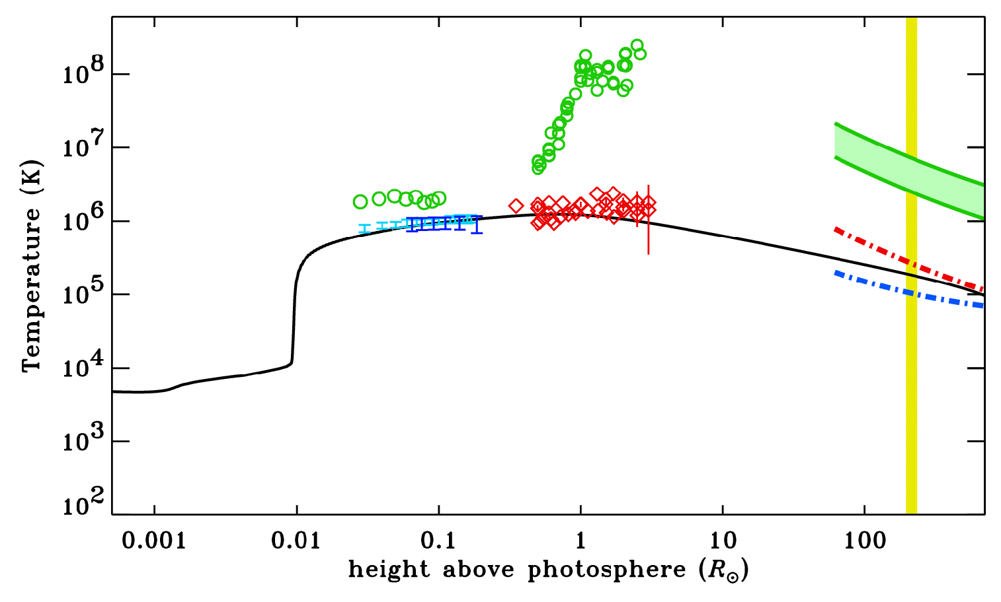
Remote & in situ data show similar things
O⁺⁵
O⁺⁶
In the lowest density solar wind streams . . .
electron temperatures
proton temperatures
heavy ion temperatures

Slide 10
Outline:
Measurements of collisionless particle properties
How are those properties produced & maintained?
  Lots of ideas have been proposed
  I’ve got opinions…

Slide 11
Alfvénic turbulence in the fast wind
Cranmer & van Ballegooijen (2005) collected a range of observational inferences of transverse wave amplitudes vs. height in the fast wind.
Theories of low-frequency MHD turbulence seem to be doing a good job in explaining those amplitudes, & the overall amount of coronal heating.
Simulations & experiment tell us energy flux through the
“inertial range”
Energy injection from waves driven at solar surface
Power
Something’s got to terminate the cascade in small-scale dissipation
(viscosity? magnetic diffusivity?)
frequency or wavenumber

Slide 12
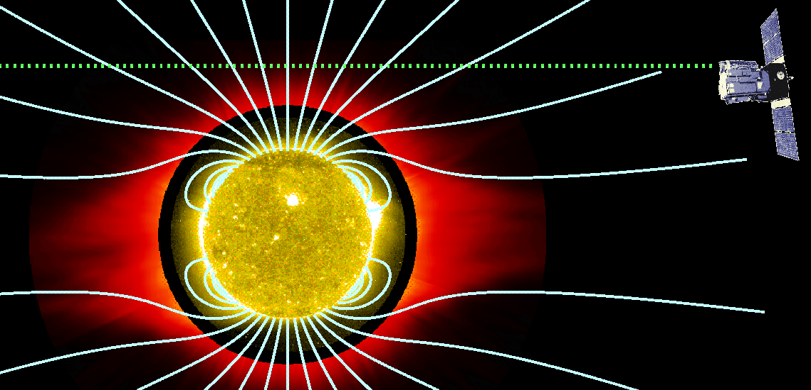
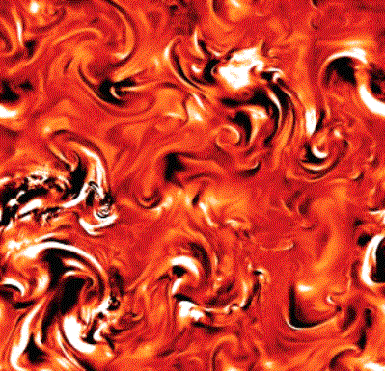

Alfvénic turbulence in the fast wind
The UVCS results brought about a resurgence of interest in ion cyclotron resonance as a possible collisionless way of dissipating the cascading MHD turbulent energy.
UVCS
However… the expected frequencies of turbulent eddies are in the mHz range.
Ion cyclotron waves in the corona would have frequencies in the kHz range!
something else?

Slide 13
What is that “something else?”
Alfvénic turbulence may induce some kind of “parallel cascade” that gradually produces ion cyclotron waves in the corona and solar wind.
When MHD turbulence cascades to small perpendicular scales, the small-scale shearing motions may be unstable to generation of cyclotron waves (Markovskii et al. 2006).
Dissipation-scale current sheets may preferentially spin up ions (Dmitruk et al. 2004).
If MHD turbulence exists for both Alfvén and fast-mode waves, the two types of waves can nonlinearly couple with one another to produce high-frequency ion cyclotron waves (Chandran 2005; Cranmer & van Ballegooijen 2012).
If nanoflare-like reconnection events in the low corona are frequent enough, they may fill the extended corona with electron beams that would become unstable and produce ion cyclotron waves (Markovskii 2007).
If kinetic Alfvén waves reach large enough amplitudes, they can damp via wave-particle interactions and heat ions (Voitenko & Goossens 2006; Wu & Yang 2007; Chandran 2010).
Kinetic Alfvén wave damping in the extended corona could lead to electron beams, Langmuir turbulence, and Debye-scale electron phase space holes which could heat ions perpendicularly (Matthaeus et al. 2003; Cranmer & van Ballegooijen 2003).

Slide 14

What is that “something else?”
BACK THE TRUCK UP

Slide 15

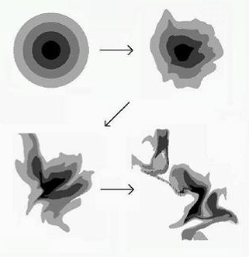
MHD turbulence is anisotropic
Without a magnetic field, turbulence is isotropic in wave-number space… there is no preferred direction.
k
high k → high freq. ?
Energy input
k

Slide 16
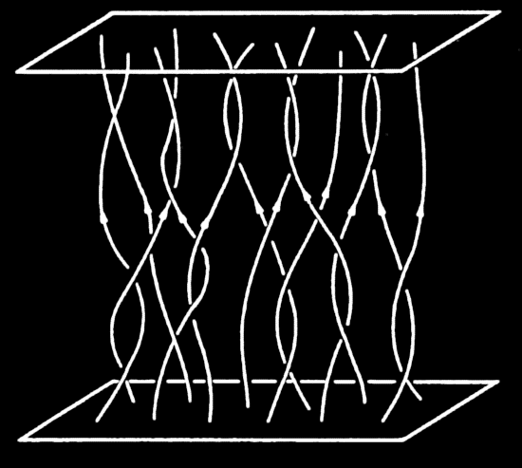
MHD turbulence is anisotropic
Without a magnetic field, turbulence is isotropic in wave-number space… there is no preferred direction.
However, when the background field is strong (β << 1), eddies are carried by Alfvén waves.
k
Alfvén waves propagate ~freely along B (and don’t interact easily with one another), but field lines can “shuffle” in the perpendicular direction.
Thus, MHD cascade proceeds mainly in the plane perpendicular to field (Strauss 1976; Montgomery 1982).
Dominant perpendicular cascade?
Energy input
k

Slide 17
MHD turbulence is anisotropic
k
ion cyclotron waves
Ω_{p}/V_{A}
This is unfortunate for fans
of ion cyclotron resonance!
ω = V_{A} k║
In a low-β plasma, cyclotron waves heat ions & protons when they damp, but kinetic Alfvén waves are Landau-damped, mainly heating electrons.
Dominant perpendicular cascade?
kinetic Alfvén waves
Energy input
k
Ω_{p}/c_{s}

Slide 18
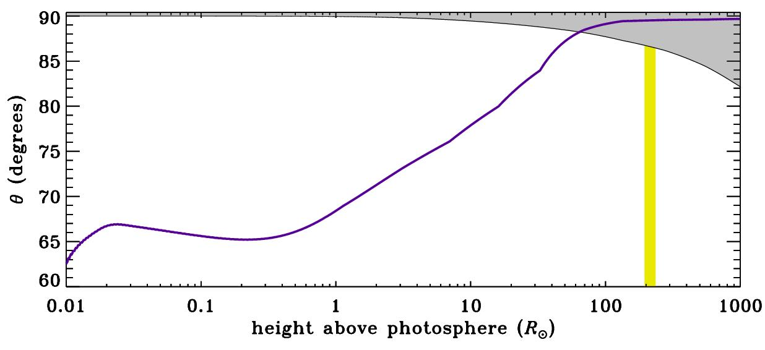
How bad is the mismatch?
What wavenumber angles are “filled” by anisotropic Alfvén-wave turbulence in the solar wind? (gray)
What is the angle that separates ion/proton heating from electron heating? (purple curve)
k
θ
k
Goldreich & Sridhar (1995)
electron heating
proton & ion heating

Slide 19
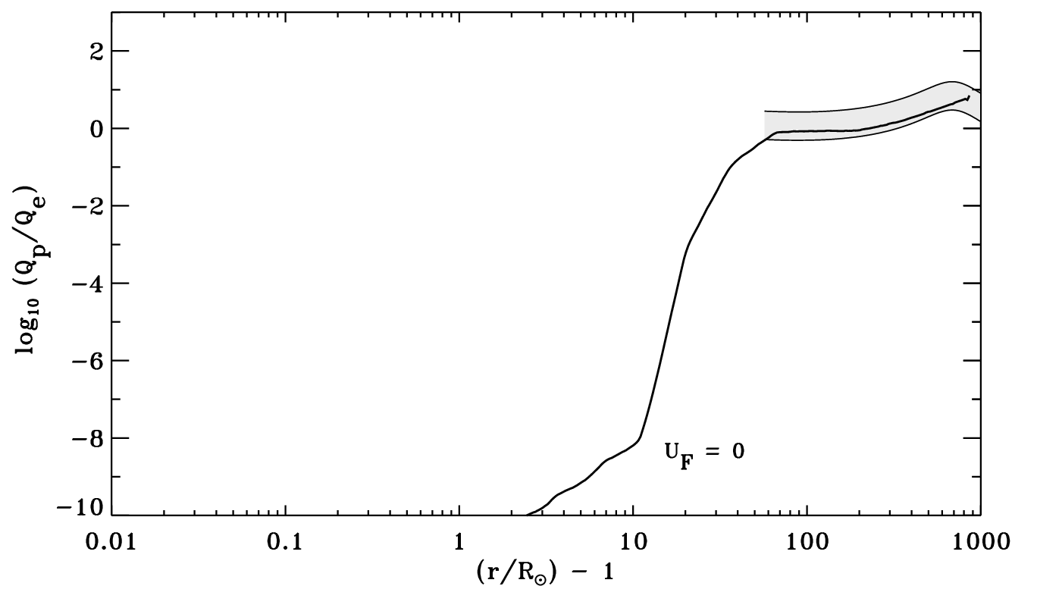
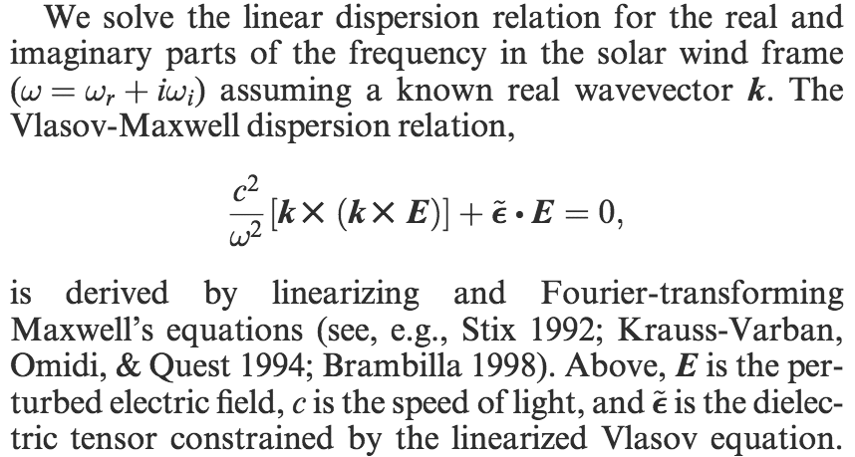
Apply linear damping to anisotropic spectrum
Howes (2010) and Cranmer & van Ballegooijen (2012) computed heating rates for protons & electrons assuming just the “expected” anisotropic spectrum.
Helios & Ulysses
(Cranmer et al. 2009)
→ (ω_{r} + iγ) for each k
→ convolve γ with wave power spectrum to get heating rates
What’s “needed” in the corona?
Q_{p} ≈ Q_{e}

Slide 20
What to do for the corona?
Two practical options:
Rescue ion cyclotron resonance! i.e., figure out what else might “populate” the high-frequency part of the spectrum.
Figure out whether there may be some conditions under which the low-frequency KAWs might end up heating protons & heavy ions?
There are several in situ lines of evidence in favor of some waves with high k║ (e.g., MacBride et al. 2008; Jian et al. 2009, 2010; Smith et al. 2012)

Slide 21
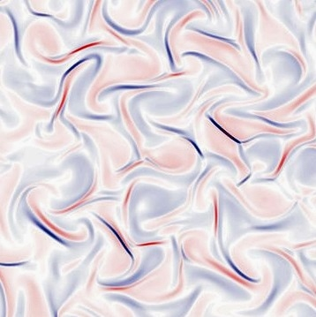
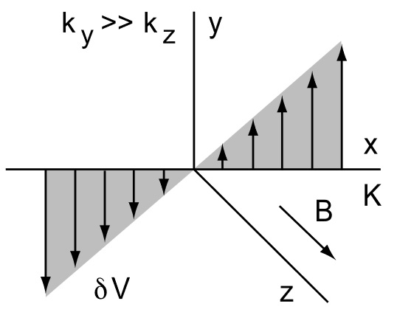
Kinetic Alfvén waves: 4 ideas
Nonlinear structures arise in low-frequency, high-k┴ turbulence:
If the velocity perturbation amplitudes are large enough, ions undergo nonlinear stochastic motions (i.e., magnetic moment non-conservation within individual gyro-orbits!) and can be heated strongly.
KAW turbulence isn’t just made of incoherent wave packets, but is organized into small dissipative current sheets. (Test particle simulations show some extra ion heating.)
KAWs undergo strong perpendicular shear motions, which may be unstable to spontaneous growth of high-freq. waves.

Slide 22
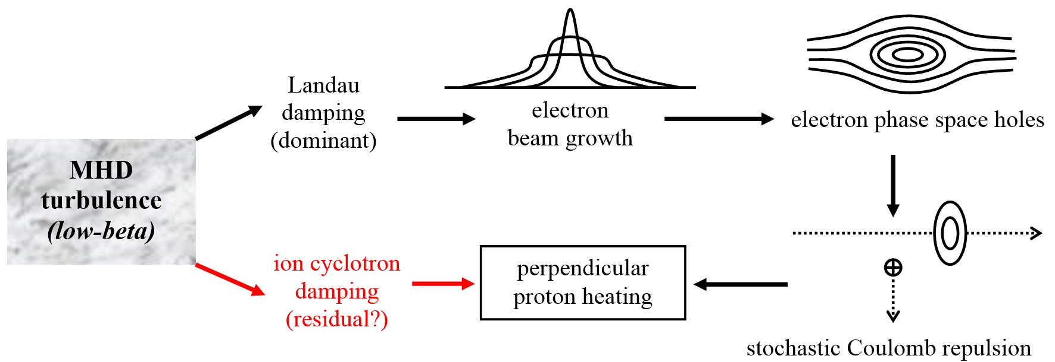
Kinetic Alfvén waves: 4 ideas
Cranmer & van Ballegooijen (2003) explored an idea first presented by Matthaeus et al. (2003), which I think came from discussions with Bob Ergun.
KAWs (δv║ & δE║) accelerate electrons into “bump on tail;” unstable to growth of Langmuir waves.
Evolved Langmuir wave trains exhibit periodic electrostatic potential wells, which can trap electrons, eventually forming electron phase space holes.
Ergun et al. (1999) suggested EPSHs can act as “scattering centers” for ions, giving them a net perpendicular boost of randomized kinetic energy!
Cranmer & van Ballegooijen (2003) showed that net ion heating rate
depends extremely sensitively on the parallel size z₀ of average EPSHs:
Q_{ion} ~ z₀¹³

Slide 23
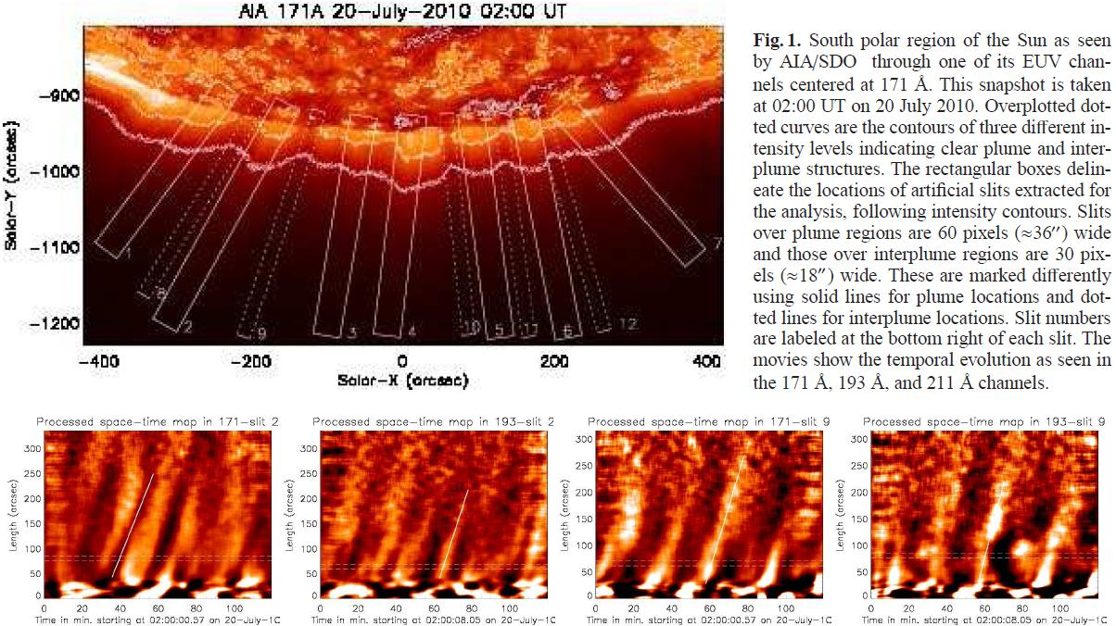
Rescuing the ion cyclotron wave?
There is observational evidence for compressive (non-Alfvén) waves, too . . .
(e.g., Krishna Prasad et al. 2011)
When fast-mode waves cascade, their k-distribution is close to isotropic!
Can Alfvén waves undergo nonlinear mode-coupling with fast-mode waves efficiently enough to feed back energy into high-freq Alfvén waves?
Chandran (2005) said maybe...
k
k

Slide 24
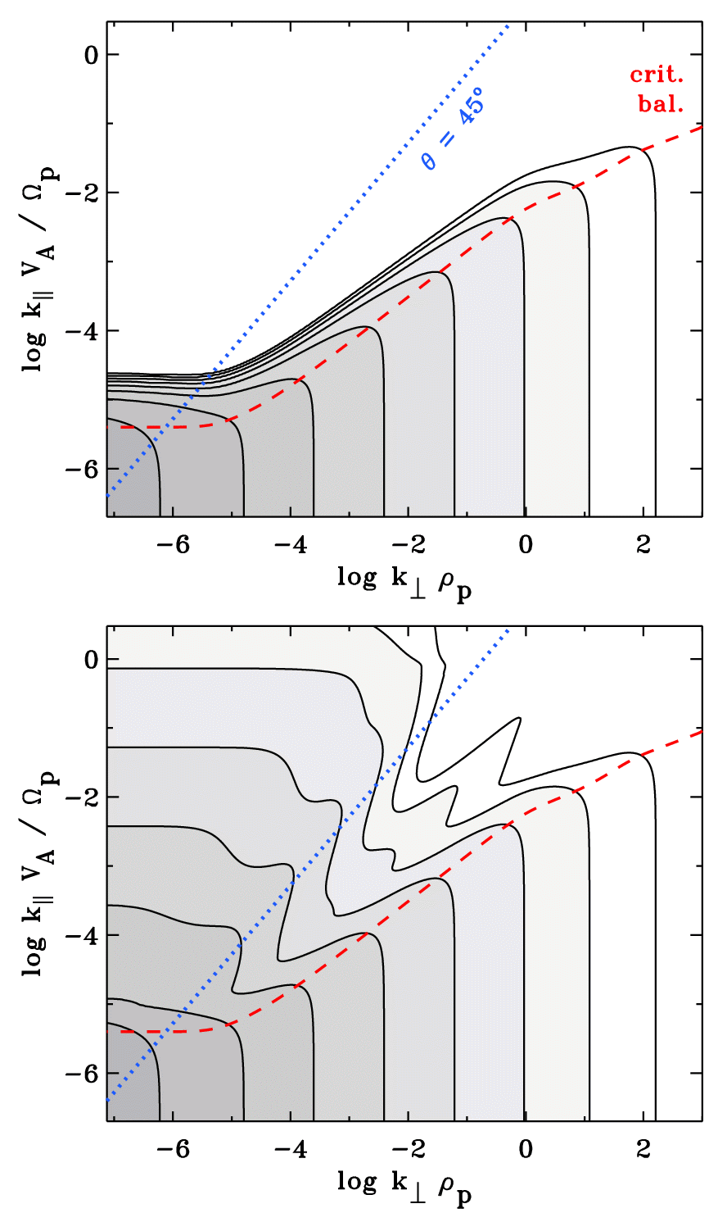
Model cascade + Alfvén/fast-mode coupling
Cranmer & van Ballegooijen (2012) modeled cascade as diffusion in (k║, k┴) space.
Dissipation from ion cyclotron & Landau resonances (A); transit-time damping (F).
Coupling between A & F modes treated with Chandran (2005) weak turb. timescale.
Pure Alfvén mode:
Alfvén mode with AAF/AFF coupling:

Slide 25
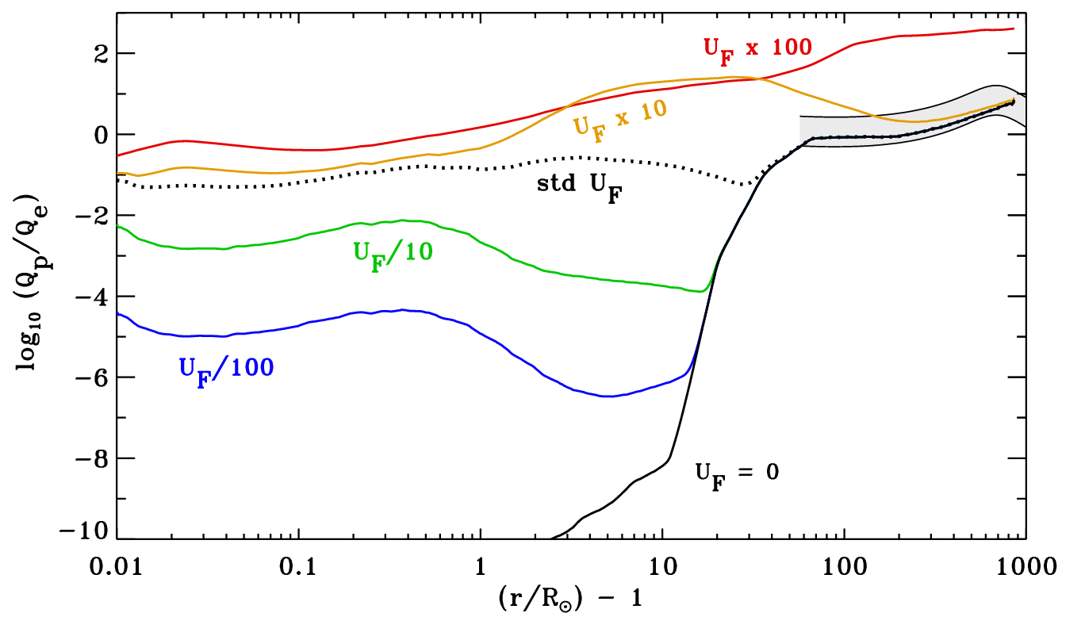
Results for proton/electron heating ratio
Cranmer & van Ballegooijen (2012) computed heating rates for protons & electrons for the “known” Alfvén wave power, plus a variable fast-mode wave component.
Helios & Ulysses

Slide 26
Other implications of a “coupled cascade”
Key result: If one believes the fast/Alfvén mode coupling is going on, then one can get lots of proton & heavy ion heating in the corona even when the high-freq. wave power is just a small fraction of the total.
Spectrum-averaged θ = 88º consistent with the expected dominance of KAWs.
Taking the existence of a small population of ion cyclotron waves as a given, Cranmer (2014, ApJ Supp) delved more deeply into how they would heat protons in the solar wind.

Slide 27
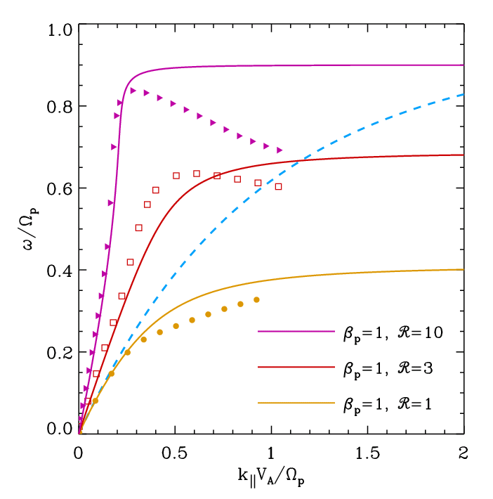
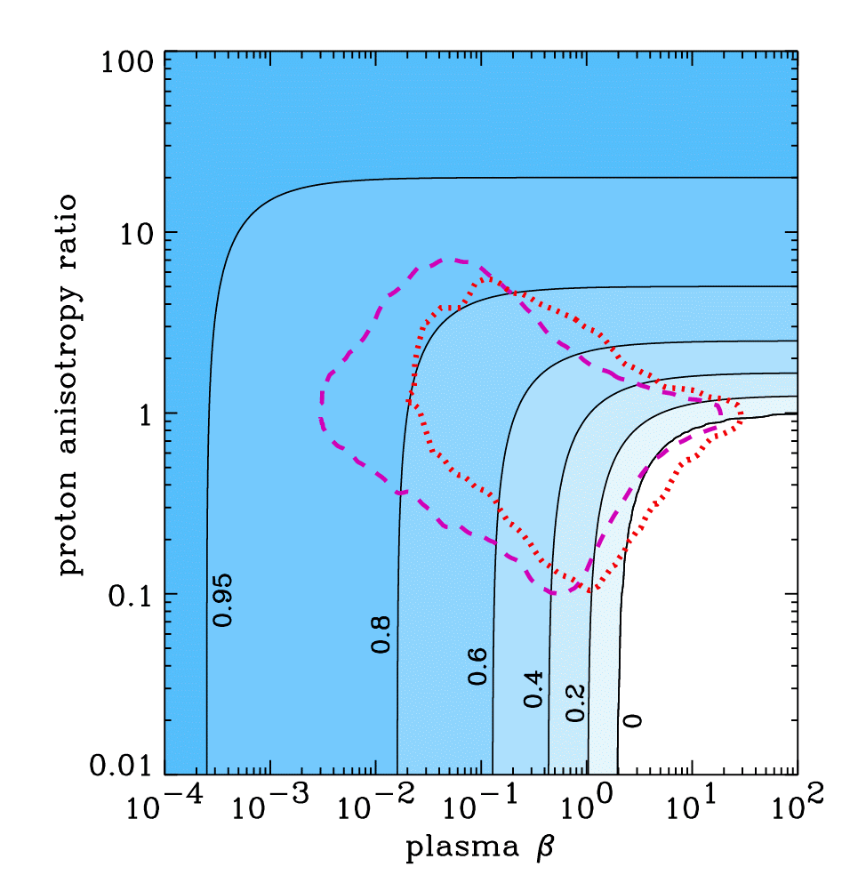
Proton cyclotron resonance
The actual proton & ion heating rates depend crucially on the dispersion relation of the parallel-propagating ion cyclotron waves.
Cranmer (2014) found new analytic warm dispersion solutions, motivated by “resonant shell” distributions, that agree well with numerical Vlasov-Maxwell codes.
Contours: ω/Ω at large k║
Wind
data
@ 1 AU
firehose unstable region
has no solutions

Slide 28
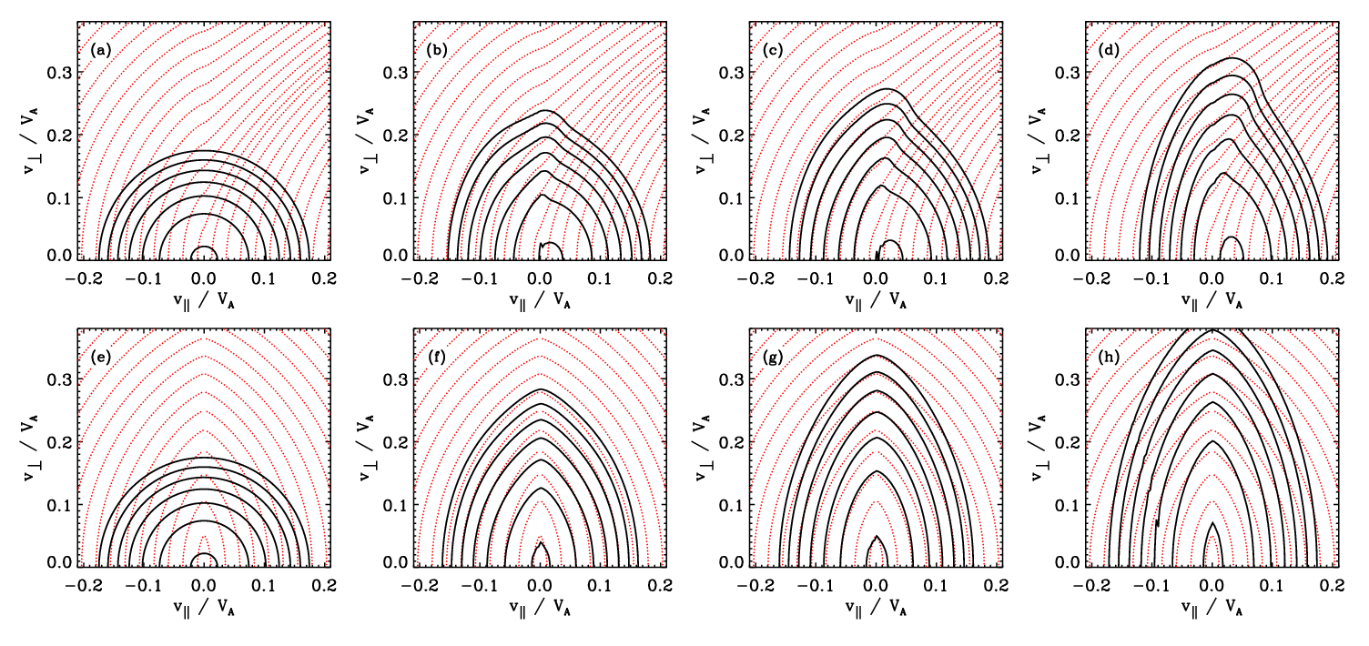
Proton cyclotron heating
Protons diffuse in velocity space, with evolution details determined by the relative amounts of power in outward vs. inward propagating cyclotron waves.
Proper quasilinear treatment of “damped resonances” (see also Gary & Saito 2003).
100% outward
50/50% out/in
→ → time → →

Slide 29
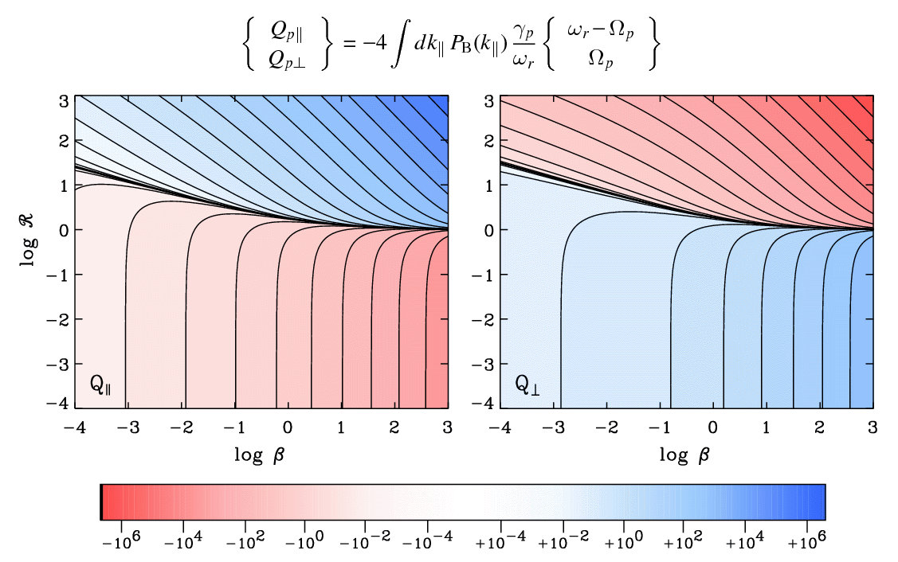
Proton cyclotron heating
Numerical models of velocity-space diffusion agree reasonably well with analytic predictions of proton heating/cooling that assume bi-Maxwellian distributions.
Different dispersion relations: different Q magnitudes & marginal stability curves.
Example:
cold plasma dispersion
T┴/T||

Slide 30
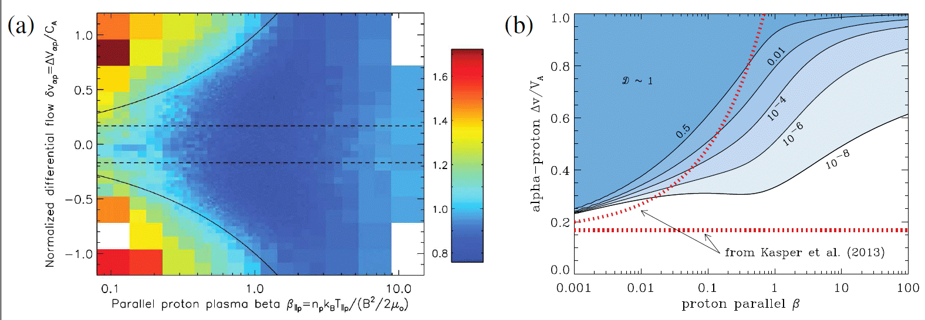
Do alpha particles block the cascade?
A phenomenological model containing both cyclotron damping and turbulent cascade seems to explain how drifting alpha particles may intercept ion cyclotron waves prior to them becoming resonant with protons.
(a) T_{p┴}/T_{p||} vs. β & alpha-proton differential speed (Kasper et al. 2013). (b) Compares favorably with contours of the ratio D (proton cyclotron heating rate, divided by same rate in absence of α’s). When D<<1, protons are not energized because α’s intercept nearly all cyclotron wave energy.

Slide 31
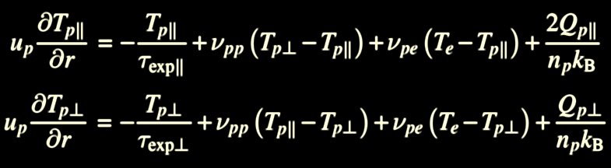
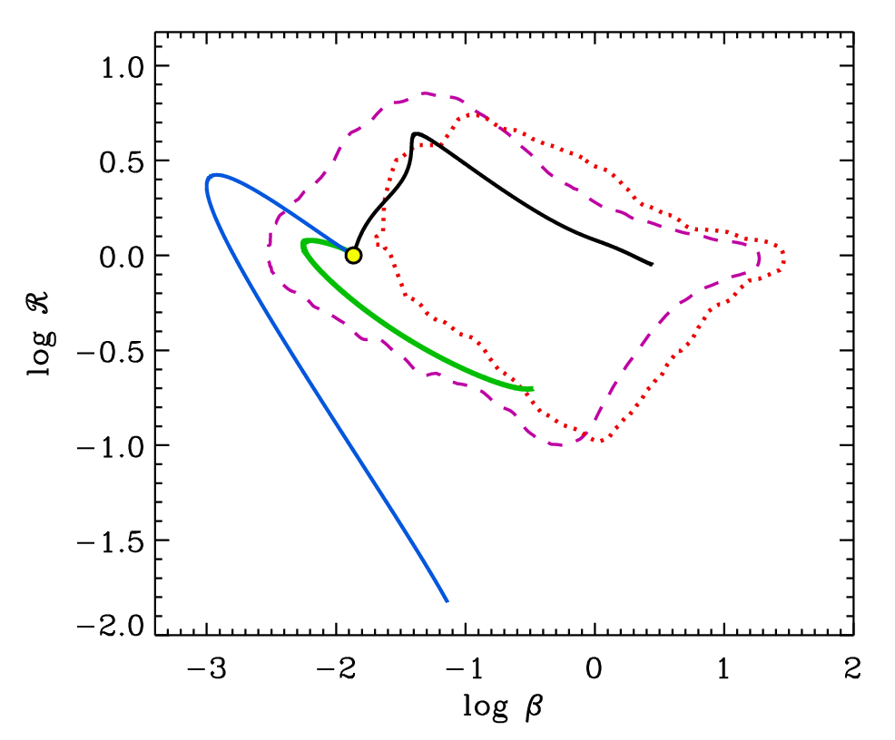
Radial evolution from the corona to 1 AU
Cranmer (2014) applied bi-Maxwellian heating rates to a macro-scale model of proton thermal evolution in ecliptic.
Start at r = 2 R with isotropic protons, T = 10⁶ K.
LEFT edges of beta-anisotropy plane can be understood as probing the “heating history” of the protons!
Example fast-wind radial histories
cyclotron & isotropic heating ~same
T┴/T||
isotropic heating only
no heating

Slide 32
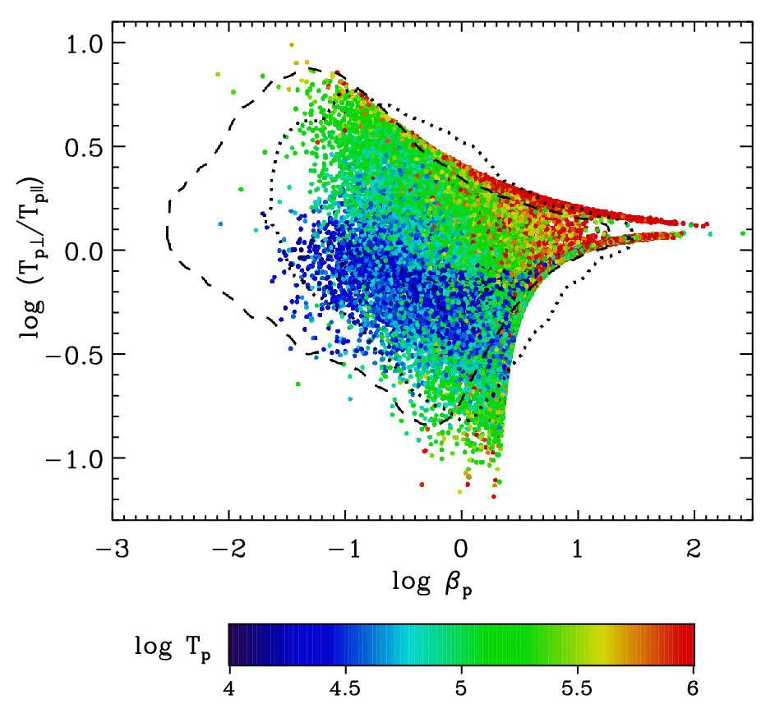
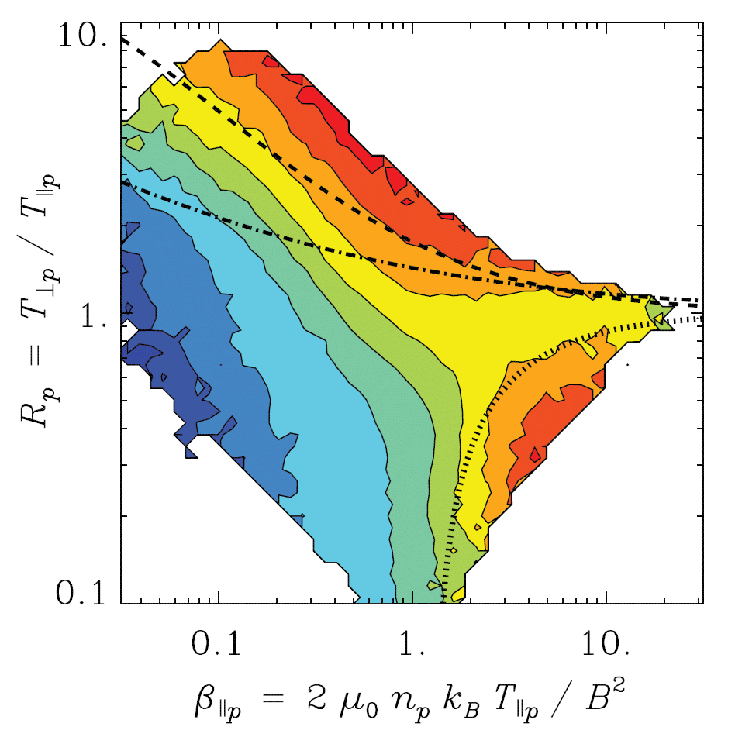
Monte Carlo ensemble of trial wind streams
We also varied solar wind parameters (with prob. distributions constrained by measurements) and available cyclotron wave power (always << total Q) to compute 100,000 random sets of proton trajectories. This reproduces the full range of proton kinetic properties seen at 1 AU.
Wind spacecraft (Maruca et al. 2011)

Slide 33

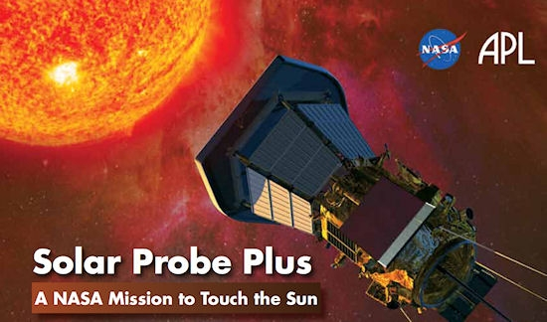
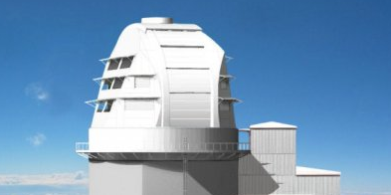



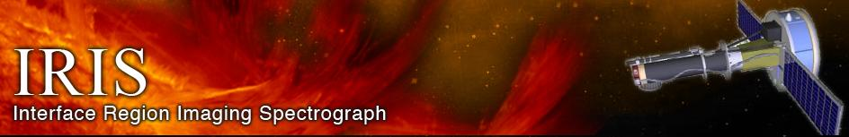
Conclusions
Advances in MHD turbulence theory & collisionless plasma physics continue to help improve our understanding of coronal heating & solar wind acceleration.
Cyclotron resonance seems to work, while still allowing most power to be low-freq.
There are many other ideas (stochastic acceleration, current sheets, etc.)
However, we still do not have complete enough observational constraints to be able to choose between competing theories.
http://lasp.colorado.edu/~cranmer/

Slide 34
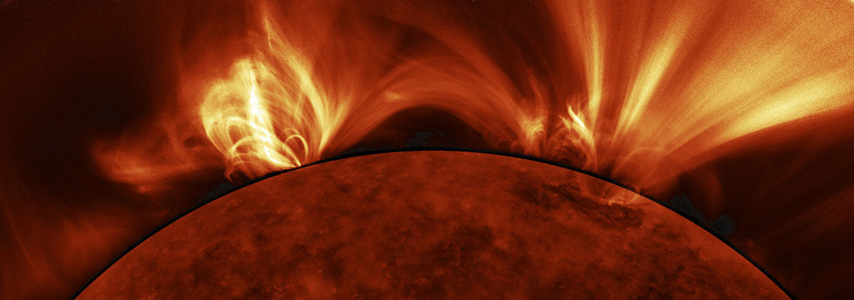

Extra slides
@solarstellar

Slide 35
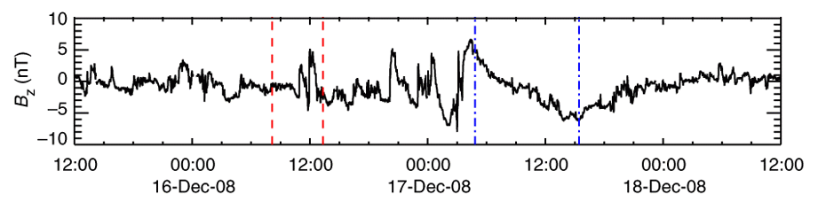
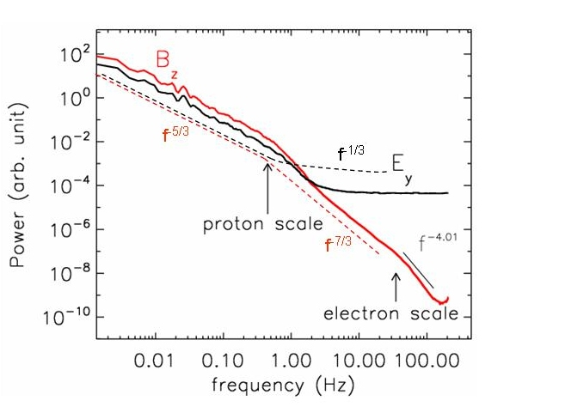
In situ detection in the solar wind
Direct measurement of E/B fields & particles (speed, density, temperature, etc.)
So far: r > 60 R (SPP: r > 9.5 R)
Challenge: how to disentangle spatial & time fluctuations in single-point data?
Taylor’s hypothesis: it’s often assumed that “eddies” flow past the spacecraft much more rapidly than they evolve (i.e., ~all variation is spatial).
Results: Alfvénic fluctuations dominate at large scales, but it’s still not clear what they “cascade into” at small scales.
(Sahraoui et al. 2009)

Slide 36
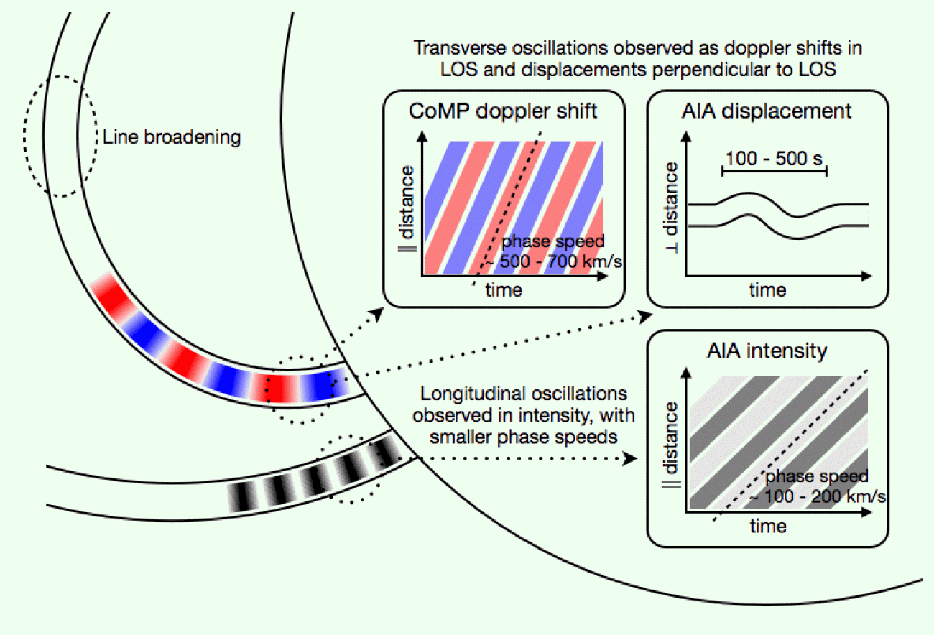
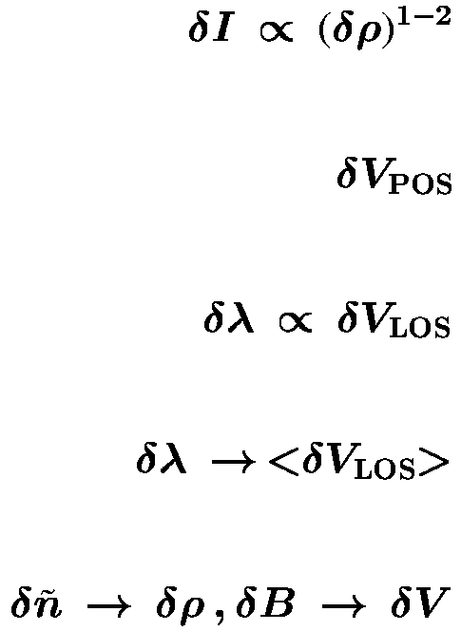
Off-limb remote sensing
With good instrumentation, imaging & spectroscopy can resolve wave-like fluctuations:
Intensity modulations . . .
Motion tracking in images . . .
Doppler shifts . . .
Doppler broadening . . .
Radio sounding . . .
Threlfall et al. (2013)
Results: Alfvén-like waves seem to have periods of order 3-5 minutes; compressive waves have periods of order 10-20 minutes.

Slide 37
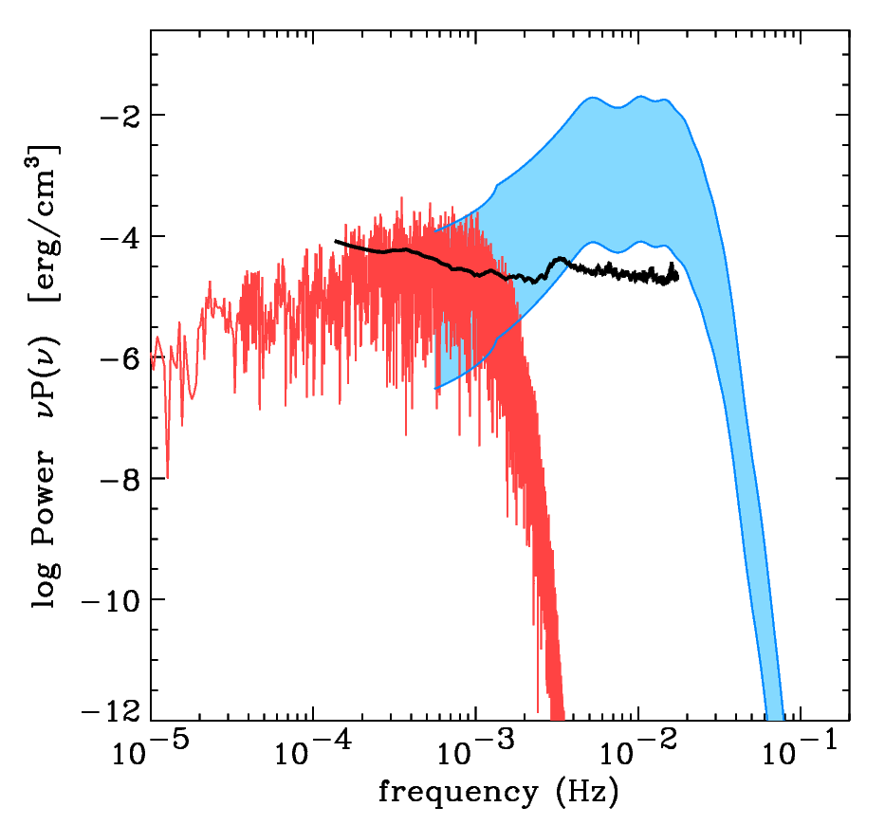
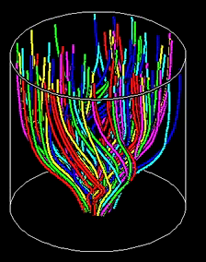
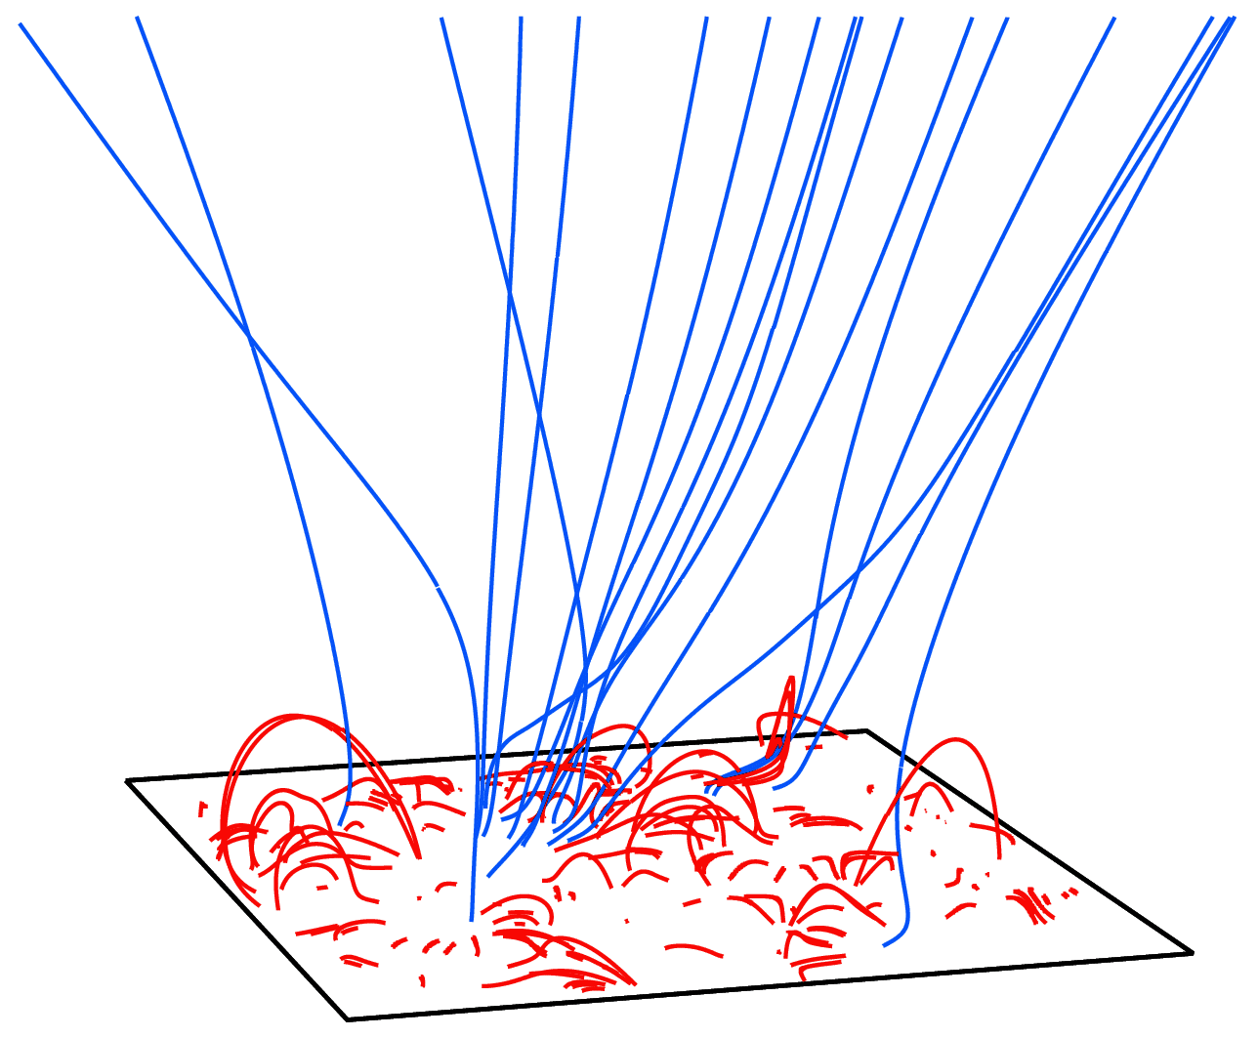
Where do waves originate?
Models of photospheric generation (via intergranular flux-tube jostling) have been successful, but they predict dominant periods of only 3-10 minutes.
In situ turbulence dominates at periods of hours–days. Whence do they come?
CoMP data
(Tomczyk & McIntosh 2009)
Footpoint driving
(van Ballegooijen et al. 2011)
Magnetic reconnection
(Cranmer & van Ballegooijen 2010;
Lynch et al. 2014)

Slide 38
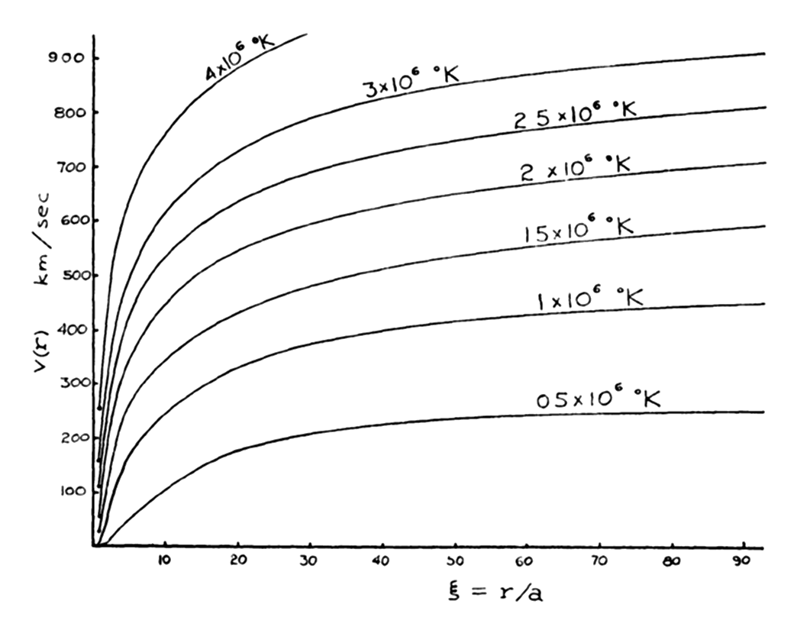
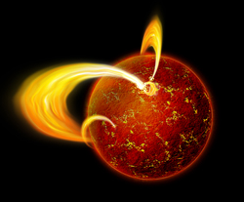
The coronal heating problem
Parker’s (1958) theory says that coronal temperatures of 1–3 MK are needed to accelerate the wind.
But why is the corona so hot?
(Nearly!) everyone agrees that there is more than enough “mechanical energy” at the top of the solar convection zone to heat the corona. How does a fraction (~1%) of that energy get:
transported up to the corona,
converted to magnetic energy,
dissipated as heat, (and/or)
provide direct wind acceleration
For other stars, the problem is even more difficult...
T > 10–20 MK !

Slide 39
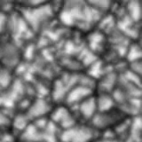
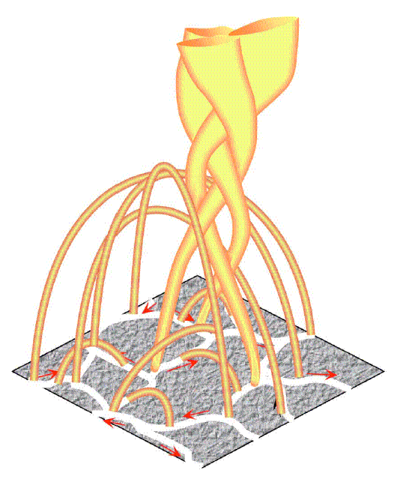

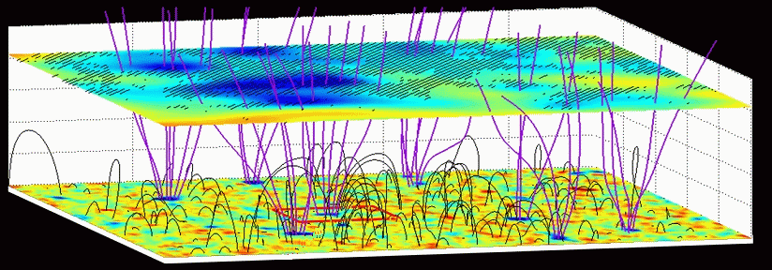
The churning magnetic carpet
The solar interior is convectively unstable, and the foot-points of all magnetic fields above the surface are moved around continually in a “random walk:”
β << 1
Fisk (2005)
β ~ 1
β > 1
Tu et al. (2005)

Slide 40


Waves versus reconnection
Slow footpoint motions (τ > L/V_{A}) cause the field to twist & braid into a quasi-static state; electric currents build up and are released via bursty reconnection. (“DC”)
Rapid footpoint motions
(τ < L/V_{A}) propagate through the field as waves, which are eventually dissipated. (“AC”)
However . . .
The Sun’s atmosphere exhibits a continuum of time scales bridging AC/DC limits.
“Waves” in the real corona aren’t just linear oscillations.
  (amplitudes are large) (fluctuations damp after only ~few periods)
“Braiding” in the real corona is highly dynamic. (see: Hi-C sounding rocket!)

Slide 41

Turbulence: a unifying picture?
Granulation shakes & braids field lines...
Alfvén waves propagate upward...
partially reflect back down...
...and cascade from large to small eddies, eventually dissipating (in the form of tiny reconnection current sheets) to heat the plasma.
A physically motivated heating rate, with essentially no free parameters (other than photospheric normalizations).

Slide 42


Anisotropic MHD turbulence
With a strong background field, it is easier to mix field lines (perp. to B) than it is to bend them (parallel to B).
Also, the energy transport along the field is far from isotropic.
Turbulent eddies are formed and “shredded” by collisions of counter-propagating Alfvén wave packets.
MHD simulations inspire phenomenological scalings for the cascade/heating rate:
(e.g., Iroshnikov 1963; Kraichnan 1965; Strauss 1976; Shebalin et al. 1983; Hossain et al. 1995; Goldreich & Sridhar 1995; Matthaeus et al. 1999; Dmitruk et al. 2002)

Slide 43

Turbulence-driven solar wind models
Cranmer et al. (2007, 2013) computed time-steady solutions for waves & wind . . .
Ulysses SWOOPS
Goldstein et al.
(1996)
For more info: Woolsey & Cranmer; talk 402.05, Thurs., 11:00 am

Slide 44
Aside: many controversies remain
Have we really taken a full “census” of the source(s) of mass, momentum, and energy that go into the solar wind?
Wave/turbulence input in open tubes?
Reconnection & mass input from loops?
Jet/shock “pistons” from chromosphere?
vs.
Cranmer & van Ballegooijen (2010) claim reconnection doesn’t work
Roberts (2010) claims neither turbulence nor reconn. works
Klimchuk (2012) claims jet/shock mass input doesn’t work
all of the above?
SDO/AIA

Slide 45

Cranmer et al. (2007): other results
Wang & Sheeley (1990)
ACE/SWEPAM
ACE/SWEPAM
Ulysses
SWICS
Ulysses
SWICS
Helios
(0.3-0.5 AU)

Slide 46

Suprathermal electrons help ion freezing-in (1/2)
Although no direct observational proof exists, there are hints that there exist suprathermal (non-Maxwellian) electrons in the corona (see, e.g., Esser & Edgar 2001; Ralchenko et al. 2007).
Scudder & Olbert (1979) outlined a theory for nonlocal electron transport that may explain how electrons from the outer corona’s temperature maximum may seed the “halo” seen at 1 AU.
Owocki & Scudder (1983) further suggested that electrons from this T_{max} region may conduct down to enhance tails in the low corona (where heavy ion charge states are “frozen-in”).
We applied the SO79 model to existing ZEPHYR models to estimate the shape of the suprathermal tail at r = 1.02 R.

Slide 47

Suprathermal electrons help ion freezing-in (2/2)
Cranmer et al. (2007) showed how wave models can reproduce well-known wind-speed trends in composition tracers at 1 AU (e.g., FIP-sensitive abundance ratios & ion charge state ratios).
Despite obtaining larger O⁺⁷/O⁺⁶ ratios in slow wind (as observed), the overall normalization was too low.
Recent suprathermal ionization balance calculations (Dzifčáková & Dudík 2013) were used to estimate the enhancement in frozen-in O⁺⁷/O⁺⁶ for the 2007 run of slow→fast wind ZEPHYR models.
Weak electron tails with κ ≈ 10, as predicted by the Scudder & Olbert transport model, appear to be sufficient to produce enough “extra” ionization to match with Ulysses slow→fast wind trends.

