Slide 1
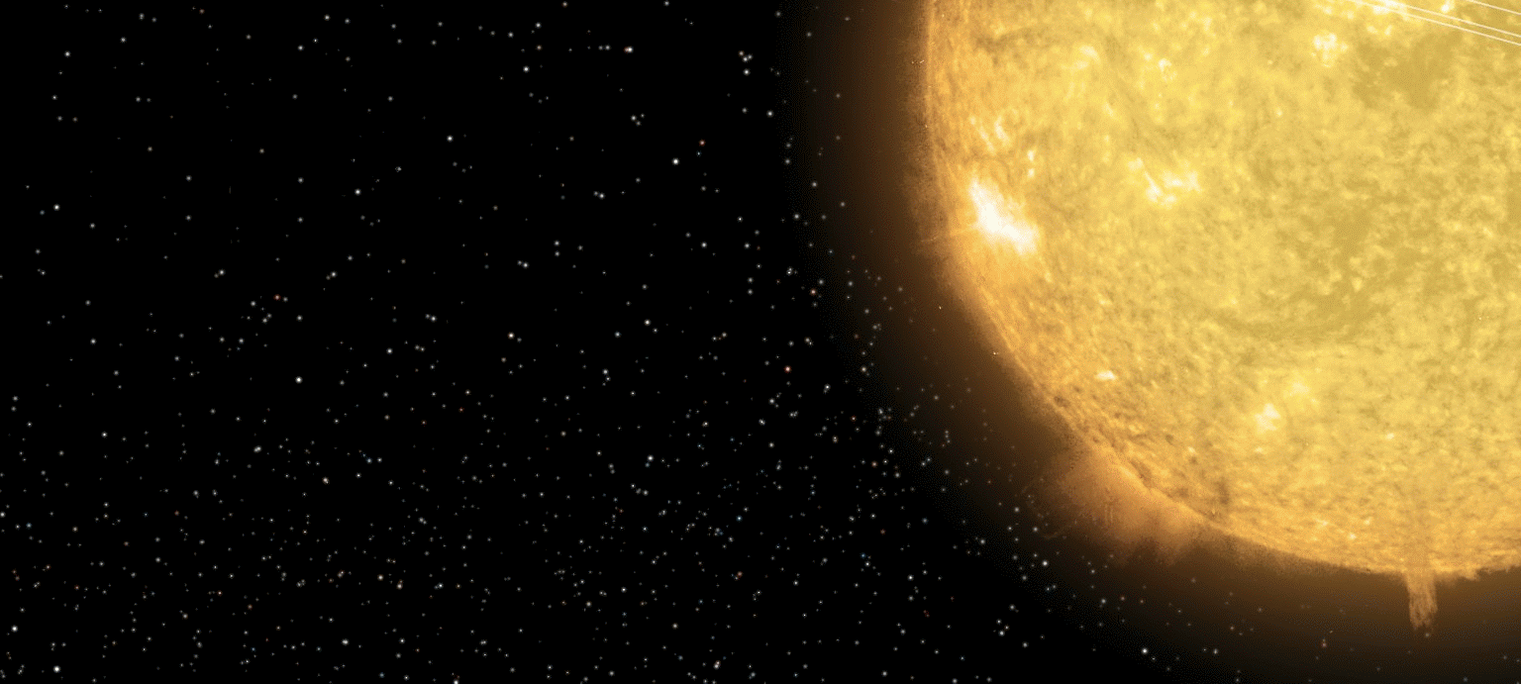
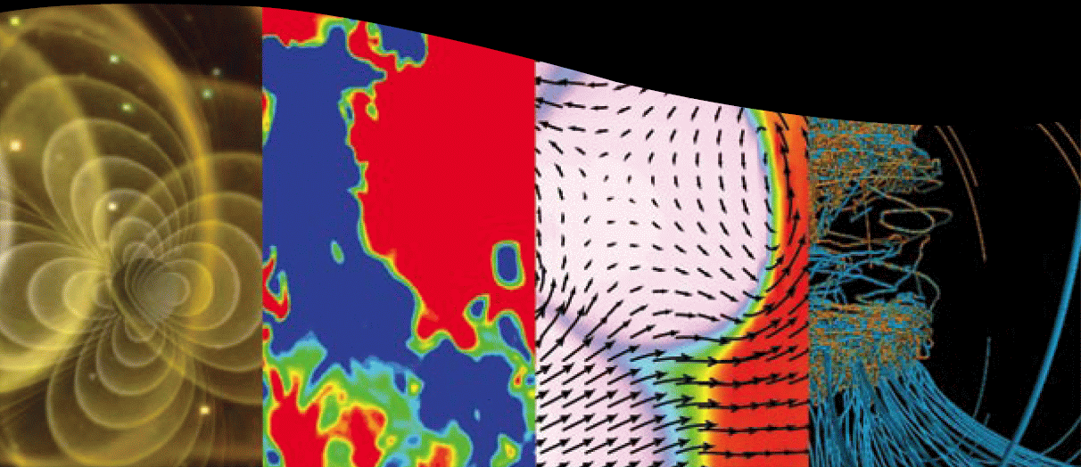
The SPP Theory & Modeling Team: Exploring Predictions & Controversies
Steven R. Cranmer
Harvard-Smithsonian CfA

Slide 2
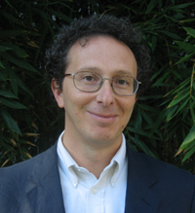
SPP Theory & Modeling Team
Started in November 2010. Chair: Marco Velli (JPL/Arcetri)
9 other members:
1st meeting: December 2010, AGU Meeting, San Francisco
Ben Chandran
Steve Cranmer
Jim Drake
Ron Ghosh
Joe Giacalone
Mark Linton
Bill Matthaeus
Zoran Mikić
Gary Zank
Goals: Still being defined. But according to Marco . . .
“One of our roles is to provide an up to date theoretical basis for estimates of the various plasma/magnetic field/energetic particle parameters we will be going to measure as SPP moves into the inner heliosphere, and help out in getting from the Level 1 objectives to data requirements.”

Slide 3
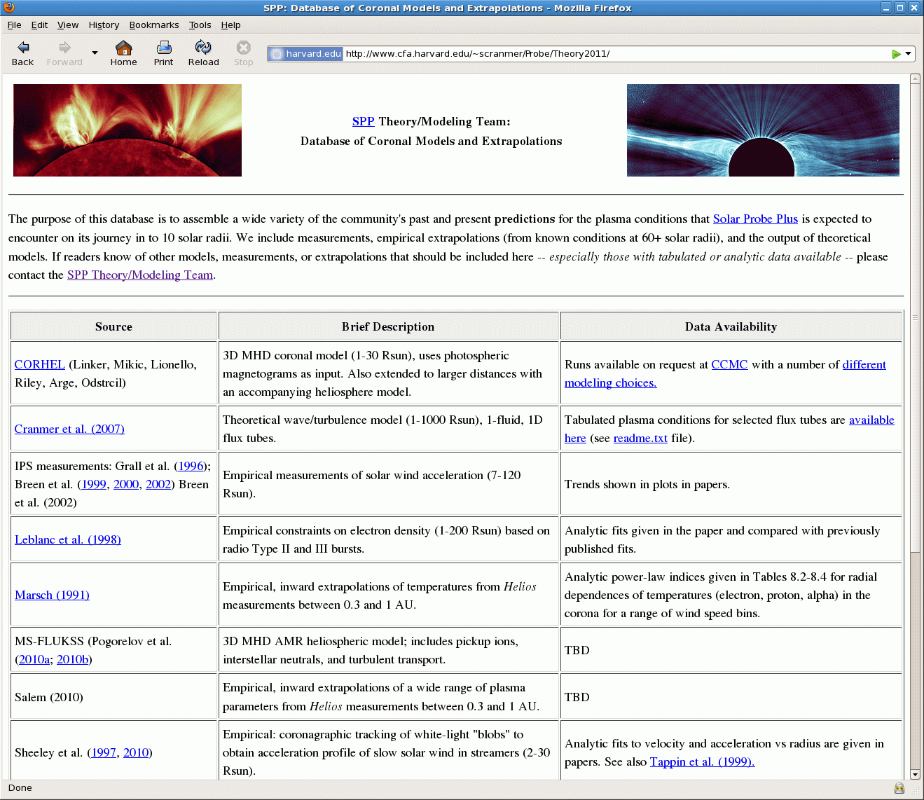
Goal: assemble predictions of what SPP will see
Step 1: http://www.cfa.harvard.edu/~scranmer/Probe/Theory2011/
Online “database” of measurements, extrapolation techniques, empirical models, theoretical models, simulation codes, etc.
As of March 2011, there are 13 entries:
More are welcome!

Slide 4
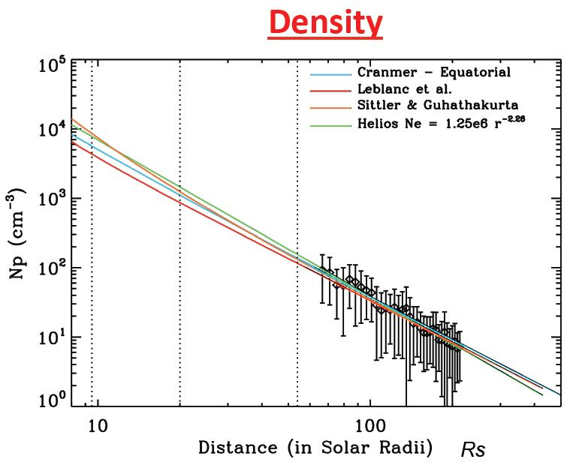
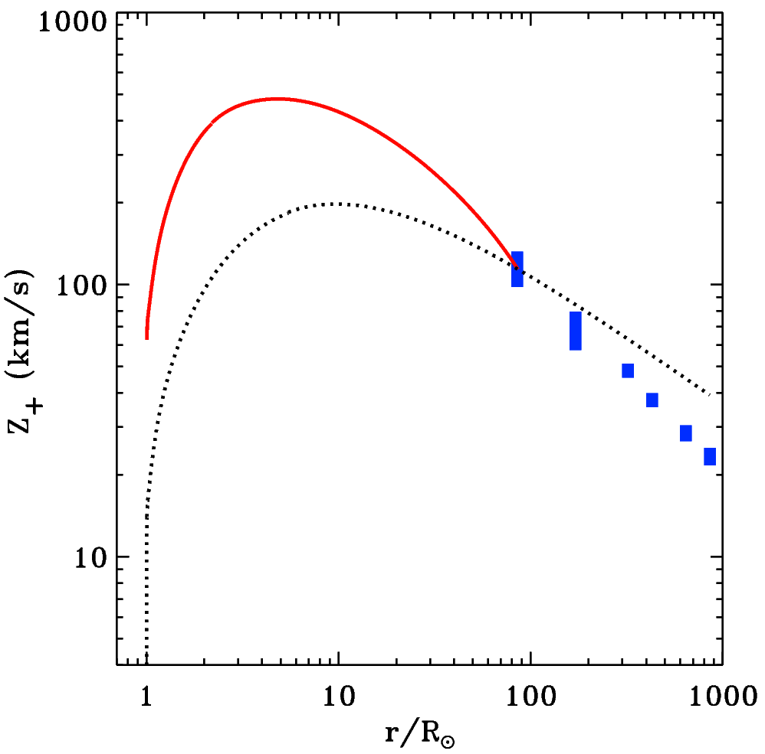
Example extrapolations
Salem & Bale collected inward extrapolations of a wide range of plasma parameters from Helios measurements between 0.3 and 1 AU.
proton density
Cranmer & Chandran extrapolated in situ wave amplitudes inward assuming either no damping or empirically constrained turbulent damping.
(2010 SHINE meeting)

Slide 5
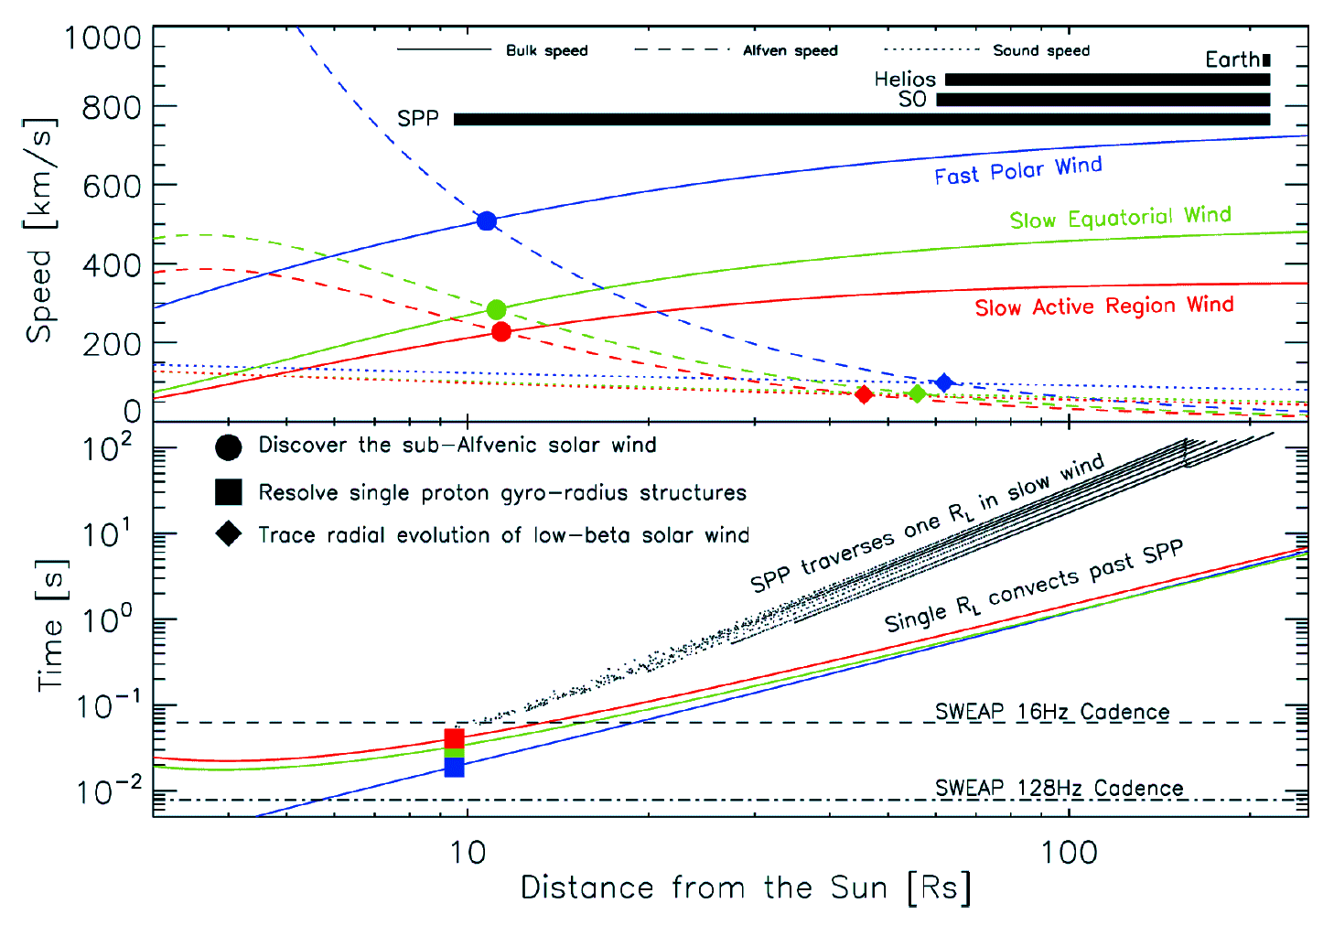
Example theoretical model
Cranmer et al. (2007) wave/turbulence models; plot swiped from SWEAP proposal

Slide 6
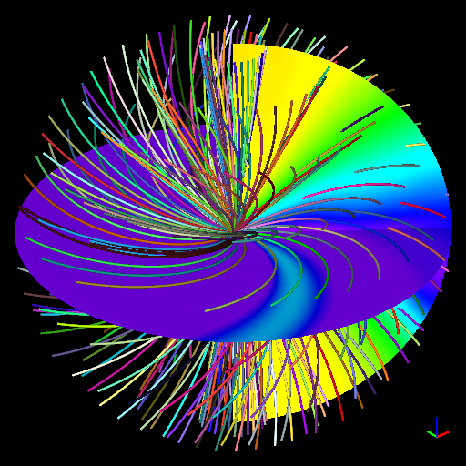
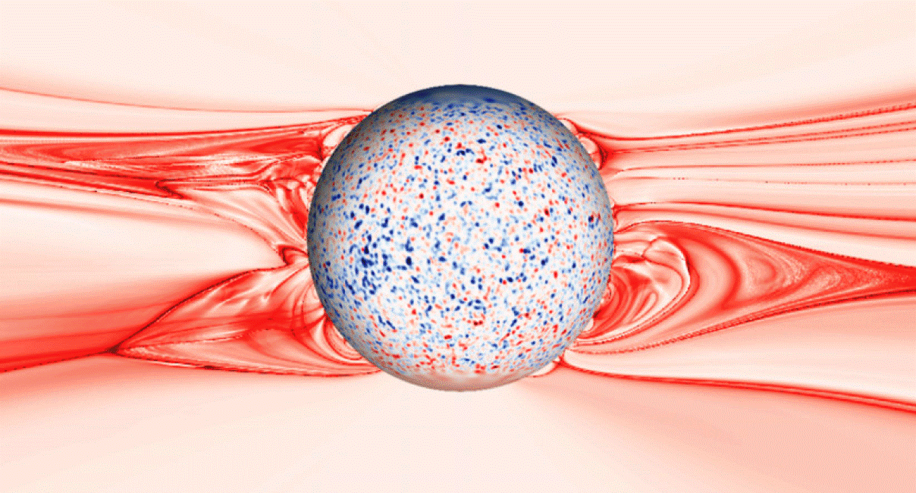
Global 3D MHD models?
CORHEL/MAS (Predictive Sciences)
SWMF/BATS-R-US (Michigan)
MS-FLUKSS, ENLIL, etc...
CCMC
CISM
Has anyone yet taken a few solar rotation’s worth of models & folded in SPP’s trajectory?
Rušin et al. (2010)

Slide 7
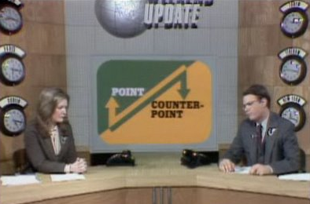
Controversies . . .

Slide 8
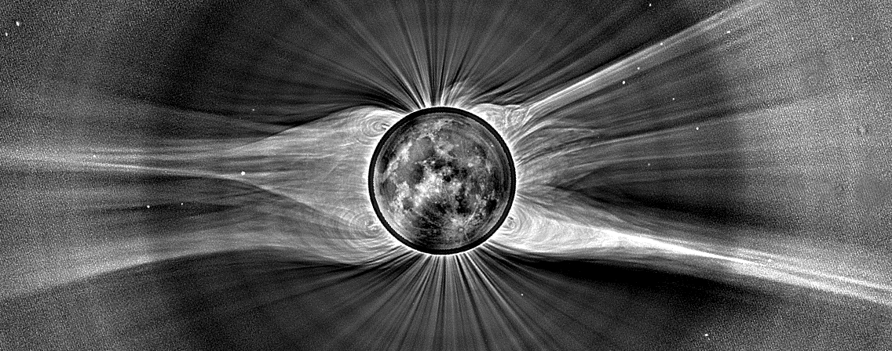
How is the solar wind accelerated?
What physical processes provide the solar wind’s
Mass?
Momentum? → Parker (1958) was largely right!
Energy?

Slide 9
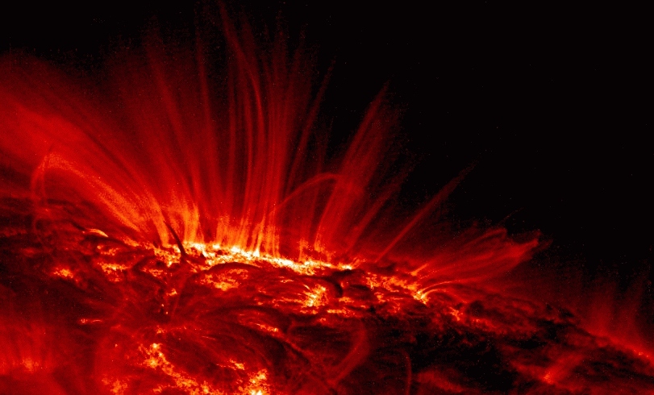
What is the dominant source of mass?
Until relatively recently, the dominant idea has been that the time-steady rate of “evaporation” is set by a balance between downward conduction, upward enthalpy flux, and local radiative cooling (Hammer 1982; Withbroe 1988).
(i.e., coronal heating sets mass flux!)
heat conduction
radiation losses
5
2
— ρvkT

Slide 10
What is the dominant source of mass?
Until relatively recently, the dominant idea has been that the time-steady rate of “evaporation” is set by a balance between downward conduction, upward enthalpy flux, and local radiative cooling (Hammer 1982; Withbroe 1988).
(i.e., coronal heating sets mass flux!)
heat conduction
radiation losses
5
2
— ρvkT
More recently, Hinode & SDO observations of the chromosphere have fueled the idea that much of the corona’s mass is injected from below in the form of jets and spicules (e.g., Aschwanden et al. 2007; De Pontieu et al. 2011; McIntosh et al. 2011).

Slide 11
What is the dominant source of energy?
i.e., what heats the corona in open flux tubes? Two general ideas have emerged . . .
Wave/Turbulence-Driven (WTD) models, in which open flux tubes are jostled continuously from below. MHD fluctuations propagate up and damp.
Reconnection/Loop-Opening (RLO) models, in which energy is injected from closed-field regions in the “magnetic carpet.”
vs.
Counterpoint:
Roberts (2010) says WTD doesn’t work.
Cranmer & van Ballegooijen (2010) say RLO doesn’t work.

Slide 12
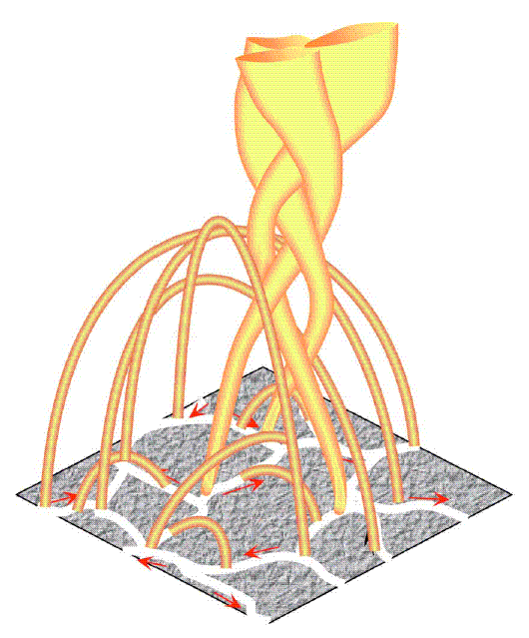
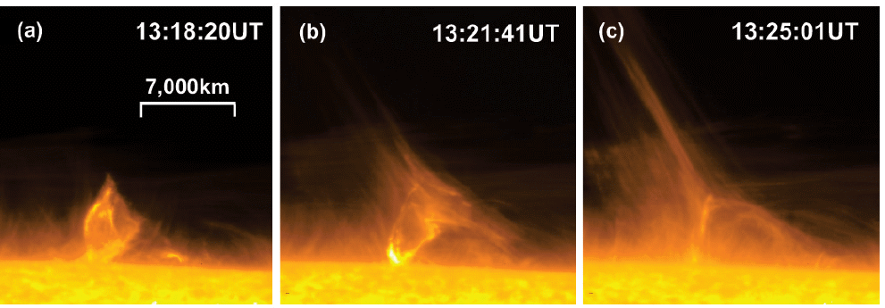
What is the dominant source of energy?
There is a natural appeal to the RLO idea, since only a small fraction of the Sun’s magnetic flux is open. Open flux tubes are always near closed loops!
The “magnetic carpet” is continuously churning.
Open-field regions show frequent coronal jets (SOHO, STEREO, Hinode, SDO).
Fisk (2005)
But is there enough energy released in the subset of reconnection events that turn closed fields into open fields to account for the coronal heating?

Slide 13
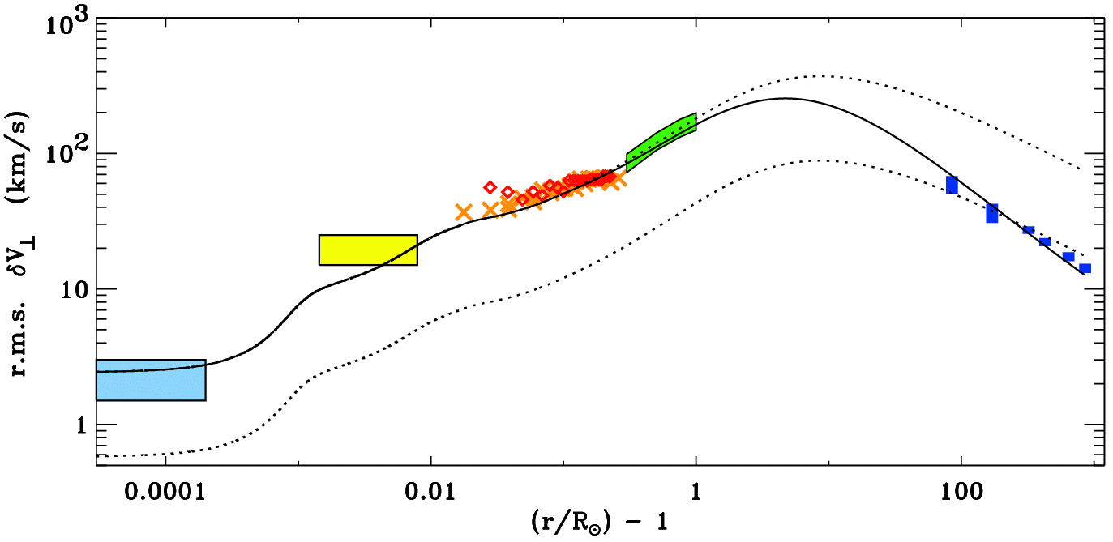
What is the dominant source of energy?
No matter the relative importance of RLO events, we do know that waves and turbulent motions are present everywhere... from photosphere to heliosphere.
How much can be accomplished by only WTD processes? (Occam’s razor?)
Hinode/SOT
SUMER/SOHO
G-band bright points
UVCS/SOHO
Helios & Ulysses
Undamped (WKB) waves
Damped (non-WKB) waves

Slide 14
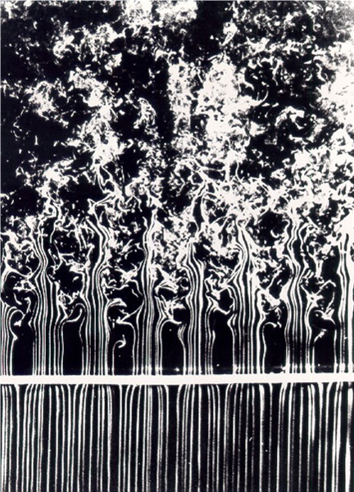
Controversies about waves & turbulence
In situ spacecraft see a dizzying array of variability:
f ⁻¹ energy containing range
f ^{-5/3}
inertial range
Magnetic Power
The inertial range is a “pipeline” for transporting magnetic energy from the large scales to the small scales, where dissipation can occur.
f ⁻³ dissipation range
few hours
0.5 Hz

Slide 15
Controversies about waves & turbulence
Origin of the low-frequency (1/f) spectrum:
The self-consistent product of a turbulent cascade?
Spacecraft passage through “spaghetti-like” flux tubes rooted on the solar surface? (Borovsky 2008)
Physics of the inertial range (f ^{–5/3}) of the spectrum:
Is it really 5/3 or 3/2 ? It matters for some models! (Chandran 2010)
Is the magnetic fluctuation spectrum different from velocity and/or density spectra?
How does the “spacecraft-frame frequency” map into true wavenumber space (k┴ ≠ k║) ?

Slide 16
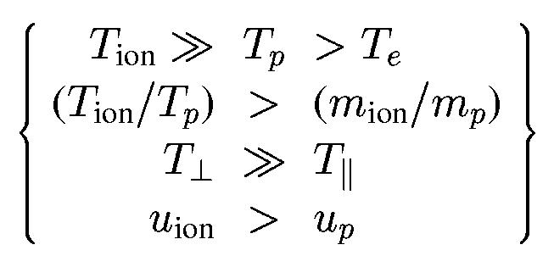
Controversies about waves & turbulence
Physics of the dissipation range:
Is it really dissipation, or just a different dispersion relation?
If dissipation, what processes are responsible?
Minor ions may be able to distinguish one process from another! In the fast wind:
dissipation &
particle energization
inhomogeneous
& non-Maxwellian
particle
VDFs
waves:
varying E, B
instabilities

Slide 17
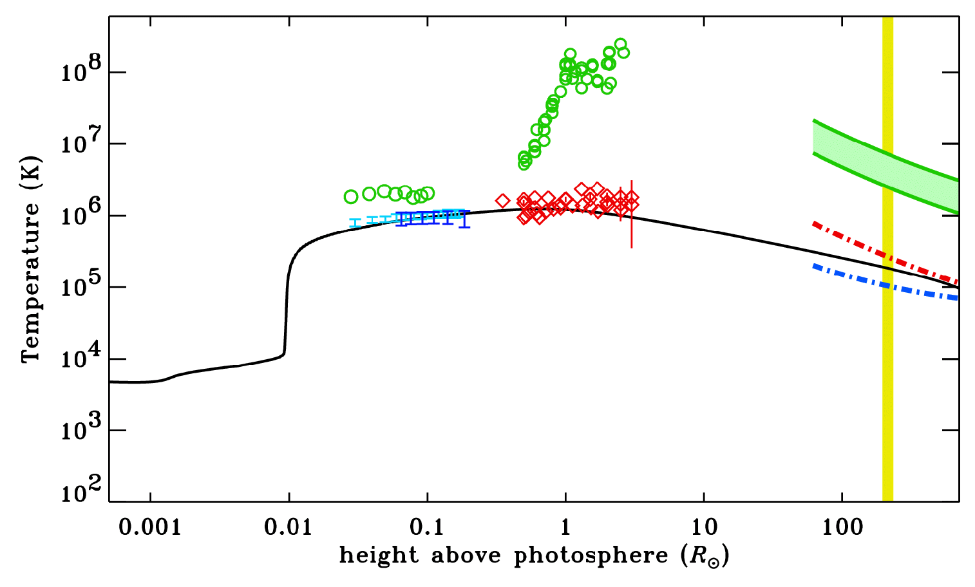
The heating is multi-fluid & collisionless
UVCS/SOHO
O⁺⁵
O⁺⁶
e–
p⁺
In the lowest density solar wind streams . . .
electron temperatures
proton temperatures
heavy ion temperatures

Slide 18
How are ions preferentially heated?
MHD turbulence may have some kind of “parallel cascade” that gradually produces ion cyclotron waves in the corona and solar wind.
When MHD turbulence cascades to small perpendicular scales, the small-scale shearing motions may be unstable to generation of cyclotron waves (Markovskii et al. 2006).
Dissipation-scale current sheets may preferentially spin up ions (Dmitruk et al. 2004).
If MHD turbulence exists for both Alfvén and fast-mode waves, the two types of waves can nonlinearly couple with one another to produce high-frequency ion cyclotron waves (Chandran 2005).
If nanoflare-like reconnection events in the low corona are frequent enough, they may fill the extended corona with electron beams that would become unstable and produce ion cyclotron waves (Markovskii 2007).
If kinetic Alfvén waves reach large enough amplitudes, they can damp via wave-particle interactions and heat ions (Voitenko & Goossens 2006; Wu & Yang 2007).
Kinetic Alfvén wave damping in the extended corona could lead to electron beams, Langmuir turbulence, and Debye-scale electron phase space holes which could heat ions perpendicularly (Matthaeus et al. 2003; Cranmer & van Ballegooijen 2003).

Slide 19
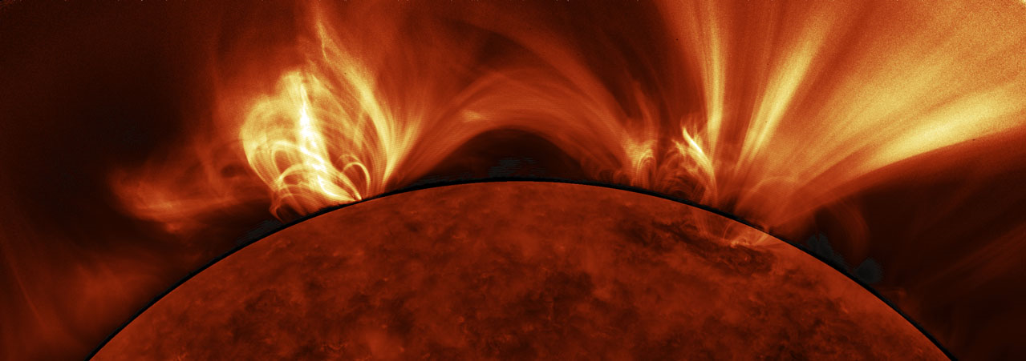
Conclusions
The SPP Theory & Modeling Team welcomes additional predictions – especially those that come with tabulated or analytic data that we can play work with.
See: http://www.cfa.harvard.edu/~scranmer/Probe/Theory2011/
It is becoming easier to include “real physics” in 1D → 2D → 3D models of the complex Sun-heliosphere system, so hopefully some of the controversies will be resolved by the time of SPP’s launch!
Added inspiration from SDO/AIA

