Slide 1
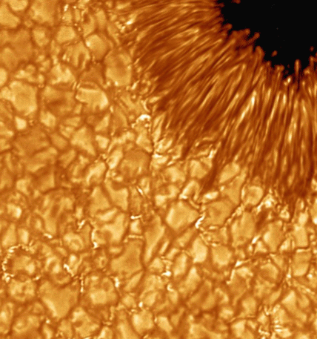
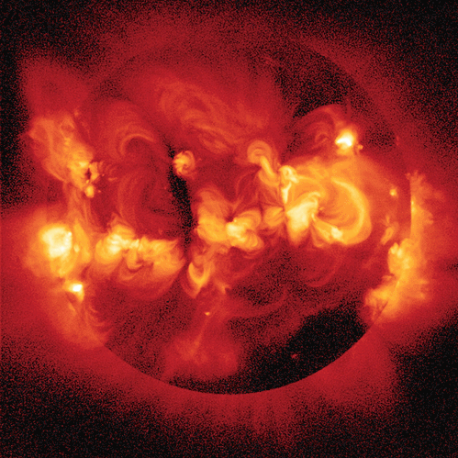
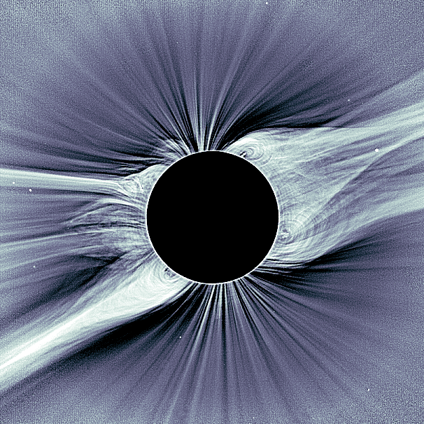
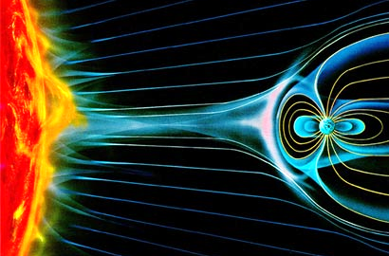
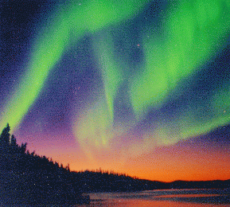
Hale Collaborative Graduate Education Program (CGEP) Workshop: June 4-5, 2015
Main local contact: Steven Cranmer (steven.cranmer@colorado.edu)
Workshop web page: http://tinyurl.com/cgep2015

Slide 2
Workshop Agenda
Thurs., June 4, Morning:
9:00... Gather for coffee, donuts, etc.
9:15... Welcome; go around room to introduce everyone
9:20... (Cranmer) History and motivation for CGEP in the Boulder NSO Bid
9:40... (Toomre) Lessons learned from 2013 CGEP course
9:55... (Gerrard) Lessons learned from 2014 CGEP course
10:10... Round robin discussion of graduate program core curricula & prerequisites for CGEP courses (no more than 7-10 minutes per university)
10:50... Quick break for more coffee, snacks.
11:00... (Cranmer & Pillet) Initial plans for the 2016 CGEP course: proposed topics
11:30… Wider discussion of how to move forward with best “content delivery” methods (pedagogical & technological) & interactive learning techniques
12:00... LUNCH (sandwiches brought in, to accommodate next talk…)

Slide 3
Workshop Agenda
Thurs., June 4, Afternoon:
12:30… (Kuskin) Overview of MOOCs and how they can support specialized graduate education
1:30… Break before afternoon session
2:00... Reconvene & make agenda changes. Sort through afternoon topics:
2:10... Brainstorm topics for courses & modules: both specialized and introductory (filling in prerequisite gaps)
2:40... (Jackiewicz) NMSU progress on the Sunspot site: running the DST and/or hosting summer student programs?
3:10... (Toomre or Cranmer) Is there a need to think about proposals (NSF or NASA) for new TelePresence infrastructure or support of summer programs?
3:40... The CGEP consortium: Rebranding (new acronym)? Should we devote energy to expanding to other universities?
4:00... Adjourn & Homework: Think more about topical modules that are needed, and/or that each participant is willing to develop/teach.

Slide 4
Workshop Agenda
Fri., June 5, Morning:
9:00... Gather for coffee, donuts, etc.
9:10... Finalize (?) topics for Spring 2016 course; clarify instrumentation & diagnostic components
9:30… (McAndrew) Example images & videos of BBA & MOOC options
10:00… Attend NSO science talk by Tom Schad (IfA), room W312
11:00… Agree (?) about how to best execute the Spring 2016 course (technology aspects), without reinventing wheel or becoming video pros.
11:30… Discuss proposal plans:
state of the art equipment?
summer salaries for developing online course material?
student summer school / training site?
12:00… Adjourn

Slide 5
What is the CGEP?
At the time of the Boulder NSO bid, it was realized there is a mismatch between the need for graduate level teaching in solar and space physics and the ability to meet that need at any single institution. (e.g., continuous instructor availability… minimum class-size limits)
Essential expertise is distributed across universities, at research labs, and within industry.
Summer schools help, but aren’t a substitute for full courses.
The Collaborative Graduate Education Program (CGEP) aims to:
create advanced solar courses that often would attract small numbers of students at any one institution, but are needed for capacity building,
teach the courses using web-enabled technologies to multiple institutions,
employ the highest quality interactive learning methodologies.

Slide 6
Timeline
2009-2011:
NSO Boulder bid written, competed, & awarded
Original CGEP consortium: NSO + {CU Boulder, NJIT, U. Hawaii}
2013-2014:
Two CGEP courses taught from CU & NJIT, broadcast & recorded by WebEx
Example: http://zeus.colorado.edu/astr7500-toomre
Increasing interest & involvement from NMSU & MSU
2015:
New CU solar faculty helping to update CU solar/space graduate curriculum
4+2 graduate student fellowships and 1+1 postdoctoral fellowships awarded
June: CGEP workshop to plan for future & expand consortium
2016 & beyond:
Spring: next CGEP course?… upgrade to TelePresence/MOOC tech?
Summer Events to help connect students (Sunspot, NM… Boulder?)

Slide 7
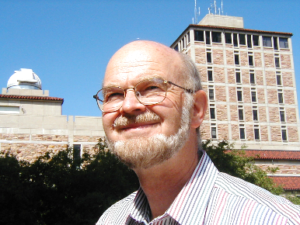
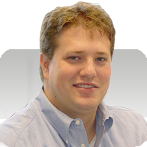
First two CGEP courses
Spring 2013: Juri Toomre taught ASTR-7500: “Solar & Stellar Magnetism”
7 instructors from CU, HAO, and NSO
Students from CU (7), NJIT (10), Hawaii (2), NMSU (3)
Fall 2013: White paper/progress report submitted to NSF
Differing levels of prerequisite knowledge was a challenge
WebEx performance was mixed: best for lectures; interactive classroom discussions more difficult
Spring 2014: Andrew Gerrard (NJIT) took the lead on “Magnetospheric and Ionospheric Response to Solar Output”
Mostly taught by Gerrard; 3 guest lecturers
Students from CU (2), NJIT (6), NMSU (1 + auditors)
More info at: http://tinyurl.com/cgep2015

Slide 8
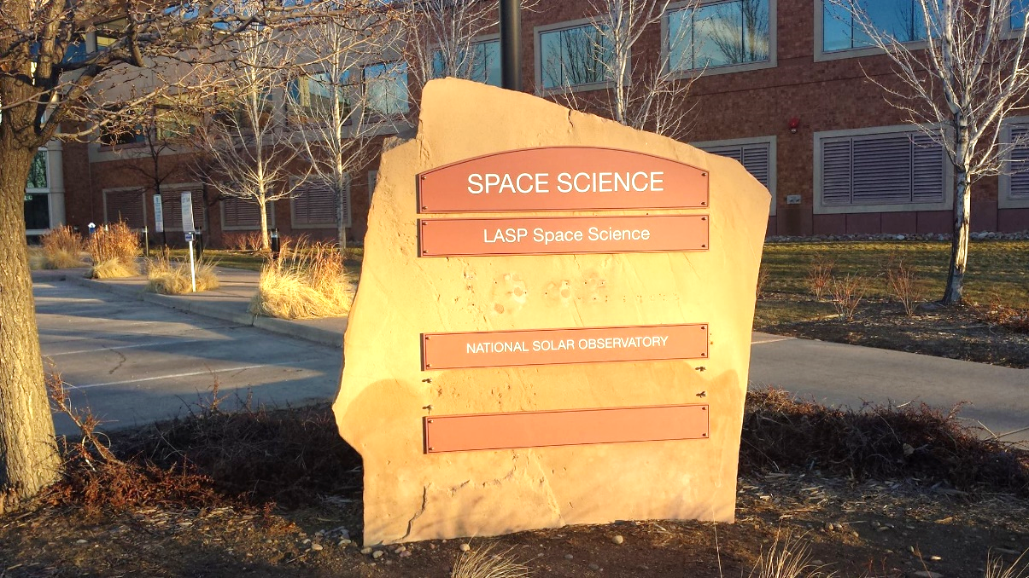
2015: Rebuilding Year
CU brought in first faculty hires enabled by the NSO bid (Brown, Cranmer)
CU continuing to formalize solar & space physics graduate “core” curriculum
NSO moving into 3rd floor of LASP SPSC building
No CGEP course was offered
Photo:
V. Pillet

Slide 9
CGEP Workshop
What do we want to accomplish?
Formalize existing & new partner institutions. “Consortium?”
Go over everyone’s solar course curriculum needs & constraints (i.e., make sure we understand the “prerequisite problem” & design CGEP courses to account for differing levels of preparedness).
Assimilate lessons learned from 2013 & 2014 courses.
Plan for the next course (Spring 2016?), with “buy-in” from partner institutions to develop specific modules/material.
Work on NSF proposal for summer programs to keep students connected & improved TelePresence infrastructure?
Discuss alternate modes of “content delivery” (e.g., MOOC)?
A better acronym ?!?

Slide 10
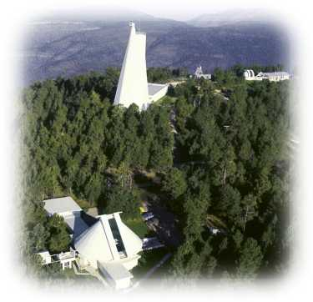
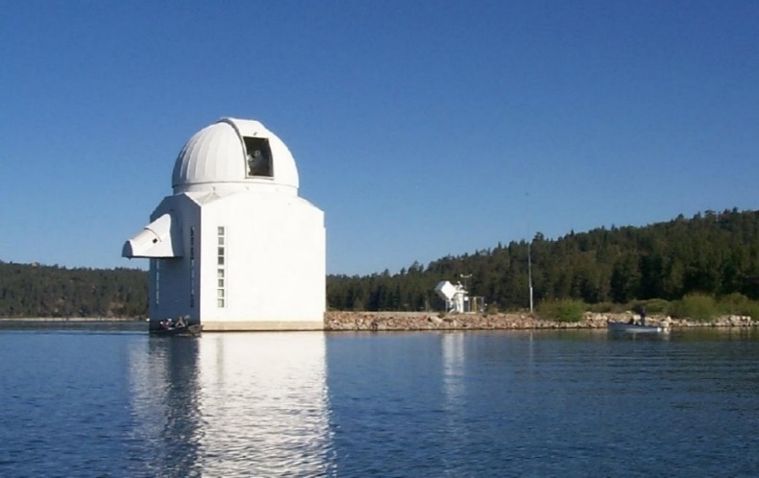
Beyond 2016?
We hope each year’s course will have a different focus from the previous 3-4 years’ courses. Eventually, some topics will come back into rotation, so instructors are not always having to develop new material ex nihilo.
We should discuss possibility for summer events to keep the students at different universities in contact as a cohesive group. Location themes (observation, instrumentation, computation)? Engagement with NASA/UCAR Heliophysics Summer School, Boulder? Length? Cost?
Sac
Peak
BBSO

Slide 11
Round robin discussion of graduate program curricula

Slide 12
Round robin discussion of graduate program curricula:
Aspects that may differ from institution to institution…
Academic discipline of each “home” department
Core curriculum (required vs. recommended courses)
Assumed “prerequisite knowledge” for CGEP solar courses

Slide 13
Boulder: Dept. of Astrophys. & Planetary Sci.
39 credits: usually 12 x (3-credit courses) + 3 x (1-credit seminars)
 | Fall | Spring
Year 1 | Core Core Elective | Core Core Elective
Year 2 | Core Elective (Seminar) | Elective Elective (Seminar)
Atomic & Molecular Processes
Radiative & Dynamical Processes
Introduction to Fluid Dynamics
Mathematical Methods
Observations, Data Analysis, & Statistics
5 required core courses:
(the written comprehensive exam = 1 question from each)

Slide 14
Boulder: Dept. of Astrophys. & Planetary Sci.
39 credits: usually 12 x (3-credit courses) + 3 x (1-credit seminars)
 | Fall | Spring
Year 1 | Core Core Elective | Core Core Elective
Year 2 | Core Elective (Seminar) | Elective Elective (Seminar)
Specialty Core
Specialty Core
Specialty Core
Specialty Core
Planetary core: 3 set courses + 1 special topics course
Astrophysics core: 8 set courses (usually 2 choices per even/odd fall/spring)

Slide 15
Solar/Space Core (proposed Spring 2015)
Even years |  | Odd years
Spring | Fall | Spring | Fall
Stellar Astrophysics (5700) | Fluids II: waves, instabilities, & turbulence (5410) | Magnetospheres (5300) | Astrophysical & Space Plasmas / MHD (5140)
Note: “solar” doesn’t appear! Short-term expediency: use existing courses to avoid drawn-out new-course development.
Additional electives…
CGEP: Special Topics in Solar/Space Physics (7500) Plasma 1 (Phys 5150) | Plasma 2 (Phys 7160) | CGEP: Special Topics in Solar/Space Physics (7500) Plasma 1 (Phys 5150)

Slide 16
What topics will CGEP students know?
Each for about 1/4 to 1/3 of a semester…
Radiative transfer: 1D basics, up to gray/LTE photosphere
MHD: ideal & resistive equations, force-free equilibria, A/F/S waves
Atomic processes: ioniz. equilib., collisions, radiative cooling, charge exchange
Observations: geometric optics, spectroscopy basics, CCDs, in-situ basics

Slide 17
Proposed Ideas & Topics for the next (Spring 2016 ?) CGEP Course

Slide 18
The next CGEP course(s): meta
We hope each year’s course will have a different focus from the previous 3-4 years’ courses. Eventually, some topics will come back into rotation, so instructors are not always having to develop new material ex nihilo.
Instead of each course being developed as a monolithic whole, we’ve been thinking about a new “standard model:” a nominal 3-part structure.
i.e., 3 lecturers, each using material developed (perhaps) from a 1-credit seminar -- but with topics deeply inter-linked.
each part: ~15 class hours (or equivalent) of material + problem sets.
final project: students can choose which part of course to draw on.
At CU, we are also exploring ways of doing the primary “content delivery” (just one part of traditional lecture) via Coursera “MOOC” platform.

Slide 19
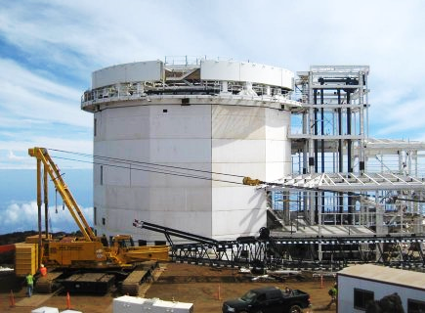
The next CGEP course: topics
To help build support & community for DKIST, we’ve been thinking of an observationally focused set of topics.
Draft idea:
Topics in Solar Observation Techniques:
Solar Instrumentation: Ground-based and Space-based (V. Pillet)
Spectropolarimetric diagnostic techniques (?)
Off-limb coronagraphy & spectroscopy (S. Cranmer)

Slide 20
3. Off-limb coronagraphy & spectroscopy (?)
3.1. Coronagraph occultation
historical overview (eclipses & Lyot)
quantitative need for it: discuss how I(r) drops rapidly
why is an occulter not enough? non-specular light: (a) diffraction (linear & circular, + aberrations) (b) mirror roughness (c) dust on surfaces
Solutions: the Lyot stop, the internal occulter
3.2. Visible continuum formation above the limb
formation of K-corona (Thomson scattering, pB)
formation of F-corona (dust)
inversion methods for obtaining 3D n_e distribution
other techniques: difference imaging, new STEREO/HI ideas
3.3. Emission line formation above the limb
basic optically thin RT along off-limb lines of sight
collisional lines: (a) derive standard G(T) and DEM(T) in ioniz. equilibrium (b) using lines as a diagnostic of Doppler shifts & T_ion
scattering lines: (a) derive standard redistribution functions (b) summarize basic diagnostics (no wind) (c) Doppler dimming/pumping!

Slide 21
“Rebranding?”

Slide 22
A new acronym?
Hale CGEP (Collaborative Graduate Education Program); see-jip?
HELIOS ?
Hale
Education
Laboratory for
Inter-university
O…?
S... ?
HASPEC / HASPEN ?
Hale
Advanced
Solar
Physics
Education
Consortium / Network?
Please share your ideas!
Mark Miesch’s idea: COLLAGE (COLLAborative Graduate Education)

