Slide 1
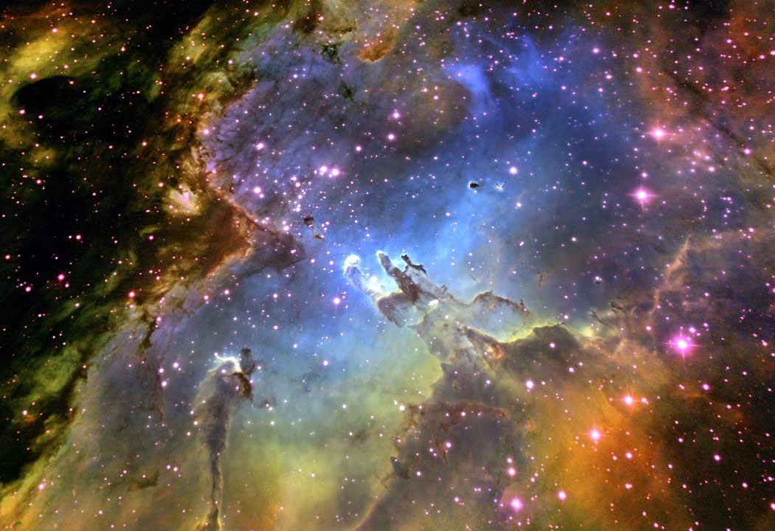
ASTR-5700 Stellar Astrophysics
Prof. Steven R. Cranmer
Notes:
You want a syllabus, here’s a syllabus… (next slide)

Slide 2
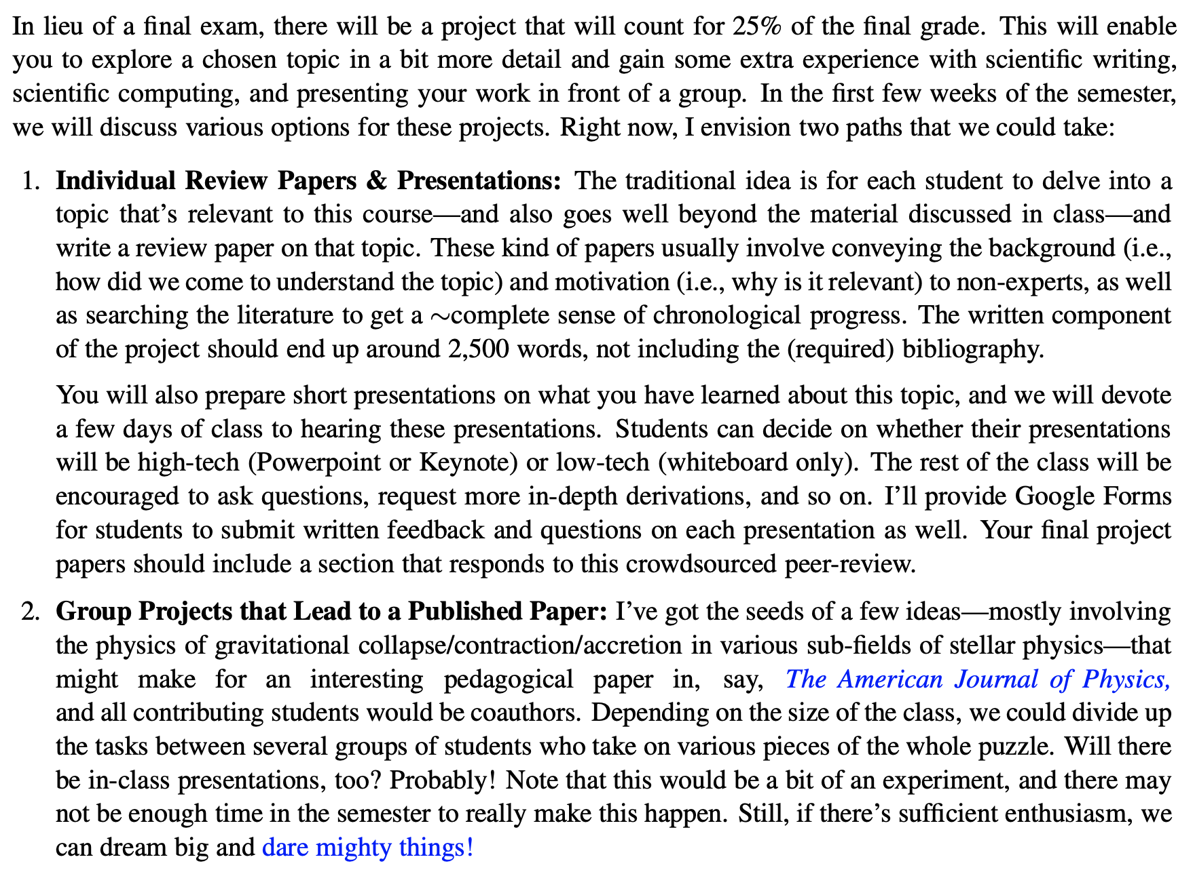
From the syllabus . . .

Slide 3
Example topics: individual projects (1 of 2)
When discussing equations of state in class, we didn't spend much time on the gradual transitions between the various cases (ideal gas, radiation pressure dominated gas, non-relativistic electron degeneracy, ultra-relativistic electron degeneracy). However, one can write down fully general equations based on what was discussed in the lecture notes. Explore the properties of the thermodynamics (i.e., P and U versus ρ and T, and the Gamma's) at an arbitrary point in the temperature/density diagram.
We introduced the Thomas-Fermi equation of state in lecture set 1, but we didn't derive the modified Debye screening needed to make it work for a Fermi-Dirac distribution function. If you work it out, I'm curious what additional insights you may glean. Do these results say anything about the subjective "solidity" of everyday matter?
People often write the virial theorem with extra terms that we didn't discuss in class (e.g., magnetic energy, rotation, time-variable moments of inertia). What can we learn about stellar physics when these terms are included? George Collins, author of our primary textbook, also wrote a short monograph on the virial theorem that discussed lots of this for stars.
In nuclear reactions, we glossed over details about the shape of the strong-force attractive potential well. Are there closed-form expressions (using, e.g., the Yukawa potential) that can be used to solve directly for the Gamow-peak scattering cross section?
When discussing the mixing-length theory of convection, I mentioned a complicated cubic polynomial that describes the full (inefficient and non-adiabatic) problem. Track down a good derivation of this cubic equation (say, in Cox & Giuli's Stellar Structure) and show how one can turn the "efficiency knob" to obtain the temperature gradient in both limits of convective stability and instability.
Produce an up-to-date version of the mass-radius (and mass-density) diagram on page 4.10 of the lecture notes. There are thousands of new exoplanets, of course, but you can also add observational data for white dwarfs and neutron stars. There are also other exotic stars (e.g., “pion stars”) that have been proposed but never seen; where would they fit on diagrams like this?
Explore in-depth one or two of the "quasi-tropes" described on page 4.30 of the lecture notes.

Slide 4
Example topics: individual projects (2 of 2)
The concept of a "synestia" (i.e., a differentially rotating set of equipotential surfaces) was discussed briefly on page 5.6 of the lecture notes. Is it possible to compute equipotential surfaces given an angular velocity Ω(r) that is ~constant in a stellar interior, but gradually becomes ∝ 1/r² in the outer layers? Can this model reproduce some odd shapes derived in classical papers by, e.g., Stoeckly or Bodenheimer?
Solar evolution models say that, about 4 billion years ago, the Sun's luminosity was only about 0.7 times its current value. If that was true, the Earth should have been a frozen ice-ball. The geological record, however, says it was warm and wet. Carl Sagan pointed this out in the 1970s, but are we any closer now to a solution to the Faint Young Sun Problem? Some recent proposals include higher CO₂ and lunar tides!
Supernova light curves: In class, we'll briefly mention David Arnett's 1982 analytic model of SN light curve energetics. Digesting and implementing this model -- and exploring what happens when its parameters are varied -- could be interesting.
Black holes: Kerr (1963) had his metric. However, Kerr (2023) has now said there aren't necessarily singularities inside BHs!
In the past, students have sometimes written papers that focus on a single type of interesting star... e.g.,
Classical novae are white dwarfs in close binary systems that undergo explosive nucleosynthesis from thin layers on their surfaces.
Some pulsating stars have amplitudes and periods that vary slowly in time -- sometimes (in the case of RR Lyrae stars undergoing the "Blazkho effect") in a chaotic manner!
CEMP (carbon enhanced metal poor) stars may be candidates for being "relic" Population III stars from the early universe.
T Tauri stars are young, low-mass stars that are still accreting matter from gaseous disks. A small fraction of them (FU Orionis objects) undergo huge flare-like outbursts.
Do Thorne-Zytkow objects (red supergiants with neutron-star cores) really exist?
Hot subdwarfs (sdO/sdB) are the cores of horizontal branch stars (i.e., core helium burning stars) that lost their (thin) H envelopes in a "quiet" way; i.e., without going back up the red giant branch.
What's up with Przybylski's Star exhibiting plutonium lines in its spectrum?
Can we tell neutron stars apart from strange stars made up of exotic baryons?
Googling the phrase "weird types of stars" may return a few interesting items, too.

Slide 5
Group project brainstorming
There are quite a few simple “toy models” that are used in undergrad & grad classes to help explain star/planet formation... e.g.,
Homologous collapse (free-fall)
Polytropes for spherical stars
Spherical Bondi accretion
Angular momentum conservation

Slide 6
Group project brainstorming
There are quite a few simple “toy models” that are used in undergrad & grad classes to help explain star/planet formation... e.g.,
Homologous collapse (free-fall)
Polytropes for spherical stars
Spherical Bondi accretion
Angular momentum conservation
Can we supplement those models with some new pieces... and do the new pieces help answer some questions that the standard toys don’t?
Quasi-homologous collapse
Polytrope rotation & oblateness
“Neo-Laplacian” contraction & mass shedding
Ulrich’s rotational accretion & wind-compressed disks
Do any of these collapse/contraction ideas apply to pre-WD cores of red giants?

Slide 7
Quasi-homologous collapse?
For the model given in lecture set 2, if we start with a uniform density sphere, it always remains uniform as it collapses.
However, we know that “real” star formation can start with a constant-ρ cloud, but will soon end up with a protostar with ρ_{c} >> <ρ>. How does that happen?
If we started instead with a slightly higher central density, say, ρ(r) = ρ₀ [1 - ε (r/R*) ] , with 0 < ε << 1 , then it’s possible to show that ρ_{c}/<ρ> increases as the collapse occurs!
A good literature review will need to be done to make sure we’re not reinventing the wheel; start with Tsui & Navia (2014); Zhou et al (2023).

Slide 8
Polytrope rotation & oblateness
Lecture set 5 will introduce the Roche model for rotating stars: assume all the mass is concentrated at the center (i.e., essentially an n → 5 polytrope)?
Homework 4 will have you compare this model to a “Maclaurin spheroid” (i.e., a rotating constant-density fluid; essentially an n = 0 polytrope).
What happens for n values in between 0 and 5? Is there a way to write the moment of inertia as a function of the rotation rate and n?
Chandrasekhar (1933) studied this problem, but didn’t have our modern-day computing resources. (I’m not making a better/worse distinction... but it’s true that scientists a century ago just focused on different aspects of a problem than we would...)

Slide 9
Neo-Laplacian contraction & mass shedding
In lecture set 8, we’ll see that our Sun started out as a cloud with an angular momentum about 100,000 times higher than the angular momentum in the present-day Sun. Where did it all go? Into the accretion disk.
As the young solar nebula contracted, it reached “critical rotation” and thus had to shed mass in order to keep contracting. I think modern models of the “extruded mass” ~correctly predict the properties of the MMSN (minimum-mass solar nebula), but I think the pedagogical benefits of teaching this model haven’t been publicized as much as they should be.
Schatzman (1949, 1962) developed a lot of these ideas. However, I think better rotating polytrope models (previous slide) could improve them.
Prentice (1978) took the idea further (too far?) & convinced himself that it predicts the exact orbital distances of the planets in the solar system. I’m pretty sure this was wrong, but I don’t know if anyone has ever really figured out why that model doesn’t really work. Tracking that down may make for an interesting “history of science” addendum to this story.

Slide 10
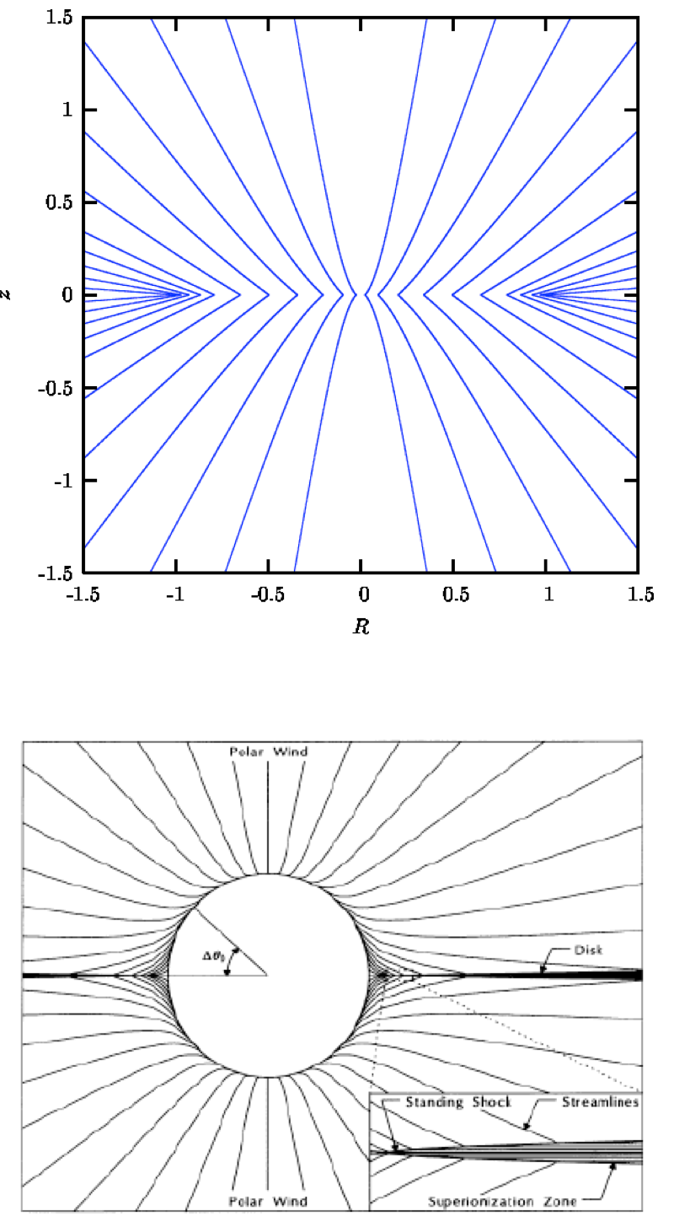
Rotational accretion . . . & “excretion?”
Ulrich (1976) worked out an elegant theory of fluid-infall streamlines in a system undergoing both rotation and accretion. (Though the paper had some infamous typos.)
Bjorkman & Cassinelli (1993) reinvented the wheel and derived very similar equations, but for outflowing streamlines in a rotating stellar wind... where the gas ultimately crashes into the equatorial plane to form a “wind-compressed disk.”
I’m not sure how this fits into the pedagogical flow of the earlier ideas, but it’s certainly very closely related to them!

Slide 11
Moving forward
Initial thoughts? (Canvas poll posted: due Fri., March 15)
The “division of labor” for the group project would depend critically on the number of people who want to be involved.
If we do this, I suggest that at least one person be a dedicated literature-search-supervisor. Reinventing the wheel can be a fine thing to do... as long as we know what the earlier inventors did, and how our work provides unique added value!

